Slide 1


A CD of this message will be available (free of charge) immediately following today's message
14:1-33
This message will be available via podcast later this week at calvaryokc.com

Slide 2

14:1-33
What would you do if you knew it was your last week?
Jesus went to a party

Slide 3

14:1-33

Slide 4
14:1-33
John Trapp ~ "so dangerous a thing it is to converse with hypocrites. One rotten sheep may rot the rest."
Wasted (v. 4) ~ apōleia – same as John 17:12 ~ son of perdition

Slide 5
14:1-33

Slide 6
14:1-33
Matt. 26:14-15 ~ ¹⁴ Then one of the twelve, called Judas Iscariot, went to the chief priests ¹⁵ and said, "What are you willing to give me if I deliver Him to you?"

Slide 7
14:1-33
David Guzik ~ "Whatever Judas’ motive was, it was his motive. God used a willing Satan, who used a willing Judas. God ordained that these things happen, but He did not prompt Judas to sin."

Slide 8
14:1-33

Slide 9
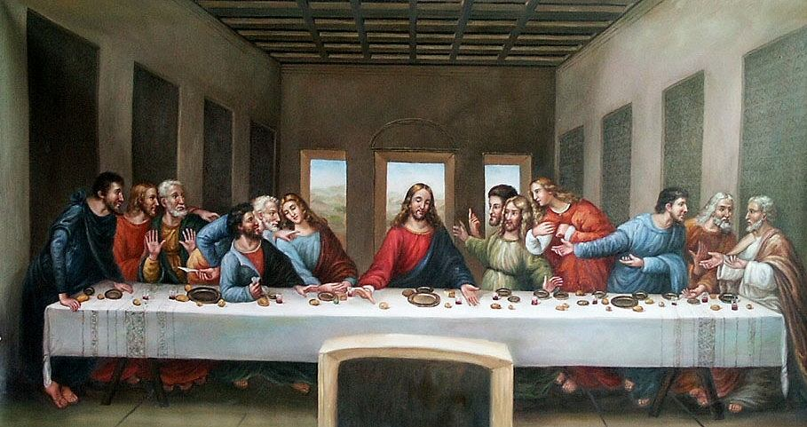
14:1-33

Slide 10
14:1-33
Other disciples
Judas
Jesus
Triclinium
Peter
John

Slide 11
14:1-33

Slide 12
14:1-33
Ps. 41:9 ~ Even my own familiar friend in whom I trusted, who ate my bread, has lifted up his heel against me.

Slide 13
14:1-33

Slide 14
14:1-33
The Afikoman
From epikomen ~ that which comes after (dessert)
Sought by children and "redeemed“ when found
Substitute for the Korban Peshach (Passover sacrifice)
Piece given to each guest at the table
The middle of three loaves
Dates back to about the time of Christ
Middle loaf traditionally represents the priesthood
Hidden by the papa

Slide 15
14:1-33
Symbolism of The Afikoman
Three loaves = Trinity
Middle loaf = 2nd Person (the Son)
Broken and wrapped in linen
"Hidden" in the tomb
Resurrected and freely distributed to who would partake

Slide 16
14:1-33

Slide 17
14:1-33
Hallel Psalms ~ Ps. 113-118
The “Great Hallel” ~ Ps. 136

Slide 18
14:1-33

Slide 19
14:1-33
Gethsemane ~ oil press
Troubled ~ ekthameō – to throw into terror
Distressed ~ adēmoneō – strongest of 3 Greek words for depression

Slide 20
14:1-33

