Slide 1
A CD of this message will be available (free of charge) immediately following today's message
13:1-13
This message will be available via podcast later this week at calvaryokc.com

Slide 2
13:1-13
Buffy the Vampire Slayer - “If the Apocalypse comes, beep me.”
R. E. M. – “It’s The End Of The World As We Know It (And I Feel Fine)”

Slide 3
13:1-13

Slide 4
13:1-13
Popular Mechanics, 1949 ~
"Com-puters in the future may weigh no more than 1.5 tons."
The editor in charge of business books for Prentice Hall, 1957 ~
"I have traveled the length and breadth of this country and talked with the best people, and I can assure you that data processing is a fad that won't last out the year."

Slide 5
13:1-13
Gary Cooper on his decision not to take the leading role in "Gone With The Wind." ~
"I'm just glad it'll be Clark Gable who's falling on his face and not Gary Cooper."
Irving Fisher, Professor of Economics, Yale University, 1929 ~
"Stocks have reached what looks like a permanently high plateau."

Slide 6
13:1-13
Decca Records rejecting the Beat-les, 1962 ~
"We don't like their sound, and guitar music is On the way out."
1 Pet. 3:3-4 ~
³ knowing this first: that scoffers will come in the last days, walking according to their own lusts, ⁴ and saying, "Where is the promise of His coming? For since the fathers fell asleep, all things continue as they were from the beginning of creation."

Slide 7
13:1-13

Slide 8
13:1-13
Over 1/4 of the Bible was prophetic at the time of its writing
Jer. 25:11 ~ And this whole land shall be a desolation and an astonishment, and these nations shall serve the king of Babylon seventy years.

Slide 9
13:1-13
Two important lessons of Bible prophecy:
100% track record
Always fulfilled literally

Slide 10
13:1-13
Basic Hermeneutics: the 5 “Ws” –
Who?
What?
When?
Where?
Why?

Slide 11
13:1-13

Slide 12
13:1-13
Message ~ Jesus said, “You’re impressed by this grandiose architecture? There’s not a stone in the whole works that is not going to end up in a heap of rubble.”
Not … shall / Shall not ~ Literally "no, no" – ou mē

Slide 13
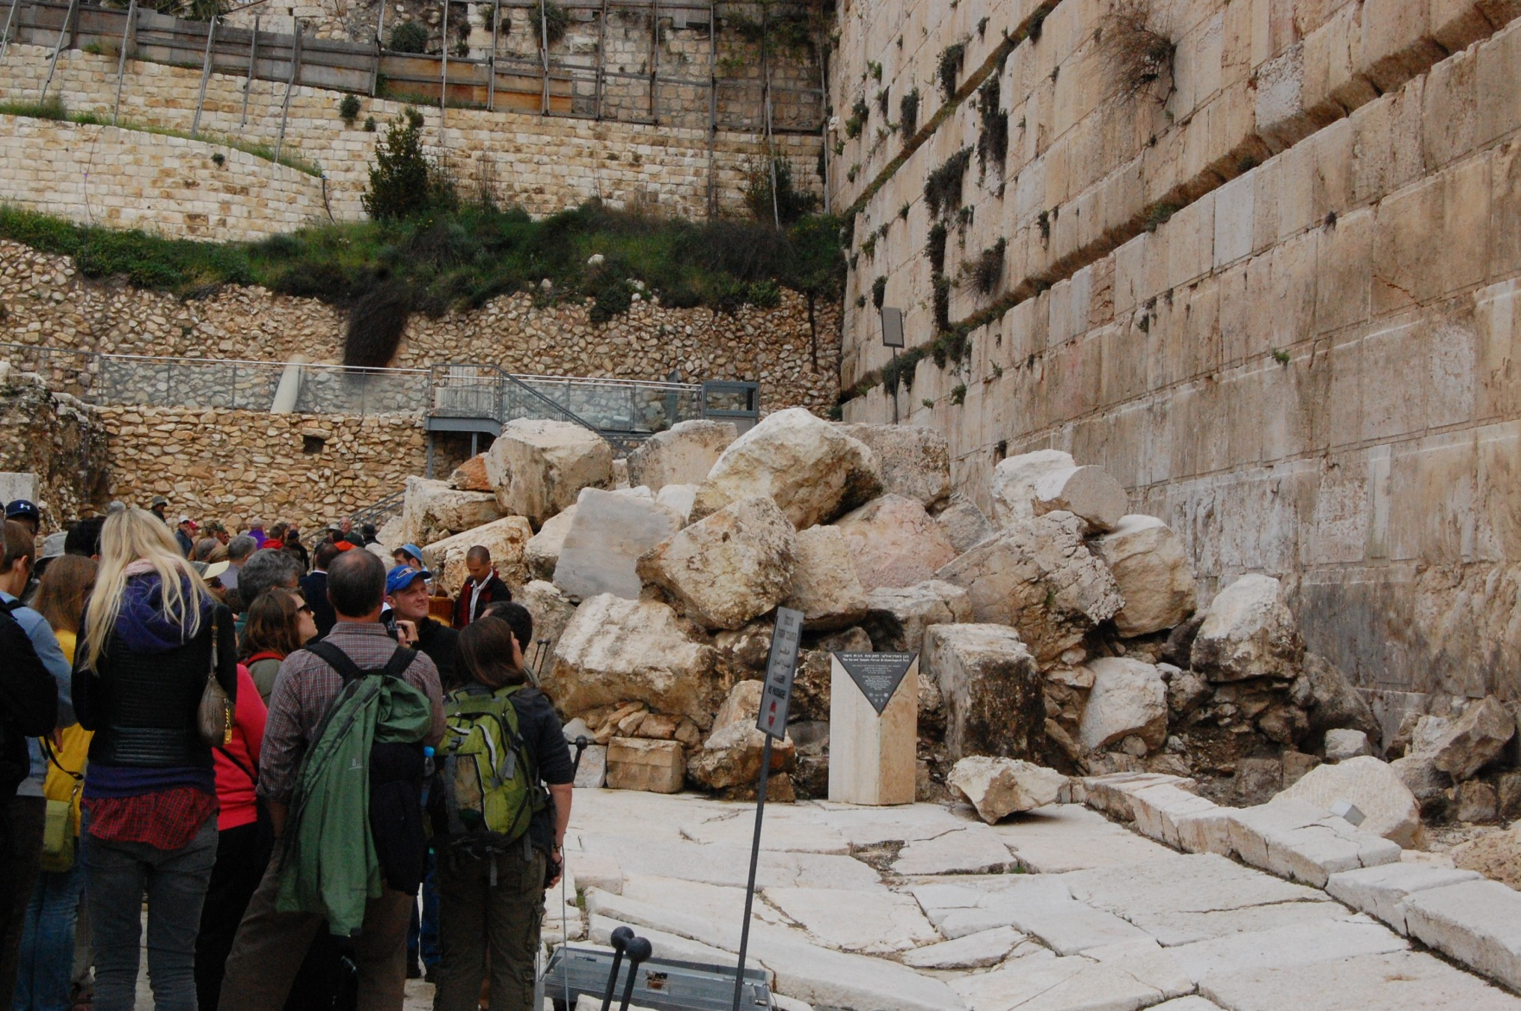
13:1-13

Slide 14
13:1-13

Slide 15
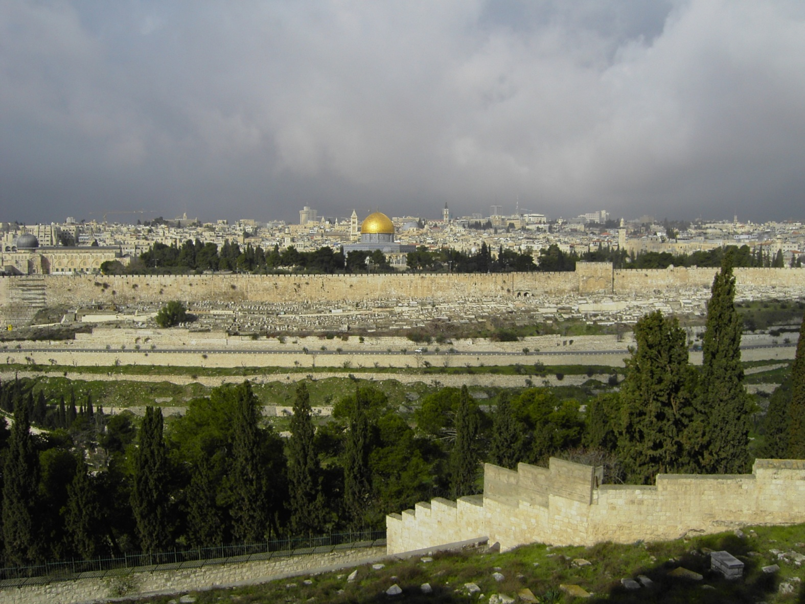
13:1-13

Slide 16
13:1-13

Slide 17
13:1-13
Fulfilled ~ sunteleō – total, completely fulfilled, consummated

Slide 18
13:1-13

Slide 19
13:1-13
Dr. Wayne Stanton, “The Bible in 2012” (as reported in “World Weekly News”)
January, 2012 - A comet will pass so close to Earth that temperatures will hit 140 degrees in some countries.
February, 2012 – As a result, all the countries of the world will come together in peace and form a single government to repair the damage.

Slide 20
13:1-13
Dr. Wayne Stanton, “The Bible in 2012” (as reported in “World Weekly News”)
April, 2012 – Unrest will begin to undermine the world government and the friction will worsen over the next four years.
May, 2012 – aliens from another planet will try to restore peace in the world.

Slide 21
13:1-13
Dr. Wayne Stanton, “The Bible in 2012” (as reported in “World Weekly News”)
November, 2012 – A true Christian will be elected President of the United States.

Slide 22
13:1-13

Slide 23
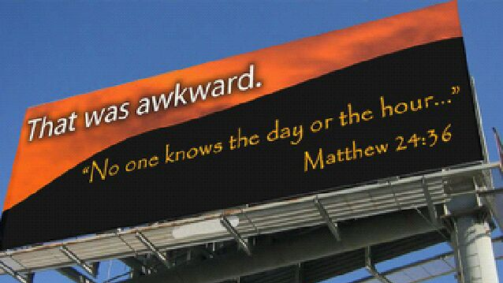
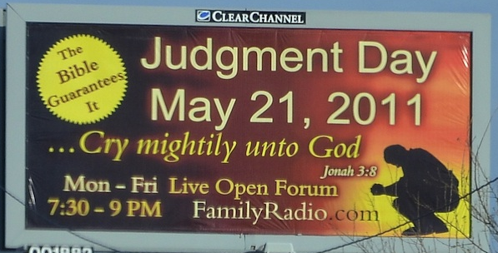
13:1-13

Slide 24
13:1-13

Slide 25
13:1-13
Luke 12:39-40 ~ ³⁹ But know this, that if the master of the house had known what hour the thief would come, he would have watched and not allowed his house to be broken into. ⁴⁰ Therefore you also be ready, for the Son of Man is coming at an hour you do not expect.

Slide 26
13:1-13

Slide 27
13:1-13
Sorrows ~ ōdin
Birth pangs

Slide 28
13:1-13

Slide 29
13:1-13
Rev. 14:6-7 ~ 6 Then I saw another angel flying in the midst of heaven, having the everlasting gospel to preach to those who dwell on the earth —to every nation, tribe, tongue, and people — 7 saying with a loud
voice, "Fear God
and give glory to Him, for the hour of His judgment has come; and worship Him who made heaven and earth, the sea and springs of water."

Slide 30
13:1-13

Slide 31
13:1-13
To the end ~ eis telos – to the limit

Slide 32
13:1-13

