Slide 1


A CD of this message will be available (free of charge) immediately following today's message
12:18-44
This message will be available via podcast later this week at calvaryokc.com

Slide 2

12:18-44
Sadducees
Did not believe in afterlife
Did not believe in Angels
Only accepted Pentateuch

Slide 3

12:18-44

Slide 4
12:18-44
1 John 3:2-3 ~ ² Beloved, now we are children of God; and it has not yet been revealed what we shall be, but we know that when He is revealed, we shall be like Him, for we shall see Him as He is. ³ And everyone who has this hope in Him purifies himself, just as He is pure.

Slide 5
12:18-44

Slide 6
12:18-44
3 Reasons for Marital intimacy
Procreation
Type of Oneness of Jesus and His Bride
Pleasure

Slide 7
12:18-44

Slide 8
12:18-44
613 Precepts
365 Positive
248 Negative

Slide 9
12:18-44

Slide 10

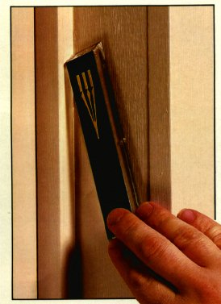
12:18-44
Mezuzah

Slide 11
12:18-44

Slide 12
12:18-44
1 John. 2:4 ~ He who says, "I know Him," and does not keep His commandments, is a liar, and the truth is not in him.
1 Jonn. 2:9 ~ He who says he is in the light, and hates his brother, is in darkness until now

Slide 13
12:18-44

Slide 14
12:18-44
Ps. 110:1 ~ The LORD said to my Lord…
Paraphrase: "Yahweh said to David's Lord…"

Slide 15
12:18-44

Slide 16
12:18-44
Poor ~ ptōchos – utterly destitute

Slide 17
12:18-44

Slide 18
12:18-44
Count
Cost

Slide 19
12:18-44
Portion
Proportion

Slide 20
12:18-44
Given
Kept

Slide 21
12:18-44
Money
Spirit

Slide 22
12:18-44

