Slide 1
A CD of this message will be available (free of charge) immediately following today's message
10:17-52
This message will be available via podcast later this week at calvaryokc.com

Slide 2
10:17-52
He was very rich (v. 22)
He was very young (Matt. 19:20)
He was very powerful (Luke 18:18)

Slide 3
10:17-52

Slide 4
10:17-52
Honor your father and your mother
You shall not murder
You shall not commit adultery
You shall not steal
You shall not bear false witness
You shall not covet

Slide 5
10:17-52

Slide 6
10:17-52
Looking at him ~ emblepō – “the Jesus look”
In the previous examples, Mark used periblebō – to look around
Here (and if v. 27) he uses emblebō – to look in

Slide 7
10:17-52

Slide 8
10:17-52
John Trapp ~ “Which he would have not done, if he had loved God and his neigh-bour, as he professed to do. The Greek word lupoumenos signifies, that he went away pouting and louring, with a cloudy forehead, betokening his great discontent: he came hastily, but went away heavily.”

Slide 9
10:17-52

Slide 10
10:17-52
Astonished ~ thambeō
– From a root meaning to dumbfound

Slide 11
10:17-52

Slide 12
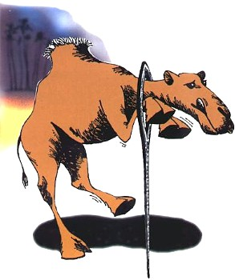
10:17-52
e
i
Camel ~ kam los
Ship’s cable or rope
Albert Barnes ~ "This was a proverb in common use among the Jews, and is still common among the Arabians."

Slide 13
10:17-52

Slide 14
10:17-52
C. H. Spurgeon ~ “In the final account, it shall be found that no man has been a loser through giving up anything for the Lord Jesus Christ though he has his own method of deciding who are to be first and who are to be last.”

Slide 15
10:17-52
David Livingstone ~ “If a commission by an earthly king is considered a honour, how can a commission by a Heavenly King be considered a sacrifice?”

Slide 16
10:17-52

Slide 17
10:17-52
Matt. 7:7-8 ~ ⁷ (Keep on) ask(ing), and it will be given to you; (keep on) seek(ing), and you will find; (keep on) knock(ing), and it will be opened to you. ⁸ For everyone who (keeps on) ask(ing) receives, and he who (keeps on) seek(ing) finds, and to him who (keeps on) knock-(ing) it will be opened.

Slide 18
10:17-52
C. H. Spurgeon ~ “Take the gates of heaven and shake them with thy vehemence, as though thou wouldst pull them up post and bar and all. Stand at Mercy’s door, and take no denial. Knock, and knock, and knock again, as though thou wouldst shake the very spheres,
but what thou wouldst obtain an answer to thy cries. ‘The kingdom of heaven suffereth violence, and the violent take it by force.’ Cold prayers never win God’s ear. Draw thy bow with thy full strength, if thou wouldst send thy arrow up so high as heaven.”

Slide 19
10:17-52

Slide 20
10:17-52
The “i” suffix in Hebrew indicates 1st person, person-al, possessive pronoun
E. g. Malachi = “my Messenger”
Rabboni = “my Master”

Slide 21
10:17-52

Slide 22
10:17-52
Adam Clarke ~ “Apply to the Son of David; lose not a moment; he is passing by, and thou art passing into eternity, and probably wilt never have a more favourable opportunity than the present.”

Slide 23
10:17-52

