Slide 1


A CD of this message will be available (free of charge) immediately following today's message
10:1-16
This message will be available via podcast later this week at calvaryokc.com

Slide 2

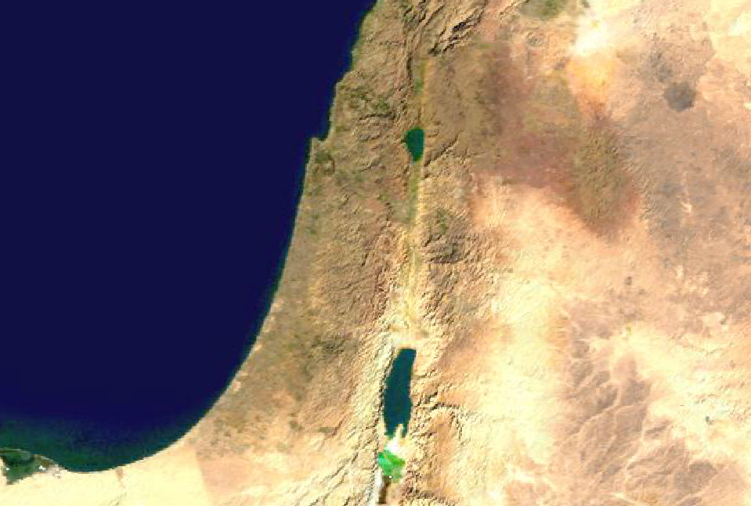
10:1-16
Tetrarchy of Herod Antipas
Perea

Slide 3

10:1-16

Slide 4
10:1-16
Deut. 24:1 ~ When a man takes a wife and marries her, and it happens that she finds no favor in his eyes because he has found some uncleanness in her, and he writes her a certificate of divorce, puts it in her hand, and sends her out of his house
uncleanness – ervah,
shameful nakedness

Slide 5
10:1-16
Shammai
Only unfaithfulness
Hillel
Any Reason

Slide 6
10:1-16

Slide 7
10:1-16
Matt. 19:9 ~And I say to you, whoever divorces his wife, except for sexual immorality, and marries another, commits adultery; and whoever marries her who is divorced commits adultery.
Sexual immorality ~ porneia – illicit sexual activity
Not moicheia ~ adultery

Slide 8
10:1-16
1 Cor. 7:15 ~ But if the unbeliever departs, let him depart; a brother or a sister is not under bondage in such cases. But God has called us to peace.

Slide 9
10:1-16

Slide 10
10:1-16
Joined ~ proskollaō – glued
Gen. 2:24 ~ dabaq

Slide 11
10:1-16

Slide 12
10:1-16
Matthew Poole ~ “And the law of God was not, that a man should forsake his wife whenever he had a mind to it, but that he should rather forsake his father and mother than his wife; loving his wife as his own body.”

Slide 13
10:1-16
Adam Clarke ~ “Not only meaning that they should be considered as one body, but also as two souls in one body, with a complete union of interests, and an indis-soluble partnership of life and fortune, comfort and support, desires and inclin-ations, joys and sorrows.”

Slide 14
10:1-16

Slide 15
10:1-16
Americans
Christians
1950s
50%
30%
14%

Slide 16
10:1-16

Slide 17
10:1-16
Not "Is it permissible?"
But "Is it what God wants?"

Slide 18
10:1-16

Slide 19
10:1-16
Greatly displeased ~ better, indignant (NIV, NASB, ESV)

Slide 20
10:1-16

Slide 21
10:1-16
Took them up ~ enagkalisomai – literally, enfolded them

Slide 22
10:1-16

Slide 23
10:1-16
Barclay ~ “He has not yet learned to bear grudges and nourish bitterness. Even when he is unjustly treated – and who among us is not sometimes unjust to his children? – he forgets, and forgets so completely that he does not even need to forgive. Indeed, such is the Kingdom
of God.”

Slide 24
10:1-16

