Slide 1


A CD of this message will be available (free of charge) immediately following today's message
9:30-50
This message will be available via podcast later this week at calvaryokc.com

Slide 2

9:30-50
Luke 9:51 ~ Now it came to pass, when the time had come for Him to be received up, that He steadfastly set His face to go to Jerusalem,

Slide 3
9:30-50
Luke 9:52-53 ~ ⁵² and sent messengers before His face. And as they went, they entered a village of the Samaritans, to prepare for Him. ⁵³ But they did not receive Him, because His face was set for the journey to Jerusalem.

Slide 4

9:30-50

Slide 5
9:30-50
John Trapp ~ “He said it often, that they might remember it once; which they had no mind to do,”

Slide 6
9:30-50
Zech. 11:12-13 ~ ¹² Then I said to them, “If it is agreeable to you, give me my wages; and if not, refrain.”
So they weighed out for my wages thirty pieces of silver.
¹³ And the LORD said to me, “Throw it to the potter”
— that princely price they set on me.
So I took the thirty pieces of silver and threw them into the house of the LORD for the potter.

Slide 7
9:30-50

Slide 8
9:30-50
William Barclay ~ “It was not that Jesus abolished ambi-tion. Rather he recreated and sublimated ambition. For the ambition to rule he substituted the ambition to serve. For the ambition to have things done for us he substituted the ambition to do things for others.”

Slide 9
9:30-50

Slide 10
9:30-50
Matt. 12:30 ~ He who is not with Me is against Me, and he who does not gather with Me scatters abroad.
To the Pharisees (Matt. 12:30): He who is not for us is against us
To the disciples: He who is for us is not against us

Slide 11
9:30-50

Slide 12
9:30-50
David Guzik ~ “Some Chris-tians think nothing of drawing young, weak Chris-tians into their own little squabbles and divisions. They themselves emerge without much damage, but the little ones they brought with them into the squabble often end up shipwrecked.”

Slide 13
9:30-50

Slide 14
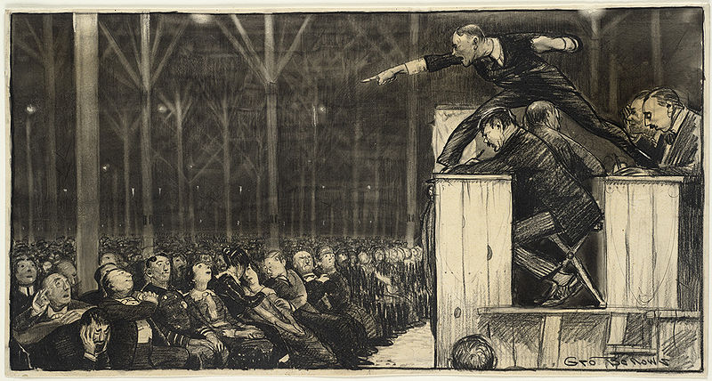
9:30-50
Billy Sunday ~ “If we had more hell in the pulpit, we would have less hell in the pew.”
C. H. Spurgeon ~ “When you preach on heaven, have a face that reflects the sweetness of God; when you preach on hell …
Your normal face will do quite well.”

Slide 15
9:30-50

Slide 16
9:30-50
Hell ~ ge’ena –occurs in 4 different passages (3 in Matthew and 1 in James)
Corresponds to the Lake of Fire (Rev. 20)
Hadēs ~ corresponds to sheol; the abiding place of the dead

Slide 17
9:30-50
Tartaroō ~ only in 1 Pet. 2:4
Verb form of Tartaros ~ lowest recesses of hell

Slide 18
9:30-50

Slide 19
9:30-50
will be revealed by fire; and the fire will test each one’s work, of what sort it is. ¹⁴ If anyone’s work which he has built on it endures, he will receive a reward. ¹⁵ If anyone’s work is burned, he will suffer loss; but he himself will be saved, yet so as through fire.
1 Cor. 3:11–15 ~ ¹¹ For no other foundation can anyone lay than that which is laid, which is Jesus Christ. ¹² Now if anyone builds on this foundation with gold, silver, precious stones, wood, hay, straw, ¹³ each one’s work will become clear; for the Day will declare it, because it

Slide 20
9:30-50

Slide 21
9:30-50
Is 66:24 ~ And they shall go forth and look
Upon the corpses of the men
Who have transgressed against Me.
For their worm does not die,
And their fire is not quenched.
They shall be an abhorrence to all flesh.

Slide 22
9:30-50

Slide 23
9:30-50
swarm in sepulchres. Oh the terrors and torments, the fathomless perdition, the remediless misery into which the damned are plunged, without the least hope of ever either mending or ending!”
John Trapp ~ “Where there is eternity of extremity. Of all outward torments none more insufferable than that by fire; as of all inward, none like that of having worms ever grubbing and gnawing upon the entrails. Add
hereunto, that worms and fire use to make an end of other things; not so here. The fire fails not, as did that fire in the valley of Hinnom, wherein the dead carcases were burnt without Jerusalem, The worm dies not, as do
those worms that

Slide 24
9:30-50

Slide 25
9:30-50
Mark 7:20-23 ~ ²⁰ And He said, "What comes out of a man, that defiles a man. ²¹ For from within, out of the heart of men, proceed evil thoughts, adulteries, fornications, murders, ²² thefts, covetousness, wickedness, deceit, lewdness, an evil
eye, blasphemy, pride, foolishness. ²³ All these evil things come from within and defile a man."

Slide 26
9:30-50

Slide 27
9:30-50
Rev. 20:14-15 ~ ¹⁴ Then Death and Hades were cast into the lake of fire. This is the second death. ¹⁵ And anyone not found written in the Book of Life was cast into the lake of fire.
Rev. 20:10 ~ The devil, who deceived them, was cast into the lake of fire and brimstone where the beast and the false prophet are. And they will be tormented day and night forever and ever.

Slide 28
9:30-50
John Trapp ~ “A child with a spoon may sooner empty the sea than the damned accomplish their misery. A river of brimstone is not consumed by burning.”

Slide 29
9:30-50

Slide 30
9:30-50
Matt. 5:13 ~ You are the salt of the earth; but if the salt loses its flavor, how shall it be seasoned? It is then good for nothing but to be thrown out and trampled underfoot by men.

Slide 31
9:30-50

