Slide 1
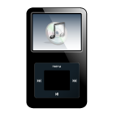
A CD of this message will be available (free of charge) immediately following today's message
8:1-21
This message will be available via podcast later this week at calvaryokc.com

Slide 2
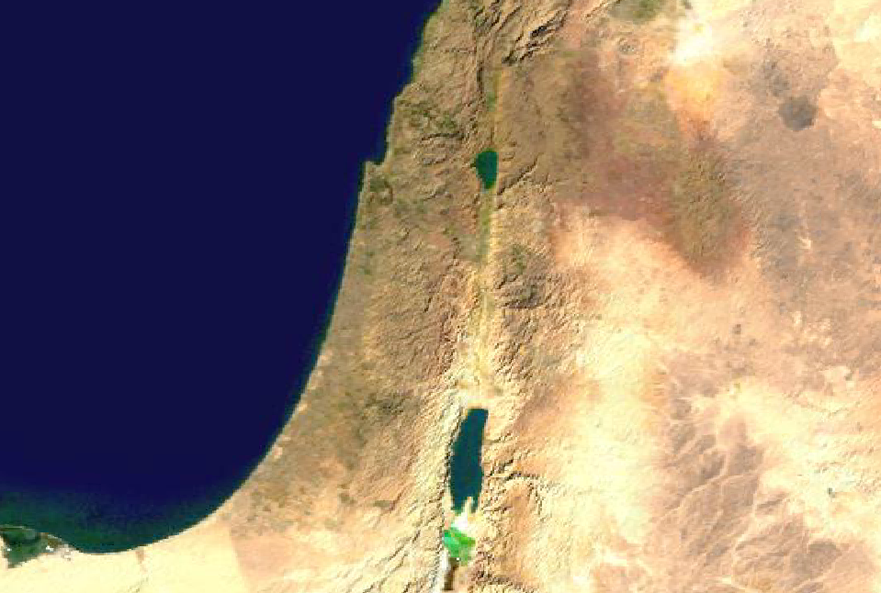
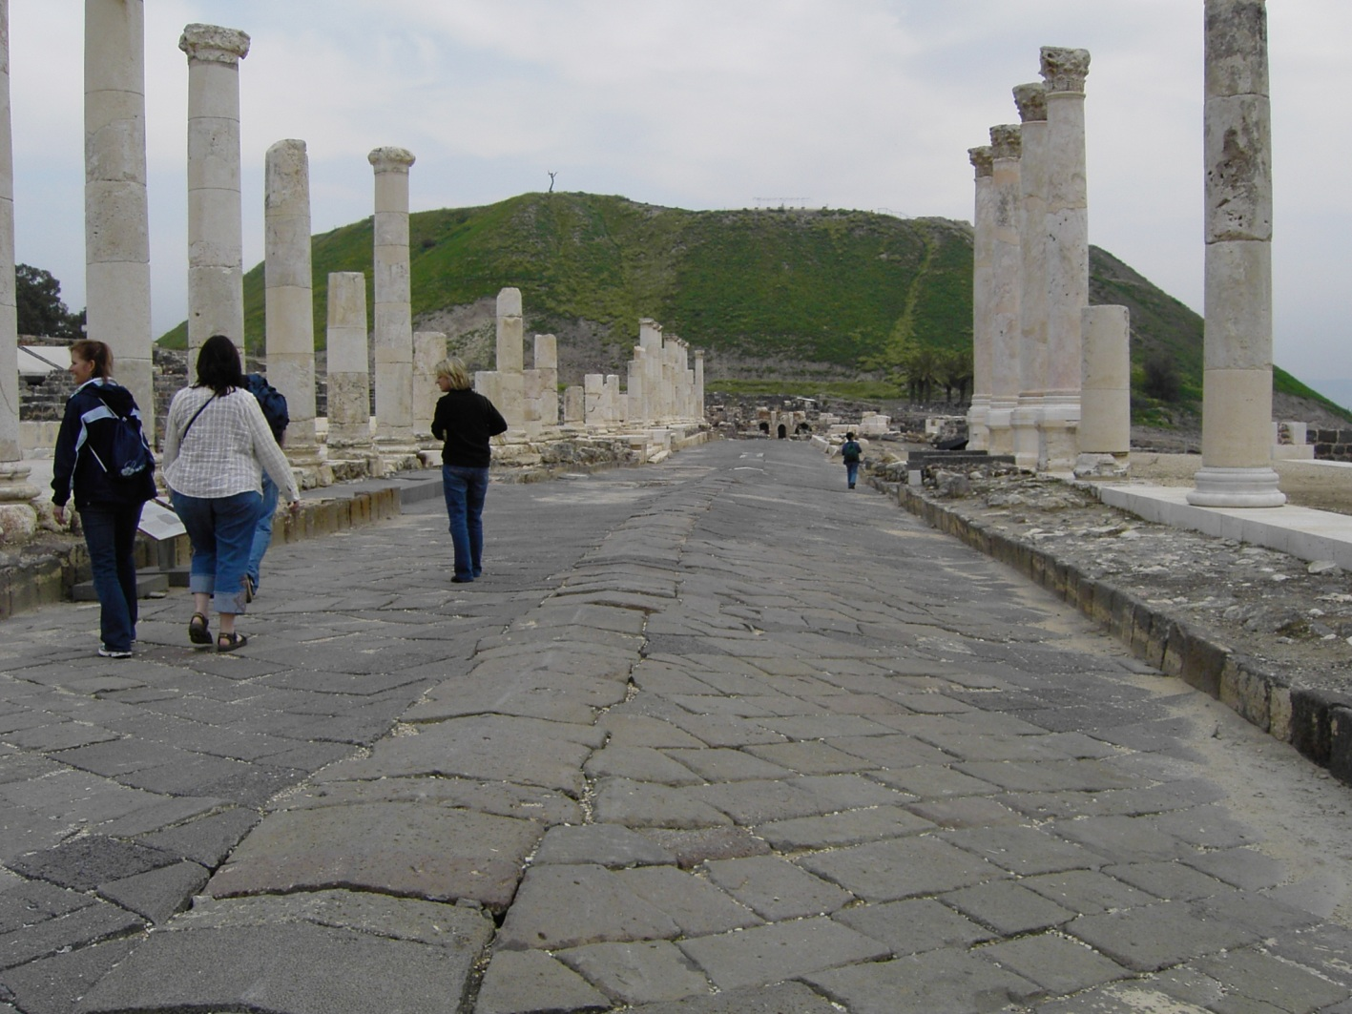
8:1-21
1. Damascus
1
2. Canatha
3. Capitolias
2
3
4
4. Hippus
5
5. Raphana
7
6
6. Gadara
8
9
7. Scythopolis
10
8. Pella
9. Gerasa
Decapolis
Cardo Maximus
10. Philadelphia

Slide 3
8:1-21

Slide 4
8:1-21
Ps. 103:14 ~ For He knows our frame; He remembers that we are dust.

Slide 5
8:1-21

Slide 6
8:1-21
Chapter 6 ~ kophinos (small basket)
Here and Acts 9 ~ sphuris (large basket)

Slide 7
8:1-21

Slide 8
8:1-21
Sign ~ sēmeion – occurs 77x in New Testament
50 ~ sign, 23 ~ miracle, 3 ~ wonder, 1 ~ token
Primary meaning ~ That by which a person or a thing is distinguished from others and is known

Slide 9
8:1-21

Slide 10
8:1-21
Father
Son
Spirit

Slide 11
8:1-21

Slide 12
8:1-21
John 3:2 ~ … "Rabbi, we know that You are a teacher come from God; for no one can do these signs that You do unless God is with him."

Slide 13
8:1-21
Matt. 5:16 ~ Let your light so shine before men, that they may see your good works and glorify your Father in heaven.

Slide 14
8:1-21
may, by your good works which they observe, glorify God in the day of visitation.
1 Pet. 2:11-12 ~ ¹¹ Beloved, I beg you as sojourners and pilgrims, abstain from fleshly lusts which war against the soul, ¹² having your conduct honorable among the Gentiles, that when they speak against you as evildoers, they

Slide 15
8:1-21

Slide 16
8:1-21
hear them.” ³⁰ And he said, 'No, father Abraham; but if one goes to them from the dead, they will repent.' ³¹ But he said to him, 'If they do not hear Moses and the prophets, neither will they be persuaded though one rise from the dead."
Luke 16:27-31 ~ ²⁷ Then he said, “I beg you therefore, father, that you would send him to my father’s house, ²⁸ for I have five brothers, that he may testify to them, lest they also come to this place of torment.” ²⁹ Abraham said to him, “They have Moses and the prophets; let them

Slide 17
8:1-21

Slide 18
8:1-21
Blaise Pascal (1623-1662) ~ “Miracles serve not to convert, but to condemn.”
St. Augustine (AD 354-430) ~ “I should not be a Christian but for the miracles.”

Slide 19
8:1-21

Slide 20
8:1-21
Warren Wiersbe ~ “Their desire for a sign from heaven was but another evidence of their unbelief, for faith does not ask for signs. True faith takes God at His Word and is satisfied with the inward witness of the Spirit.”

Slide 21
8:1-21
Voltaire (1694-1778) ~ “Even if a miracle should be wrought in the open market place before a thousand witnesses, I would rather mistrust my senses than admit a miracle.”

Slide 22
8:1-21

Slide 23
8:1-21
4 things about leaven:
1) It's hidden
2) It permeates the whole loaf
3) It corrupts
4) It's puffed up

Slide 24
8:1-21

