Slide 1
A CD of this message will be available (free of charge) immediately following today's message
7:14-37
This message will be available via podcast later this week at calvaryokc.com

Slide 2
7:14-37
H. A. Ironside ~ “To the spiritual mind, it is a question of unceasing wonder that men should be so ready to follow and even fearlessly contend for the authority of human traditions, while they are just as ready to ignore the plain teachings of the Word of God.”

Slide 3
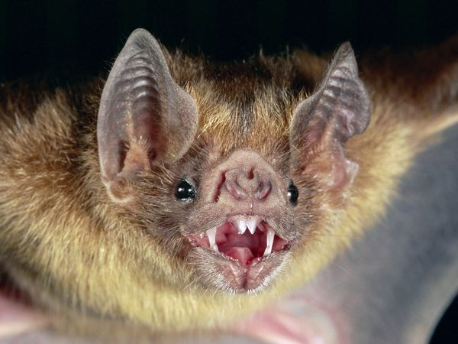
7:14-37
Lev. 11:13-19 ~ ¹³ And these you shall regard as an abomination …
¹⁹ … the stork, the heron after its kind, the hoopoe, and the bat.

Slide 4
7:14-37
Lev. 11:4-6 ~ ⁴ Nevertheless these you shall not eat among those that chew the cud or those that have cloven hooves: …
⁶ … and the swine, though it divides the hoof, having cloven hooves, yet does not chew the cud, is unclean to you.

Slide 5
7:14-37
A. W. Tozer ~ “A Pharisee is hard on others and easy on himself, but a spiritual man is easy on others and hard on himself.”

Slide 6
7:14-37
Matt. 12:30-31 ~ ³⁰ And you shall love the LORD your God with all your heart, with all your soul, with all your mind, and with all your strength.’ This is the first commandment. ³¹ And the second, like it, is this: You shall love your neighbor as yourself.

Slide 7
7:14-37
grace
Legalistic liberties
Legalism
Disciple-o-Meter

Slide 8
7:14-37

Slide 9
7:14-37
William Barclay ~ “Although it may not seem so now, this passage, when it was first spoken, was well-nigh the most revolutionary passage in the New Testament.”

Slide 10
7:14-37

Slide 11
7:14-37
C. H. Spurgeon ~ “’We shall not be hanged for our thoughts,’ cries one. I wish that such idle talkers would remember that they will be damned for their thoughts; and that instead of evil thoughts being less sinful than evil acts, it may sometimes happen that in the thought the man may be worse than in the deed.
He may not be able to carry out all the mischief that lurks within his designs, and yet in forming the design he may incur all the guilt. Thoughts are the eggs of words and actions, and within the thoughts lie compacted and condensed all the villainy of actual transgressions.”

Slide 12
7:14-37

Slide 13
7:14-37
Evil eye
~ ophalmos ponēros – Hebraism for miserliness, covetousness (an eye that is always on evil)
NIV, NASB ~ envy
Blasphemy ~ blasphēmia – to hurt the fame
Pride ~ huperēphania – to over-shine

Slide 14
7:14-37

Slide 15
7:14-37
Matt. 15:28 ~ Then Jesus answered and said to her, "O woman, great is your faith! Let it be to you as you desire."
Matt. 8:10 ~ When Jesus heard it, He marveled, and said to those who followed, "Assuredly, I say to you, I have not found such great faith, not even in Israel!”

Slide 16
7:14-37

Slide 17
7:14-37
G. Campbell Morgan ~ “Behold, ‘a Man of sorrows, and acquainted with grief!’ Behold a Man exercising a ministry full of healing power and elemental light; but never forget that this service was costly.”

Slide 18
7:14-37

