Slide 1
A CD of this message will be available (free of charge) immediately following today's message
6:1-29
This message will be available via podcast later this week at calvaryokc.com

Slide 2
6:1-29
Carpenter ~ tektōn – an artisan, a handyman
Craftsman in wood, metal and stone

Slide 3
6:1-29
Philips Brooks ~ “Familiarity breeds contempt …
only with contemptible things or among contemptible people.”
Offended ~ scandalizō

Slide 4
6:1-29

Slide 5
6:1-29
not mean that God’s power is absolutely limited, but that God has chosen to act only in response to faith.”
D. A. Carson ~ “The trouble was that they were too busy arguing about him to listen to his words. So even the Son of God could do no miracles there, apart from healing a few sick folk, humble enough and needy enough to believe
in him. That does

Slide 6
6:1-29

Slide 7
6:1-29
Marveled ~ thaumazō – only here and the Roman centurion (Matt. 8)
John Trapp (1601-1669) ~ “Unbelief must needs be a monstrous sin, that puts Christ to the marvel.”

Slide 8
6:1-29

Slide 9
6:1-29
Luke 12:47-48 ~ And that servant who knew his master's will, and did not prepare himself or do according to his will, shall be beaten with many stripes. "But he who did not know, yet committed things deserving of
stripes, shall be beaten with few. For everyone to whom much is given, from him much will be required; and to whom much has been committed, of him they will ask the more.

Slide 10
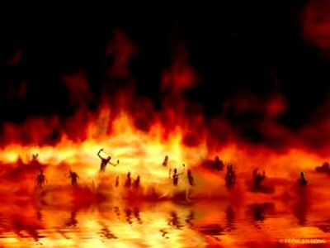
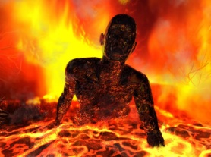
6:1-29
3,000,000⁰
2,000,000⁰
1,000,000⁰

Slide 11
6:1-29

Slide 12
6:1-29
Mal. 4:5 ~ Behold, I will send you Elijah the prophet
Before the coming of the great and dreadful day of the LORD.
Deut. 18:15 ~ The LORD your God will raise up for you a Prophet like me from your midst, from your brethren. Him you shall hear ,,,

Slide 13
6:1-29

Slide 14
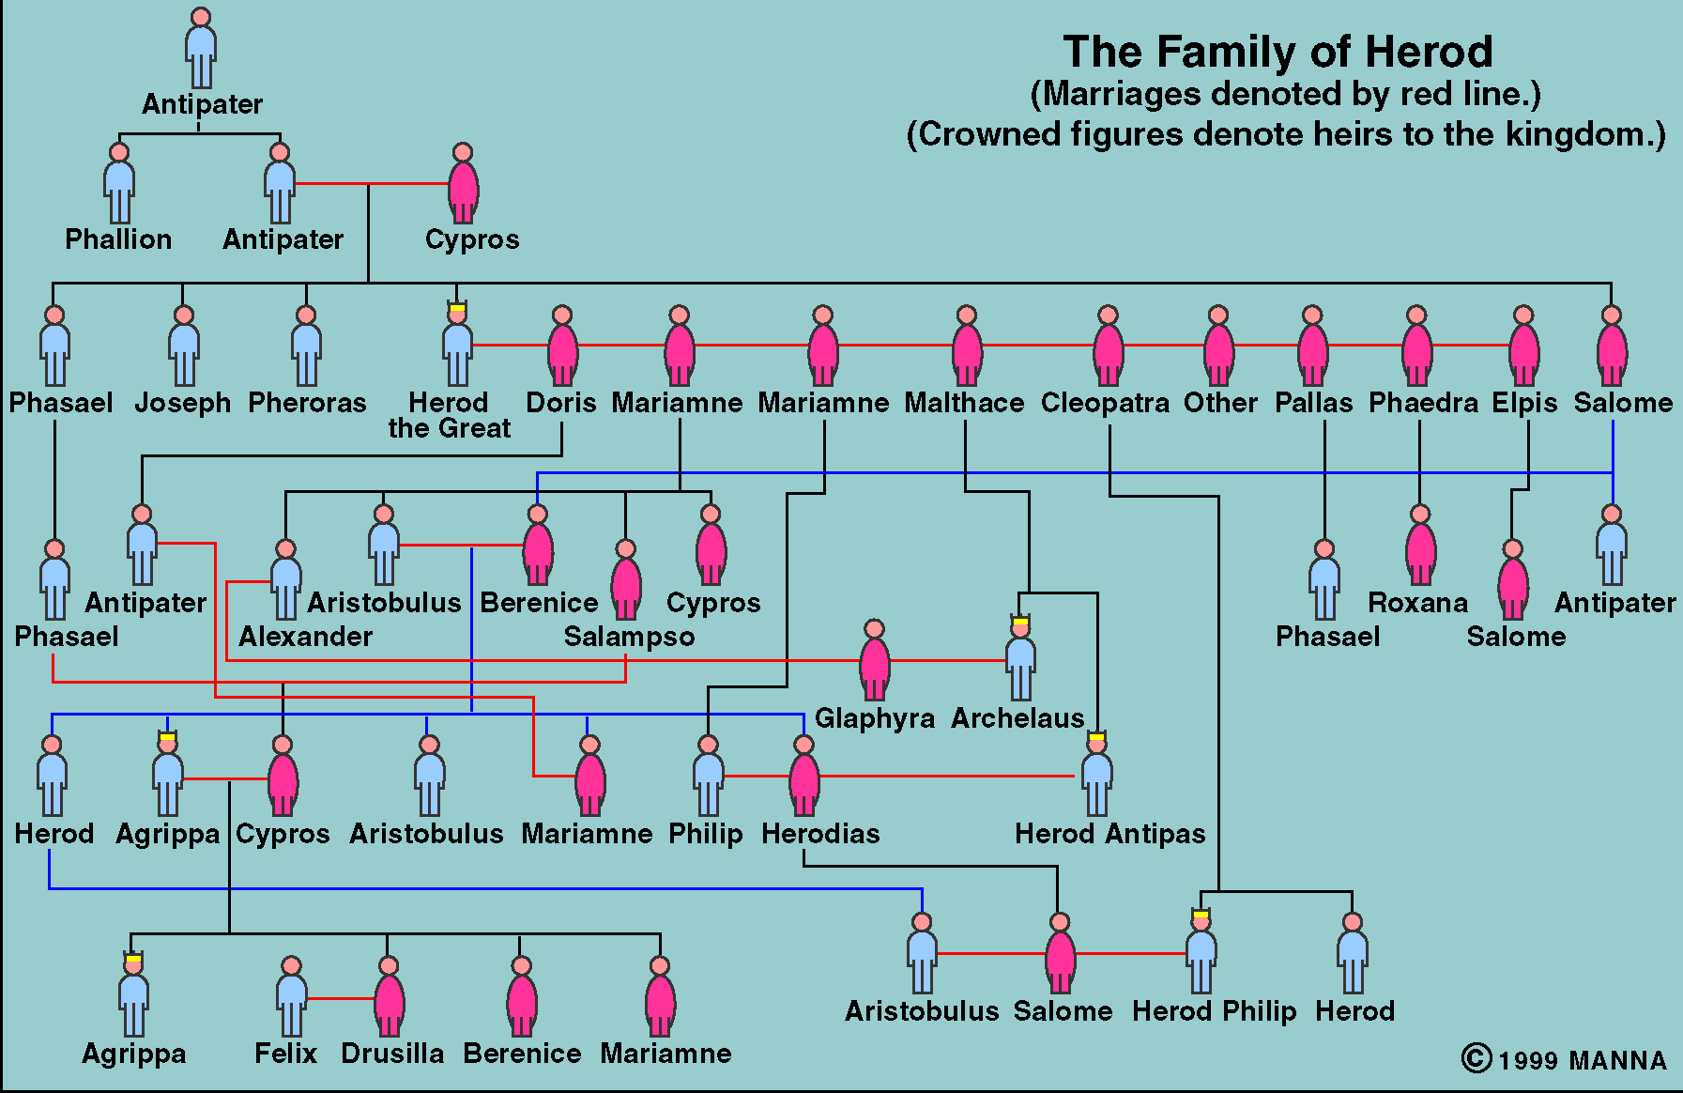
6:1-29
All in the family

Slide 15
6:1-29

Slide 16
6:1-29
Ask ~ middle voice – literally, “Ask for myself?”

Slide 17
6:1-29

Slide 18
6:1-29
What kept Herod from God?
We name our sons John and our dogs Herod
He compromised his morals
He was ruled by his lusts
He was afraid of what his friends might think

Slide 19
6:1-29

