Slide 1


A CD of this message will be available (free of charge) immediately following today's message
5:1-20
This message will be available via podcast later this week at calvaryokc.com

Slide 2

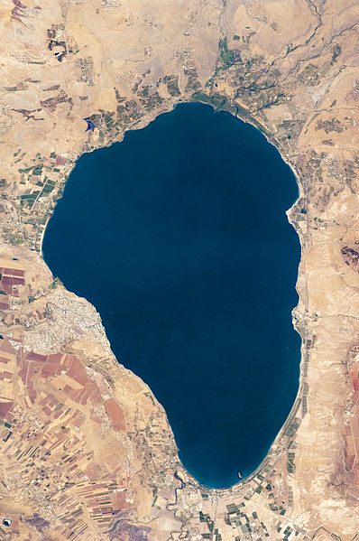
5:1-20
Capernaum
Kursi
Sea of Galilee

Slide 3

5:1-20

Slide 4
5:1-20
Evil Spirits
Spiritual boogerheads
Unclean Spirits
Demons
“Fallen Angel” not found in Scripture

Slide 5
5:1-20

Slide 6
5:1-20
Matt 9:32-33 ~ ³² As they went out, behold, they brought to Him a man, mute and demon-possessed. ³³ And when the demon was cast out, the mute spoke. And the multitudes marveled, saying, "It was never seen like this in Israel!"

Slide 7
5:1-20

Slide 8
5:1-20
1 John 4:4 ~ You are of God, little children, and have overcome them, because He who is in you is greater than he who is in the world.

Slide 9
5:1-20

Slide 10
5:1-20
150 '
Holy of Holies
Spirit
Soul
75'
15 '
Holy Place
Outer court
Flesh
45 '

Slide 11
5:1-20

Slide 12
5:1-20
Worshiped ~ proskuneō
pros (before) + kuon (canine)

Slide 13
5:1-20

Slide 14
5:1-20
Jam. 2:19 ~ You believe that there is one God. You do well. Even the demons believe — and tremble!

Slide 15
5:1-20

Slide 16
5:1-20
Roman military division
Century (100 men – company)
Cohort (10 centuries – battalion)
Legion (6 cohorts – brigade)
6,000 demons?

Slide 17
5:1-20

Slide 18
5:1-20
Demon-possessed ~ daimonizomenos
daimonizomai = demonized
menō = to remain

Slide 19
5:1-20

Slide 20
5:1-20
1 John 3:8 ~ For this purpose the Son of God was manifested, that He might destroy the works of the devil.

Slide 21
5:1-20

Slide 22
5:1-20
G. K. Chesterton ~ “The Christian ideal has not been tried and found wanting, it has been found difficult and left untried.”

Slide 23
5:1-20

Slide 24
5:1-20
pursuit of we don’t know what, are the wants which neither God nor nature, nor reason hath subjected us to, but are solely infused into us by pride, envy, ambition, and covetousness.”
William Law – “All the wants which disturb human life, which make us uneasy to ourselves, quarrelsome with others, and unthankful to God, which weary us in vain labors and foolish anxieties, which carry us from project to project, from place to place in a poor

Slide 25
5:1-20
Disciple ~ mathētēs – verb from of mathanō ; to learn
Phil. 4:11 ~ Not that I speak in regard to need, for I have learned in whatever state I am, to be content …

Slide 26
5:1-20
Chuck Swindoll – “If finding God’s way in the suddenness of storms makes our faith grow broad, then trusting God’s wisdom in the ‘dailyness’ of living makes it grow deep. And strong.”

Slide 27
5:1-20
John Bunyon – “If we have not quiet in our minds, outward comfort will do no more for us than a golden slipper on a gouty foot.”

Slide 28
5:1-19

