Slide 1
A CD of this message will be available (free of charge) immediately following today's message
4:21-41
This message will be available via podcast later this week at calvaryokc.com

Slide 2
4:21-41
Prov. 25:2 ~ It is the glory of God to conceal a matter, But the glory of kings is to search out a matter.

Slide 3
4:21-41
Deut. 29: 29 ~ The secret things belong to the Lord our God, but those things which are revealed belong to us and to our children forever, that we may do all the words of this law.

Slide 4
4:21-41
Rom. 11:33 ~ Oh, the depth of the riches both of the wisdom and knowledge of God! How unsearchable are His judgments and His ways past finding out!

Slide 5
4:21-41

Slide 6
4:21-41
A. T. Robertson ~ “The secret of growth is in the seed, not in the soil nor in the weather nor in the cultivating. These all help, but the seed spontaneously works according to its own nature.”
By itself ~ automatos

Slide 7
4:21-41

Slide 8
4:21-41
Heb. 4:12 ~ For the word of God is living and powerful, and sharper than any two-edged sword, piercing even to the division of soul and spirit, and of joints and marrow, and is a discerner of the thoughts and intents of the heart.

Slide 9
4:21-41

Slide 10
4:21-41
Wiersbe ~ “The growth of the kingdom will not result in the conversion of the world. In fact, some of the growth will give opportunity for Satan to get in and go to work!”

Slide 11
4:21-41
⁴⁹ So it will be at the end of the age. The angels will come forth, separate the wicked from among the just, ⁵⁰ and cast them into the furnace of fire. There will be wailing and gnashing of teeth.
Matt. 13:47–50 ~ ⁴⁷ Again, the kingdom of heaven is like a dragnet that was cast into the sea and gathered some of every kind, ⁴⁸ which, when it was full, they drew to shore; and they sat down and gathered the good into vessels, but threw the bad away.

Slide 12
4:21-41

Slide 13
4:21-41
Wuest ~ And having dismissed the crowd, they take Him under their care just as He was …

Slide 14
4:21-41

Slide 15
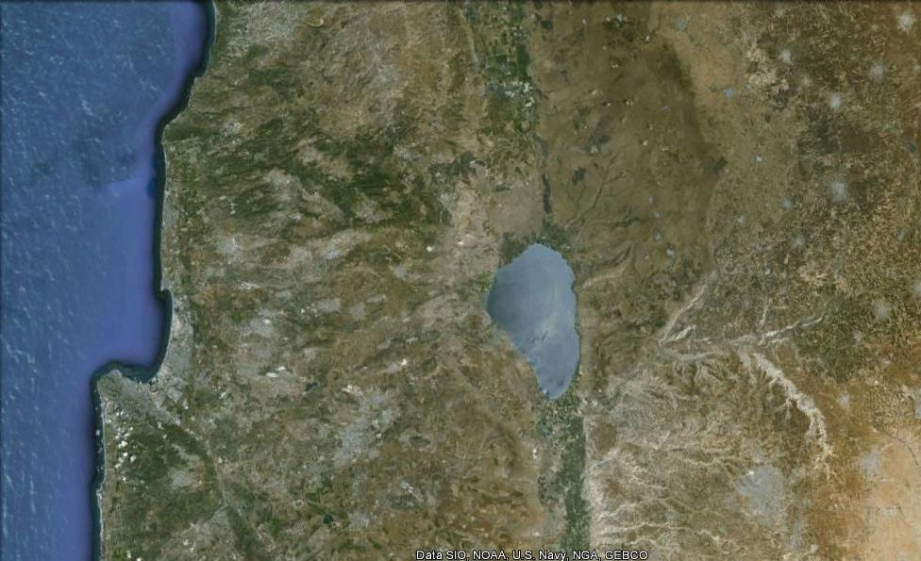
4:21-41

Slide 16
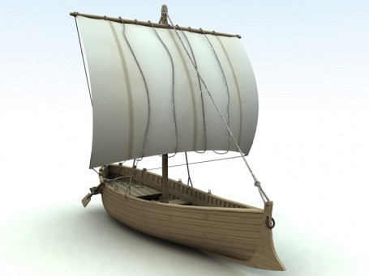
4:21-41
27’ long
7.5’ wide

Slide 17
4:21-41

Slide 18
4:21-41
G. Campbell Morgan ~ “It was not a request to Him to do anything; but a protest against His apparent indifference.”

Slide 19
4:21-41

Slide 20
4:21-41
C. H. Spurgeon~ “I am inclined to think that the secret of weak faith in God is our having a good deal of self-reliance; but when you cannot trust to yourselves, then you hang upon Christ, and cling to him as your only hope; then you give the grip of a sinking man, and there is no hold like that.”

Slide 21
4:21-41

Slide 22
4:21-41
Tuned mass damper

Slide 23
4:21-41
John 16:33 ~ These things I have spoken to you, that in Me you may have peace. In the world you will have tribulation; but be of good cheer,
I am your tuned mass damper.
I have overcome the world.

Slide 24
4:21-41

Slide 25
4:21-41
Ps. 46:1-3 ~ ¹ God is our refuge and strength, A very present help in trouble. ² Therefore we will not fear, Even though the earth be removed, And though the mountains be carried into the midst of the sea; ³ Though its waters roar and be troubled, Though the mountains shake with its swelling. Selah

Slide 26
4:21-41

