Slide 1
A CD of this message will be available (free of charge) immediately following today's message
4:1-20
This message will be available via podcast later this week at calvaryokc.com

Slide 2
4:1-20
3 X 3 =
274
3 X 3 =
Tuesday
3 X 3 =
9
Tuesday – 274 =
9

Slide 3
4:1-20

Slide 4
4:1-20
Parables ~ para (with, alongside) + ballō (to throw)
Designed not to test intellectual knowledge but spiritual responsiveness

Slide 5
4:1-20
David Guzik ~ “A good teacher can illustrate by stating a truth, and then illustrat-ing the truth through a story or an analogy. But when Jesus used parables, He didn’t start by stating a truth. Instead, the parable was like a doorway. Jesus’ listeners stood at the
doorway and heard Him. If they were not interested, they stayed on the outside. But if they were interested, they could walk through the doorway, and think more about the truth behind the parable and what it meant to their life.”

Slide 6
4:1-20

Slide 7
4:1-20
KJV, waxed gross
G. Campbell Morgan ~ “There-fore Jesus used the parabolic method, not in order to blind them, but in order to make them look again; not in order to prevent them coming to forgiveness, but in order to lure them toward a new attention.”

Slide 8
4:1-20

Slide 9
4:1-20
1st understand ~ eidō
– comprehend intuitively
2nd understand ~ ginōskō
– comprehend by experience

Slide 10
4:1-20
“Law of Expositional Constancy”

Slide 11
4:1-20

Slide 12
4:1-20
Tribulation ~ thlipsis – from root meaning pressure
John 16:33 ~ These things I have spoken to you, that in Me you may have peace. In the world you will have tribulation; but be of good cheer, I have overcome the world.

Slide 13
4:1-20

Slide 14
4:1-20
Stumble ~ skandalizō – from the noun meaning a snare or a trap
Present tense; passive voice

Slide 15
4:1-20

Slide 16
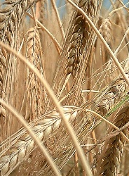
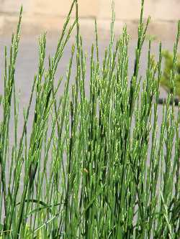
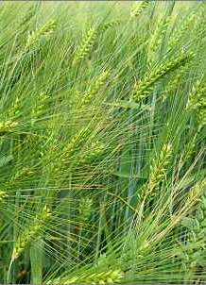
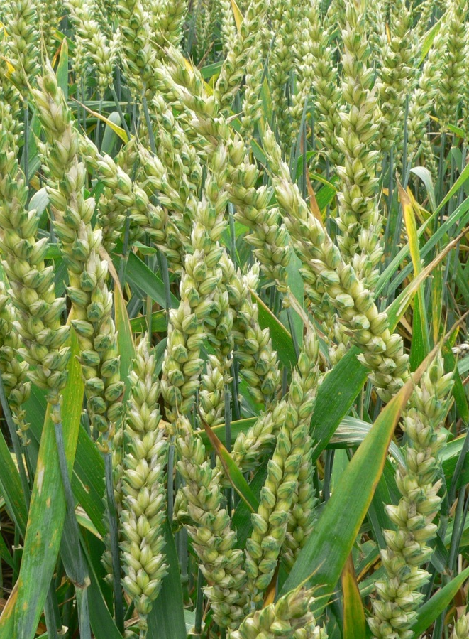
4:1-20
Barley
Darnel
wheat

Slide 17
4:1-20

Slide 18
4:1-20
Three things that rip us off
1. The devil (hard ground)
2. Flesh (stony)
3. World (thorny)

Slide 19
4:1-20

