Slide 1
A CD of this message will be available (free of charge) immediately following today's message
1:16-45
This message will be available via podcast later this week at calvaryokc.com

Slide 2
1:16-45
Rest in Peace
Congratulations on your
new location

Slide 3
1:16-45

Slide 4
1:16-45
Become ~ literally as KJV, to become – it entails a process
Not make as in the NIV and NASB

Slide 5
1:16-45

Slide 6
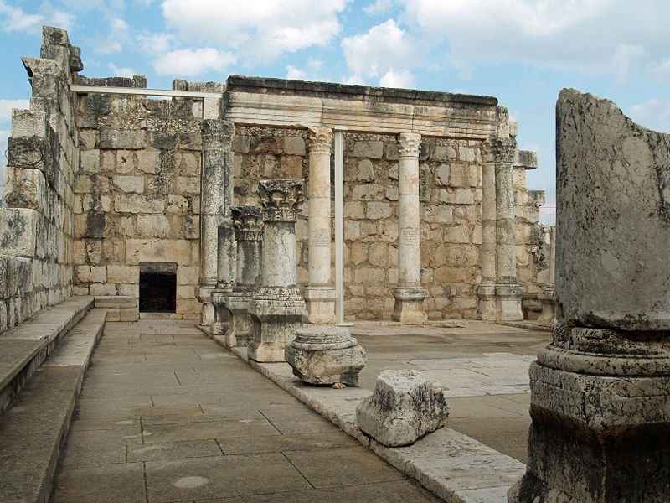
1:16-45
Capernaum ~ K’far Na’um – village of nahum or village of comfort

Slide 7
1:16-45

Slide 8
1:16-45
The demons believe
… and tremble (Jam. 2:19)
2 Cor. 11:14 ~ For Satan himself transforms himself into an angel of light.

Slide 9
1:16-45

Slide 10
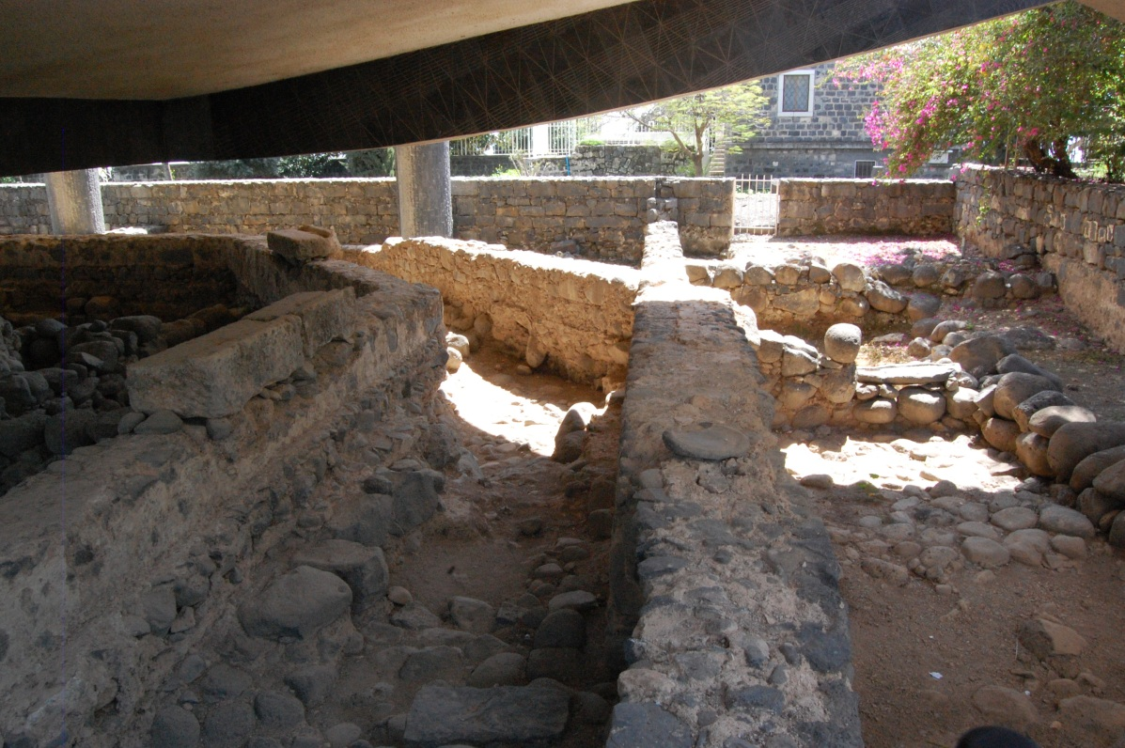
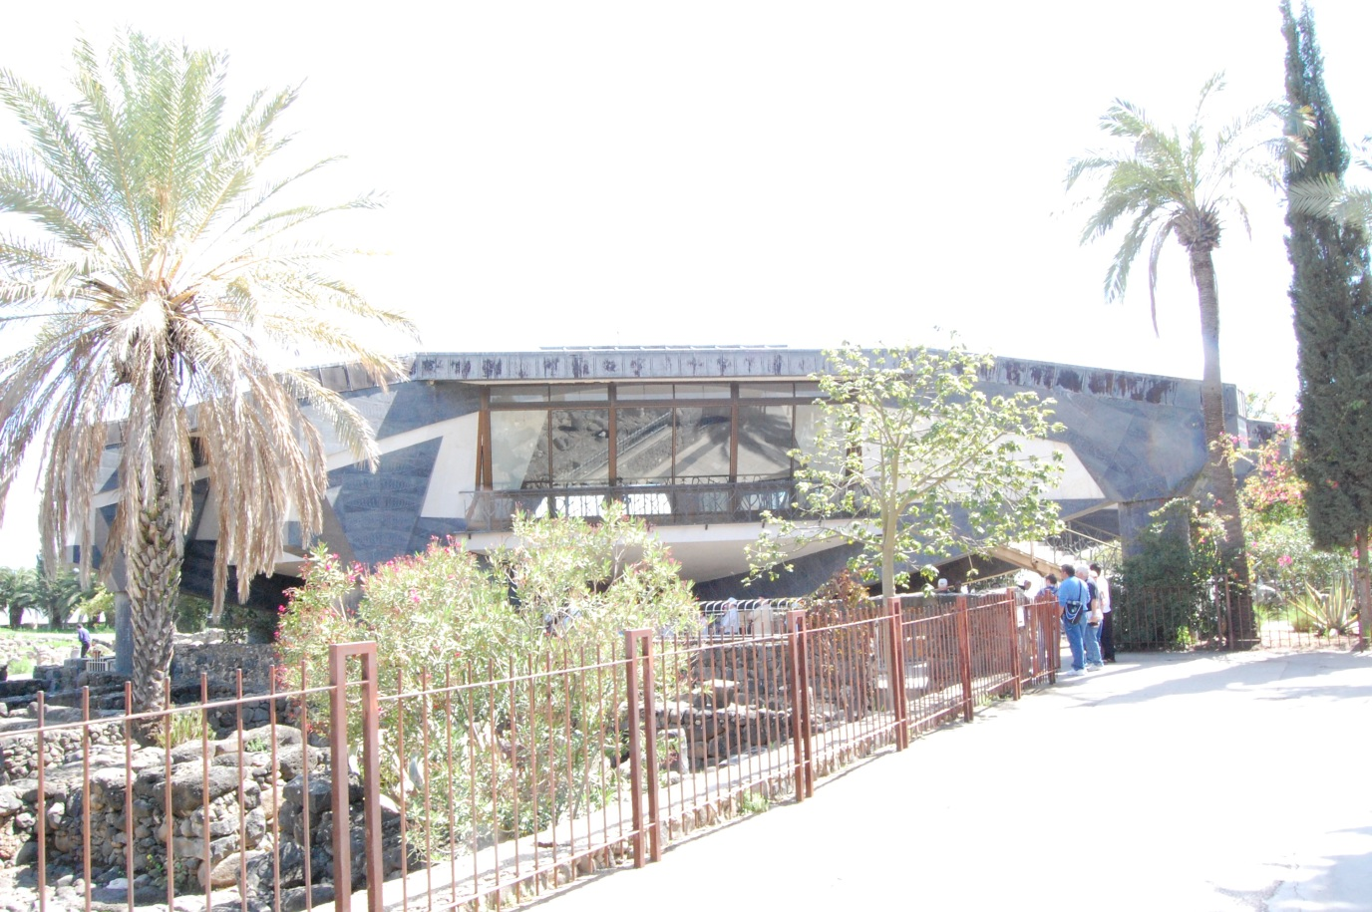
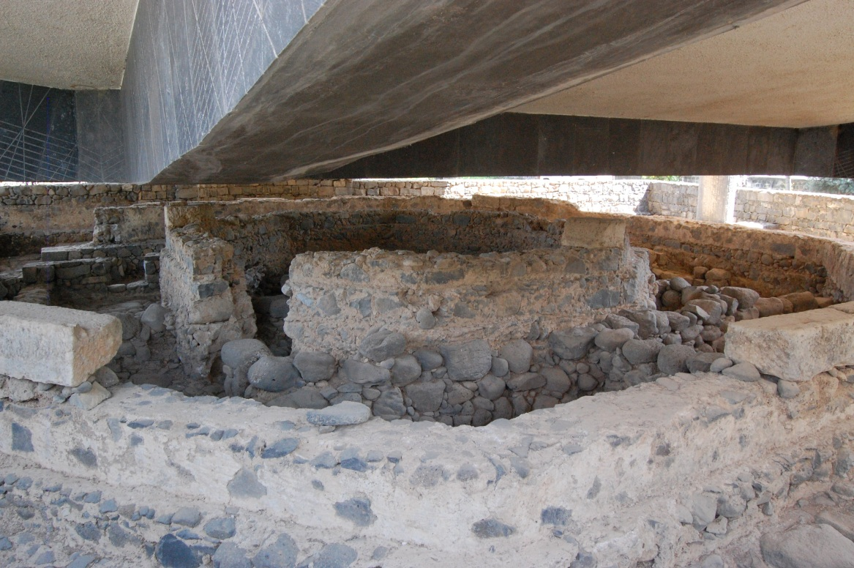
1:16-45

Slide 11
1:16-45

Slide 12
1:16-45
Devotional life is important because repentance is not enough
Pope Pius XII (1876–1958) ~ “A man without prayer is like a tree without roots.”

Slide 13
1:16-45

Slide 14
1:16-45
Lev. 14:1-7 ~ ¹ Then the LORD spoke to Moses, saying, ² "This shall be the law of the leper for the day of his cleansing: He shall be brought to the priest. ³ And the priest shall go out of the camp, and the
priest shall examine
him; and indeed, if the leprosy is healed in the leper, ⁴ then the priest shall command to take for him who is to be cleansed two living and clean birds, cedar wood, scarlet, and hyssop.” ⁵ And the priest shall
command that one of the birds be killed in an earthen vessel over running water. ⁶ As for the living bird, he shall take it, the cedar wood and the scarlet and the hyssop, and dip them and the living bird in the blood
of the bird that was killed over the running water. ⁷ And he shall sprinkle it seven times on him who is to be cleansed from the leprosy, and shall pronounce him clean, and shall let the living bird loose in the open field.

Slide 15
1:16-45
1st bird ~ death of Jesus
Scarlet ~ the blood of Jesus
Earthen vessel ~ humanity of Jesus
Hyssop ~ faith in action
2nd bird ~ Jesus taking our sins to Himself
Running water ~ work of the Holy Spirit in redemp-tion
Cedar wood ~ incorrup-tion of Jesus' life
Cedar wood ~ incorrup-tion of Jesus' life

Slide 16
1:16-45

Slide 17
1:16-45
Spread the matter ~ KJV, blaze abroad – diaphēmizō

Slide 18
1:16-45

Slide 19
1:16-45
Jesus him not to tell … he did
Jesus tells us to tell … we don't
His healing was temporal
Ours is eternal
Which sin is greater?

Slide 20
1:16-45

