Slide 1
A CD of this message will be available (free of charge) immediately following today's message
1:1-15
This message will be available via podcast later this week at calvaryokc.com

Slide 2
1:1-15
Acts 2:38 ~ "Repent, and let every one of you be baptized in the name of Jesus Christ for the remission of sins”

Slide 3
1:1-15

Slide 4
1:1-15
Matthew ~ Lion (King)
Mark ~ OX (Servant)
Luke ~ Man (Son of Man)
John ~ Eagle (Son of God)

Slide 5
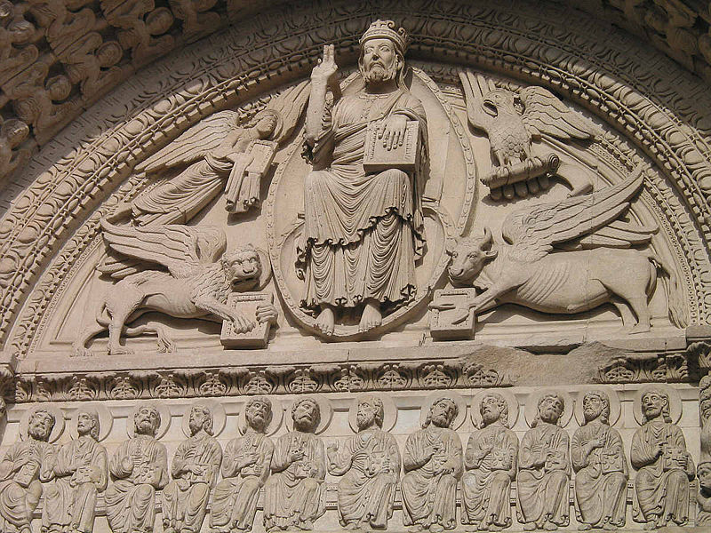
1:1-15
John
Luke
Matthew
Mark

Slide 6
1:1-15
Immediately (straight-forward) ~ euthus – 42 of 80x
8x in chapter 1

Slide 7
1:1-15

Slide 8
1:1-15
Lord ~ kurios – lord (title of great respect)
Is. 40:3 ~ YHWH

Slide 9
1:1-15
Ray Stedman ~ “Without a road you cannot drive out into the desert in order to help somebody. You must have a road, a highway in the desert. John was God's bulldozer to build that highway.”

Slide 10
1:1-15

Slide 11
1:1-15
For ~ eis – either “with a view towards” or “because of”
You need to reach for the brass ring (with a view towards)
He jumped for joy (because of)

Slide 12
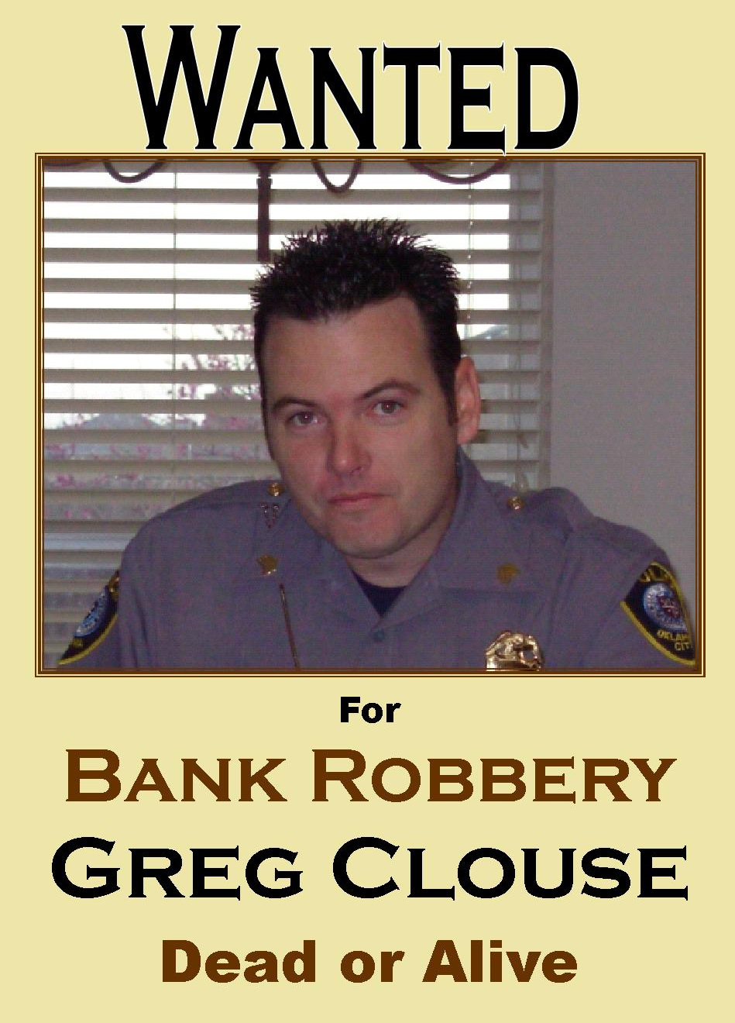
1:1-15
Wanted with a view towards bank robbery …
Wanted because
of bank robbery …

Slide 13
1:1-15

Slide 14
1:1-15
Parting ~ schizō – literally; torn open, ripped

Slide 15
1:1-15

Slide 16
1:1-15
Matt. 3:15 ~ But Jesus answered and said to him, "Permit it to be so now, for thus it is fitting for us to fulfill all righteousness."

Slide 17
1:1-15

Slide 18
1:1-15
Drove ~ ekballō – Literally, to throw out (same as v. 34)

Slide 19
1:1-15

Slide 20
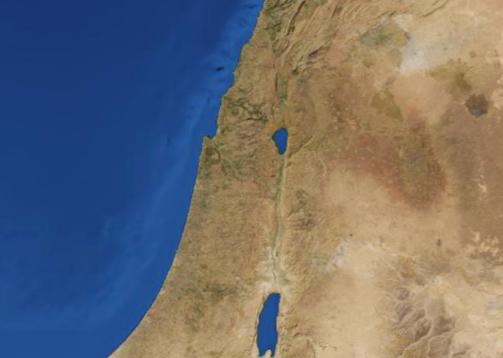
1:1-15
Galilee
Capernaum
Nazareth
30 X 60 miles
Josephus;
204 villages
15,000 people each
3,000,000

Slide 21
1:1-15

Slide 22
1:1-15
At hand ~ engizō – nigh, imminent

Slide 23
1:1-15

Slide 24
1:1-15
Repent ~ metanoeō – to change your mind concerning

Slide 25
1:1-15
C. S. Lewis ~ “Fallen man is not simply an imperfect creature who needs improvement; he is a rebel who must lay down his arms . . . This process of surrender—this movement full speed astern—is what Christians call repentance. Now repentance is no fun at all. It is something much harder than merely
eating humble pie. It means unlearning all the self-conceit and self-will that we have been training ourselves into for thousands of years. It means killing part of yourself, undergoing a kind of death.”
“To turn away from an existing object of trust”

Slide 26
1:1-15
Believe ~ Pisteuō – to commit oneself wholeheartedly to an object of trust

Slide 27
1:1-15

Slide 28
1:1-15
Christianity is not a crutch …
It’s the cure

Slide 29
1:1-15

