Slide 1
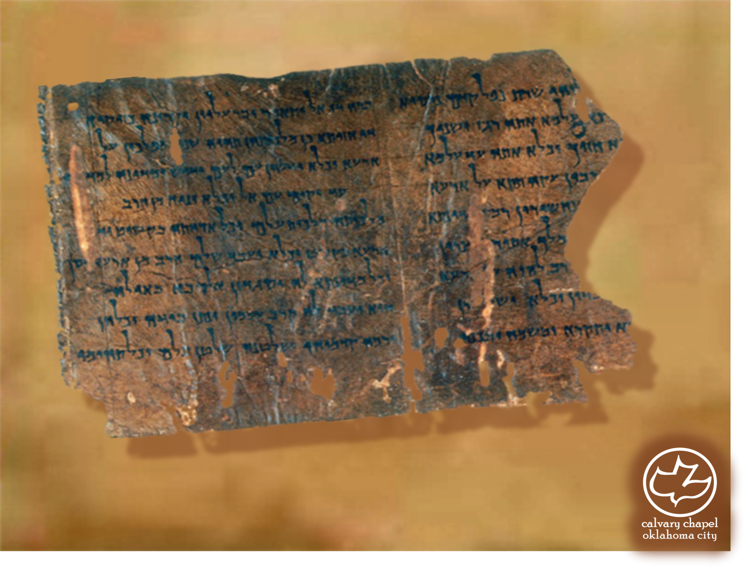

Minor Prophets … Major Message:
Malachi 3-4
A CD of this message will be available (free of charge) immediately following today's message
This message will be available via podcast later this week at calvaryokc.com

Slide 2
Malachi 3-4
Messenger ~ malak (literally, Malachi)
Is. 40:3-4 ~ ³ The voice of one crying in the wilderness: "Prepare the way of the LORD; Make straight in the desert A highway for our God. ⁴ Every valley shall be exalted And every mountain and hill brought low; The crooked places shall be made straight And the rough places smooth;

Slide 3
Malachi 3-4
Is. 29:13 ~ …these people draw near to Me with their mouths and honor Me with their lips, but have removed their hearts from Me, and their fear toward Me is taught by the commandment of men.

Slide 4
Malachi 3-4
Matt. 11:14 ~ And if you are willing to receive it, he is Elijah who is to come.
Matt. 17:11 ~ Jesus answered and said to them, “Indeed, Elijah is coming first and will restore all things.

Slide 5
Malachi 3-4
McGee ~ "Pimple of rebellion became an internal cancer."

