Slide 1
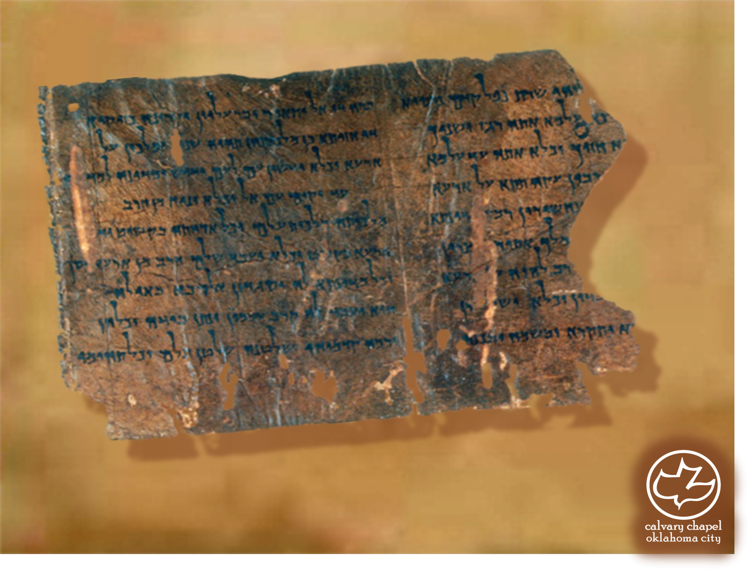
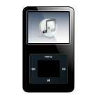
Minor Prophets … Major Message:
Malachi 1-2
A CD of this message will be available (free of charge) immediately following today's message
This message will be available via podcast later this week at calvaryokc.com

Slide 2
Malachi 1-2
Malachi ~ My messenger
Considered a title by LXX and some others
c. 450-430 BC
Under Persian rule
Dialectical method ~ “A dialogue between two or more people holding different points of view about a subject, who wish to establish the truth of the matter by dialogue, with reasoned arguments.”

Slide 3
Malachi 1-2
Chapters 1 and 2 deal with 3 problems:
Actions of the priests (1:6-11)
Attitude of the priests (1:12-13)
Apathy of the people (1:14ff)

Slide 4
Malachi 1-2
In what way have You loved us? (1:2)
In what way have we despised Your name? (1:6)
In what way have we defiled You? (1:7)
In what way have we wearied Him? (2:17)
In what way shall we return? (3:7)
In what way have we robbed You? (3:8)
In what way have we spoken
against You? (3:13)

Slide 5
Malachi 1-2
Matt. 10:37 ~ He who loves father or mother more than Me is not worthy of Me. And he who loves son or daughter more than Me is not worthy of Me.
Jackals ~ KJV, dragons

Slide 6
Malachi 1-2
1 Pet. 2:5 ~ you also, as living stones, are being built up a spiritual house, a holy priesthood, to offer up spiritual sacrifices acceptable to God through Jesus Christ.
1 Pet. 2:9 ~ But you are a chosen generation, a royal priesthood, a holy nation, His own special people, that you may proclaim the praises of Him who called you out of darkness into His marvelous light;

Slide 7
Malachi 1-2
Heb. 13:15 ~ Therefore by Him let us continually offer the sacrifice of praise to God, that is, the fruit of our lips, giving thanks to His name.

Slide 8
Malachi 1-2
Rom. 12:1 ~ I beseech you therefore, brethren, by the mercies of God, that you present your bodies a living sacrifice, holy, acceptable to God, which is your reasonable service.
G. Campbell Morgan ~ "I am more afraid of the profanity of the sanctuary than I am of the profanity of the streets."

Slide 9
Malachi 1-2
Sneer ~ KJV, snuffed – naphach

Slide 10
Malachi 1-2
Jam. 3:1 ~ My brethren, let not many of you become teachers, knowing that we shall receive a stricter judgment.

Slide 11
Malachi 1-2
Refuse ~ KJV, dung; NIV, offal

Slide 12
Malachi 1-2
Dealt treacherously ~ bagad – to act unfaithfully with respect to a prior agreement of covenant
NIV, broken faith

Slide 13
Malachi 1-2
Remnant of the Spirit ~ or spiritual remnant

