Slide 1
20:19-47

Slide 2
20:19-47
Ps. 118:22 ~ The stone which the builders rejected
Has become the chief cornerstone.
Is. 8:14 ~ He will be as a sanctuary,
But a stone of stumbling and a rock of offense
To both the houses of Israel,
As a trap and a snare to the inhabitants of Jerusalem.

Slide 3
20:19-47
Pharisees ~ strict separatists
Herodians ~ Herod loyalists (Pro-Roman)
Sadducees ~ denied resurrection

Slide 4
20:19-47

Slide 5
20:19-47
’s unwise lines for a college application:
“When I told my friends I was like applying to LeHigh, they were all like, no way, and I was all like, yes way. And they were all like, way cool.”
“Four years of fees at your institution come to about $78,000. Just bill my father and mail me half the money. He’ll never find out.”
“First off, coach said there weren’t gonna
be no writin’.”

Slide 6
20:19-47
‘s unwise lines for a college application:
“To demonstrate my love for your school, I have spray-painted your logo on my town’s water tower.”
“College is probably the last place they’ll look for me.”

Slide 7
20:19-47

Slide 8
20:19-47
sent spies ~ literally, sent spies out as missionaries

Slide 9
20:19-47

Slide 10
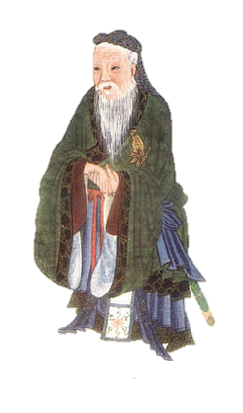
20:19-47
Confucius say, “Never flatter a woman too
much …”
“If you stop,
she’ll believe you don’t love her anymore”
“If you
continue she’ll think she’s better than you”

Slide 11
20:19-47

Slide 12
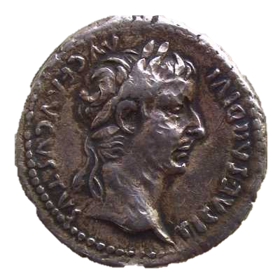
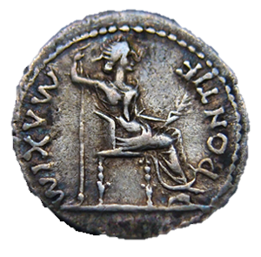
20:19-47
pay (v. 22) ~ didōmi – to give
Render (v. 25) ~ apodidōmi – to give back
P O N T I F
M A X I M
Caesar Augustus Tiberius
Son of divine Augustus

Slide 13
20:19-47

Slide 14
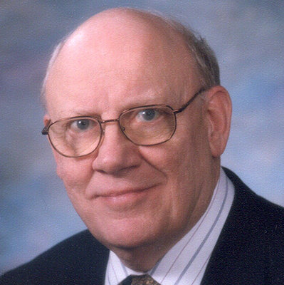
20:19-47
Warren Wiersbe (1929-2019) ~
“Caesar’s image is on his coins, so
they must be minted by his authority.
The fact that you possess these coins
and use them indicates that you think
they are worth something. Therefore,
you are already accepting Caesar’s
authority, or you would not use his
money! But don’t forget that you created in the image of God and therefore must live under
God’s authority as well.”

Slide 15
20:19-47

Slide 16
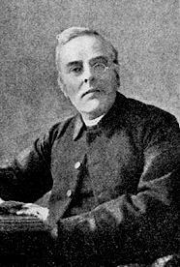
20:19-47
John Ellerton (1826-1893) ~ “Give
yourselves anew to God and to God’s
service, and He will give you the desire
and the power to open your treasures;
to give to Him, it may be wealth, it may
be time, it may be personal service, it
may be life itself. In His store there is a
place for all, for the tears of the penitent,
the barley loaves of the child, the two
mites of the widow, the savings of the
Philippians’ ‘deep poverty,’ as well
as for Mary’s ointment,

Slide 17
20:19-47
John Ellerton (1826-1893) ~ for the land
of Barnabas, for the gold and incense
and myrrh of these Eastern sages. And
if the vision of Christ be before his eyes,
and the love of Christ be in his heart, the
man of wealth will give his large offering,
the man of learning his dear-bought
knowledge, the man of business his
hard-earned leisure, for the glory of God,
for the benefit of his fellow-men, for the
Church or for the poor; to feed the
hungry,

Slide 18
20:19-47
John Ellerton (1826-1893) ~ or to teach
the ignorant, to help the struggling, or
to guide the erring; and each gift will be
welcomed by Him who gave Himself for
us all, and who asks in return for our-
selves as a living sacrifice to Him.”

Slide 19
20:19-47

Slide 20
20:19-47
Matt. 22:29 ~ You are mistaken, not knowing the Scriptures nor the power of God.

Slide 21
20:19-47

Slide 22
20:19-47
equal ~ isos – isosceles triangle
NIV, NASB ~ like
x
x
y

Slide 23
20:19-47
1 John 3:1-2 ~ ¹ Behold what manner of love the Father has bestowed on us, that we should be called children of God! Therefore the world does not know us, because it did not know Him. ² Beloved, now we are children of God; and it has not yet been revealed what we shall be, but we know that when He is revealed, we shall be like Him, for we shall see Him as He is.

Slide 24
20:19-47

Slide 25
20:19-47
Ex. 3:6, 14 ~ ⁶ Moreover He said, “I am the God of your father – the God of Abraham, the God of Isaac, and the God of Jacob.” And Moses hid his face, for he was afraid to look upon God.
¹⁴ And God said to Moses, “I AM WHO I AM.” And He said, “Thus you shall say to the children of Israel, ‘I AM has sent me to you.’”
“I WILL BE THAT I WILL BE … say … ’I WILL BE has sent me’”
I AM … not … I was

Slide 26
20:19-47

Slide 27
20:19-47
Psalm 110:1 ~
YHWH said to my Adonai,

Slide 28
20:19-47

