Slide 1
20:1-19

Slide 2
20:1-19
Pharisees ~ strict separatists
Herodians ~ Herod loyalists (Pro-Roman)
Sadducees ~ denied resurrection
Rand Paul
Donald Trump
Chuck Schumer

Slide 3
20:1-19

Slide 4
20:1-19
vercomers
NIVERSITY

Slide 5
20:1-19

Slide 6
20:1-19
MAR
JUDEA
AD33
Accredited
TABLTRNR
Dead
Raiser-upper

Slide 7
20:1-19

Slide 8
20:1-19
Certainly not! ~ mē genoito
KJV, God forbid!
Literally, it can’t possibly be

Slide 9
20:1-19
Is. 5:1-7 ~ ¹ Now let me sing to my Well-beloved A song of my
Beloved regarding His vineyard:
My Well-beloved has a vineyard
On a very fruitful hill.
² He dug it up and cleared out its stones,
And planted it with the choicest vine.
He built a tower in its midst,
And also made a winepress in it;
So He expected it to bring forth good
grapes,
But it brought forth wild grapes.

Slide 10
20:1-19
Is. 5:1-7 ~ ³ “And now, O inhabitants of Jerusalem and men of Judah,
Judge, please, between Me and My vineyard.
⁴ What more could have been done to My vineyard
That I have not done in it?
Why then, when I expected it to bring forth good grapes,
Did it bring forth wild grapes?
⁵ And now, please let Me tell you what I will do to My vineyard:
I will take away its hedge, and it shall
be burned;
And break down its wall, and it shall be
trampled down.

Slide 11
20:1-19
Is. 5:1-7 ~ ⁶ I will lay it waste;
It shall not be pruned or dug,
But there shall come up briers and thorns.
I will also command the clouds
That they rain no rain on it.”
⁷ For the vineyard of the Lord of hosts is the house of Israel,
And the men of Judah are His pleasant plant.
He looked for justice, but behold, oppression;
For righteousness, but behold, a cry for help.

Slide 12
20:1-19

Slide 13
20:1-19
Wuest ~ And having looked at them with a piercing gaze,
Phillips ~ But he looked them straight in the eyes

Slide 14
20:1-19

Slide 15
20:1-19
Ps. 118:22 ~ The stone which the builders rejected
Has become the chief cornerstone.
Ps. 118:26 ~ Blessed is he who comes in the name of the Lord!
We have blessed you from the house of the Lord.

Slide 16
20:1-19

Slide 17
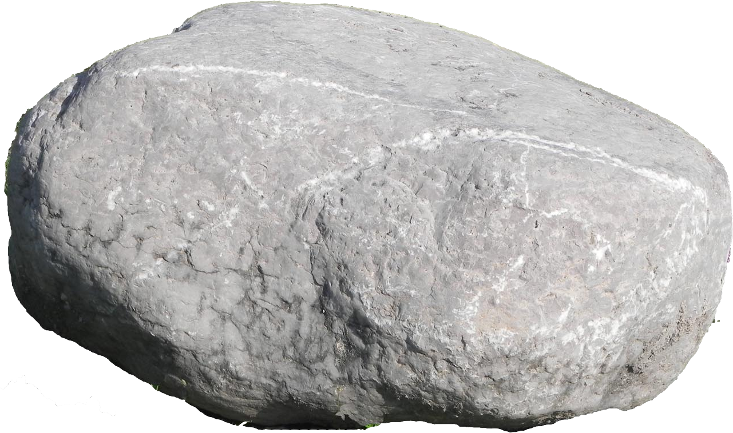
20:1-19
Head of Gold ~ Babylon (605-539 BC)
Breast of Silver ~ Persia (539-331BC)
Thighs of Brass ~ Greece (331-168 BC)
Legs of Iron ~ Rome (168 BC-AD 476
Feet of Iron and Clay ~ Revived Roman Empire

Slide 18
20:1-19

Slide 19
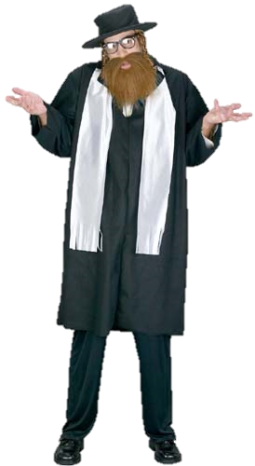
20:1-19
If the stone falls
on the pot,
If the pot falls on the stone, alas, for the pot;
alas,
for the pot.

Slide 20
20:1-19

Slide 21
20:1-19
Napoleon Bonaparte (1769-1821) ~
I know men and I tell you, Jesus Christ is
no mere man. Between Him and every
other person in the world there is no
comparison. Alexander, Caesar,
Charlemagne, and I have founded
empires but on what rest the creations
of our genius? Upon force. Jesus Christ
founded His empire upon love; and at
this very hour millions of men would
die for Him.”

Slide 22
20:1-19

