Slide 1
19:1-27

Slide 2
19:1-27
Zacchaeus ~ pure one
tax collector ~ telonēs
telos ~ end, continual, eternal
oneomai ~ to buy
architelonēs – the grand poobah of those who are always continually collecting taxes

Slide 3
19:1-27
Zacchaeus
TC
TC
TC
TC
TC
TC
TC
TC

Slide 4
19:1-27

Slide 5
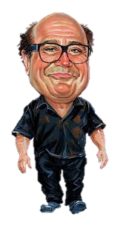
19:1-27
70
Danny
60
Zach
50
40

Slide 6
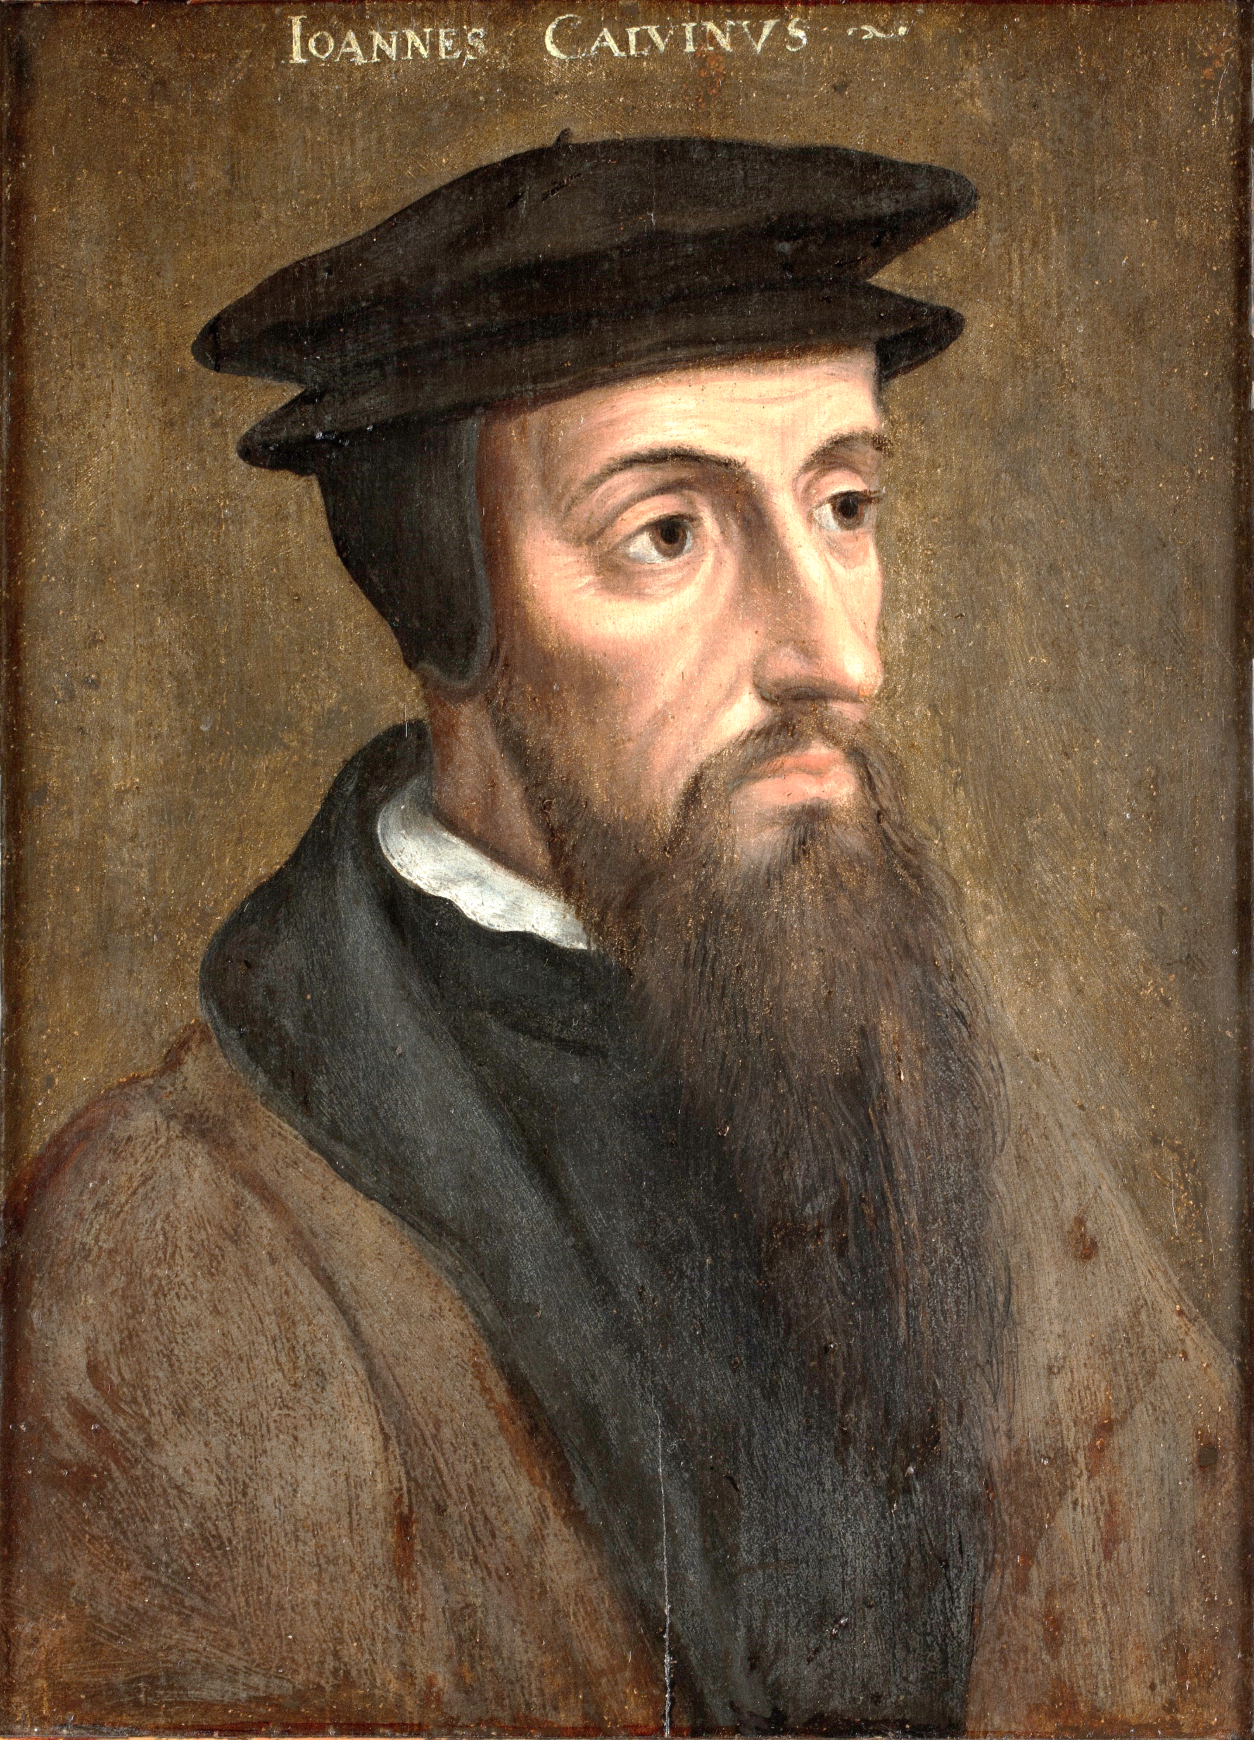
19:1-27
John Calvin (1509-1564) ~ “Curiosity and simplicity are a sort of preparation for faith.”

Slide 7
19:1-27

Slide 8
19:1-27
Luke 18:17 ~ Assuredly, I say to you, whoever does not receive the kingdom of God as a little child will by no means enter it.

Slide 9
19:1-27

Slide 10
19:1-27
guest ~ kataluō – to destroy, dissolve, disunite
Matt. 24:2 ~ And Jesus said to them, “Do you not see all these things? Assuredly, I say to you, not one stone shall be left here upon another, that shall not be thrown down.”
to destroy the burden of your journey

Slide 11
19:1-27

Slide 12
19:1-27
Phil. 4:8 ~ Finally, brethren, whatever things are true, whatever things are noble, whatever things are just, whatever things are pure, whatever things are lovely, whatever things are of good report, if there is any virtue and if there is anything praiseworthy—meditate on these things.
Lev. 5:16 ~ And he shall make restitution for the harm that he has done in regard to the holy thing, and shall add one-fifth to it and give it to the priest.

Slide 13
19:1-27

Slide 14
19:1-27
There is
something missing in my life
I know that Jesus is the answer
I don’t want to give it all up
I want to give it all up
Rich, young ruler
Zacchaeus

Slide 15
19:1-27

Slide 16
19:1-27
minas ~ KJV, pounds

Slide 17
19:1-27
Parable of the Talents
Parable of the Minas
Matt. 25:14-31
Luke 19:11-27
6,000 denarii
100 denarii
3 servants
10 servants
5,2, 1
1 each
100%, 100%, 0%
1000%, 500%, 0%
Faithfulness with His enabling
Faithfulness to the Lord

Slide 18
19:1-27
do business ~ pragmateuomai – KJV, occupy
NLT ~ Invest this for me while I am gone.

Slide 19
19:1-27

Slide 20
19:1-27
austere ~ austēros – harsh, severe

Slide 21
19:1-27

Slide 22
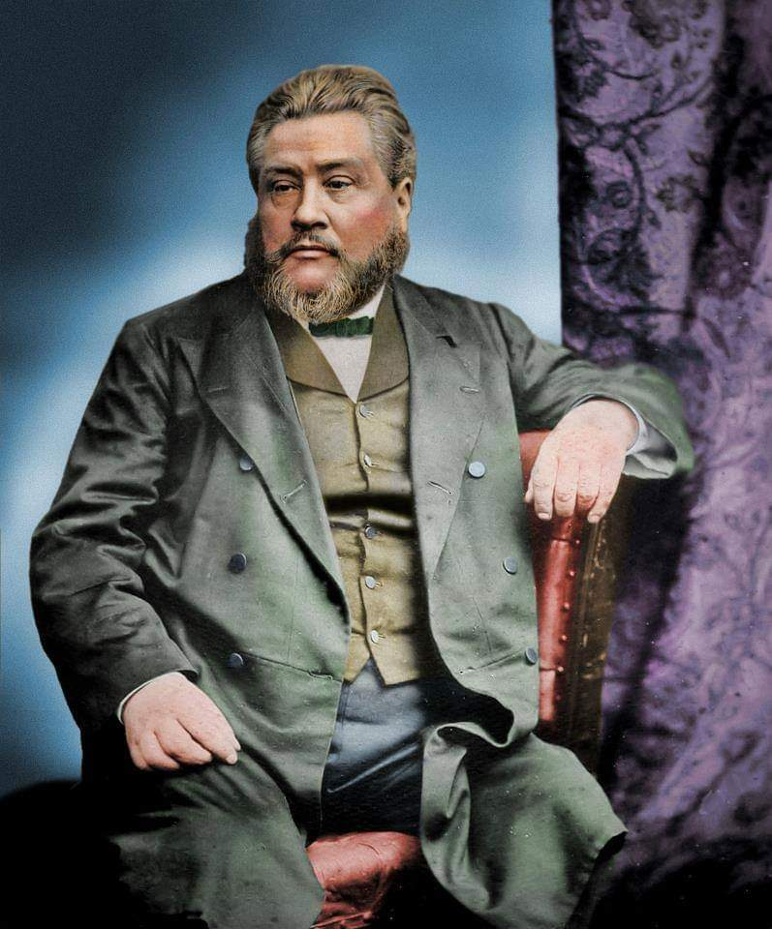
19:1-27
C. H. Spurgeon (1834-1892) ~
“When you preach on heaven,
have a face that reflects the
sweetness of God;
when you
preach on hell,
your normal face will do quite well.”

Slide 23
19:1-27

