Slide 1

18:18-43

Slide 2

18:18-43
$6,000,000.00
- .25
$5,999,999.75

Slide 3
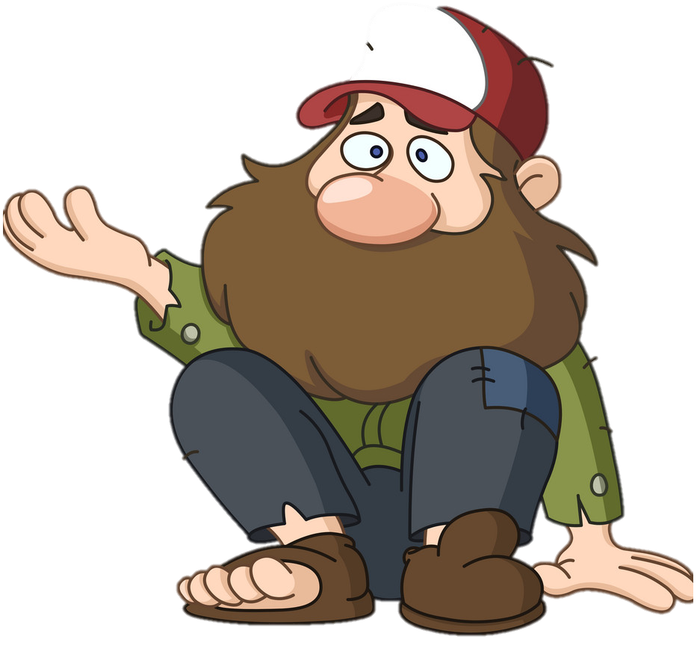

18:18-43
One day, this could be you.
This Photo by Unknown Author is licensed under CC BY

Slide 4

18:18-43

Slide 5

18:18-43
He was very young (Matt. 19:20)
He was very rich (v. 23)
He was very powerful (v. 18)
Rich Y. Ruler
mayja playa
“my peeps will get in touch w/ your peeps”
011-972-1-234-5678
rippinit@gmail.com

Slide 6
18:18-43

Slide 7
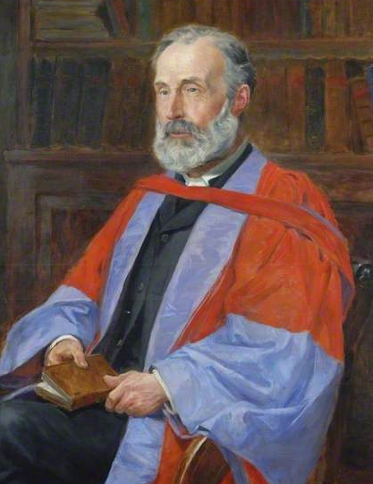
18:18-43
Alfred Plummer (1841-1926) ~ “There
is no instance in the whole Talmud of
a Rabbi being addressed as ‘Good
Master’; the title was absolutely un-
known among the Jews. This, therefore,
was an extraordinary address, and
perhaps a fulsome compliment. The
Talmud says, ‘There is nothing else that
is good but the Law.’”

Slide 8
18:18-43

Slide 9
18:18-43
Matthew 19:19 ~ … and You shall love your neighbor as yourself.

Slide 10
18:18-43

Slide 11
18:18-43
He was very young (Matt. 19:20)
He was very rich (v. 23)
He was very powerful (v. 18)
He was very moral (v. 21)
Rich Y. Ruler
mayja playa
“my peeps with get in touch w/ your peeps”
011-972-1-234-5678
rippinit@gmail.com

Slide 12

18:18-43

I. No Other Gods
II. No Carved Image
III. Don’t take My name in vain
IV. Remember the Sabbath
V. Honor Father and Mother
VI. Don’t Murder
VII. Don’t Commit adultery
VIII. Don’t Steal
IX. Don’t Lie
X. Don’t Covet





Slide 13
18:18-43

Slide 14
18:18-43
~ emblepō
Mark 10:21 ~ looking at him,
loved him
literally, looking in him

Slide 15
18:18-43

Slide 16
18:18-43
John 6: 28-29 ~ ²⁸ Then they said to Him, “What shall we do, that we may work the works of God?”
²⁹ Jesus answered and said to them, “This is the work of God, that you believe in Him whom He sent.”
pisteuō (verb) ~ believe
pistis (noun) ~ faith
trust
Matt. 19:22; Mark 10:22 ~ he went away sorrowful

Slide 17
18:18-43

Slide 18
18:18-43
1 Tim. 6:10 ~ For the love of money is a root of all kinds of evil, for which some have strayed from the faith in their greediness, and pierced themselves through with many sorrows.

Slide 19
18:18-43

Slide 20
18:18-43
eye of a needle ~ kamēlos (camel)
kamilos (ship’s rope)

Slide 21
18:18-43

Slide 22
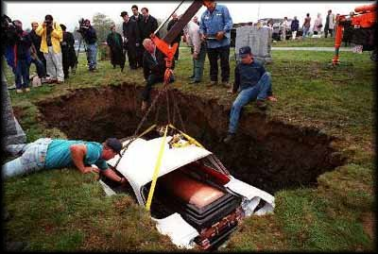
18:18-43
“Woman Takes Her Corvair for an Eternal Cruise”
© LA Times, 05/07/98

Slide 23
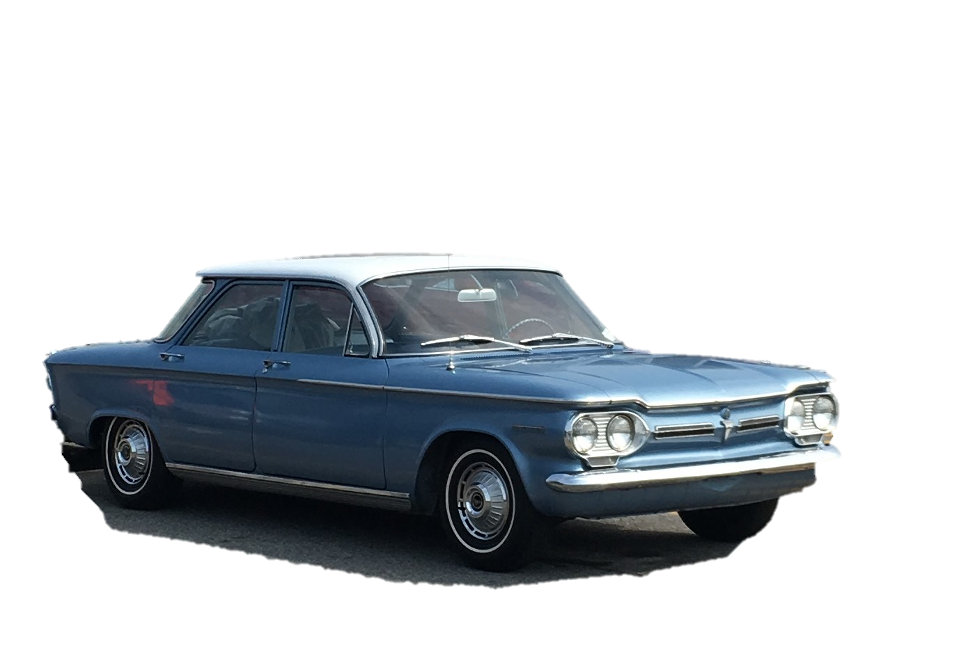
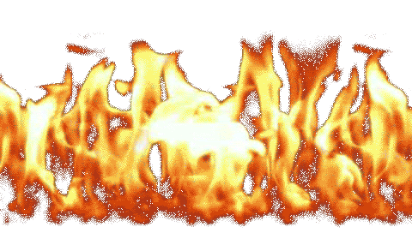
18:18-43

Slide 24
18:18-43

Slide 25
18:18-43
cried out ~ boaō – to shout (for help or in a tumultuous way)
Mark 15:34 ~ And at the ninth hour Jesus cried out with a loud voice, saying, “… My God, My God, why have You forsaken Me?”

Slide 26
18:18-43

