Slide 1
18:1-17

Slide 2
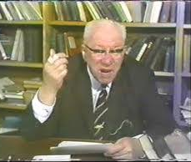
18:1-17
William Barclay (1907-1978) ~
“He has not yet learned to bear
grudges and nourish bitterness.
Even when he is unjustly
treated – and who among us is
not sometimes unjust to his
children? – he forgets and forgets so completely that he does not even need to forgive. Indeed, such is the Kingdom of God.”

Slide 3
18:1-17

Slide 4
18:1-17
Luke 18:37 ~ And they answered and said to Him, “Where, Lord?”
So He said to them, “Wherever the body is, there the eagles will be gathered together.”

Slide 5
18:1-17

Slide 6
18:1-17
Pray with consistence (vv. 1-8)
Pray with contrition (vv. 9-14)
Pray with childlikeness (vv. 15-17)

Slide 7
18:1-17

Slide 8
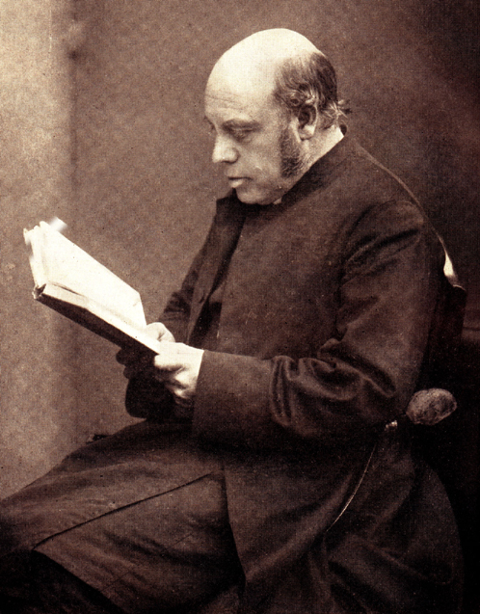
18:1-17
1 Thess. 5:17 ~ pray without ceasing,
J. B. Lightfoot (1828-1889) ~ “It
is not in the moving of the lips,
but in the elevation of the heart
to God, that the essence of prayer
consists.”

Slide 9
18:1-17

Slide 10
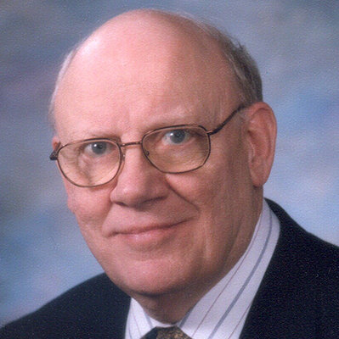
18:1-17
Warren Wiersbe (1929-2019) ~
“… it means to make prayer
as natural to us as our regular
breathing. Unless we are sick
or smothering, we rarely think
about our breathing; we just
do it. Likewise with prayer – it
should be the natural habit of our lives, the ‘atmosphere’ in which we
constantly live.”

Slide 11
18:1-17

Slide 12
18:1-17
v. 7) bears long ~ NIV, will he keep putting them off?
v. 3) came to him ~ (imperfect tense) kept coming to him
v. 8) find faith ~ literally, the faith

Slide 13
18:1-17

Slide 14
18:1-17
with (v. 11) ~ pros – better, NASB ~ to

Slide 15
18:1-17

Slide 16
18:1-17
The tax collector’s standard was Jesus
The Pharisee’s standard was the tax collector

Slide 17
18:1-17

Slide 18
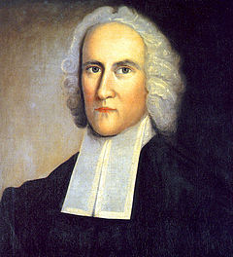
18:1-17
Jonathan Edwards (1703-1758) ~ “You contribute nothing to
your salvation other than the
sin that made it necessary.”

Slide 19
18:1-17

Slide 20
18:1-17
Mark 10:16 ~ He took them up
enagkalizomai – enfolded them

Slide 21
18:1-17

Slide 22
18:1-17
Pray with consistence (vv. 1-8)
Pray with contrition (vv. 9-14)
Pray with childlikeness (vv. 15-17)

Slide 23
18:1-17

