Slide 1
16:17-31

Slide 2
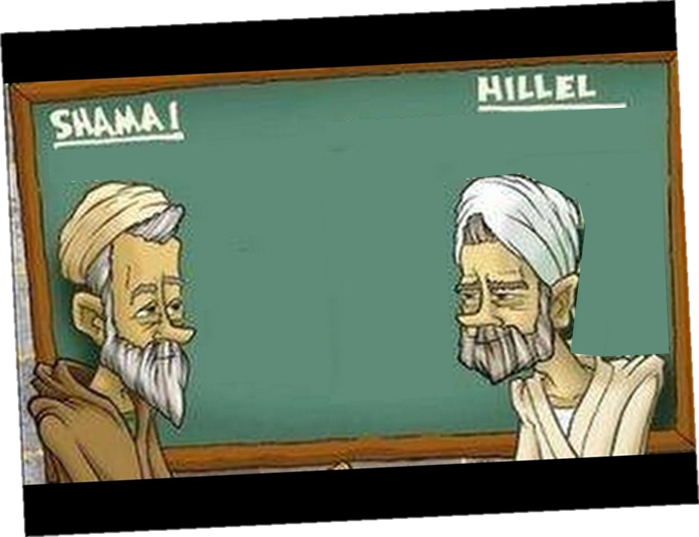
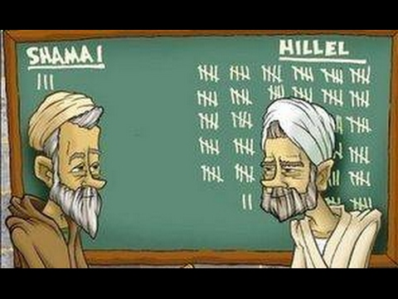
16:17-31
Divorce for any reason
Divorce only for adultery

Slide 3
16:17-31

Slide 4
16:17-31
Lazarus ~ Hebrew – Eleazar

Slide 5
16:17-31

Slide 6
16:17-31
Hades ~ hadēs – also in NASB, ESV
KJV, NIV ~ hell
NLT ~ the place of the dead
Wuest ~ the unseen world of departed human beings
Hebrew ~ sheol

Slide 7
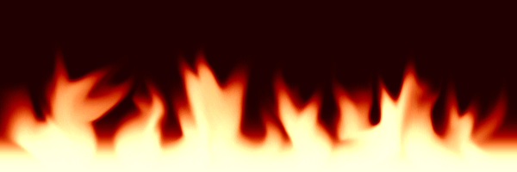
16:17-31
Sheol / Hades
Great Gulf
Abraham’s Bosom
Place of Torments

Slide 8
16:17-31

Slide 9
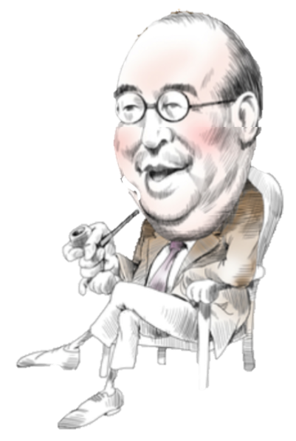
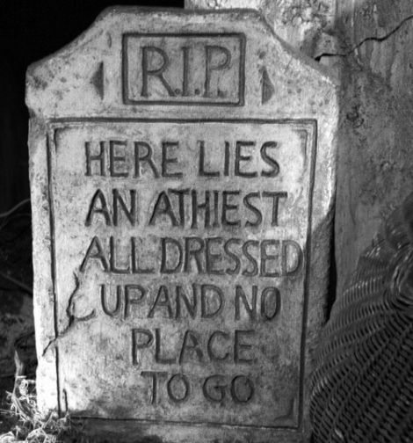
16:17-31
I bet he wishes that were so!
tormented ~ odunaō – from a word meaning to be plunged into
C. S. Lewis

Slide 10
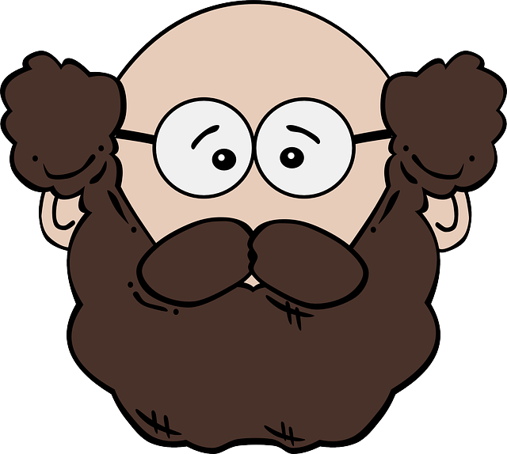
16:17-31
The faith that isn’t
strong enough to change a life probably isn’t strong enough to save a soul

Slide 11
16:17-31

Slide 12
16:17-31
The Four Judgments
The Judgment of the bēma (2 Cor. 5:10)
The Judgment of the Old Testament Israelites (Dan. 12:1-3)
The Judgment of the Sheep and the Goats (Matt. 25:31-33)
The Judgment of the Great White Throne (Rev. 20:11-15)

Slide 13
16:17-31
Old Testament Israelites (Dan. 12:1-3)
Great White Throne (Rev. 20:11-15)
Bēma
(2 Cor. 5:10)
Sheep and Goats (Matt. 25:31-33)
1
2
3
4
5
6
7
Church age
Tribulation
1000 yr. Millennium
Rapture
2nd Coming

Slide 14
16:17-31

Slide 15
16:17-31
The Judgment of the bēma
2 Cor. 5:10 ~ For we must all appear before the judgment seat of Christ, that each one may receive the things done in the body, according to what he has done, whether good or bad.
Takes place following the Rapture
Only for believers
A judgment of works, not sins

Slide 16
16:17-31

Slide 17
16:17-31
The Judgment of the Old Testament Israelites
Dan. 12:1-3 ~ ¹ At that time Michael shall stand up,
The great prince who stands watch over the sons of your people;
And there shall be a time of trouble,
Such as never was since there was a nation,
Even to that time.
And at that time your people shall be delivered,
Every one who is found written in the book.

Slide 18
16:17-31
The Judgment of the Old Testament Israelites
Dan. 12:1-3 ~ ² And many of those who sleep in the dust of the earth shall awake,
Some to everlasting life,
Some to shame and everlasting contempt.
³ Those who are wise shall shine
Like the brightness of the firmament,
And those who turn many to righteousness
Like the stars forever and ever.

Slide 19
16:17-31
The Judgment of the Old Testament Israelites
Following the rise and fall of Antichrist
Those that lived by faith will be saved, those didn’t won’t

Slide 20
16:17-31

Slide 21
16:17-31
The Judgment of the Sheep and the Goats
Matt. 25:31-33 ~ ³¹ When the Son of Man comes in His glory, and all the holy angels with Him, then He will sit on the throne of His glory. ³² All the nations will be gathered before Him, and He will separate them one from another, as a shepherd divides his sheep from the goats. ³³ And He will set the sheep on His right hand, but the goats on the left.

Slide 22
16:17-31
The Judgment of the Sheep and the Goats
At the end of the Tribulation
3 groups: Sheep, Goats and “My brethren”
Survivors of the Tribulation
Begin repopulating the earth during the Millennium

Slide 23
16:17-31

Slide 24
16:17-31
The Judgment of the Great White Throne
Rev. 20:11-15 ~ ¹¹ Then I saw a great white throne and Him who sat on it, from whose face the earth and the heaven fled away. And there was found no place for them. ¹² And I saw the dead, small and great, standing before God, and books were opened. And another book was opened, which is the Book of Life. And the dead were judged according to their works, by the things which were written in the books.

Slide 25
16:17-31
The Judgment of the Great White Throne
Rev. 20:11-15 ~ ¹³ The sea gave up Click the dead who were in it, and Death and Hades delivered up the dead who were in them. And they were judged, each one according to his works. ¹⁴ Then Death and Hades were cast into the lake of fire. This is the second death. ¹⁵ And anyone not found written in the Book of Life was cast into the lake of fire.

Slide 26
16:17-31
The Judgment of the Great White Throne
1,007 years after the bēma
No reprieves, acquittals, continuances, repeals, paroles or probations

Slide 27
16:17-31

Slide 28
16:17-31
If God loves everyone, He would never send them to hell
1. The nature of sin
2. The nature of God’s love

Slide 29
16:17-31

Slide 30
16:17-31
Old Testament Israelites (Dan. 12:1-3)
Great, White Throne (Rev. 20:11-15)
Bēma
(2 Cor. 5:10)
Sheep and Goats (Matt. 25:31-33)
1
2
3
4
5
6
7
Church age
Tribulation
1000 yr. Millennium
Rapture
2nd Coming

Slide 31
16:17-31

Slide 32
16:17-31
torment ~ not odunaō, but noun often used of a torture rack

Slide 33
16:17-31

Slide 34
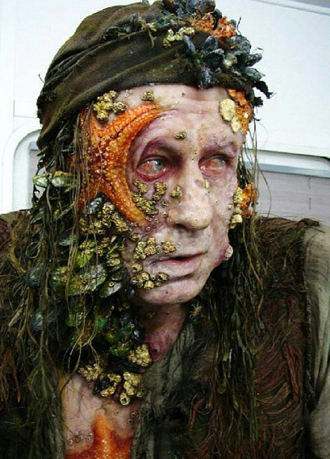
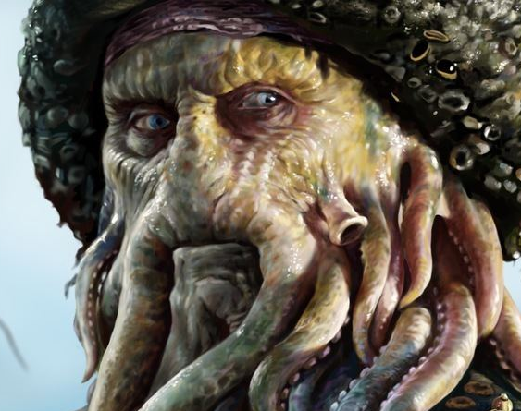
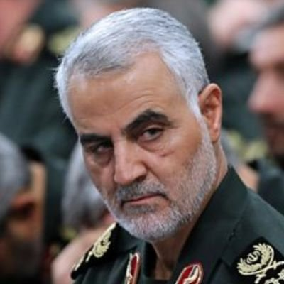
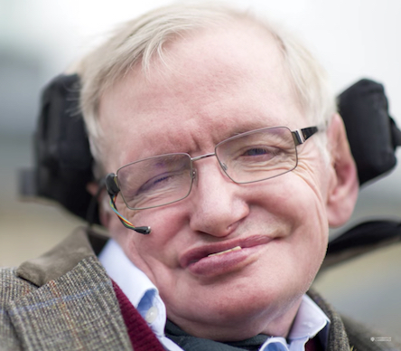
16:17-31

Slide 35
16:17-31

Slide 36
16:17-31
If God wants
me, He needs to show me a sign
Waaaaw!Whoa!
Holy
Bible

Slide 37
16:17-31

