Slide 1

16:1-16

Slide 2
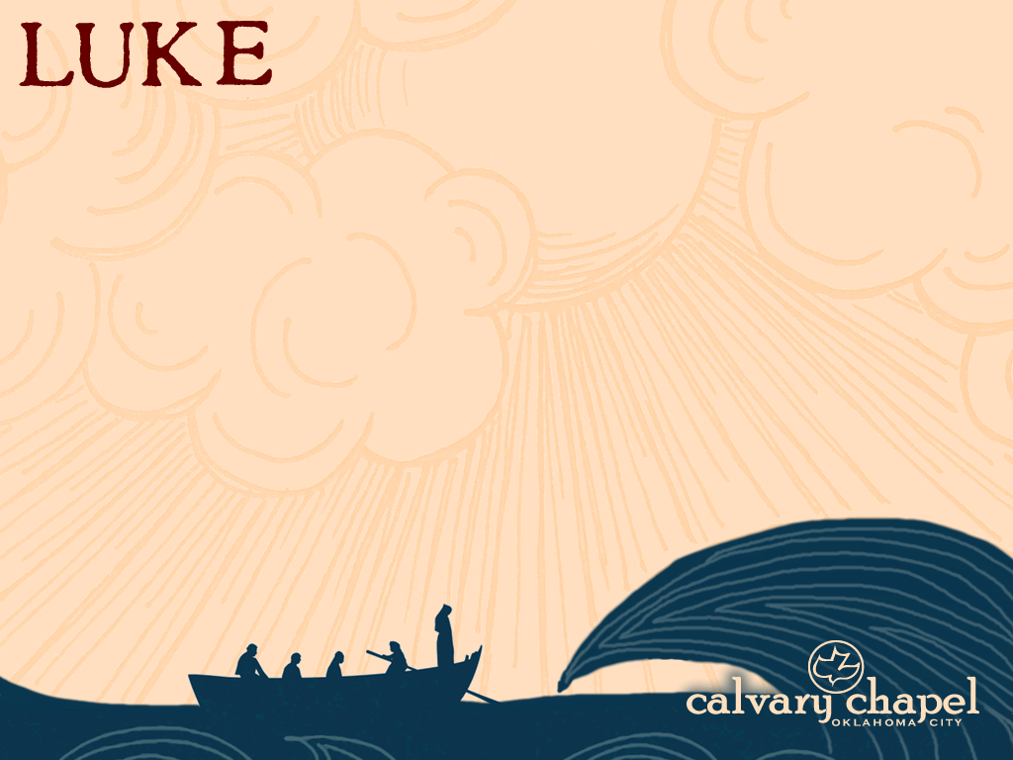
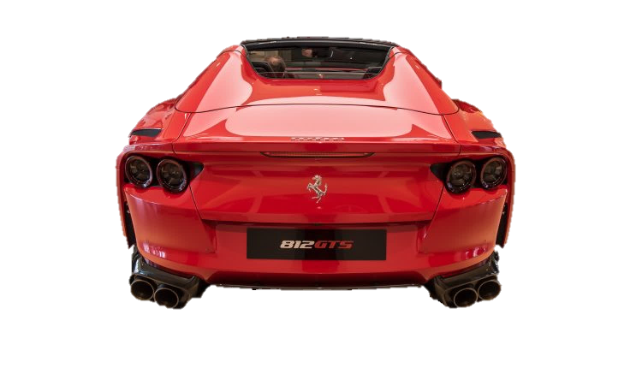
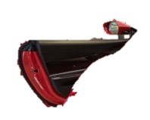
16:1-16

Slide 3
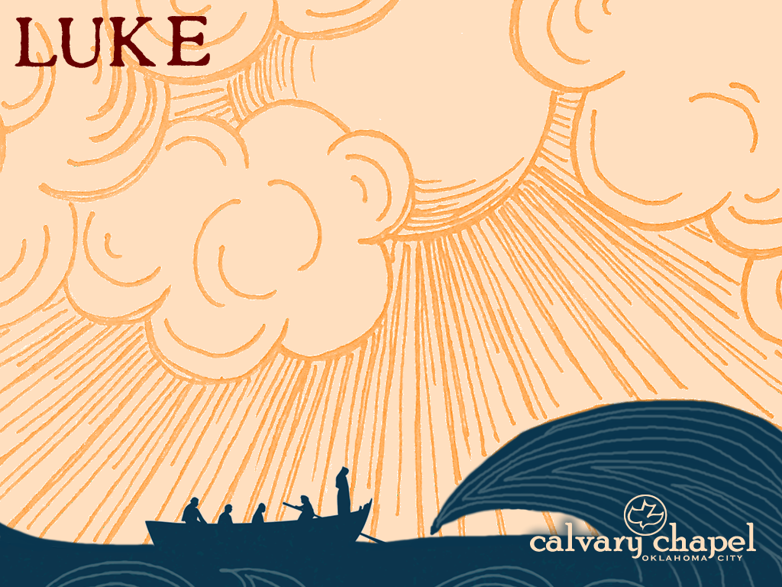
16:1-16

Slide 4
16:1-16
steward ~ oikonomos – oikos (house) + nomos (law)
House manager

Slide 5
16:1-16

Slide 6
16:1-16
Prov. 6:6-8 ~ ⁶ Go to the ant, you sluggard! Consider her ways and be wise,
⁷ Which, having no captain, overseer or ruler,
⁸ Provides her supplies in the summer, and gathers her food in the harvest.

Slide 7
16:1-16

Slide 8
16:1-16
mammon ~ mammōnas (Aramaic) – “that in which one trusts”
NLT ~ Here’s the lesson: Use your worldly resources to benefit others and make friends. Then, when your earthly possessions are gone, they will welcome you to an eternal home.

Slide 9
16:1-16

Slide 10
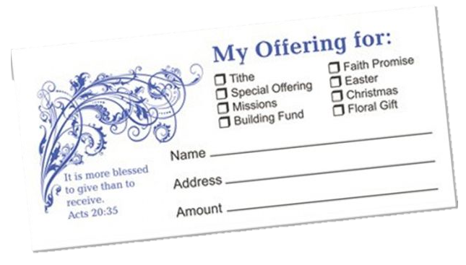
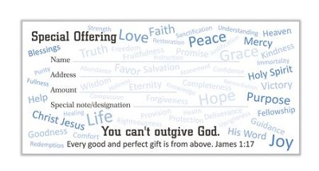
16:1-16
You can’t
out give God

Slide 11
16:1-16

Slide 12
16:1-16
2 Cor. 9:6 ~ So let each one give as he purposes in his heart, not grudgingly or of necessity; for God loves a giver.
careful
cheerful

Slide 13
16:1-16

Slide 14
16:1-16
“Tithe” ~ from Old English word meaning “tenth”

Slide 15
16:1-16

Slide 16
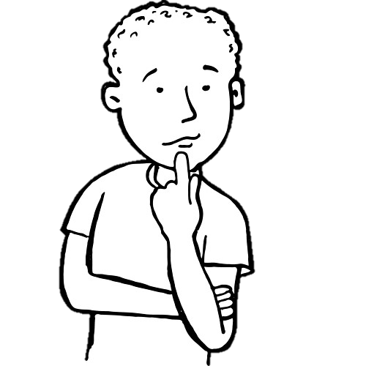

16:1-16
I think tithing
means that 90% belongs to me and 10% belongs to God

Slide 17
16:1-16

Slide 18
16:1-16
1 Pet. 4:10 ~ As each one has received a gift, minister it to one another, as good stewards of the manifold grace of God.

Slide 19
16:1-16

Slide 20
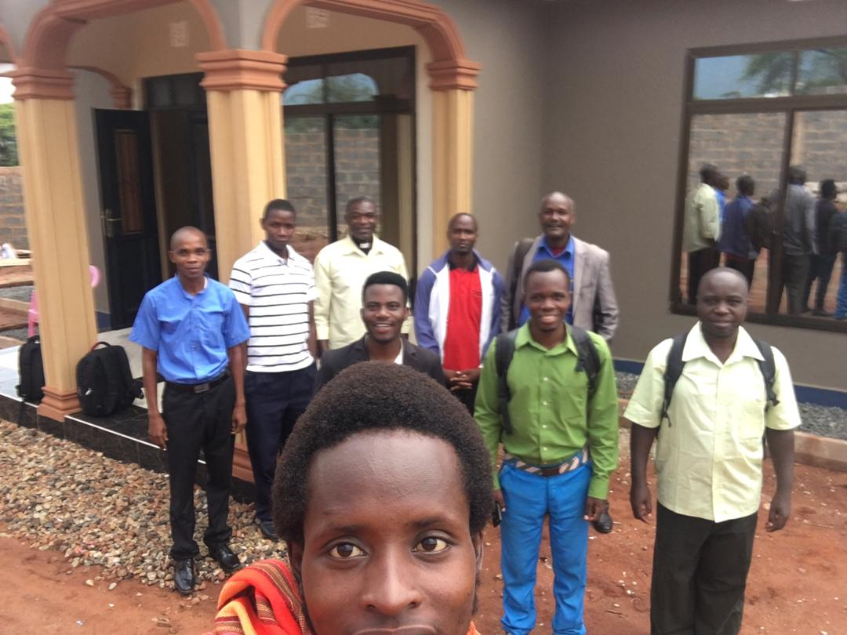
16:1-16

Slide 21
16:1-16

Slide 22
16:1-16
2 Cor. 5:10 ~ For we must all appear before the judgment seat of Christ, that each one may receive the things done in the body, according to what he has done, whether good or bad.
bēma
1. Takes place following the Rapture
2. Only for believers
3. A judgment of works, not sins

Slide 23
16:1-16
Rom. 8:1 ~ There is therefore now no condemnation to those who are in Christ Jesus, who do not walk according to the flesh, but according to the Spirit.

Slide 24
16:1-16
1 Cor. 3:11-15 ~ ¹¹ For no other foundation can anyone lay than that which is laid, which is Jesus Christ. ¹² Now if anyone builds on this foundation with gold, silver, precious stones, wood, hay, straw, ¹³ each one’s work will become clear; for the Day will declare it, because it will be revealed by fire; and the fire will test each one’s work, of what sort it is. ¹⁴ If anyone’s work which he has built on it endures, he will receive a reward. ¹⁵ If anyone’s work is burned, he will suffer loss; but he himself will be saved, yet so as through fire.

Slide 25
16:1-16

Slide 26
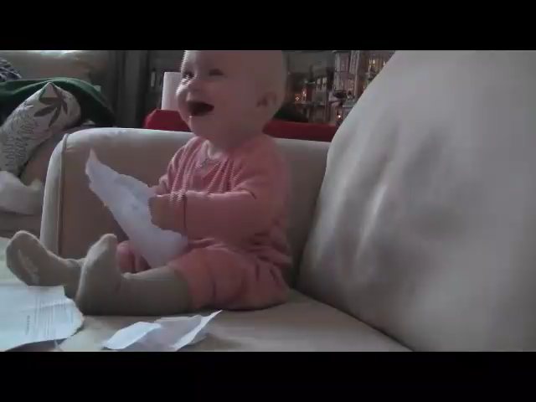
16:1-16

Slide 27
16:1-16

Slide 28
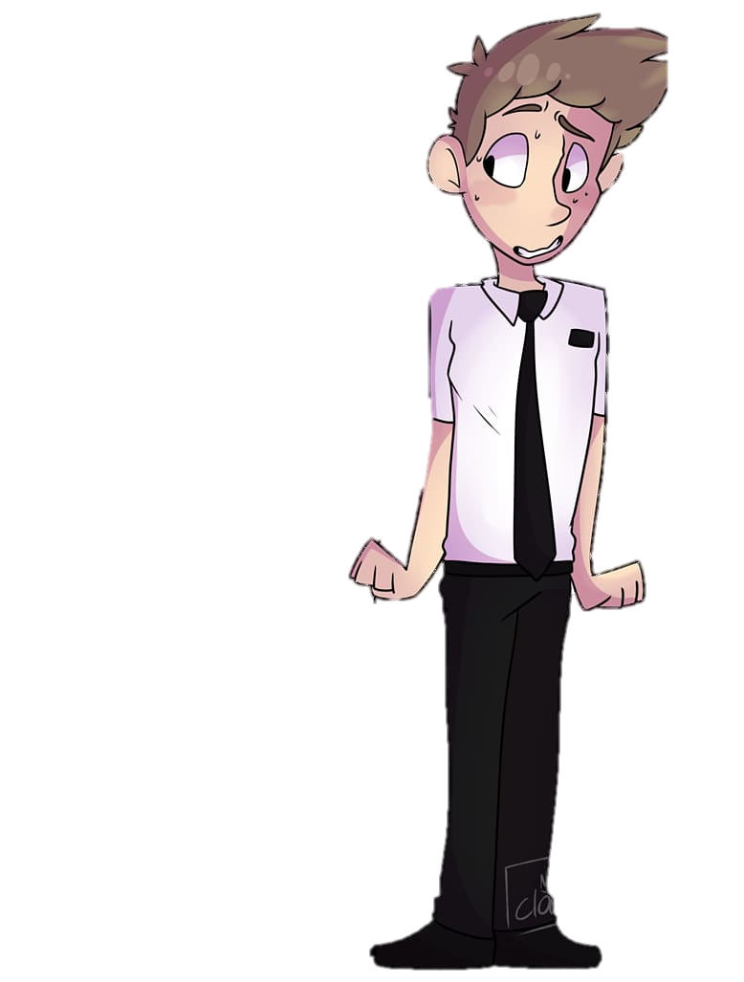
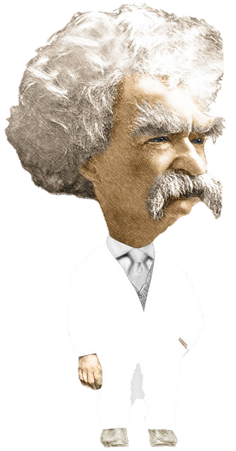
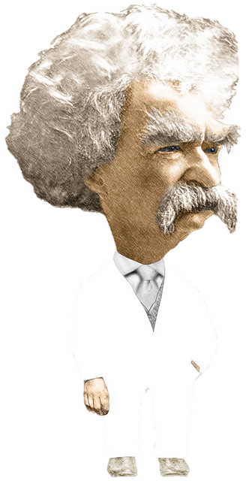

16:1-16
Nothing easier …
“No man can serve two masters.”
Can you show me any Scripture that expressly forbids polygamy?

Slide 29
16:1-16

Slide 30
16:1-16
derided ~ ekmukterizō – turned up nose

Slide 31
16:1-16

Slide 32
16:1-16
pressing ~ biazō – to use or apply force
Matt. 11:12 ~ And from the days of John the Baptist until now the kingdom of heaven suffers violence, and the violent take it by force.

Slide 33
16:1-16
Three enemies to pressing on:
1. Against the enemy ~
he has one desire – to derail us
2. Against the world ~
it is diametrically opposed to us
3. Against our own flesh ~
it hates to be denied

Slide 34
16:1-16

