Slide 1

15:11-32

Slide 2

15:11-32
A lost sheep ~ (vv. 3-6)
A lost coin ~ (vv. 7-10)
A lost son ~ (vv. 11-32)

Slide 3
15:11-32
Luke 15:2 ~ And the Pharisees and scribes complained, saying, “This Man receives sinners and eats with them.”

Slide 4

15:11-32

Slide 5
15:11-32
Luke 12:13-15 ~ ¹³ Then one from the crowd said to Him, “Teacher, tell my brother to divide the inheritance with me.”
¹⁴ But He said to him, “Man, who made Me a judge or an arbitrator over you?” ¹⁵ And He said to them, “Take heed and beware of covetousness, for one’s life does not consist in the abundance of the things he possesses.”

Slide 6
15:11-32

Slide 7
15:11-32
prodigal ~ A recklessly extravagant consumer
NLT, NIV ~ wild living
NASB ~ loose living
Phillips ~ wildest extravagance
Wuest ~ abandoned, dissolute life
asōtōs ~ a, negative particle + sōzō, to save

Slide 8
15:11-32

Slide 9
15:11-32
Rom. 2:4b ~ Or do you despise the riches of His goodness, forbearance, and longsuffering, not knowing that the goodness of God leads you to repentance?

Slide 10
15:11-32

Slide 11
15:11-32
Deut. 21:18-21 ~ ¹⁸ If a man has a stubborn and rebellious son who will not obey the voice of his father or the voice of his mother, and who, when they have chastened him, will not heed them, ¹⁹ then his father and his mother shall take hold of him and bring him out to the elders of his city, to the gate of his city. ²⁰ And they shall say to the elders of his city, “This son of ours is stubborn and rebellious; he will not obey our voice; he is a glutton and a drunkard.” ²¹ Then all the men of his city shall stone him to death with stones; so you shall put away
the evil from among you, and all Israel
shall hear and fear.

Slide 12
15:11-32

Slide 13
15:11-32
ring ~ authority
robe ~ honor
sandals ~ sonship

Slide 14
15:11-32

Slide 15
15:11-32
Ps. 103:10-14 ~ ¹⁰ He has not dealt with us according to our sins,
Nor punished us according to our iniquities.
¹¹ For as the heavens are high above the earth,
So great is His mercy toward those who fear Him;
¹² As far as the east is from the west,
So far has He removed our transgressions from us.
¹³ As a father pities his children,
So the Lord pities those who fear Him.
¹⁴ For He knows our frame;
He remembers that we are dust.

Slide 16
15:11-32

Slide 17
15:11-32
safe and sound ~ hugiainō – hygiene

Slide 18
15:11-32

Slide 19
15:11-32
Wuest ~ But he flew into a rage that was the explosive outlet of a long-time resentment against his brother, a resentment that had been smouldering in his breast.
pleaded ~ parakaleō – used over 100x
Usually translated beseech or plead
Imperfect tense ~ he pleaded he pleaded

Slide 20
15:11-32

Slide 21
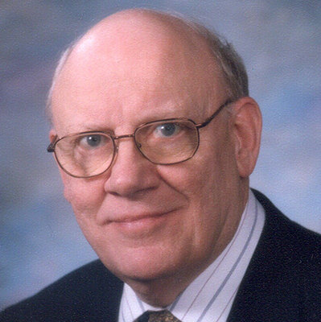
15:11-32
Warren Weirsbe (1929-2019) ~ “… the covetous person can never be satisfied, no matter how much he acquires, and a dissatisfied heart leads to a disappointed life. The prodigal learned the hard way that you cannot enjoy the things money can buy if you ignore the things money cannot buy.”

Slide 22
15:11-32
Luke 7:46 ~ Therefore I say to you, her sins, which are many, are forgiven, for she loved much. But to whom little is forgiven, the same loves little.”

Slide 23
15:11-32

