Slide 1
15:1-10

Slide 2
15:1-10
A lost sheep ~ (vv. 3-6)
A lost coin ~ (vv. 7-10)
A lost son ~ (vv. 11-32)

Slide 3
15:1-10

Slide 4
15:1-10
tax collectors ~ telōnēs – telos (to set a limit); ōneomai (to buy)

Slide 5
15:1-10

Slide 6
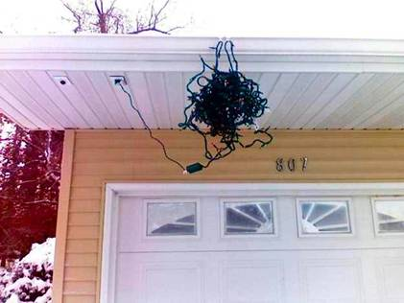
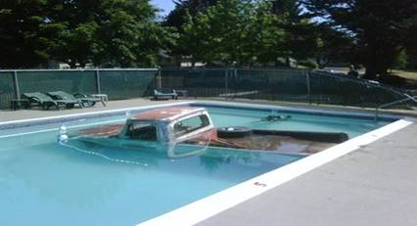
15:1-10

Slide 7
15:1-10

Slide 8
15:1-10
complained ~ literally, grumbled and grumbled
receives ~ present tense, middle voice – “This Man continually receives to Himself these sinners”

Slide 9
15:1-10

Slide 10
15:1-10
Pharisee ~ from the Hebrew word paras
Ezra 8:8 ~ So they read distinctly from the book, in the Law of God; and they gave the sense, and helped them to understand the reading.

Slide 11
15:1-10
John 7:45-49 ~ ⁴⁵ Then the officers came to the chief priests and Pharisees, who said to them, “Why have you not brought Him?”
⁴⁶ The officers answered, “No man ever spoke like this Man!” ⁴⁷ Then the Pharisees answered them, “Are you also deceived? ⁴⁸ Have any of the rulers or the Pharisees believed in Him? ⁴⁹ But this crowd that does not know the law is accursed.”

Slide 12
15:1-10

Slide 13
15:1-10
Come, Ye Sinners – Joseph Hart, 1759 ©
Come, ye sinners, poor and needy,
Weak and wounded, sick and sore;
Jesus ready stands to save you,
Full of pity, love and power.
Come, ye weary, heavy laden,
Lost and ruined by the fall;
If you tarry till you’re better,
You will never come at all.

Slide 14
15:1-10
Come, Ye Sinners – Joseph Hart, 1759 ©
View Him prostrate in the garden;
On the ground your Maker lies.
On the bloody tree behold Him;
Sinner, will this not suffice?

Slide 15
15:1-10

Slide 16
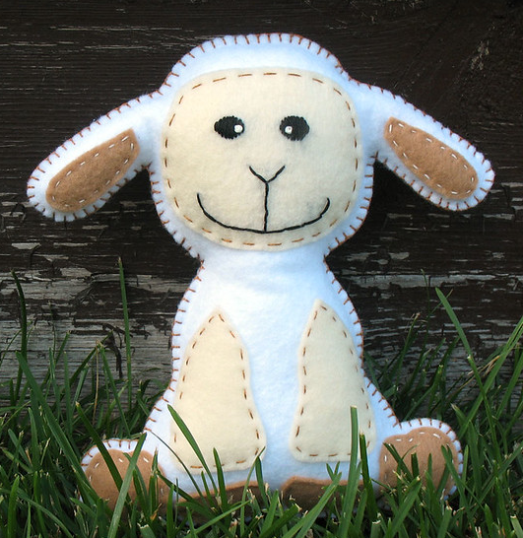
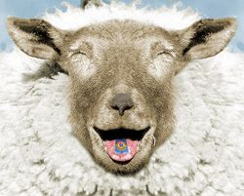
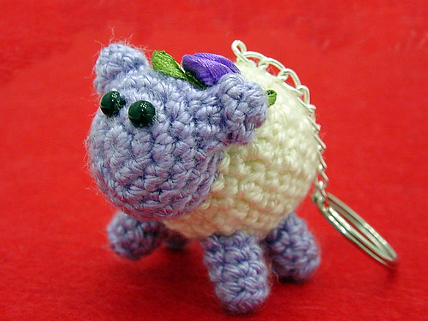
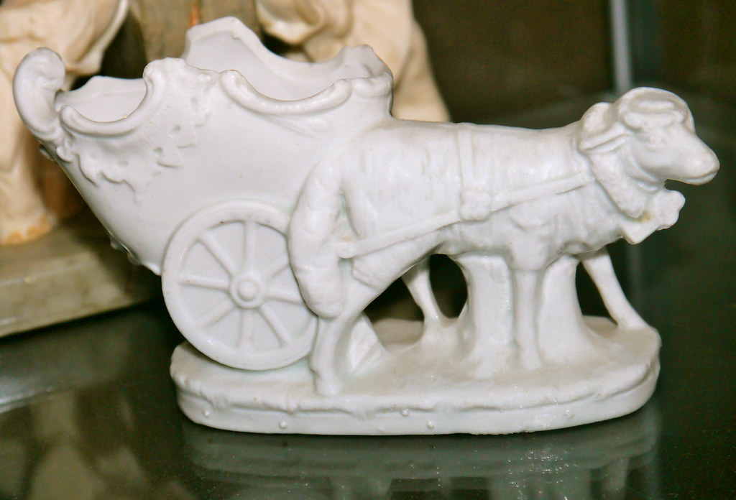
15:1-10
Literally, “my sheep, my lost one”

Slide 17
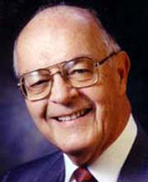
15:1-10
Howard Hendricks (1924-2013) ~ “If you want to be a shepherd, you’d better like the smell of sheep”

Slide 18
15:1-10
John 10:11 ~ I am the good shepherd. The good shepherd gives His life for the sheep.

Slide 19
15:1-10

Slide 20
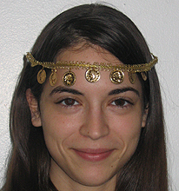
15:1-10

Slide 21
15:1-10
Is. 49: 15-16a ~ ¹⁵ “Can a woman forget her nursing child,
And not have compassion on the son of her womb?
Surely they may forget,
Yet I will not forget you.
^{16a} See, I have inscribed you on the palms of My hands;

Slide 22
15:1-10

Slide 23
15:1-10
Jesus ~ “there is joy in heaven over one sinner who is repentant before God”
Pharisees ~ “there is joy in heaven over one sinner who is obliterated before God”

Slide 24
15:1-10

Slide 25
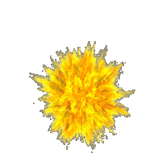
15:1-10
“ψψψχγχγχγχγχ”

Slide 26
15:1-10
Come, Ye Sinners – Joseph Hart, 1759 ©
Let not conscience make you linger,
Not of fitness fondly dream;
All the fitness He requireth
Is to feel your need of Him.
Chorus: I will arise and go to Jesus,
He will embrace me in His arms;
In the arms of my dear Savior,
O there are ten thousand charms.

Slide 27
15:1-10

