Slide 1
13:14-30

Slide 2
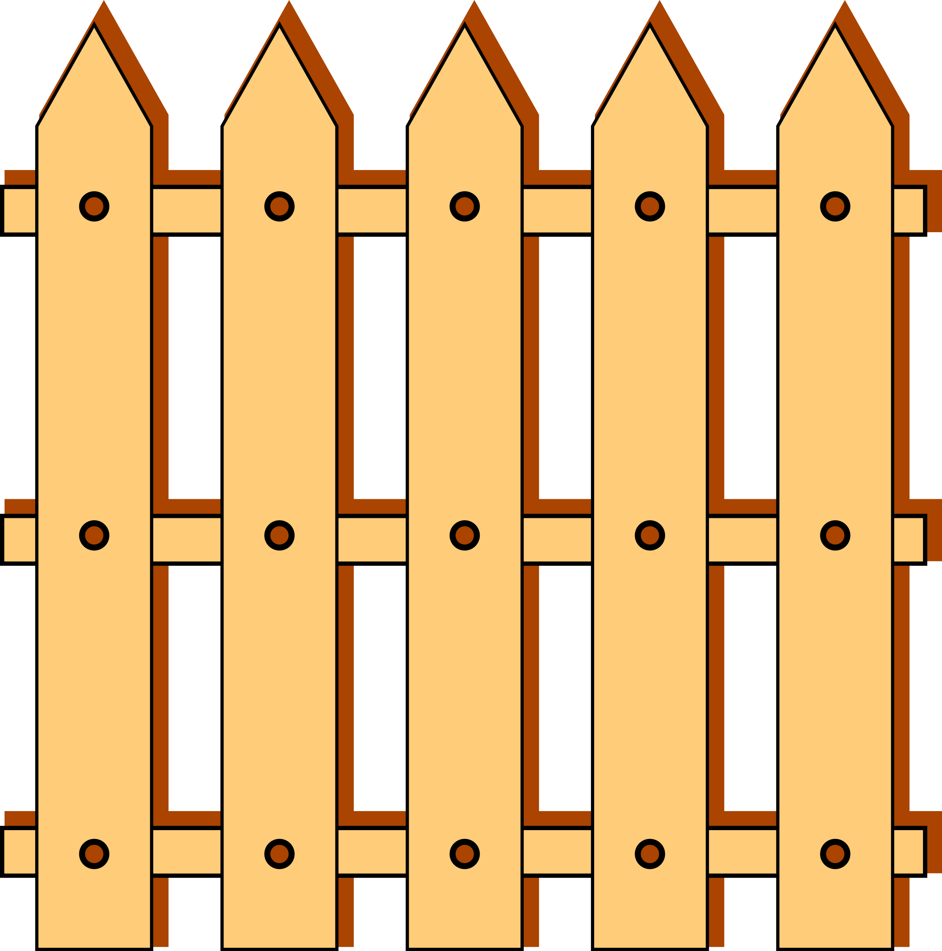
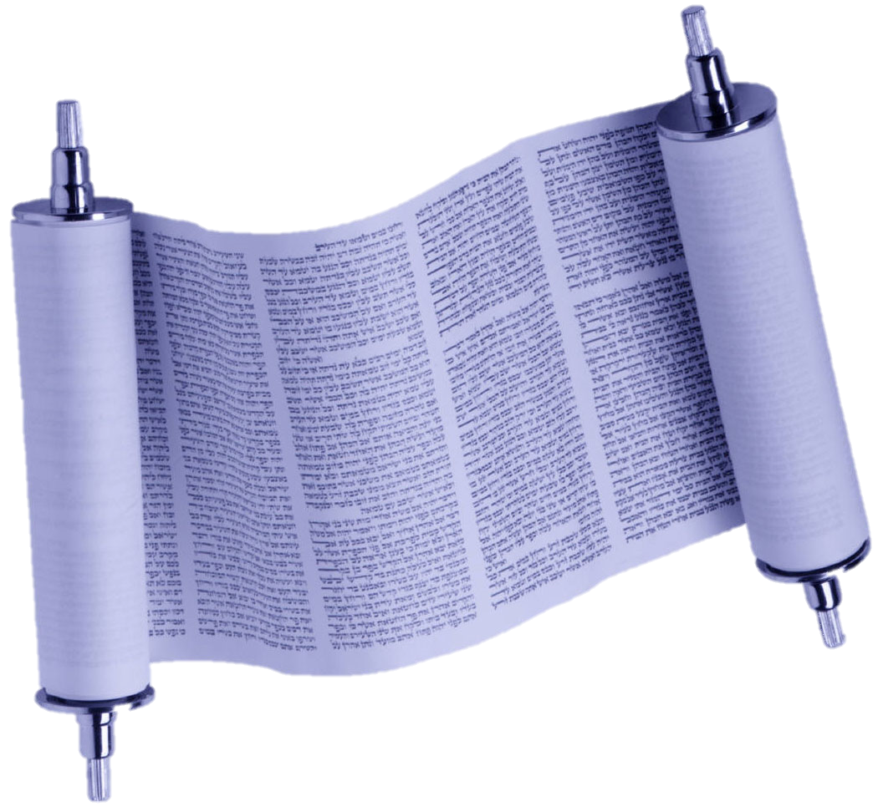
13:14-30

Slide 3
13:14-30
Mishnah, Shabbat 7:2 ~ the 40 minus 1
Sowing
Plowing
Reaping
Binding sheaves
Threshing
Winnowing
Polishing
Grinding
Sifting
Kneading
Baking
12. Shearing wool
13. Washing
14. Combing
15. Dyeing
16. Spinning
17. Weaving
18. The making
of two loops
19. Weaving two threads
20. Undoing two threads
21. Tying (a knot)
22. Untying (a knot)
23. Sewing two stitches
24. Tearing in order to sew two stitches
25. Hunting a deer
26. Slaughtering
27. Flaying or
28. Salting it
29. Curing its hide
30. Scraping it (of its hair)
31. Cutting it up
32. Writing two letters
33. Erasing in order to write two
letters (over the erasure)
34. Building
35. Tearing down
36. Kindling
37. Extinguishing,
38. Hitting with a hammer (and)
39. Carrying from place to place

Slide 4
13:14-30

Slide 5
13:14-30
Hypocrite ~ hupokritēs – either pretends to be something else (Luke 11:44) or hide what really is (here)

Slide 6
13:14-30

Slide 7
13:14-30
Amillennialism ~ Book of Revelation is either symbolic or was fulfilled in the first century
Postmillennialism ~ Book of Revelation is panoramic view from Pentecost to the end of the Age
Premillennialism ~ Book of Revelation describes a 7-year period of unparalleled worldwide suffering followed by literal, physical reign of Jesus Christ upon the earth

Slide 8
13:14-30
Mark 4:13 ~ And He said to them, “Do you not understand this parable? How then will you understand all the parables?
1st understand ~ eidō – comprehend intuitively
2nd understand ~ ginōskō – comprehend by experience
The Law of Expositional Constancy

Slide 9
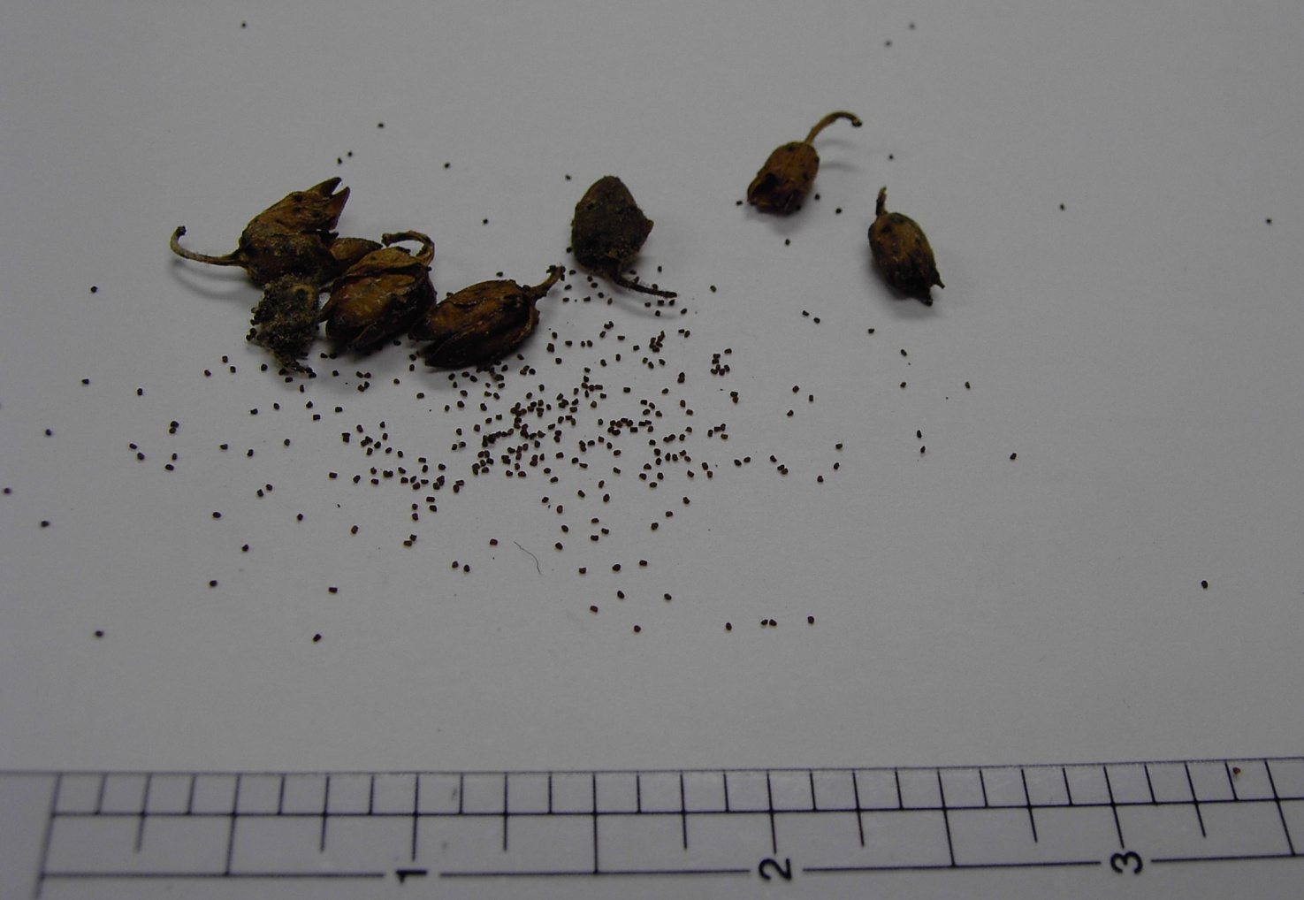
13:14-30
Mustard Seed

Slide 10
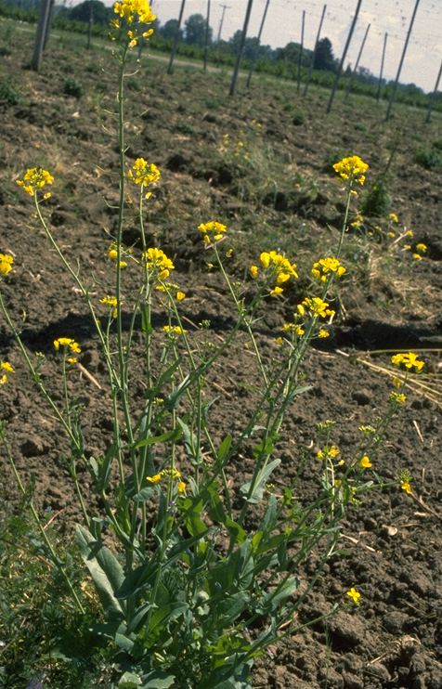
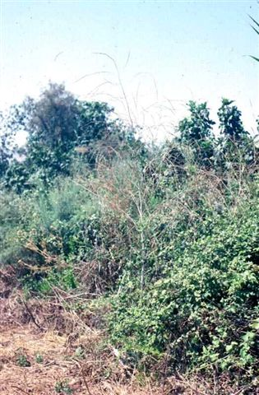
13:14-30
Wild Mustard Plant
Cultivated Mustard Plant

Slide 11
13:14-30
Edict of Toleration, AD 311 (Galerius)
Hostile neutrality
Edict of Milan, AD 313 (Constantine)
Friendly neutrality
Edict of Thessalonica, AD 380 (Theodosius)
State promotion

Slide 12
13:14-30

Slide 13
13:14-30
Gal. 5:9 ~ a little leaven leavens the whole lump

Slide 14
13:14-30

Slide 15
13:14-30
Strive ~ agōnizomai
Plural ~ all y’all
Imperative ~ do it!
Middle voice ~ do it to yourself
Present tense ~ keep on doing it
“No pain, no gain”
“No strain, no pain”

Slide 16
13:14-30

Slide 17
13:14-30

Slide 18
13:14-30
Phillips ~ “You must do your utmost to get in through the narrow door, for many, I assure you, will try to do so and will not succeed, once the master of the house has got up and shut the door.”

Slide 19
13:14-30

Slide 20
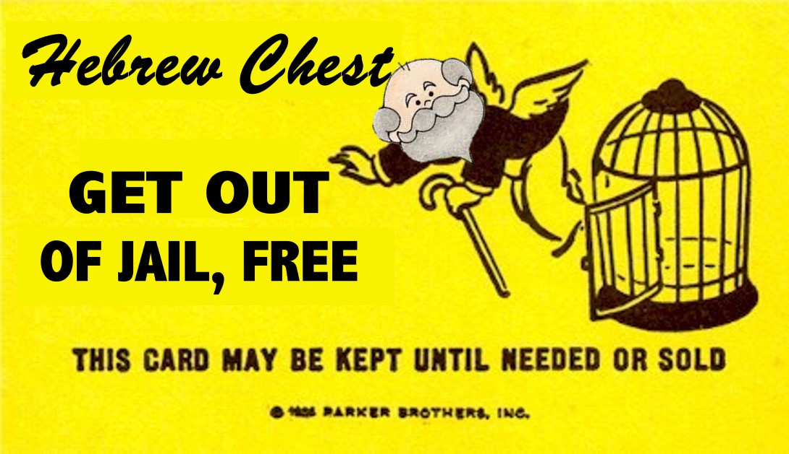
13:14-30
Resting in the finished work of the Cross ≠ having a casual attitude toward it

Slide 21
13:14-30

Slide 22
13:14-30
last will be first ~ Gentiles
first will be last ~ Jews

Slide 23
13:14-30

