Slide 1
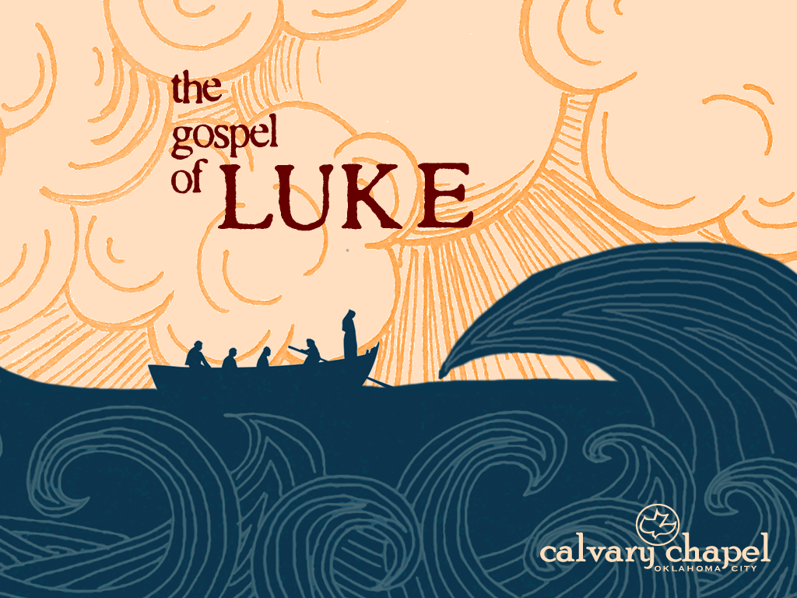
13:1-13

Slide 2
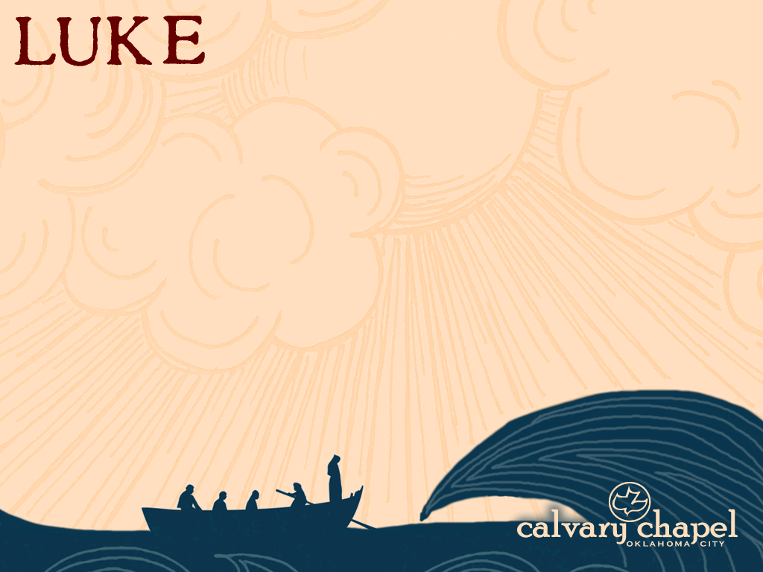
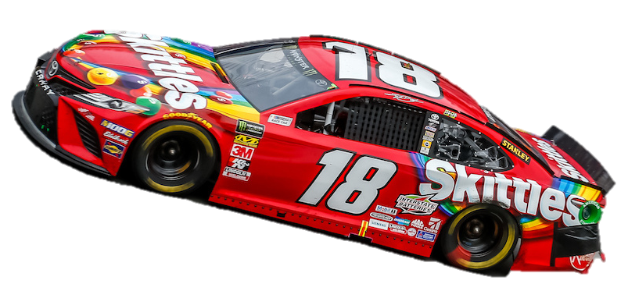
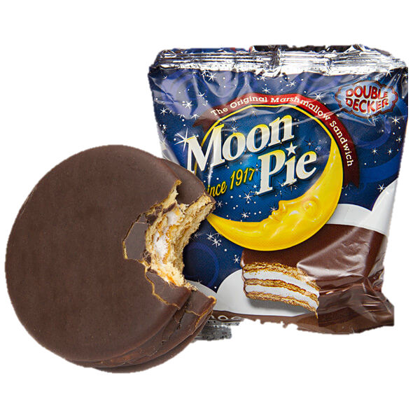


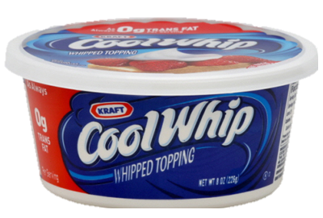

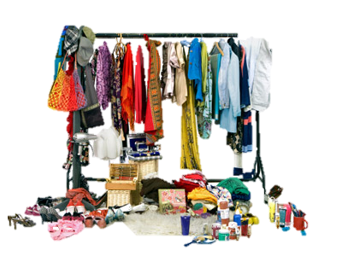

13:1-13
This Photo by Unknown Author is licensed under CC BY-SA

Slide 3
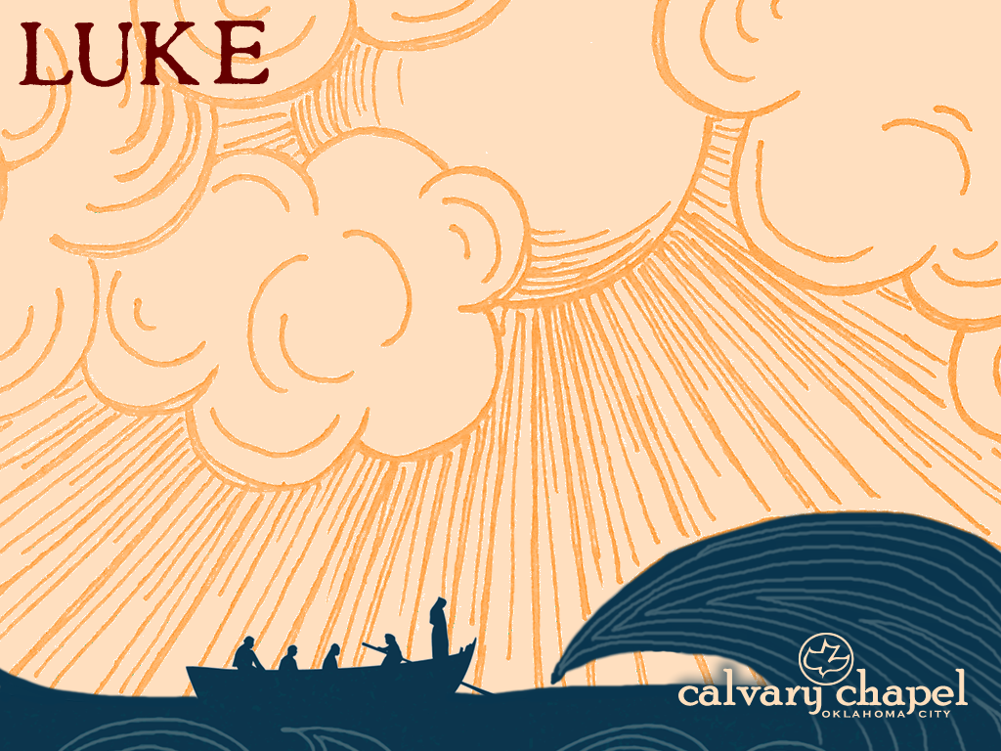
13:1-13

Slide 4
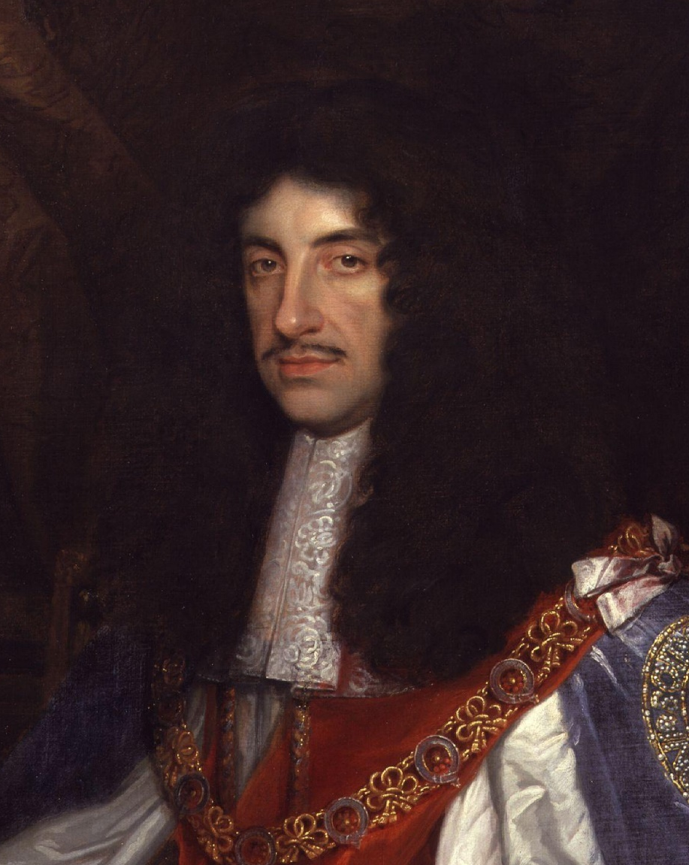
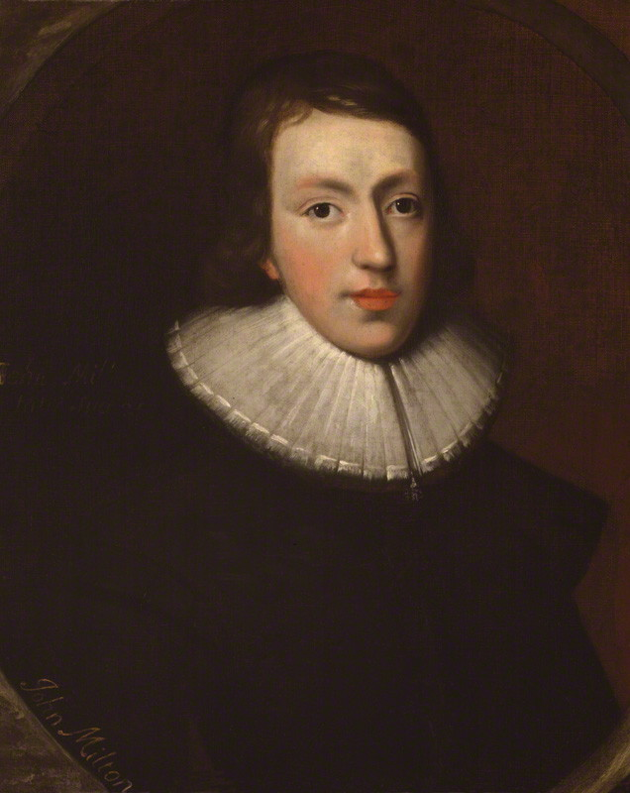
13:1-13
Your blindness
is a judgment from God for the part you took against my father
If I have lost
my sight through God’s judgment, what can you say of your father who lost his head?
Charles II
John Milton

Slide 5
13:1-13

Slide 6
13:1-13
Is. 53:6a ~ All we like sheep have gone astray;
We have turned, every one, to his own way;
Rom. 3:9-12 ~ ⁹ What then? Are we better than they? Not at all. For we have previously charged both Jews and Greeks that they are all under sin.
¹⁰ As it is written:
“There is none righteous, no, not one;
¹¹ There is none who understands;
There is none who seeks after God.
¹² They have all turned aside;
They have together become unprofitable;
There is none who does good, no, not one.”

Slide 7
13:1-13

Slide 8
13:1-13
Gen. 2:17 ~ “… but of the tree of the knowledge of good and evil you shall not eat, for in the day that you eat of it you shall surely die.”
Prior to the Fall, spiritual life was tantamount
After the Fall, physical life was tantamount
Spirit
Soul
Body

Slide 9
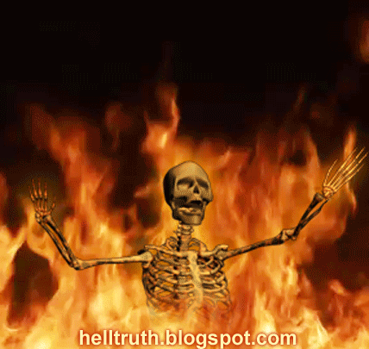
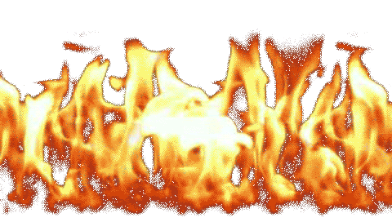
13:1-13
I sure wished
that I’d spent more time enjoying life on earth!
Lake of Fire

Slide 10
13:1-13

Slide 11
13:1-13
fertilize it ~ KJV, dung it

Slide 12
13:1-13

Slide 13
13:1-13
Gal. 5:22-25 ~ ²² But the fruit of the Spirit is love, joy, peace, longsuffering, kindness, goodness, faithfulness, ²³ gentleness, self-control. Against such there is no law.
²⁴ And those who are Christ's have crucified the flesh with its passions and desires. ²⁵ If we live in the Spirit, let us also walk in the Spirit. ²⁶ Let us not become conceited, provoking one another, envying one another.

Slide 14
13:1-13

Slide 15
13:1-13
NASB, bent double

Slide 16
13:1-13

Slide 17
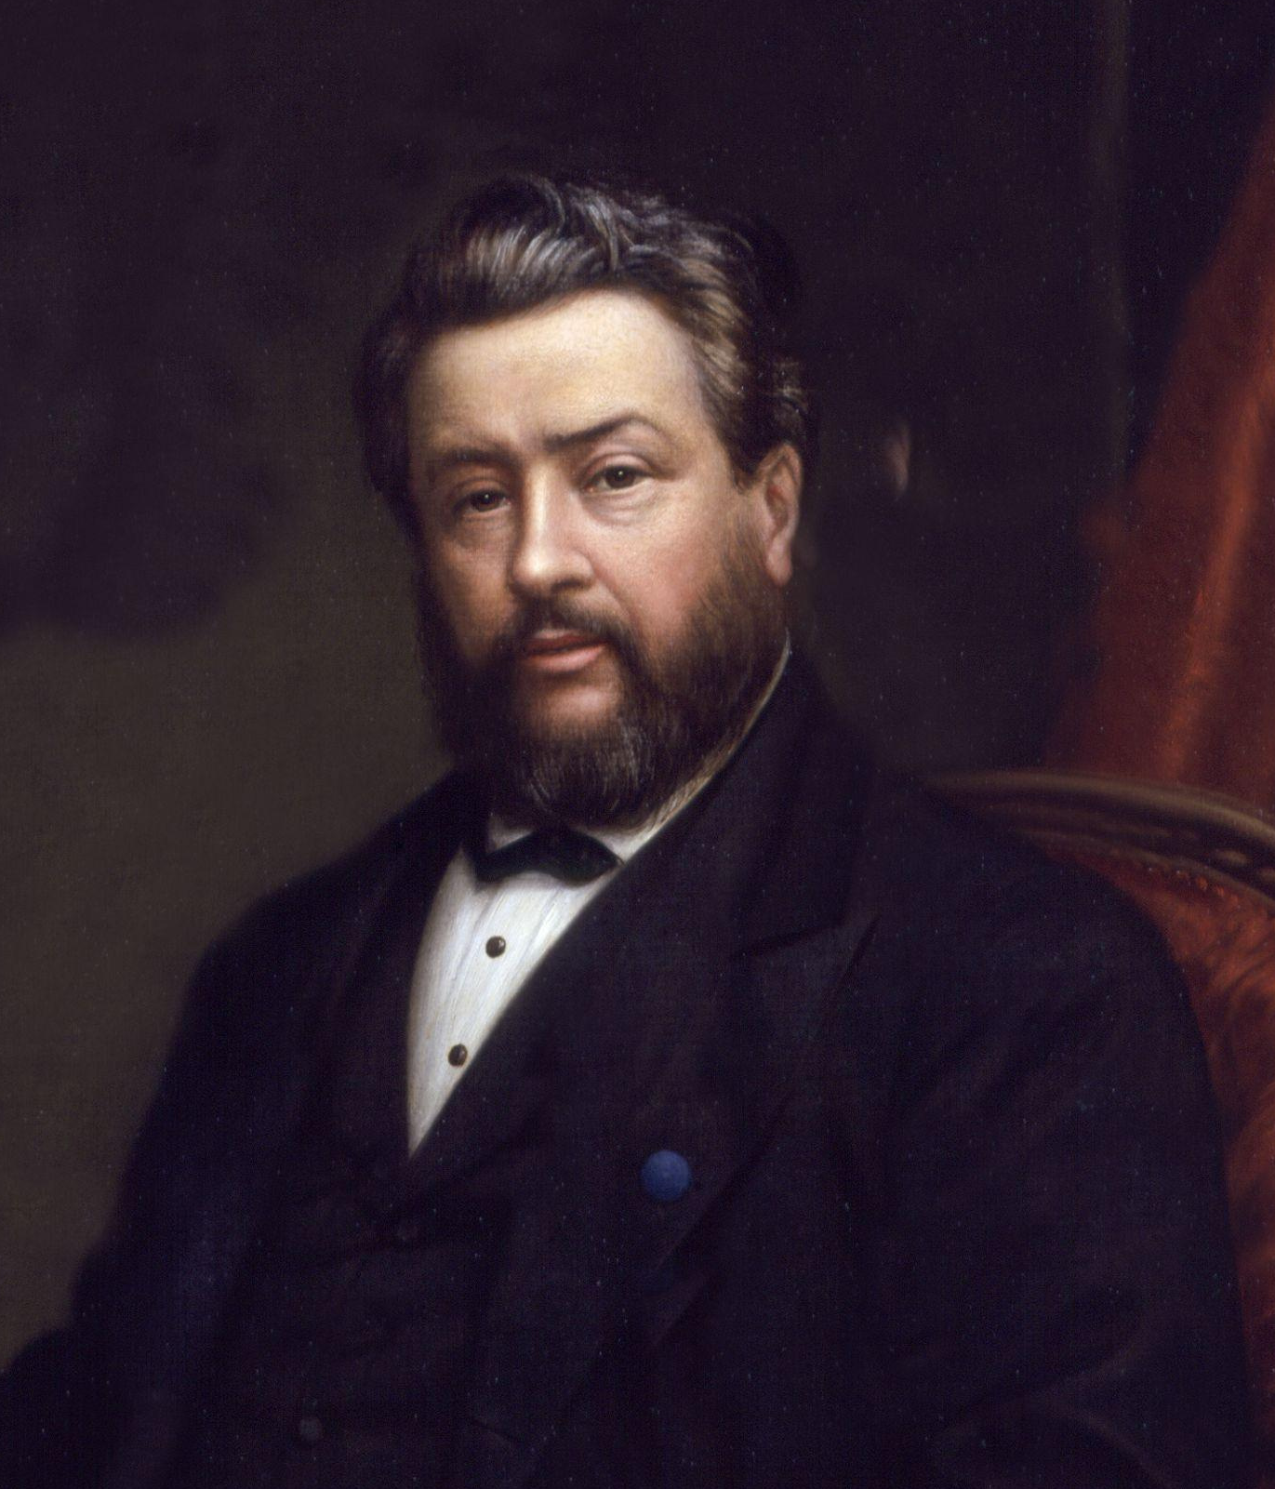
13:1-13
C. H. Spurgeon (1834-1892) ~ “It is always weakness to be fretting and worrying, questioning and mistrusting. What can we do if we wear ourselves to skin and bone? Can we gain anything by fearing and fuming? Do we not unfit ourselves for action, and unhinge our minds for wise decision? We are sinking by our struggles when we might float by faith. ... Oh for grace to be confident in God.”

Slide 18
13:1-13

