Slide 1

12:31-59

Slide 2

12:31-59
R. E. M. – “It’s the End of the World as We Know It (And I Feel Fine)”
Buffy the Vampire Slayer ~ “If the Apocalypse comes, beep me.”

Slide 3

12:31-59

Slide 4
12:31-59
Popular Mechanics, (forecasting the relentless march of science) 1949 ~
“Computers in the future may weigh no more than 1.5 tons.”
The editor in charge of business books for Prentice Hall, 1957 ~
“I have traveled the length and breadth of this country and talked with the best people, and I can assure you that data processing is a fad that won’t last out the year.”
Gary Cooper on his decision not to take the leading role in “Gone With The Wind.” ~
“I’m just glad it’ll be
Clark Gable who’s falling on his face and
not Gary Cooper.”

Slide 5
12:31-59
Irving Fisher, Professor of Economics, Yale University, 1929 ~
“Stocks have reached what looks like a permanently high plateau.”
Decca Recording Co. rejecting the Beatles, 1962 ~
“We don’t like their sound, and guitar music is on the way out.”
knowing this first: that scoffers will come in the last days, walking according to their own lusts, 4 and saying, “Where is the promise of His coming? For since the fathers fell asleep, all things continue as they were from the beginning of creation.”
1 Pet. 3:3 ~

Slide 6
12:31-59

Slide 7
12:31-59
Over 1/4 (27-28%) of the Bible was prophetic at the time of its writing (Encyclopedia of Biblical Prophecies – J. Barton Payne)
Jer. 25:11 ~ And this whole land shall be a desolation and an astonishment, and these nations shall serve the king of Babylon seventy years.
One of every 10 verses in New Testament is about the 2nd Coming

Slide 8
12:31-59
Two lessons from fulfilled Bible prophecy:
1. The Bible has a 100% track record of fulfilling prophecy.
2. Every one of them have so far been fulfilled literally.

Slide 9
12:31-59

Slide 10
12:31-59
little flock ~ micros poimnion – little, little flock

Slide 11
12:31-59

Slide 12
12:31-59
2 Tim. 4:8 ~ Finally, there is laid up for me the crown of righteousness, which the Lord, the righteous Judge, will give to me on that Day, and not to me only but also to all who have loved His appearing.

Slide 13
12:31-59

Slide 14
12:31-59
1 John 3:2-3 ~ ² Beloved, now we are children of God; and it has not yet been revealed what we shall be, but we know that when He is revealed, we shall be like Him, for we shall see Him as He is.
³ And everyone who has this hope in Him purifies himself, just as He is pure.

Slide 15

12:31-59
2nd watch ~ 9pm – midnight
3rd watch ~ mid-
night – 3am
This Photo by Unknown Author is licensed under CC BY-SA

Slide 16
12:31-59

Slide 17
12:31-59
A Profile of a “Loser”
Less than 3 years of formal education
Failed in business in ‘31
Defeated for Congress in ‘32
Again, failed in business in ‘33
Elected to Congress in ‘34
Defeated for Speaker in ‘38
Defeated for Elector in ‘40
Defeated for Congress in ‘44

Slide 18
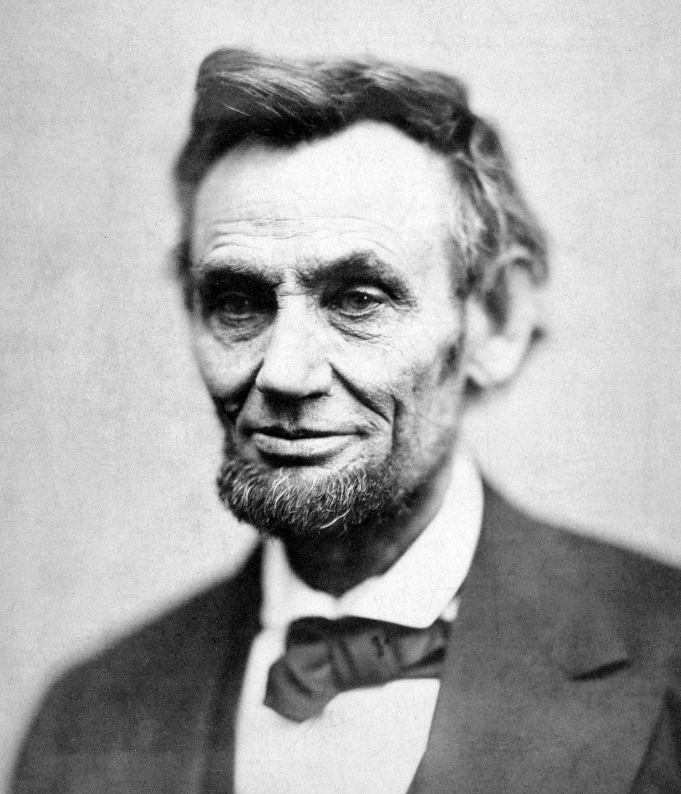
12:31-59
A Profile of a “Loser”
Elected to Congress in ‘46
Lost re-election in ‘48
Defeated for Senate in ‘55
Defeated for VP nomination in ‘56
Defeated for Senate in ‘58
Abraham Lincoln (1809-1965)

Slide 19
12:31-59

Slide 20
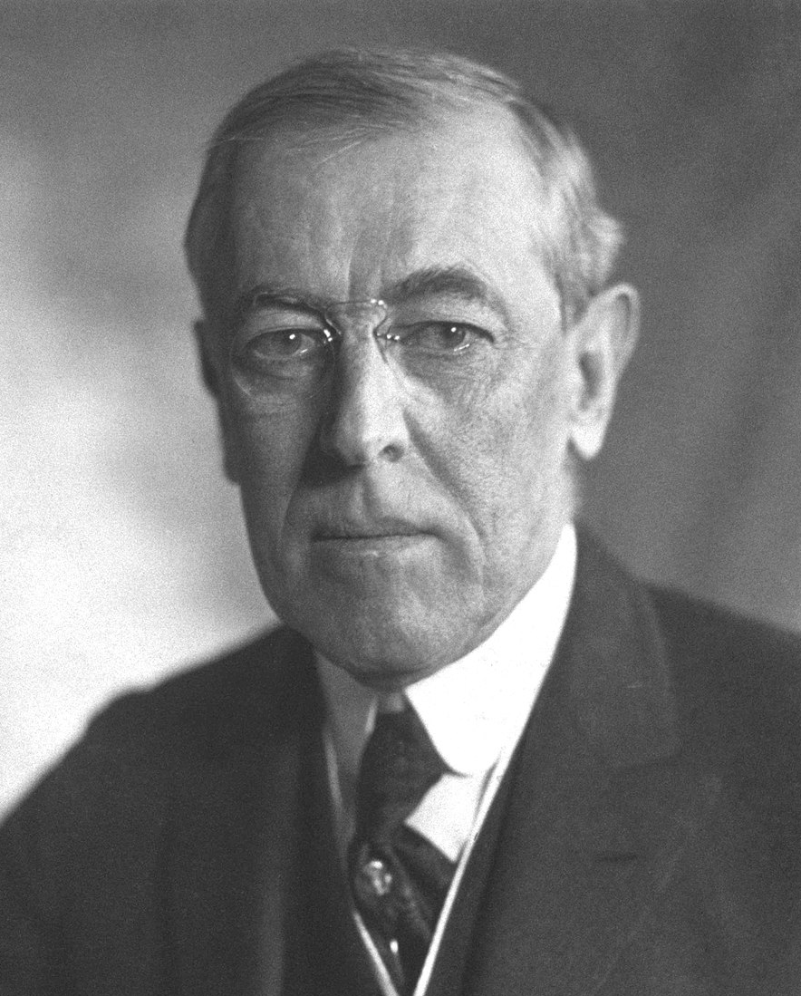
12:31-59
Woodrow Wilson (1856-1924) ~ “I would rather fail in a cause that will someday triumph than triumph in a cause that will someday fail.”

Slide 21
12:31-59

Slide 22
12:31-59
steward ~ oikonomos
oikos ~ house + nomos ~ law; a house manager (economy)

Slide 23
12:31-59

Slide 24
12:31-59
Rev. 22:20a ~ He who testifies to these things says, “Surely I am coming quickly.”

Slide 25
12:31-59

