Slide 1
12:1-10

Slide 2
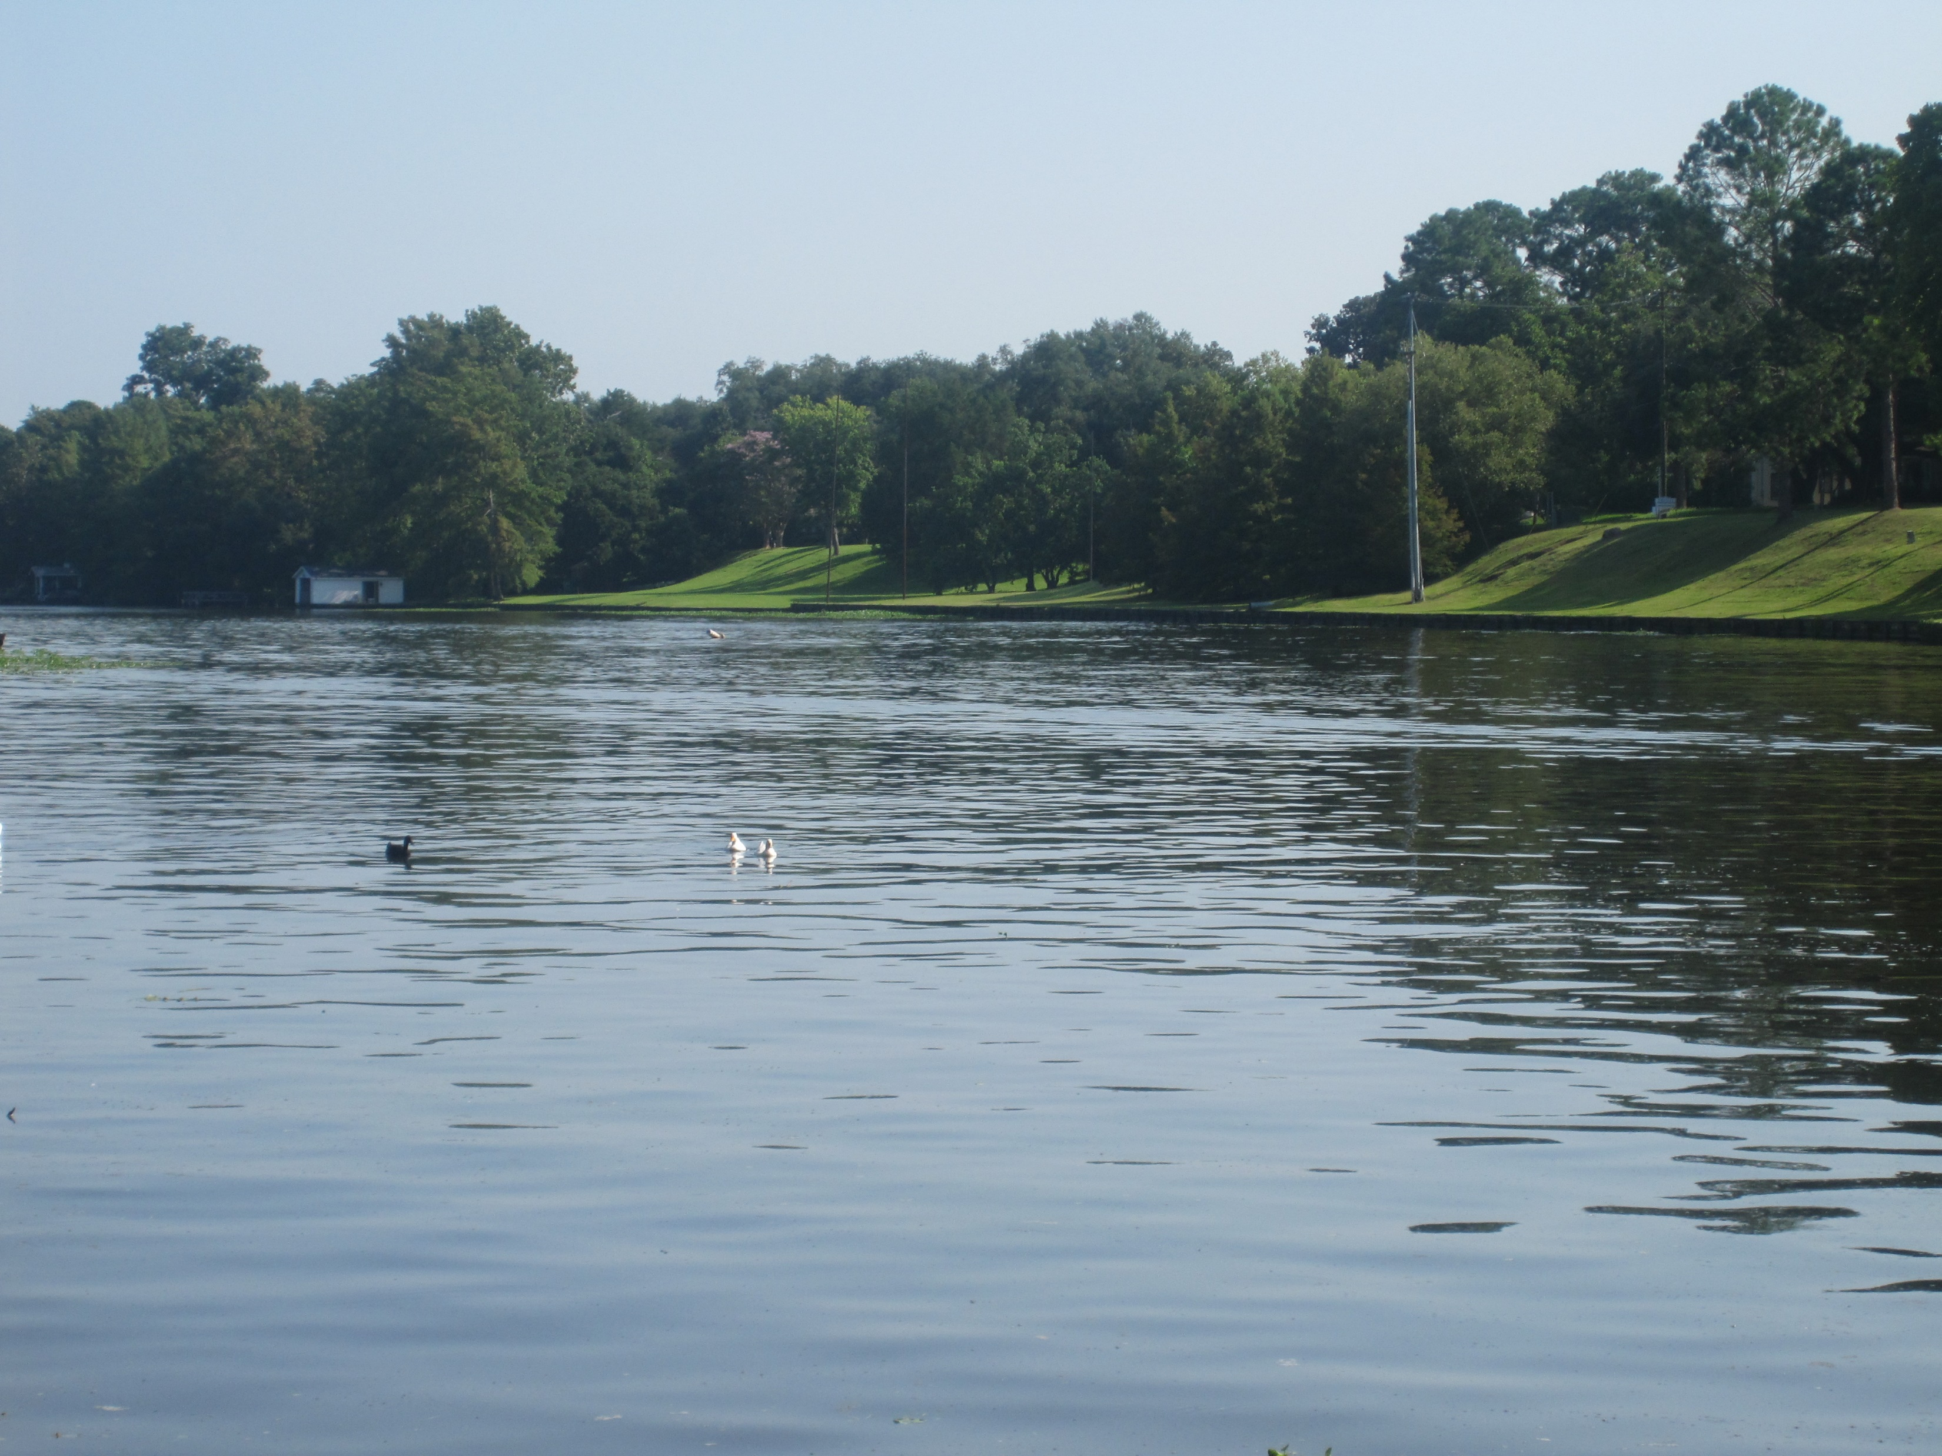
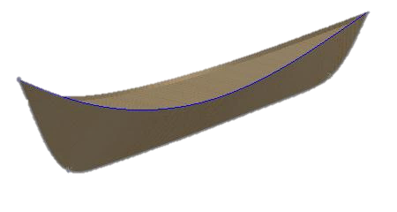
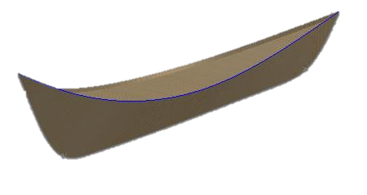
12:1-10

Slide 3
12:1-10

Slide 4
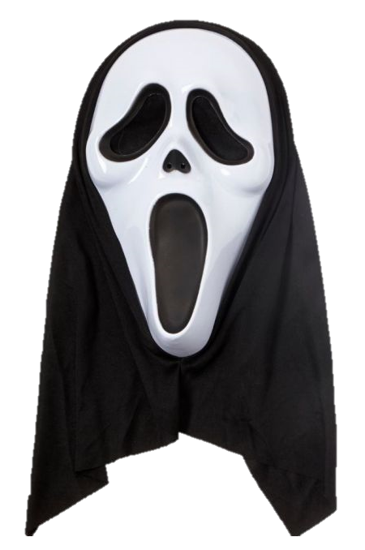
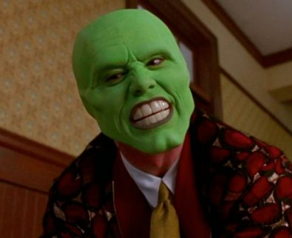
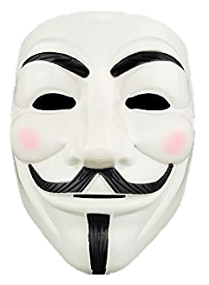
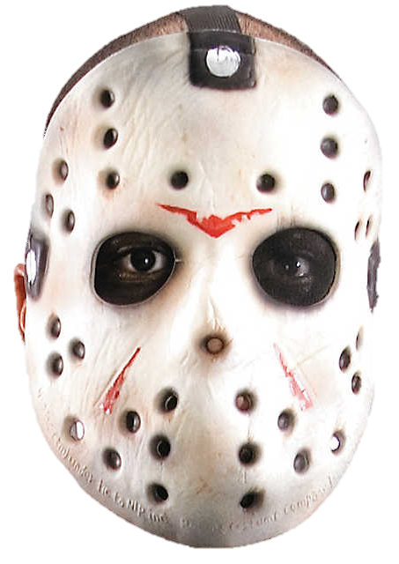
12:1-10
Luke 8:42 ~ thronged
Luke 11:29 ~ thickly gathered
Luke 12:1 ~ innumerable multitude
hypocrisy ~ hupokrisis – wearing a mask
hupō, under + krinō, to judge
I’M SMOKIN’

Slide 5
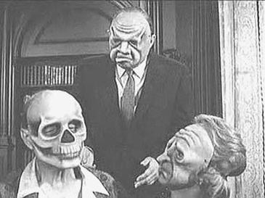
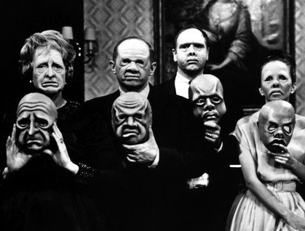
12:1-10
Twilight Zone, Mar. 20, 1964 ~ “The Masks”

Slide 6
12:1-10

Slide 7
12:1-10
Abraham Lincoln (1809-1965) ~ “If I were two-faced, would I be wearing this one?”

Slide 8
12:1-10

Slide 9
12:1-10

Slide 10
12:1-10
Is there a literal “hell”?
hadēs ~ region of the departed souls
Luke 10:15 ~ And you, Capernaum, who are exalted to heaven, will be brought down to Hades.

Slide 11
12:1-10
Is there a literal “hell”?
tartaroō
2 Pet. 2:4 ~ For if God did not spare the angels who sinned, but cast them down to hell and delivered them into chains of darkness, to be reserved for judgment;
verb form ~ literally, hellified

Slide 12
12:1-10
Is there a literal “hell”?
géenna ~ Hellenized transliteration of the Valley of Hinnom
Mark 9:43-44 ~ ⁴³ If your hand causes you to sin, cut it off. It is better for you to enter into life maimed, rather than having two hands, to go to hell, into the fire that shall never be quenched— ⁴⁴ where
‘Their worm does not die
And the fire is not quenched.’
(Is. 66:24)

Slide 13
12:1-10
Is there a literal “hell”?
Tyropoeon Valley
Temple
Mount
Jerusalem
Kidron Valley
Hinnom Valley
City of David

Slide 14
12:1-10

Slide 15
12:1-10
Universalism ~ the view that all human beings will ultimately be “saved” and restored to a right relationship with God.
Annihilationism ~ the view that after the final judgment some human beings and all fallen angels will be totally destroyed so as to not exist, or that their consciousness will be extinguished.

Slide 16
12:1-10
Rev. 20:11-15 ~ Great White Throne Judgment
Rev. 20:11-15 ~ ¹¹ Then I saw a great white throne and Him who sat on it, from whose face the earth and the heaven fled away. And there was found no place for them. ¹² And I saw the dead, small and great, standing before God, and books were opened. And another book was opened, which is the Book of Life. And the dead were judged according to their works, by the things which were written in the books.

Slide 17
12:1-10
Rev. 20:11-15 ~ ¹³ The sea gave up the dead who were in it, and Death and Hades delivered up the dead who were in them. And they were judged, each one according to his works. ¹⁴ Then Death and Hades were cast into the lake of fire. This is the second death. ¹⁵ And anyone not found written in the Book of Life was cast into the lake of fire.

Slide 18
12:1-10
Rev. 20:10 ~ The devil, who deceived them, was cast into the lake of fire and brimstone where the beast and the false prophet are. And they will be tormented day and night forever and ever.
Merrihew Standard Version ~ And they will be tormented day and night forever and ever.

Slide 19
12:1-10

Slide 20
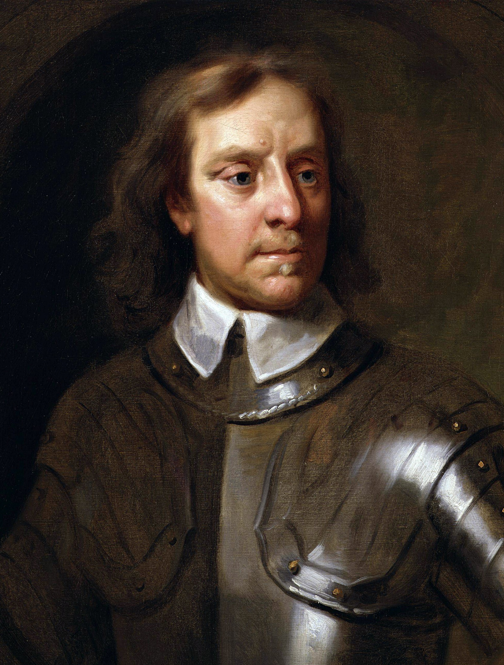
12:1-10
Oliver Cromwell (1599-1658) ~ “Fear God and no need to fear anyone else.”
This Photo by Unknown Author is licensed under CC BY-SA

Slide 21
12:1-10
Matt. 10:29 ~ Are not two sparrows sold for a copper coin? And not one of them falls to the ground apart from your Father’s will.

Slide 22
12:1-10

Slide 23
12:1-10
blasphemes ~ blasphēmeō
blapō ~ to hurt + phēmē ~ a report, a saying
aorist participle – better, having blasphemed
Merrihew Standard Version ~ Anyone who repents of speaking something against Jesus will be forgiven; however, the one who has denied the Holy Spirit’s work of bringing him or her to Jesus will not repent and therefore will not be forgiven.

Slide 24
12:1-10

Slide 25
12:1-10
Here’s how it works:
You answer
You respond
God initiates
You come
God calls
God receives
Past is forgotten
METRONOME
OF THE
HOLY SPIRIT

Slide 26
12:1-10
But what if:
You don’t respond
You don’t answer
God initiates
You don’t come
God doesn’t receive
God calls
Your heart is hardened
METRONOME
OF THE
HOLY SPIRIT

Slide 27
12:1-10

