Slide 1

11:33-54

Slide 2
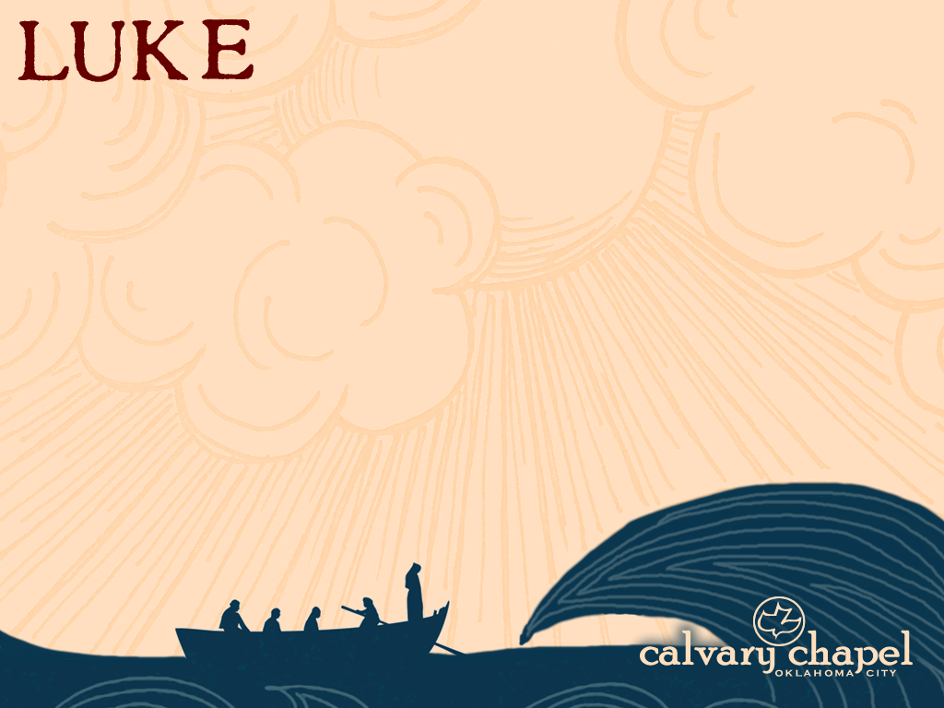
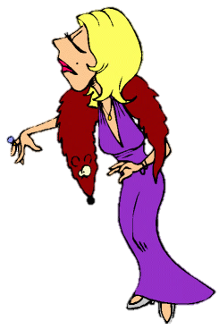
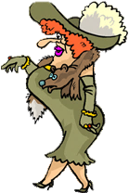
11:33-54
Yes, but for that you would need real teeth
Why yes… yes, they are
would be
for me to
bite them
Of course,
the only way I could tell
My dear … Are those real pearls?
B
A

Slide 3

11:33-54

Slide 4
11:33-54
good ~ haplous – whole, sound (fulfilling its intended purpose)
bad ~ ponēros – 51 of 76x = “evil”

Slide 5
11:33-54

Slide 6

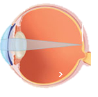

11:33-54

Slide 7
11:33-54

Slide 8
11:33-54
John 14:15-18 ~ ¹⁵ “If you love Me, keep My commandments. ¹⁶ And I will pray the Father, and He will give you another Helper, that He may abide with you forever— ¹⁷ the Spirit of truth, whom the world cannot receive, because it neither sees Him nor knows Him; but you know Him, for He dwells with you and will be in you. ¹⁸ I will not leave you orphans; I will
come to you.”

Slide 9
11:33-54

Slide 10

11:33-54
calorie chapel
oklahoma city

Slide 11
11:33-54

Slide 12
11:33-54
washed ~ baptizō – often used of ceremonial cleansing
Mark 7:6-8 ~ ⁶ He answered and said to them, “Well did Isaiah prophesy of you hypocrites, as it is written:
‘This people honors Me with their lips,
But their heart is far from Me.
⁷ And in vain they worship Me,
Teaching as doctrines the commandments of men.’
⁸ For laying aside the commandment of God, you hold the tradition of men – the washing of pitchers and cups, and many other such things you do.”

Slide 13
11:33-54
foolish ones ~ aphrōn
a ~ negative particle + phrēn (from phrēnēs, diaphragm)
1 Cor. 12:20 ~ Brethren, do not be children in understanding; however, in malice be babes, but in understanding be mature.
understanding ~ phrēn

Slide 14
11:33-54

Slide 15
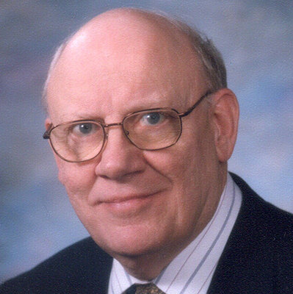
11:33-54
Warren Wiersbe (1929-2019) ~ “The way to clean up a dirty vocabulary is not to brush your teeth but to cleanse your heart.”

Slide 16
11:33-54

Slide 17
11:33-54
NASB ~ But give that which is within as charity

Slide 18
11:33-54

Slide 19

11:33-54
Matt. 23:27 ~ “Woe to you, scribes and Pharisees, hypocrites! For you are like whitewashed tombs which indeed appear beautiful outwardly, but inside are full of dead men's bones and all uncleanness.”
hypocrites ~ hupokritēs

Slide 20
11:33-54
Mishnah (oral tradition, c. AD 200)
+ Gemara (commentary on the Mishnah,
c. AD 350-400)
Talmud

Slide 21
11:33-54
Mishnah (oral tradition)
“A hollow vessel made of pottery could contract uncleanness inside but not outside; that is to say, it did not matter who or what touched it outside, but it did matter what touched it inside.
“If it became unclean it must be broken; and no unbroken piece must remain which was big enough to hold enough oil to anoint the little toe.”

Slide 22
11:33-54
Mishnah (oral tradition)
“A flat plate without a rim could not become unclean at all; but a plate with a rim could. If vessels made with leather, bone or glass were flat they could not contract uncleanness at all; if they were hollow they could become unclean outside and inside.
“If they were unclean, they must be broken; and the break must be a hole at least big enough for a medium-sized pomegranate to pass through.”

Slide 23
11:33-54
Mishnah (oral tradition)
“To cure uncleanness earthen vessels must be broken; other vessels must be immersed, boiled, and purged with fire – in the case of metal vessels – and polished.”
“A three-legged table could contract uncleanness; if it lost one or two legs it could not; it lost three legs it could, for then it could be used as a board and a board could become unclean.”

Slide 24
11:33-54
Mishnah (oral tradition)
“Things made of metal could become unclean, except a door, a bolt, a lock, a hinge, a knocker and a gutter. Wood used in metal utensils could become unclean; but metal used in wood utensils could not.
“Things made of metal could become unclean, except a door, a bolt, a lock, a hinge, a knocker and a gutter. Wood used in metal utensils could become unclean; but metal used in wood utensils could not.

Slide 25
11:33-54

Slide 26
11:33-54
Thou shalt not tie a knot on the Sabbath
Thou shall tie a knot in a girdle on the Sabbath

Slide 27
11:33-54
Talmud, Shabbat 10:3 ~ “He who carries anything, whether it be in his right hand, or in his left hand, or in his bosom, or on his shoulder is guilty; but he who carries anything on the back of his hand, with his foot, or with his mouth, or with his elbows, or with his ear, or with his hair, or with his money bag turned upside down, or between his money bag and his shirt, or in the fold of his shirt or in his shoe, or in his sandal is guiltless, because he does not carry
it in the usual way of carrying it.”

Slide 28
11:33-54

Slide 29


11:33-54
judges
1 chronicles
Nehemiah
THE
TWELVE
Joshua
2 chronicles
ruth
2 samuel
2 kings
ezra
esther
leviticus
1 samuel
1 kings
numbers
exodus
genesis
Deuteronomy
FORMER
PROPHETS
LATTER
TORAH
HISTORY
LAW
psalms
Isaiah
Hosea
job
obadiah
NAHUM
hAGGAI
hAGGAI
ezekiel
joel
jonah
Ecclesiastes
Jeremiah
Daniel
amos
MICAH
HABAKKUK
proverbs
Song of songs
Lamentations
ZEPHANIAH
ZEPHANIAH
POETRY
WRITINGS
MINOR
MAJOR
PROPHETS

Slide 30
11:33-54
Matt. 23:36 ~ Assuredly, I say to you, all these things will come upon this generation.

Slide 31
11:33-54

Slide 32

11:33-54
Sandy Adams ~ “You know there’s only one thing better than going to heaven – and that’s taking somebody with you … But you know there’s only one thing worse than going to hell – and that’s taking somebody with you … and that’s what these Pharisees were doing.”

Slide 33
11:33-54

