Slide 1

11:11-32

Slide 2

11:11-32
1. Buy a stronger whip.
2. Change riders.
3. Appoint a committee to study the horse.
4. Arrange to visit other countries to see how other cultures ride dead horses.
5. Lower the standards so that dead horses can be included.
6. Reclassify the dead horse as living-impaired.
7. Hire outside contractors to ride the
dead horse.

Slide 3
11:11-32
8. Harness several dead horses together to increase speed.
9. Provide additional funding and/or training to increase dead horse's performance.
10. Do a productivity study to see if lighter riders would improve the dead horse’s performance.
11. Rewrite the expected performance requirements for all horses.
12. Promote the dead horse to a supervisory position.

Slide 4

11:11-32

Slide 5
11:11-32
Luke 11:9-10 ~ ⁹ “So I say to you, ask, and it will be given to you; seek, and you will find; knock, and it will be opened to you. ¹⁰ For everyone who asks receives, and he who seeks finds, and to him who knocks it will be opened.”

Slide 6
11:11-32

Slide 7
11:11-32
What does it mean to “receive (lambanō) the Holy Spirit”?
1. To get something; to come into possession of
2. To go through or experience, i.e. “The player received minor injuries”
3. To express willingness to have in one’s home or environs, i.e. “The community gladly received the refugees”

Slide 8
11:11-32
“receive” (lambanō)?
John 20:22 ~ And when He had said this, He breathed on them, and said to them, “Receive the Holy Spirit.”
Definition #1 ~ to get
Acts 1:8 ~ But you shall receive power when the Holy Spirit has come upon you; and you shall be witnesses to Me in Jerusalem, and in all Judea and Samaria, and to the end of the earth.
Definition #2 ~ to go through or experience

Slide 9
11:11-32
“receive” (lambanō)?
Acts 2:38 ~ Then Peter said to them, “Repent, and let every one of you be baptized in the name of Jesus Christ for the remission of sins; and you shall receive the gift of the Holy Spirit.”
Definition #1 ~ to get

Slide 10
11:11-32
“receive” (lambanō)?
Acts 8:14-17 ~ ¹⁴ Now when the apostles who were at Jerusalem heard that Samaria had received the word of God, they sent Peter and John to them, ¹⁵ who, when they had come down, prayed for them that they might receive the Holy Spirit. ¹⁶ For as yet He had fallen upon none of them. They had only been baptized in the name of the Lord Jesus. ¹⁷ Then they laid hands on them, and they received the Holy Spirit.
Definition #2 ~ to go through or experience

Slide 11
11:11-32
“receive” (lambanō)?
Acts 19:1-6 ~ ¹ And it happened, while Apollos was at Corinth, that Paul, having passed through the upper regions, came to Ephesus. And finding some disciples ² he said to them, “Did you receive the Holy Spirit when you believed?”
So they said to him, “We have not so much as heard whether there is a Holy Spirit.”
³ And he said to them, “Into what then were you baptized?”
So they said, “Into John’s baptism.”

Slide 12
11:11-32
“receive” (lambanō)?
Acts 19:1-6 ~ ⁴ Then Paul said, “John indeed baptized with a baptism of repentance, saying to the people that they should believe on Him who would come after him, that is, on Christ Jesus.”
⁵ When they heard this, they were baptized in the name of the Lord Jesus. ⁶ And when Paul had laid hands on them, the Holy Spirit came upon them, and they spoke with tongues and prophesied.
Definition #3 ~ To express willingness to have in one’s home or environs, i.e. “The
community gladly received the
refugees”

Slide 13
11:11-32

Slide 14
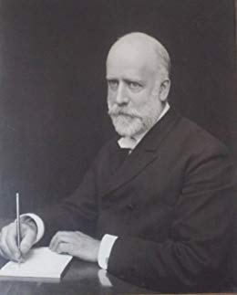
11:11-32
R. A. Torrey (1856-1928) ~ “You can call it whatever you want to call it, but I’d rather have the right thing with the wrong name than the wrong thing with the right name any day.”

Slide 15
11:11-32

Slide 16
11:11-32
Beelzebub ~ Aramaic, lord of the flies
NASB, NIV, ESV ~ Beelzebul

Slide 17
11:11-32

Slide 18
11:11-32
Luke 9:49-50 ~ ⁴⁹ Now John answered and said, “Master, we saw someone casting out demons in Your name, and we forbade him because he does not follow with us.”
⁵⁰ But Jesus said to him, “Do not forbid him, for he who is not against us is on our side.”
Chapter 9 is talking about divisive sectarianism
Chapter 11 is talking about ambivalent neutrality

Slide 19
11:11-32

Slide 20
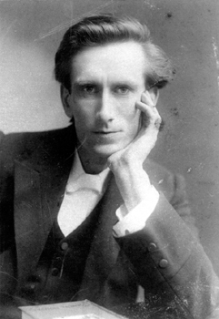
11:11-32
Oswald Chambers (1874-1917) ~
“Neutrality in religion is always
cowardice … God turns the
cowardice of a desired
neutrality into terror.”

Slide 21
11:11-32

Slide 22
11:11-32
Matthew 12:39 ~ An evil and adulterous generation seeks after a sign,

Slide 23
11:11-32

