Slide 1

10:38-11:10

Slide 2

10:38-11:10
Pussy cat, pussy cat
Where have you been?
I’ve been to London to visit the Queen.
Pussy cat, pussy cat
What did you do there?
I frightened a mouse that was under the chair.

Slide 3
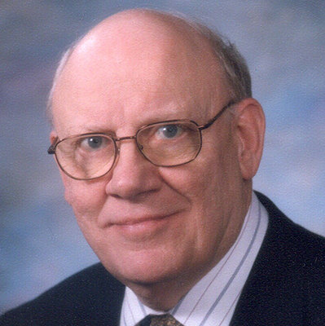
10:38-11:10
Warren Wiersbe (1929-2019) ~ “If serving Christ makes us difficult to live with, then something is terribly wrong
with our service!”
“The most important part of the Christian life is the part that only God sees.”

Slide 4
10:38-11:10
You
Y
You
Others
Others
O
Jesus
you
Jesus
J

Slide 5

10:38-11:10

Slide 6
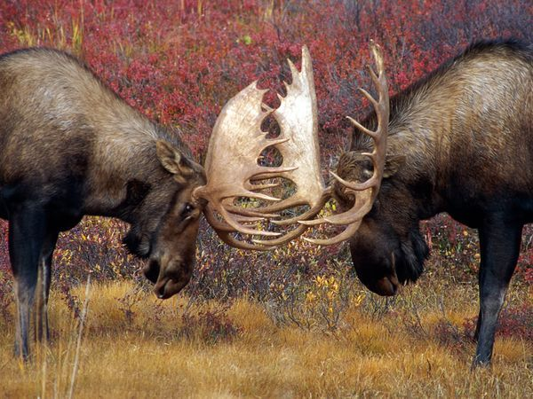
10:38-11:10

Slide 7
10:38-11:10

Slide 8
10:38-11:10
Jesus prayed:
His baptism (Luke 3:21-22)
After healing people (Luke 5:16)
Choosing disciples (Luke 6:12-13)
Feeding the 5000 (Luke 9:16)
Caesarea Philippi (Luke 9:18)
Transfiguration (Luke 9:28-29)
Return of the 70 (Luke 10:28)

Slide 9
10:38-11:10

Slide 10
10:38-11:10
Act 17:28 ~ for in Him we live and move and have our being, as also some of your own poets have said, ‘For we are also His offspring.’
Not huios (son), but genos (kin, offspring, descendant)
John 1:12 ~ But as many as received Him, to them He gave the right to become children of God, to those who believe in His name:
children ~ teknon (son,
daughter, child)

Slide 11
10:38-11:10

Slide 12
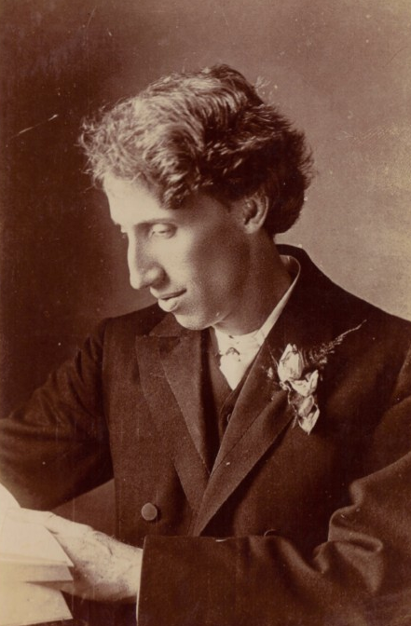
10:38-11:10
G. Campbell Morgan (1863-1945) ~ “I am more afraid of the blasphemy of the sanctuary than the blasphemy in the street.”

Slide 13
10:38-11:10

Slide 14
10:38-11:10
1 John 2:28 ~ And now, little children, abide in Him, that when He appears, we may have confidence and not be ashamed before Him at His coming.
coming ~ parousia – advent, appearing, coming near
1 John 3:2 ~ Beloved, now we are children of God; and it has not yet been revealed what we shall be, but we know that when He is revealed, we shall be like Him, for we shall see Him as He is.

Slide 15
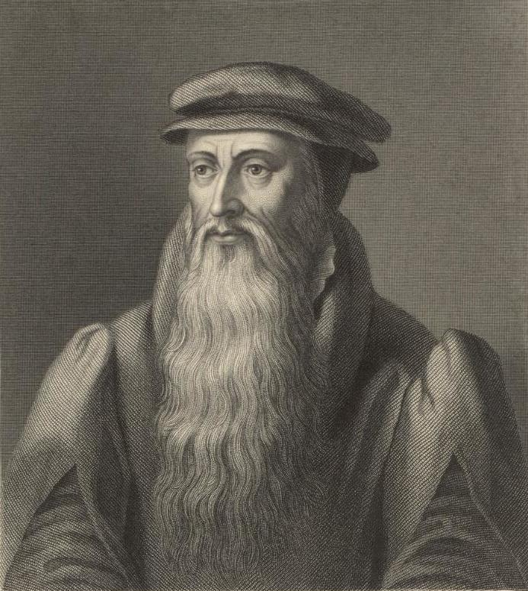
10:38-11:10
John Knox (1513-1572) ~ “Give me Scotland or I die!”

Slide 16
10:38-11:10

Slide 17
10:38-11:10
Said the robin to the sparrow,
I should really like to know
Why these anxious human beings
Rush about and worry so!
Said the sparrow to the robin,
Friend, I think that it must be
That they have no Heavenly Father
Such as cares for you and me!

Slide 18
10:38-11:10
Ps. 106:13-15 ~ ¹³ They soon forgot His works;
They did not wait for His counsel,
¹⁴ But lusted exceedingly in the wilderness,
And tested God in the desert.
¹⁵ And He gave them their request,
But sent leanness into their soul.

Slide 19
10:38-11:10
Is. 55:1-2 ~ ¹ “Ho! Everyone who thirsts,
Come to the waters;
And you who have no money,
Come, buy and eat.
Yes, come, buy wine and milk
Without money and without price.
² Why do you spend money for what is not bread,
And your wages for what does not satisfy?
Listen carefully to Me, and eat what is good,
And let your soul delight itself in
abundance.”

Slide 20
10:38-11:10
Matt. 5:6 ~ Blessed are those who hunger and thirst for righteousness,
For they shall be filled.

Slide 21
10:38-11:10

Slide 22
10:38-11:10
Eph. 4:30-5:2 ~ ³⁰ And do not grieve the Holy Spirit of God, by whom you were sealed for the day of redemption. ³¹ Let all bitterness, wrath, anger, clamor, and evil speaking be put away from you, with all malice. ³² And be kind to one another, tenderhearted, forgiving one another, even as God in Christ forgave you.
^{5:1} Therefore be imitators of God as dear children. ² And walk in love, as Christ also has loved us and given Himself for us, an offering and a sacrifice
to God for a sweet-smelling aroma.

Slide 23
10:38-11:10

Slide 24
10:38-11:10
Matt. 6:13 ~ And do not lead us into temptation, but deliver us from the evil one. For Yours is the kingdom and the power and the glory forever. Amen.

Slide 25
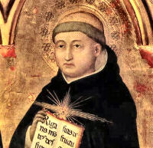
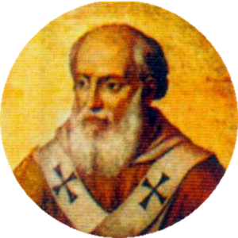
10:38-11:10
True, holy father,
neither can she any longer say to the lame, ‘Rise up and walk.’
You see, the
Church is no longer in that age in which she said, ‘Silver and gold have I none.’
Thomas Aquinas
Pope Innocent IV

Slide 26
10:38-11:10
1 Cor. 10:31 ~ Therefore, whether you eat or drink, or whatever you do, do all to the glory of God.
Westminster Confession ~
Q. What is the chief end of man?
A. Man’s chief end is to glorify God, and to enjoy him forever.

Slide 27
10:38-11:10

Slide 28
10:38-11:10
persistence ~ KJV, importunity
anaideia ~ unashamedness
chutzpah

Slide 29
10:38-11:10

Slide 30
10:38-11:10
asks, seeks, knocks ~ present participle
Literally is asking, is seeking, is knocking

Slide 31
10:38-11:10

