Slide 1

10:1-20

Slide 2


10:1-20
SUBURBAN JUNGLE

Slide 3
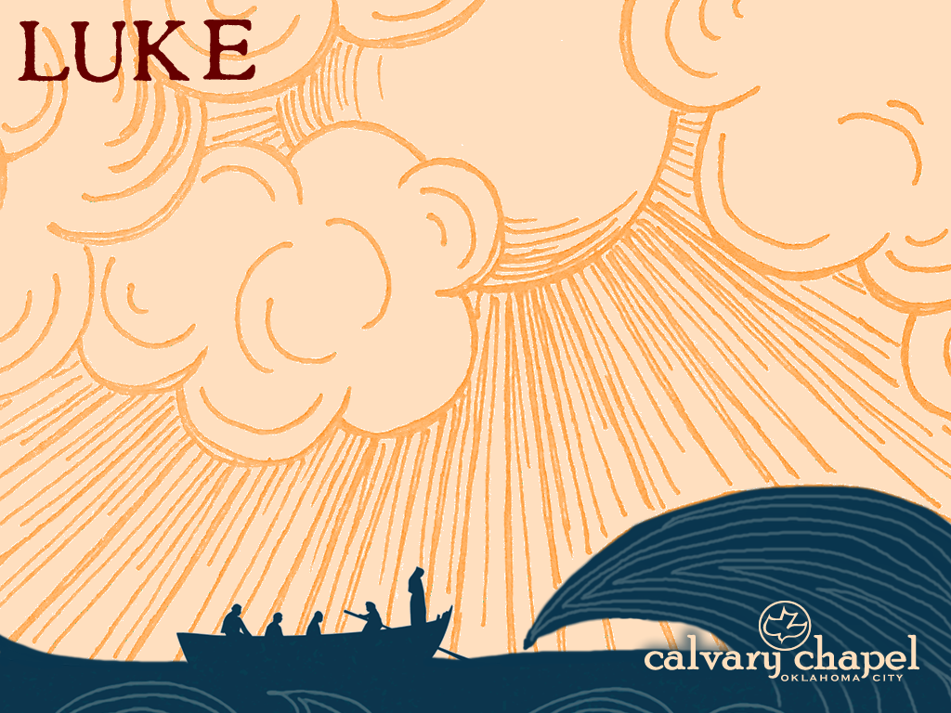
10:1-20

Slide 4
10:1-20
NLT, NIV ~ seventy-two
12 = the lost sheep of Israel (Matt. 10:6)
70 = 70 nations of Genesis 10
sent ~ apostellō – to be sent on a mission

Slide 5
10:1-20

Slide 6

10:1-20

Slide 7
10:1-20

Slide 8
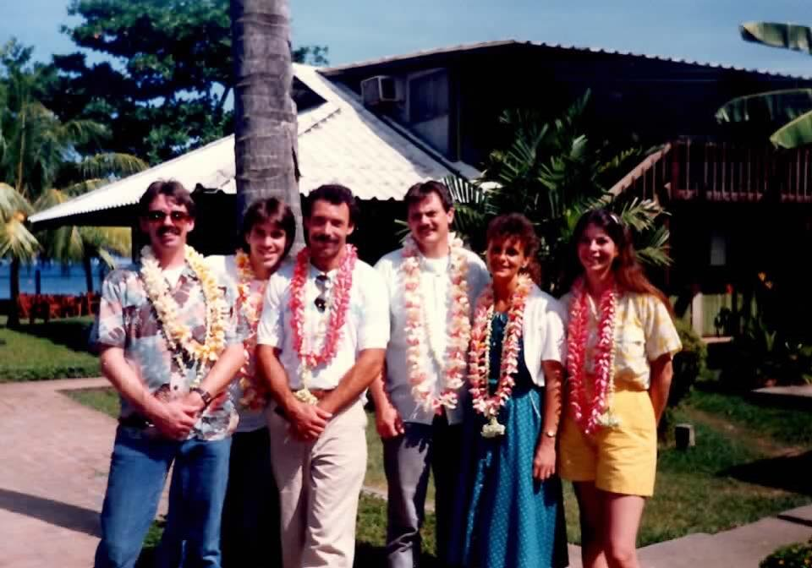
10:1-20
Ken
Mike
Don
Guy
Sue
Dena

Slide 9
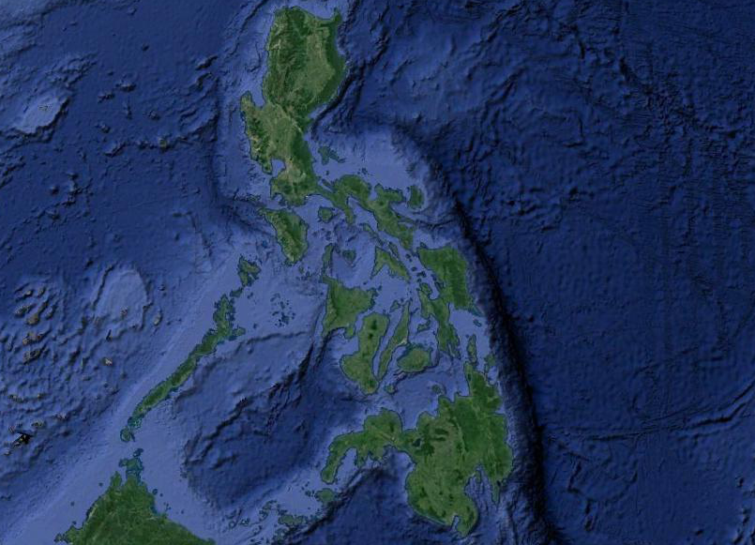
10:1-20
The Philippines
(7641 islands)
Manila
Luzon
Cebu
Cagayan de Oro
Dumaguete
Mindanao
Davao

Slide 10
10:1-20
Heb. 12:1 ~ Therefore we also, since we are surrounded by so great a cloud of witnesses, let us lay aside every weight, and the sin which so easily ensnares us, and let us run with endurance the race that is set before us,

Slide 11
10:1-20

Slide 12
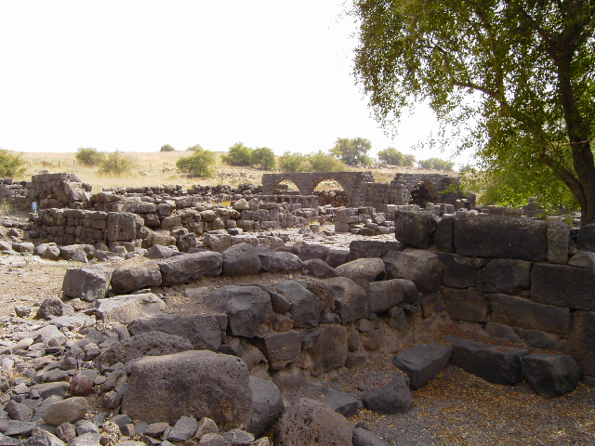
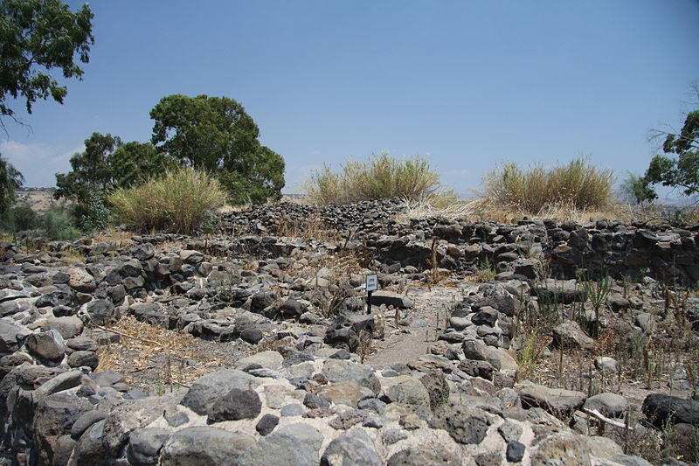
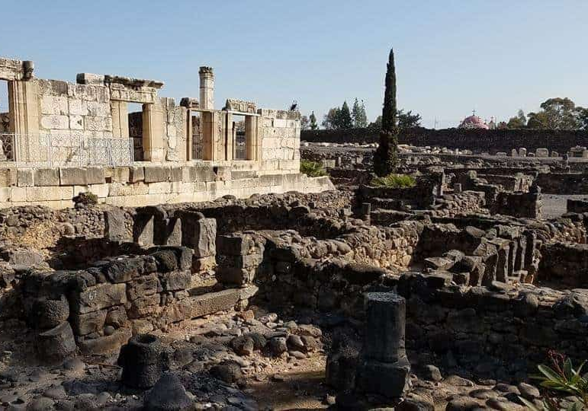
10:1-20
Chorazin
Bethsaida
Capernaum

Slide 13
10:1-20

Slide 14
10:1-20
Past?
Is. 14:12-15 – ¹² How you are fallen from heaven, O Lucifer, son of the morning!
How you are cut down to the ground,
You who weakened the nations!
¹³ For you have said in your heart:
“I will ascend into heaven,
I will exalt my throne above the stars of God;
I will also sit on the mount of the congregation
On the farthest sides of the north;
¹⁴ I will ascend above the heights of the clouds,
I will be like the Most High.”

Slide 15
10:1-20
Past?
Is. 14:12-15 – ¹⁵ Yet you shall be brought down to Sheol,
To the lowest depths of the Pit.
¹⁶ “Those who see you will gaze at you,
And consider you, saying:
‘Is this the man who made the earth tremble,
Who shook kingdoms,
¹⁷ Who made the world as a wilderness
And destroyed its cities,
Who did not open the house of his prisoners?’

Slide 16
10:1-20
Past?
Lucifer ~ heylel – literally, shining one

Slide 17
10:1-20
Past?

Slide 18
10:1-20
Past?
Ezek. 28:11–17 ~ ¹¹ Moreover the word of the Lord came to me, saying, ¹² “Son of man, take up a lamentation for the king of Tyre, and say to him, ‘Thus says the Lord God:
“You were the seal of perfection,
Full of wisdom and perfect in beauty.
¹³ You were in Eden, the garden of God;
Every precious stone was your covering:
The sardius, topaz, and diamond,
Beryl, onyx, and jasper,
Sapphire, turquoise, and emerald with gold.

Slide 19
10:1-20
Past?
Ezek. 28:11–17 ~ The workmanship of your timbrels and pipes
Was prepared for you on the day you were created.
¹⁴ “You were the anointed cherub who covers;
I established you;
You were on the holy mountain of God;
You walked back and forth in the midst of fiery stones.
¹⁵ You were perfect in your ways from the day you were created,
Till iniquity was found in you.
¹⁶ “By the abundance of your trading
You became filled with violence within,

Slide 20
10:1-20
Past?
Ezek. 28:11–17 ~ And you sinned;
Therefore I cast you as a profane thing
Out of the mountain of God;
And I destroyed you, O covering cherub,
From the midst of the fiery stones.
¹⁷ “Your heart was lifted up because of your beauty;
You corrupted your wisdom for the sake of your splendor;
I cast you to the ground,
I laid you before kings,
That they might gaze at you.”

Slide 21
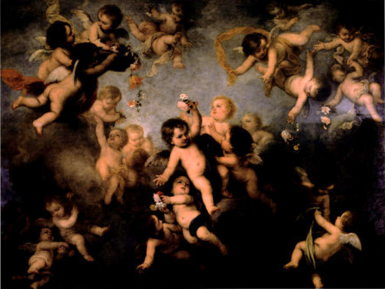
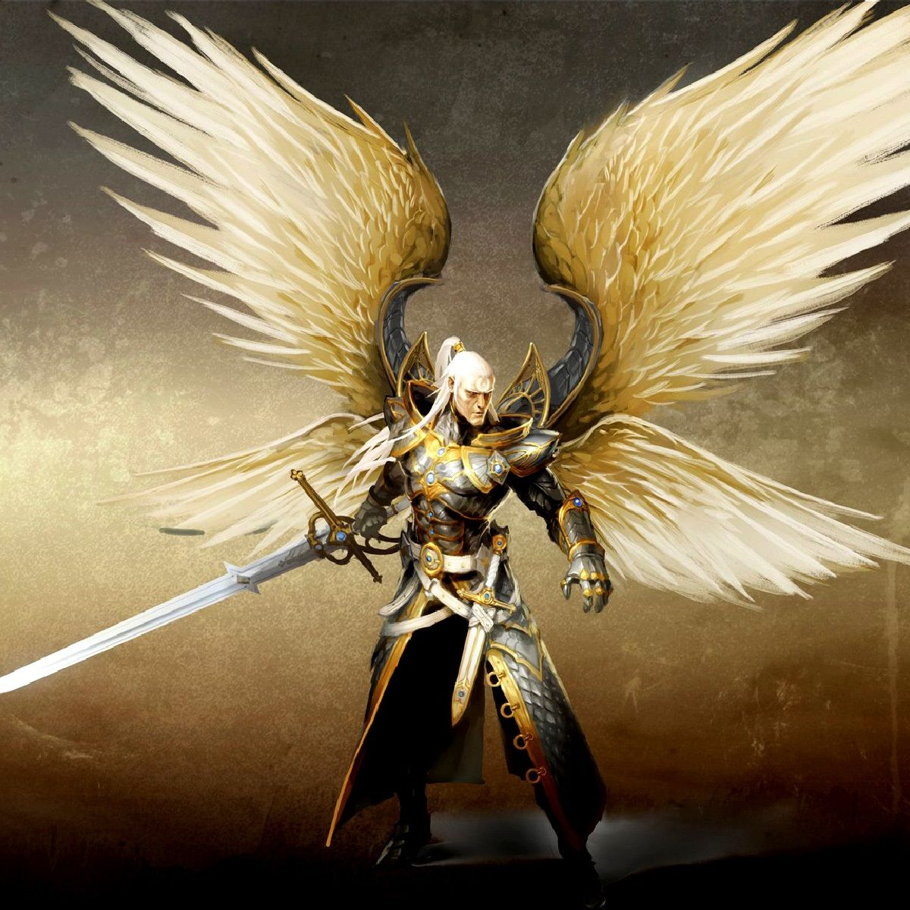
10:1-20
Past?
covers (v. 14) ~ sakak – to cover protectively

Slide 22
10:1-20

Slide 23
10:1-20
Future?
Rev. 12:7-9 – ⁷ And war broke out in heaven: Michael and his angels fought with the dragon; and the dragon and his angels fought, ⁸ but they did not prevail, nor was a place found for them in heaven any longer. ⁹ So the great dragon was cast out, that serpent of old, called the Devil and Satan, who deceives the whole world; he was cast to the earth, and his angels were cast out with him.

Slide 24
10:1-20

Slide 25
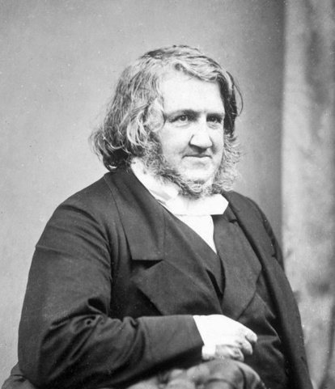
10:1-20
James Simpson (1811-1870)
Father was a baker
Discoverer of chloroform
“… but it pales in comparison to my discovery of Jesus Christ
as my Lord and Savior”

Slide 26
10:1-20

