Slide 1

9:37-62

Slide 2

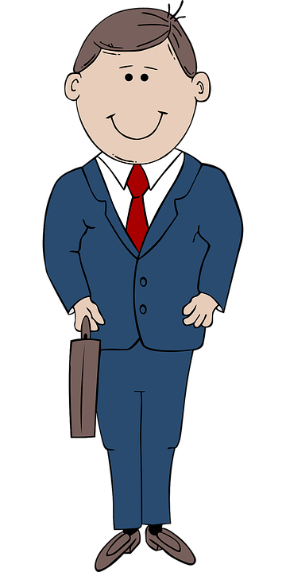




9:37-62
Hello, my
name is Mr. Paddywhack. How may I help you?
I’ll have to run this by my senior loan officer, John Dudley.
What do you have for collateral?
Mr. Dudley,
what is this thing anyway?
Hi, my name
is Kermit. Kermit Jagger. I’d like to apply for a
loan.
Any relation to Mick Jagger?
Give the frog a loan. His old man’s a Rolling Stone.
It’s a
knick knack, Paddywhack.
Oh. I know John. Tell him I said, “Hi."
Yeah, he’s my
pops.

Slide 3

9:37-62

Slide 4
9:37-62
Mark 9:24 ~ Immediately the father of the child cried out and said with tears, “Lord, I believe; help my unbelief!”
Merrihew Standard Version ~ “Lord, I believe, but please don’t let any lack of faith I might have hinder Your sovereign work!”
Mark 9:29 ~ So He said to them, “This kind can come out by nothing but prayer and
fasting.”

Slide 5
9:37-62

Slide 6
9:37-62
Wuest ~ ⁴⁷ Then Jesus, knowing the reasoning of their heart, laying hold of a little child, stood it beside himself ^{48a} and said to them, Whoever takes this little child into his family in order to bring it up and educate it in my Name, me he receives.

Slide 7
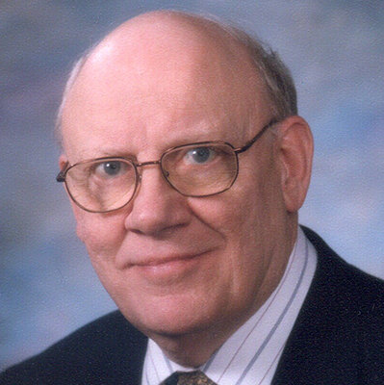
9:37-62
Warren Wiersbe (1929-2019) ~
“The selfishness and disunity of God’s people is a scandal to the Christian faith. What causes these problems?
Pride – thinking
ourselves more important than we
really are. It was pride that led man
into sin at the beginning (Gen. 3:5).
When Christians are living for themselves and not for others, then there is bound to be conflict
and division.”

Slide 8
9:37-62

Slide 9
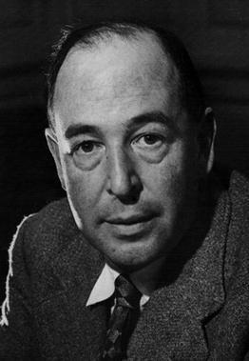
9:37-62
C. S. Lewis (1898-1863) ~ “(The truly
humble person) will not be thinking
about humility: he will not be thinking
about himself at all.
If anyone would like to acquire humility,
I can, I think, tell him the first step. The
first step is to realisze that one is proud.
And a biggish step, too. At least, nothing
whatever can be done before it. If you think you are not conceited, it means you are very
conceited indeed.”

Slide 10
9:37-62

Slide 11
9:37-62
Matt. 6:33 ~ Jesus would say, “But seek first the kingdom of God and His righteousness, and all these things shall be added to you.”

Slide 12
9:37-62

Slide 13
9:37-62
Matt. 12:30 ~ “He who is not with Me is against Me, and he who does not gather with Me scatters abroad.”

Slide 14
9:37-62
Matt. 12:30 ~ “He who is not with Me is against Me, and he who does not gather with Me scatters abroad.”
Luke 9:50 ~ But Jesus said to him, “Do not forbid him, for he who is not against us is on our side.”

Slide 15
9:37-62

Slide 16
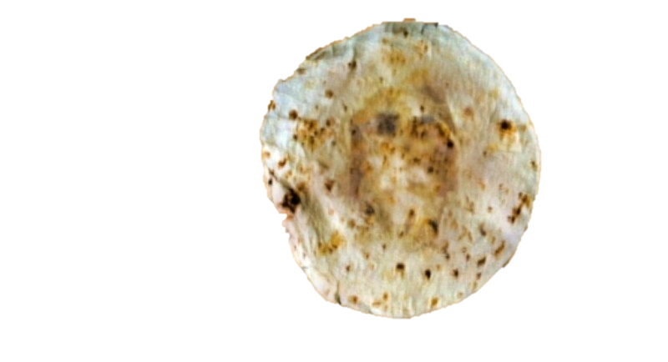
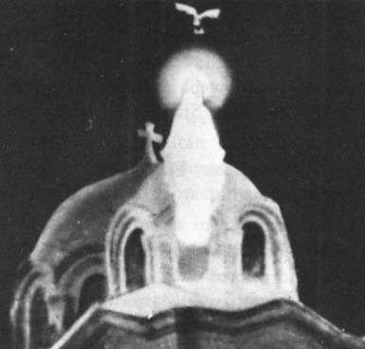
9:37-62

Slide 17
9:37-62

Slide 18

9:37-62
Luke 9:51-19:27 ~ “Luke’s travel narrative”
Luke 3:21-9:50
9:51-19:27
3 years
6 months

Slide 19
9:37-62

Slide 20
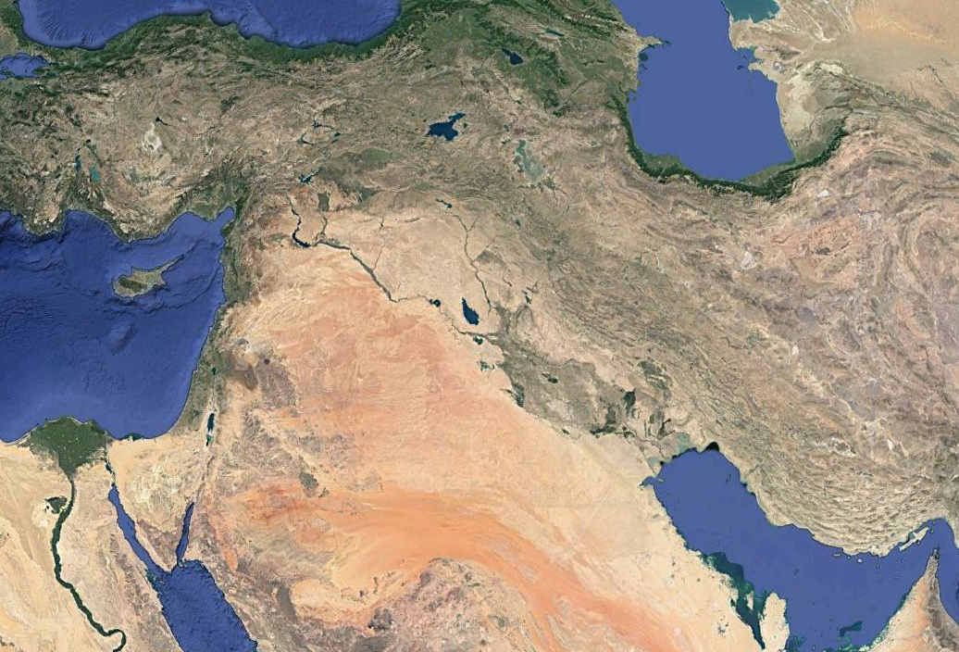
9:37-62
Assyrian Empire
Ava
(2 Kings 17:24)
Hamath
Cuthah
Sepharvaim
Babylon

Slide 21
9:37-62

Slide 22
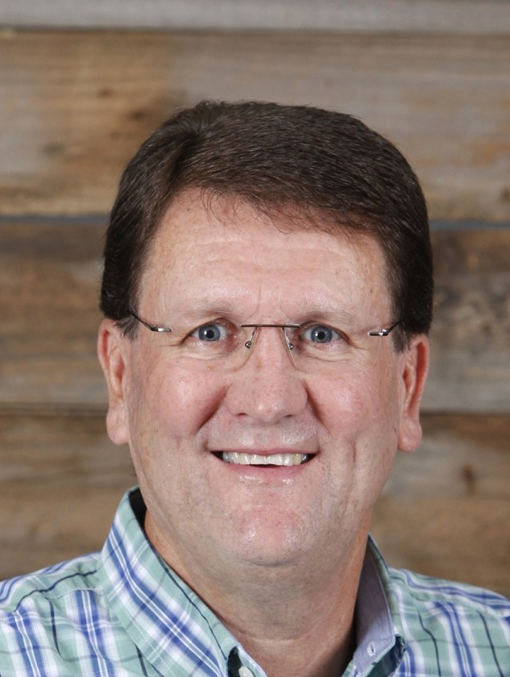
9:37-62
Sandy Adams (Calvary Chapel Stone Mountain) ~ “I think much damage has been done over the years under the banner of Christianity by people who went out in Jesus’ name but knew nothing of His nature. You can’t represent Him until you know His heart.”

Slide 23
9:37-62

Slide 24
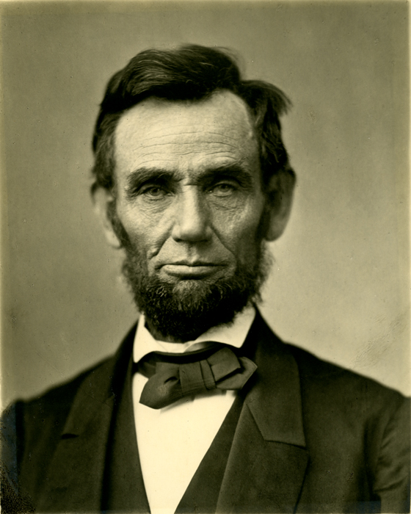
9:37-62
Abe Lincoln (1809-1865) ~
“Why, madam, do I not destroy my enemies when I make them my friends?”

Slide 25
9:37-62

Slide 26
9:37-62
Matt. 8:19 ~ Then a certain scribe came and said to Him, “Teacher, I will follow You wherever You go.”

Slide 27
9:37-62

Slide 28
9:37-62
Luke 17:32 ~ Remember Lot’s wife.
Phil. 3:13-14 ~ ¹³ Brethren, I do not count myself to have apprehended; but one thing I do, forgetting those things which are behind and reaching forward to those things which are ahead, ¹⁴ I press toward the goal for the prize of the upward call of God in Christ Jesus.

Slide 29
9:37-62

