Slide 1

9:1-17

Slide 2


9:1-17
YOU ARE NOW ENTERING THE MISSION FIELD

Slide 3

9:1-17

Slide 4
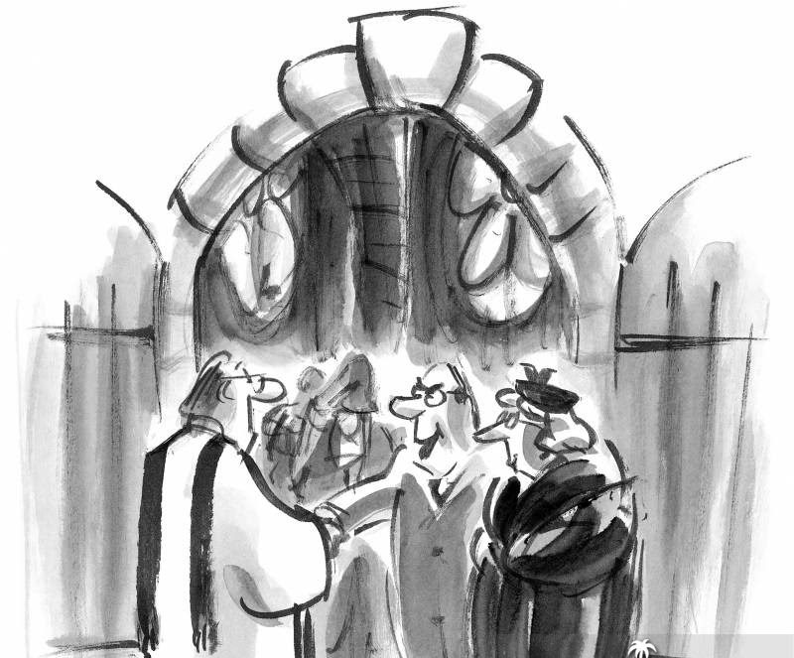
9:1-17
Don’t mind him, Pastor … he just goes around repeating what he hears others say.
That was a
very dull
and boring sermon this morning, Pastor.
I didn’t think you did any preparation for your message.
You really blew
it. You didn’t have
a thing worthy
to say.

Slide 5
9:1-17

Slide 6
9:1-17
sent ~ apostellō
authority ~ exousia – the right to accomplish a task
power ~ dunamis – the ability to accomplish a task
preach ~ kērussō – to herald or make known

Slide 7
9:1-17

Slide 8
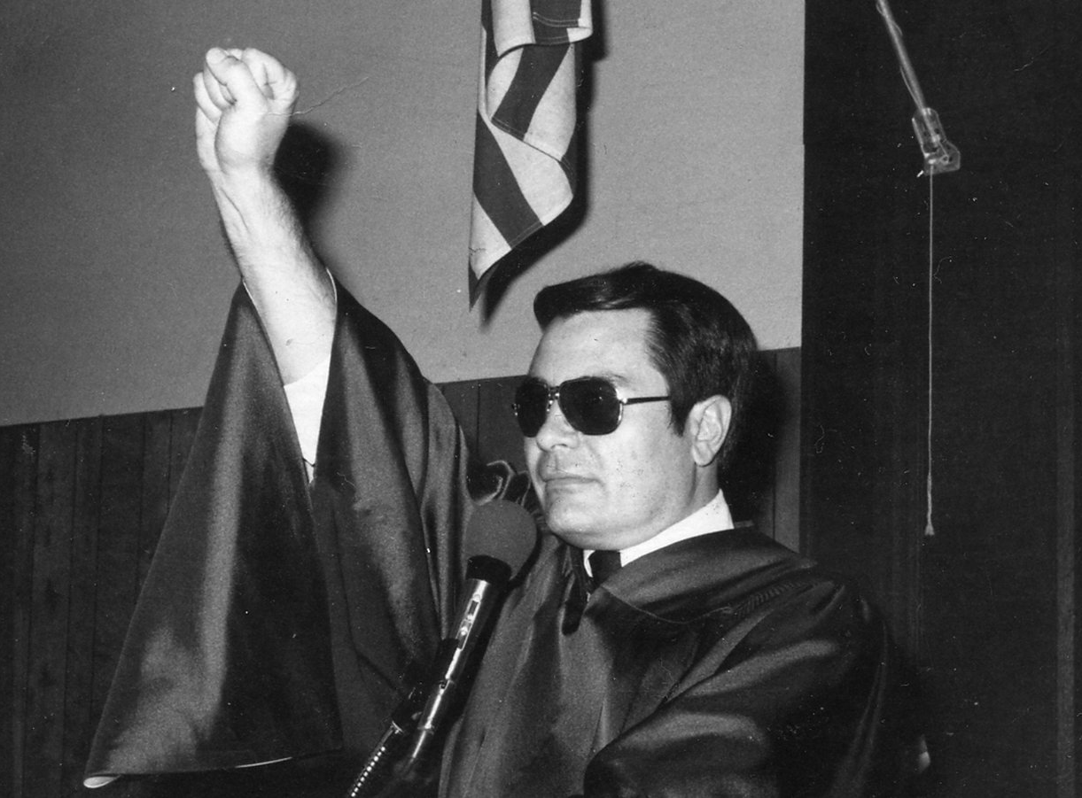
9:1-17
bag (v. 3) ~ KJV, scrip
preaching the gospel ~ euaggelizō – the Good News
Jim Jones, People’s Temple

Slide 9
9:1-17

Slide 10
9:1-17
Luke 23:8-9 ~ ⁸ Now when Herod saw Jesus, he was exceedingly glad; for he had desired for a long time to see Him, because he had heard many things about Him, and he hoped to see some miracle done by Him. ⁹ Then he questioned Him with many words, but He answered him nothing.

Slide 11
9:1-17

Slide 12
9:1-17
healing ~ therapeia

Slide 13
9:1-17

Slide 14
9:1-17
Ex. 4:1-5 ~ ¹ Then Moses answered and said, “But suppose they will not believe me or listen to my voice; suppose they say, ‘The Lord has not appeared to you.’”
² So the Lord said to him, “What is that in your hand?”
He said, “A rod.”
³ And He said, “Cast it on the ground.” So he cast it on the ground, and it became
a serpent;

Slide 15
9:1-17
Ex. 4:1-5 ~ and Moses fled from it. ⁴ Then the Lord said to Moses, “Reach out your hand and take it by the tail” (and he reached out his hand and caught it, and it became a rod in his hand), ⁵ “that they may believe that the Lord God of their fathers, the God of Abraham, the God of Isaac, and the God of Jacob, has appeared to you.”

Slide 16

9:1-17
Two things about snakes:
Never pick one up by the tail
Head
They’re all tail
Tail

Slide 17
9:1-17

Slide 18
9:1-17
BOGO (buy 1; get 1)
B2G10000 (buy 2; get 10000)
filled ~ chortazō
John 6:12 ~ empiplēmi – compound of “in” and “most”
“glutted”

Slide 19
9:1-17

Slide 20
9:1-17
twelve baskets ~ kophinos – small basket

Slide 21
9:1-17

Slide 22
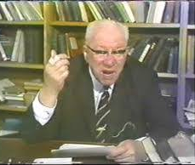
9:1-17
William Barclay (1907-1978) ~ “Second, some people think
that this is what happened. The
people were hungry – and they were utterly selfish. They all had something with them, but they would not even produce it for themselves in case they had to share it with others. The Twelve laid before the multitude

Slide 23
9:1-17
William Barclay (1907-1978) ~ their little store, and thereupon
others were moved to produce their little store, and in the end there was more than enough for everyone. So it may be regarded
as a miracle which turned selfish, suspicious folk into generous people …”

Slide 24
9:1-17
William Barclay (1907-1978) ~ “There are some people who
read the miracles of Jesus, and
feel no need to understand. Let them remain forever undisturbed
in the sweet simplicity of their faith. There are others who read and their minds question and they feel they must understand. Let them take no shame of it …”

Slide 25
9:1-17

Slide 26
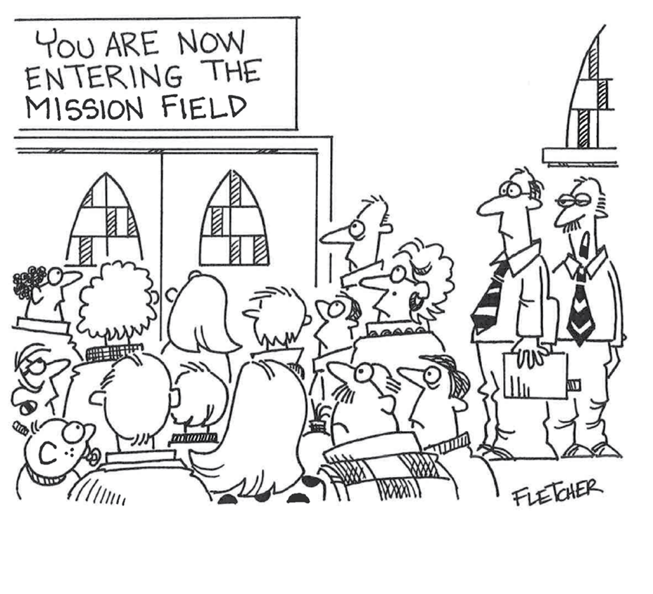
9:1-17
“What do we do if they NEVER leave the building?”

Slide 27
9:1-17

