Slide 1
8:41-56

Slide 2
8:41-56
He touched me, oh He touched me
And oh the joy that floods my soul
Something happened and now I know
He touched me and made me whole
– Bill and Gloria Gaither

Slide 3
8:41-56

Slide 4
8:41-56
worshiped ~ proskuneō – same as demoniac (Mark 5:6)

Slide 5
8:41-56

Slide 6
8:41-56
Num. 15:38-40 ~ ³⁸ “Speak to the children of Israel: Tell them to make tassels on the corners of their garments throughout their generations, and to put a blue thread in the tassels of the corners. ³⁹ And you shall have the tassel, that you may look upon it and remember all the commandments of the Lord and do them, and that you may not follow the harlotry to which your own heart and your own eyes are inclined, ⁴⁰ and that you may remember and do all My commandments, and
be holy for your God.

Slide 7
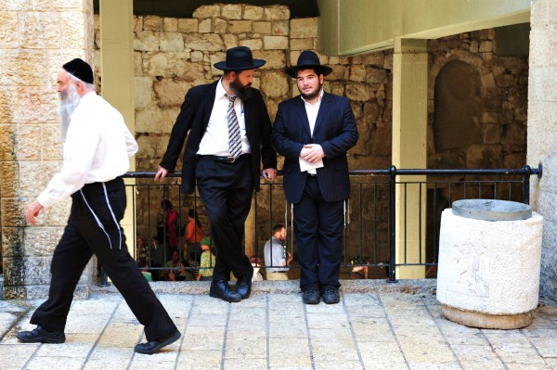
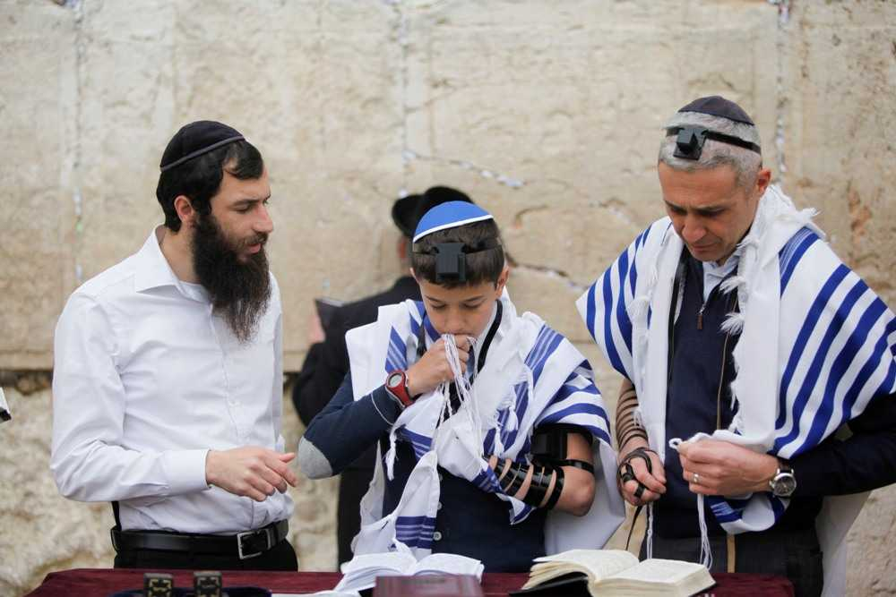
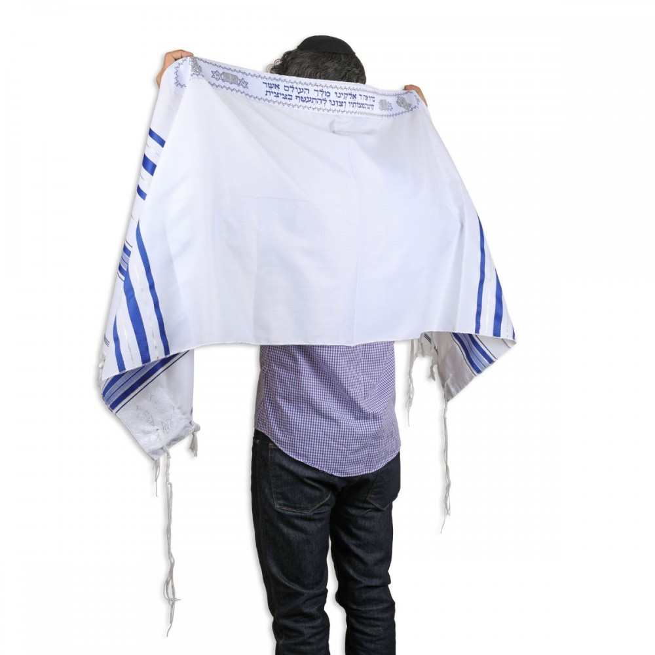
8:41-56
Tallit
Tzitzit

Slide 8
8:41-56

Slide 9
8:41-56
made you well ~ sōzō – to save

Slide 10
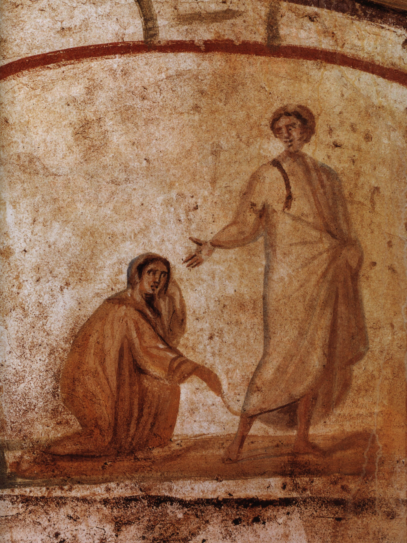
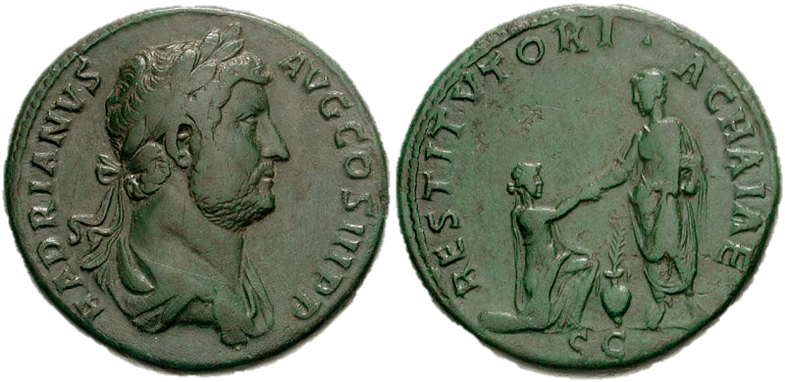
8:41-56

Slide 11
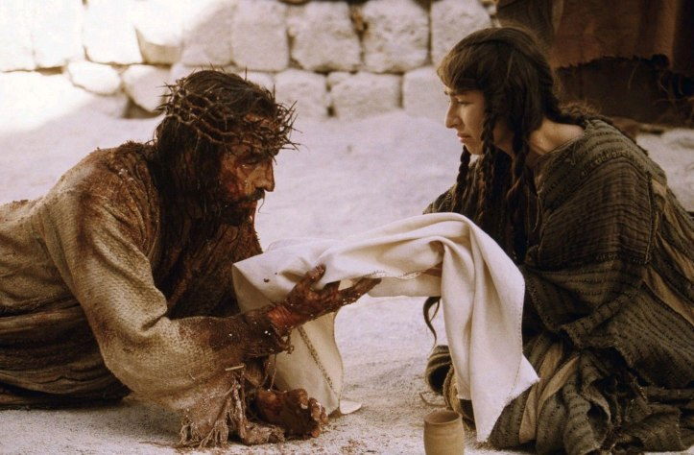
8:41-56
Veronica

Slide 12
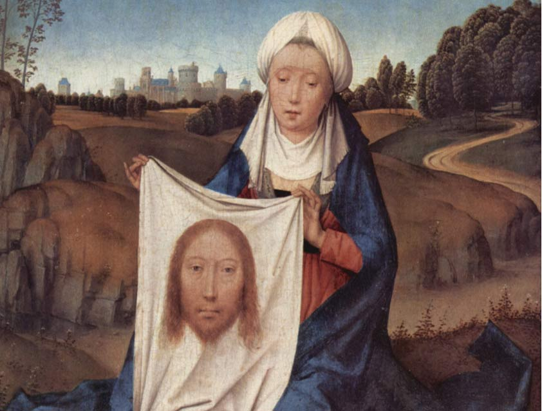
8:41-56
The Veil of
St.
Veronica

Slide 13
8:41-56

Slide 14
8:41-56
believe ~ present tense – keep on believing
Mark 5:36 ~ imperfect tense – keep on and keep on believing

Slide 15
8:41-56

Slide 16
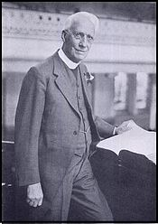
8:41-56
G. Campbell Morgan (1863-1945) ~ “I can hardly speak of the matter without becoming personal and reminiscent, remembering a time forty years ago when my own first lassie lay at the point of death, dying. I called for Him then, and He came, and surely said to our troubled hearts, ‘Fear not, believe only.’ He did not say, ‘She shall be made whole.’ She was not made whole on the earthly plane;

Slide 17
8:41-56
G. Campbell Morgan (1863-1945) ~ she passed away into the life beyond. But
He did say to her, ‘Talitha cumi,’ that He needed her, and He took her to be with Himself. She has been with Him for all these years, as we measure time here, and I have missed her every day. But His word, ‘Believe only,’ has been the strength of the passing years.”

Slide 18
8:41-56

Slide 19
8:41-56
What a contrast!
Girl was 12 years old
Woman was sick for 12 years
Wealthy family
Spent all she had
Joy of her father’s life
Social outcast
Jesus met them both!

Slide 20
8:41-56

Slide 21
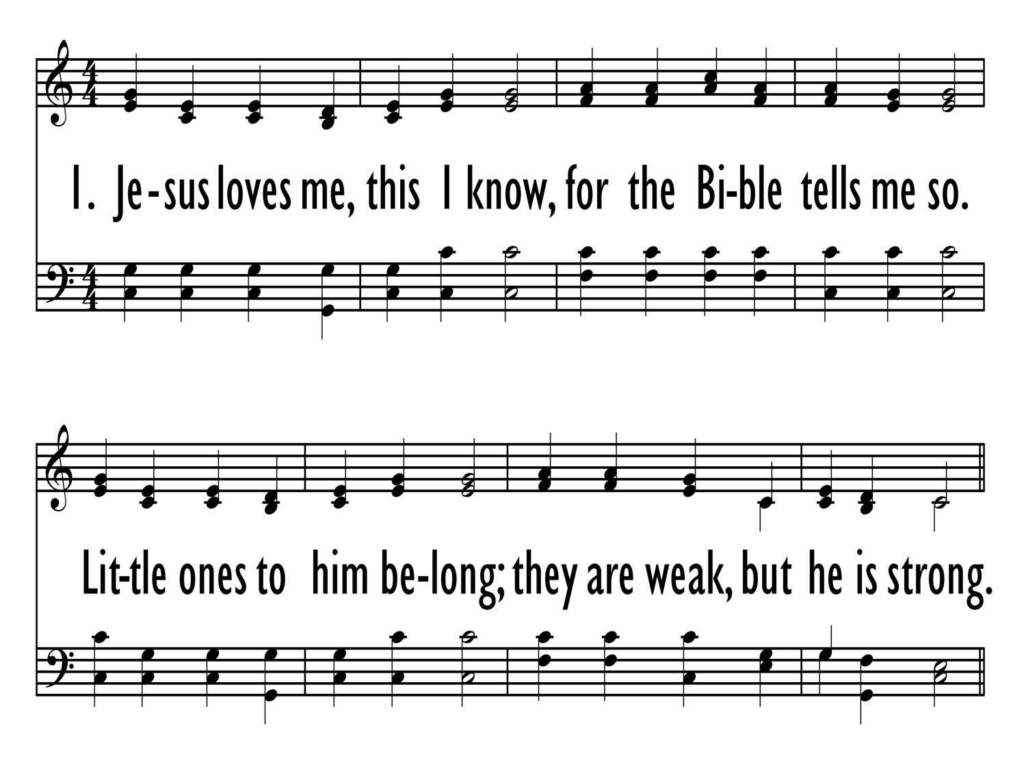
8:41-56

Slide 22
8:41-56
Mal. 3:1a ~ “Behold, I send My messenger, and he will prepare the way before Me.”
eyewitnesses ~ autoptēs

Slide 23
8:41-56

