Slide 1
8:26-40

Slide 2
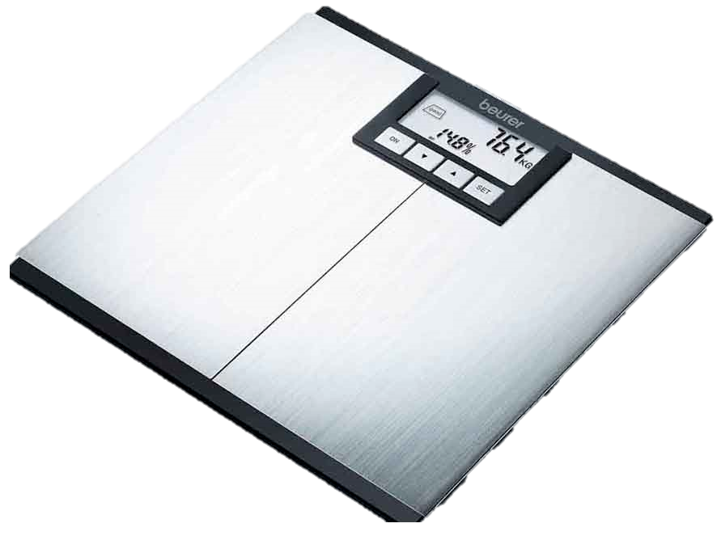
8:26-40
It had better go from 0-200 in 6 seconds!!!

Slide 3
8:26-40

Slide 4
8:26-40
Gadarenes ~ also Gergesenes, Gerasenes

Slide 5
8:26-40

Slide 6
8:26-40
How’s that working out for ya, world?

Slide 7
8:26-40

Slide 8
8:26-40

Slide 9
8:26-40

Slide 10
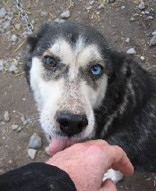
8:26-40
James 2:19 ~ You believe that there is one God. You do well. Even the demons believe — and tremble!
Mark 5:6 ~ When he saw Jesus from afar, he ran and worshiped Him
worshiped ~ proskuneō
pros ~ before, and
kuon ~ dog

Slide 11
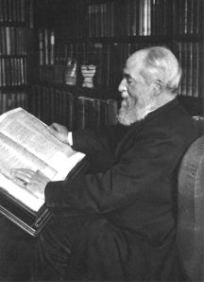
8:26-40
Henry Barclay Swete (1835-1917) ~ “At first perhaps with hostile intentions, the onrush of the naked, yelling maniac must have tried the newly recovered confidence of the Twelve. We can imagine their surprise when, on approaching, he threw himself on his knees” (cited by A. T. Robertson)

Slide 12
8:26-40

Slide 13
8:26-40
abyss ~ abussos – a = negative particle + buthos = the deep
2 Cor. 11:25 ~ … a night and a day I have been in the deep;

Slide 14
8:26-40
Rev. 9:1-5 ~ ¹ Then the fifth angel sounded: And I saw a star fallen from heaven to the earth. To him was given the key to the bottomless pit. ² And he opened the bottomless pit, and smoke arose out of the pit like the smoke of a great furnace. So the sun and the air were darkened because of the smoke of the pit. ³ Then out of the smoke locusts came upon the earth. And to them was given power, as the scorpions of the earth have power.

Slide 15
8:26-40
Rev. 9:1-5 ~ ⁴ They were commanded not to harm the grass of the earth, or any green thing, or any tree, but only those men who do not have the seal of God on their foreheads. ⁵ And they were not given authority to kill them, but to torment them for five months. Their torment was like the torment of a scorpion when it strikes a man.

Slide 16
8:26-40

Slide 17
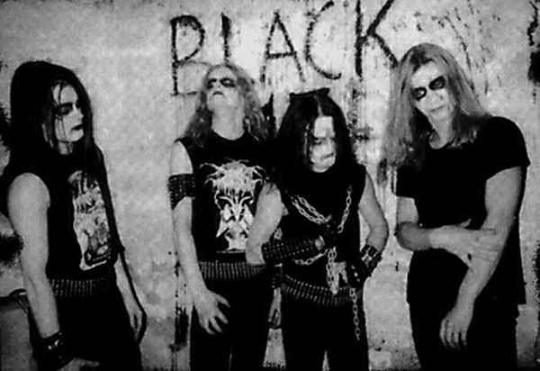
8:26-40
John 10:10 ~ The thief does not come except to steal, and to kill, and to destroy.
I have come that they may have life, and that they may have it more abundantly.

Slide 18
8:26-40
GOD
SATAN

Slide 19
8:26-40

Slide 20
8:26-40
Hippos

Slide 21
8:26-40

Slide 22
8:26-40
demon-possessed ~ daimonizomai = demonized
Mark 5:15 ~ daimonizomenon (+ menos – to remain

Slide 23
8:26-40

Slide 24
8:26-40
Ps. 106:15 ~ He gave them their request,
But sent leanness into their souls.

Slide 25
8:26-40

Slide 26
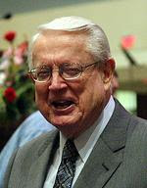
8:26-40
Chuck Swindoll (b. 1934) ~ “If finding God’s way in the suddenness of storms makes our faith grow
broad, then trusting God’s wisdom
in the ‘dailyness’ of living makes
it grow deep. And strong.”

Slide 27
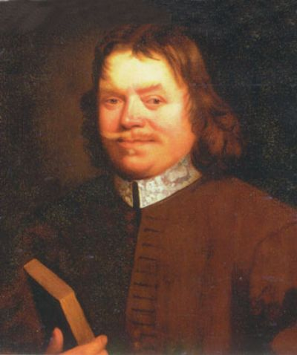
8:26-40
John Bunyon (1628-1688) ~ “If we have not quiet in our minds, outward comfort will do no
more for us than a golden
slipper on a gouty foot.”

Slide 28
8:26-40

Slide 29
8:26-40
Luke 10:15 ~ And you, Capernaum, who are exalted to heaven, will be brought down to Hades.

Slide 30
8:26-40

