Slide 1
8:1-25

Slide 2
8:1-25
In the next 24 hours:
Your heart will beat 103,689 times
Your blood will travel 168 miles, as your heart pumps approximately 4 ounces per beat
You will breathe 23,040 times, inhaling 438 cubic feet of air
Your stomach will take in 3.5lb of food and 2.9 quarts of liquid. You will lose 14oz of waste
If you are a man, you will speak 4,800 words
If you are a woman, you will speak close to 7,000 words.
You will move 750 muscles and exercise
7 million brain cells

Slide 3
8:1-25
Chris
Gizmo
Joy

Slide 4
8:1-25

Slide 5
8:1-25
Mary Magdalene ~ not the woman at Simon’s house
Herod’s steward ~ chief of staff
Susanna ~ a lily
Color blind
Class vacant
Church
Culture neutral

Slide 6
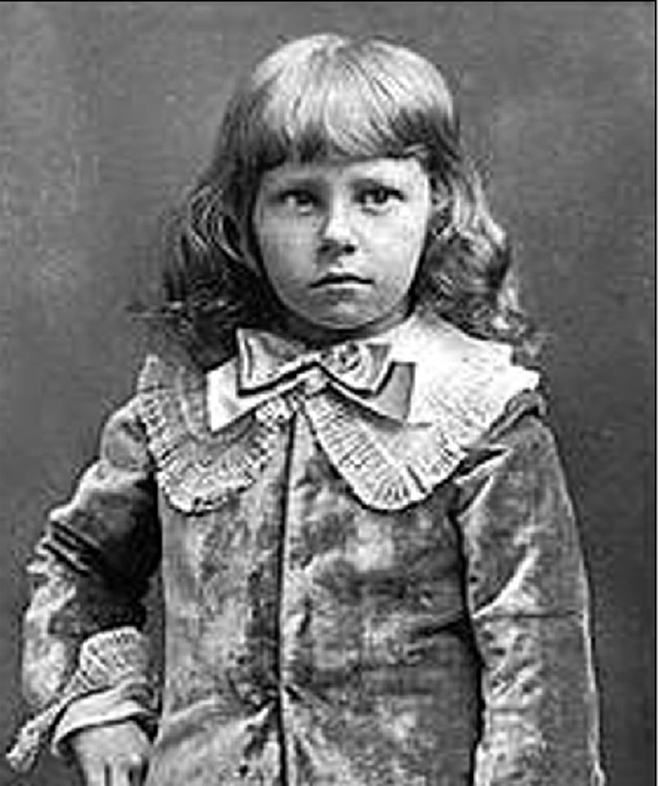
8:1-25
Little Lord Fauntleroy

Slide 7
8:1-25

Slide 8
8:1-25
parable ~ parabolē
para (alongside) + ballō (to throw)
3 rules of parable interpretation:
1) Simplicity of interpretation
2) Restrict symbols to those revealed by Jesus
3) Consistency of symbolism

Slide 9
8:1-25

Slide 10
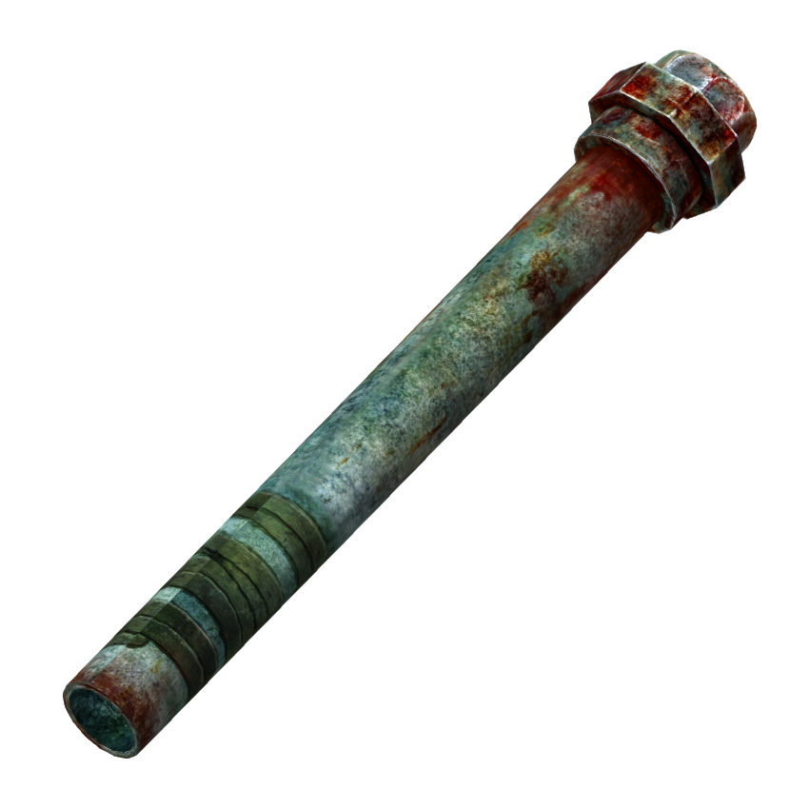
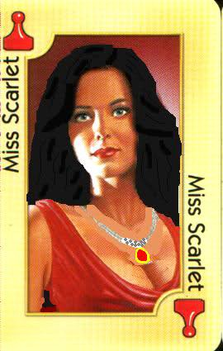
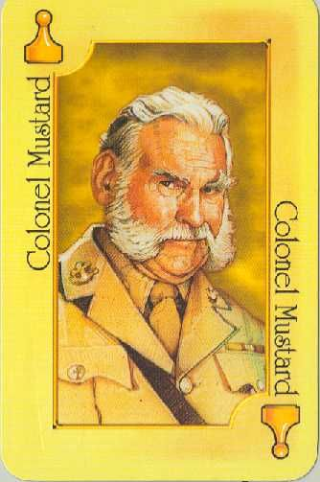
8:1-25
mysteries ~ mustērion – a hidden secret revealed only to the initiate

Slide 11
8:1-25

Slide 12
8:1-25
John 3:19 ~ And this is the condemnation, that the light has come into the world, and men loved darkness rather than light, because their deeds were evil.

Slide 13
8:1-25

Slide 14
8:1-25
temptation ~ NIV, testing

Slide 15
8:1-25

Slide 16
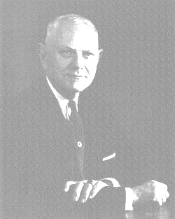
8:1-25
riches ~ ploutos – from a root meaning to be full
Robert Ketcham (1889-1978), I Shall Not Want: “The Lord is my shepherd, that’s all I want.” (4-y/o little girl)

Slide 17
8:1-25

Slide 18
8:1-25
Gal. 5:22-23a ~ ²² But the fruit of the Spirit is love, joy, peace, longsuffering, kindness, goodness, faithfulness, ²³ gentleness, self-control. Against such there is no law.

Slide 19
8:1-25

Slide 20
8:1-25
Four kinds of soil
Hard ground
does not withstand the devil
Stony ground
does not withstand the sun
Thorny ground
does not withstand the cares
Good ground
bears good crops

Slide 21
8:1-25

Slide 22
8:1-25
Don’t worry … I won’t
GOD
Don’t try to
cram Your religion down my throat!!!

Slide 23
8:1-25
Freak flag
Overfed, long-haired leaping gnome

Slide 24
8:1-25

Slide 25
8:1-25
2 Tim. 3:1-2, 7 ~ ¹ But know this, that in the last days perilous times will come. ² For men will become lovers of themselves …
⁷ always learning and never able to come to the knowledge of the truth.

Slide 26
8:1-25

Slide 27
8:1-25
Mark 3:21 ~ But when His own people heard about this, they went out to lay hold of Him, for they said, “He is out of His mind.”
existimi ~ ek, out of + histēmi, to stand or place

Slide 28
8:1-25

Slide 29
8:1-25
Matt. 8:24 ~ tempest – seismos
14x in the New Testament
13x it’s translated earthquake

Slide 30
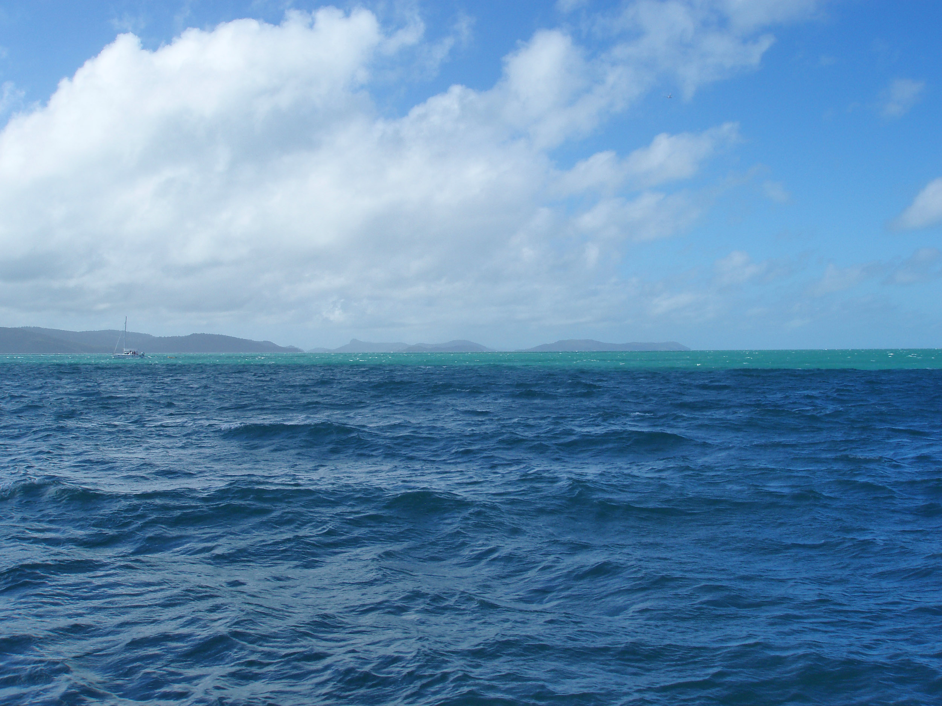
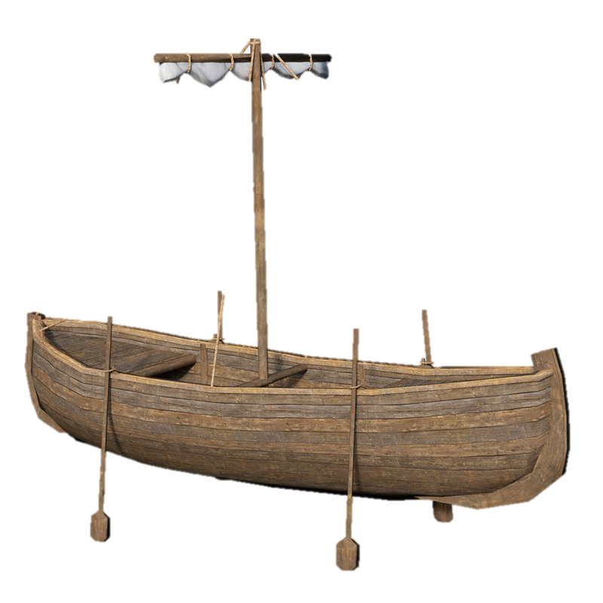
8:1-25
27’ X 7.5’

Slide 31
8:1-25
rebuked ~ (Mark 4:39) Peace! ~ siōpaō – an inability to speak, be still ~ phimaō – to muzzle

Slide 32
8:1-25

Slide 33
8:1-25
Heb. 11:10 ~ for (Abraham) waited for the city which has foundations, whose builder and maker is God.

Slide 34
8:1-25

Slide 35
8:1-25
Hos. 10:12 ~ Sow for yourselves righteousness;
Reap in mercy;
Break up your fallow ground,
For it is time to seek the Lord,
Till He comes and rains righteousness on you.

Slide 36
8:1-25

