Slide 1

7:24-50

Slide 2

7:24-50
Rom. 10:14-15 ~ ¹⁴ How then shall they call on Him in whom they have not believed? And how shall they believe in Him of whom they have not heard? And how shall they hear without a preacher? ¹⁵ And how shall they preach unless they are sent? As it is written:
“How beautiful are the feet of those who preach the gospel of peace,
Who bring glad tidings of good things!”

Slide 3

7:24-50

Slide 4
7:24-50
reed shaken by the wind?
Common, ordinary
Fickle

Slide 5
7:24-50

Slide 6
7:24-50
Merrihew Standard Version ~ ²⁴ “What did you expect to see when you left the city and traveled far out into the countryside? A feather that is one minute blown this way and then blown another the next? ²⁵ Just what were you looking for? Some guy in silk, designer clothing? Of course not. Those guys never leave the coziness of their opulent creature comforts.

Slide 7
7:24-50

Slide 8
7:24-50
NIV ~ All the people, even the tax collectors, when they heard Jesus’ words, acknowledged that God’s way was right,

Slide 9
7:24-50

Slide 10
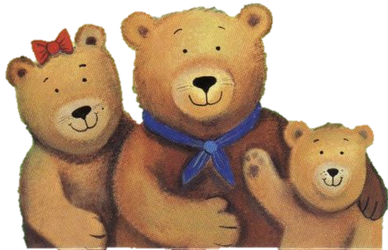
7:24-50
This religion’s too soft
This religion’s too hard
This religion’s just right
This Photo by Unknown Author is licensed under CC BY-NC-ND

Slide 11

7:24-50
Not “just right” … but the “right way”

Slide 12
7:24-50
Matt. 18:3 ~ “Assuredly, I say to you, unless you are converted and become as little children, you will by no means enter the kingdom of heaven.”

Slide 13
7:24-50

Slide 14
7:24-50
Lao Tzu (6th century BC) ~ “Care about what other people think and you will always be their prisoner.”
Aesop (c. 680-564 BC) ~ “If you try to please all, you please none.”
Aristotle (384-322 BC) ~ “There is only one way to avoid criticism: do nothing, say nothing, and be nothing.”
Prov. 29:25 ~ The fear of man brings a snare,
But whoever trusts in the Lord shall be safe.
Col. 3:23 (NLT) ~ Work willingly at whatever
you do, as though you were working
for the Lord rather than for people.

Slide 15
7:24-50

Slide 16
7:24-50
Luke 16:15 ~ And He said to them, “You are those who justify yourselves before men, but God knows your hearts. For what is highly esteemed among men is an abomination in the sight of God.”

Slide 17
7:24-50

Slide 18
7:24-50
Her sin is unspecified because …
It’s irrelevant
We would turn it into a standard

Slide 19
7:24-50

Slide 20
7:24-50
It is the degree of brokeness
It is not the degree of sinfulness

Slide 21
7:24-50

Slide 22
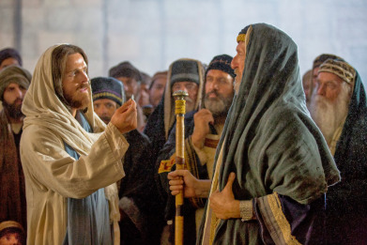
7:24-50
The only
thing I can see is her repentance
All you
can see is her sin

Slide 23
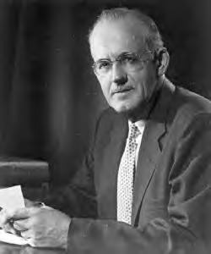
7:24-50
W. Tozer (1897-1963) ~ “The unbelieving mind would
not be convinced by any
proof, and the worshiping
heart needs none.”

Slide 24
7:24-50

Slide 25
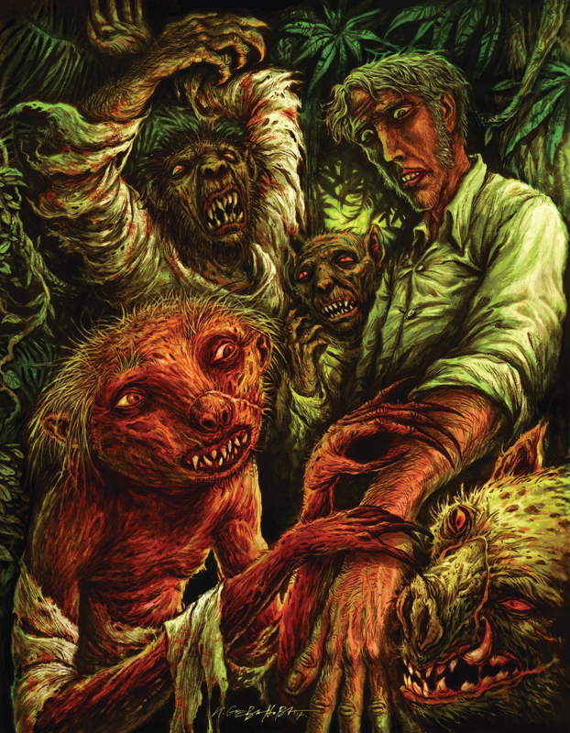
7:24-50
the island of Dr. Moreau

Slide 26
7:24-50

Slide 27
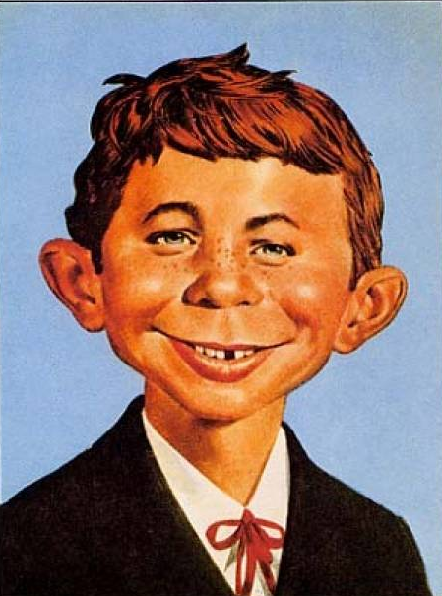
7:24-50
What, me sin?

Slide 28
7:24-50
1 Tim. 1:15 ~ Christ Jesus came into the world to save sinners, of whom I am chief.
St. Francis (c. 1181-1226) ~ “There is nowhere a more wretched and more miserable sinner
than I.”
Martin Luther (1453-1546) ~ Sleep naked in snow, flagellate ‘til bloody, spent hours in confession, climbed the “holy stairs” (Scala Sancto) in Rome on his knees –
kissing each step

Slide 29
7:24-50

Slide 30
7:24-50
poreuou eis eirēnē
Go in peace
Travel into peace

Slide 31
7:24-50

