Slide 1
6:20-49

Slide 2
6:20-49
Law is the Old Testament standard
613 precepts
}
365 negative
248 positive
Sermon on the Mount/Plain are the New Testament standard
Old Testament says, “Do” (Do-attitudes)
New Testament says, “Be” (Be-attitudes)

Slide 3
6:20-49

Slide 4
6:20-49
blessed ~ makarios
“Beatitudes” comes from Latin, beatus

Slide 5
6:20-49

Slide 6
6:20-49
poor in spirit (Matt. 5:3)
penēs – one who is so poor he earns his bread by daily labor
ptōchos – one who only earns his living by begging
Merrihew Standard Version ~ When you find yourself in abject destitution, God’s kingdom comes into view.

Slide 7
6:20-49

Slide 8
6:20-49
Ps. 56:8 ~ You number my wanderings;
Put my tears into Your bottle;
Are they not in Your book?

Slide 9
6:20-49

Slide 10
6:20-49
1 Cor. 15:19 ~ If in this life only we have hope in Christ, we are of all men the most pitiable.

Slide 11
6:20-49

Slide 12
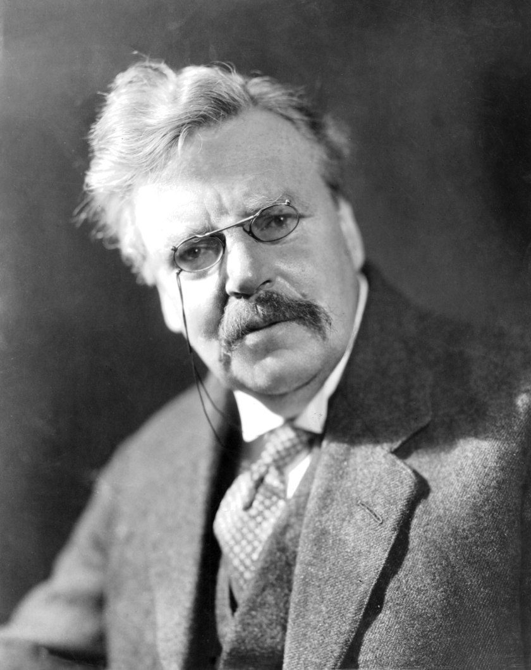
6:20-49
G. K. Chesterton (1874-1936) ~ “I like being in hot water
– it keeps me clean.”

Slide 13
6:20-49

Slide 14
6:20-49

Slide 15
6:20-49

Slide 16
6:20-49
Eccl. 7:20-22 ~ ²⁰ For there is not a just man on earth who does good
And does not sin.
²¹ Also do not take to heart everything people say,
Lest you hear your servant cursing you.
²² For many times, also, your own heart has known
That even you have cursed others.

Slide 17
6:20-49
Col. 2:13-15 ~ ¹³ And you, being dead in your trespasses and the uncircumcision of your flesh, He has made alive together with Him, having forgiven you all trespasses, ¹⁴ having wiped out the handwriting of requirements that was against us, which was contrary to us. And He has taken it out of the way, having nailed it to the cross. ¹⁵ Having disarmed principalities and powers, He made a public spectacle of them, triumphing over them in it.

Slide 18
6:20-49
Eph. 1:3 ~ Blessed be the God and Father of our Lord Jesus Christ, who has blessed us with every spiritual blessing in the heavenly places in Christ,

Slide 19
6:20-49

Slide 20
6:20-49
Jesus commands us to not judge the things we cannot know
Jesus commands us to judge the things we
can know
It’s a sin to make a judgment regarding these matters
It’s a sin not to make a judgment regarding these matters

Slide 21
6:20-49
Phil. 1:9 ~ And this I pray, that your love may abound still more and more in knowledge and all discernment,

Slide 22
6:20-49

Slide 23
6:20-49
1 Cor. 6:19-20 ~ ¹⁹ Or do you not know that your body is the temple of the Holy Spirit who is in you, whom you have from God, and you are not your own? ²⁰ For you were bought at a price; therefore glorify God in your body and in your spirit, which are God’s.

Slide 24
6:20-49

Slide 25
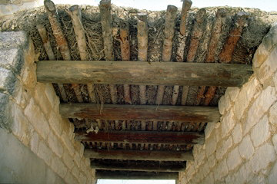
6:20-49
Speck (karphos)
8” plank (dokos)

Slide 26
6:20-49

Slide 27
6:20-49
Rom. 7:25a ~ I thank God – through Jesus Christ our Lord!

Slide 28
6:20-49

Slide 29
6:20-49
vehemently (vv. 48, 49) ~ prosrēgnumi – medical term referring to an internal rupture

Slide 30
6:20-49
Wuest ~ ⁴⁶ But why are you calling me, Lord, Lord, and are not doing the things which I am saying? ⁴⁷ Everyone who comes to me and is hearing my words and is putting them into practice, I will show you to whom he is like. ⁴⁸ He is like a man who is building a house, who dug and went deep and laid a foundation upon the solid rock. And a flood having come, the river dashed against that house, and it was not strong enough to shake it because it was built securely.
⁴⁹ But he who heard and did not do is like a man who built a house upon the ground without a foundation, against which the river dashed, and immediately it collapsed,
and the ruin of that house was great.

Slide 31
6:20-49

Slide 32
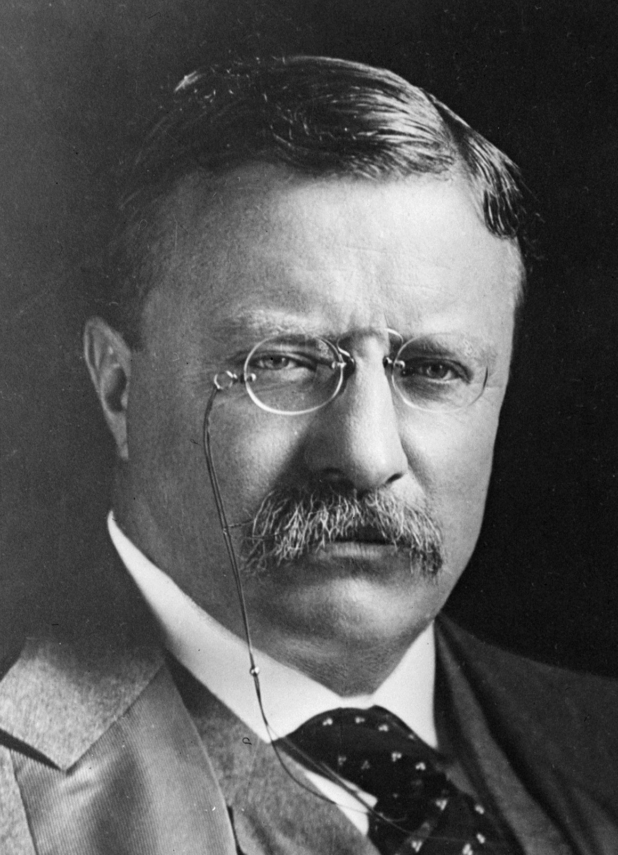
6:20-49
Teddy Roosevelt (1858-1919) ~ “There has never yet been a man in our history who led a life of ease whose name is worth remembering.”

Slide 33
6:20-49

