Slide 1
6:1-19

Slide 2
6:1-19
Acts 2:38b ~ Repent, and let every one of you be baptized in the name of Jesus Christ for the remission of sins; and you shall receive the gift of the Holy Spirit.

Slide 3
6:1-19

Slide 4
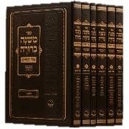
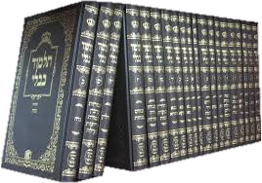
6:1-19
Gemara ~ Commentary on the Mishnah
Mishnah ~ Oral tradition
Mishnah
(c. 220 BC-AD 135)
Gemara
(AD 350-400)
Talmud
63 treatises; 517 chapters

Slide 5
6:1-19

Slide 6
6:1-19
Deut. 23:24-25 ~ ²⁴ When you come into your neighbor’s vineyard, you may eat your fill of grapes at your pleasure, but you shall not put any in your container. ²⁵ When you come into your neighbor’s standing grain, you may pluck the heads with your hand, but you shall not use a sickle on your neighbor’s standing grain.

Slide 7
6:1-19
Deut. 25 ~ 1-3 ~ ¹ If there is a dispute between men, and they come to court, that the judges may judge them, and they justify the righteous and condemn the wicked, ² then it shall be, if the wicked man deserves to be beaten, that the judge will cause him to lie down and be beaten in his presence, according to his guilt, with a certain number of blows. ³ Forty blows he may give him and no more, lest he should exceed this and beat him with many blows
above these, and your brother be
humiliated in your sight.

Slide 8
6:1-19
Mishnah, Shabbath 7:2 ~ the 40 minus 1
Sowing
Plowing
Reaping
Binding sheaves
Threshing
Winnowing
Selecting
Grinding
Sifting
Kneading
Baking
12. Shearing wool
13. Bleaching
14. Hackling
15. Dyeing
16. Spinning
17. Weaving
18. The making
of two loops
19. Weaving two threads
20. Dividing two threads
21. Tying and
22. Untying
23. Sewing two stitches
24. Tearing in order to sew two stitches
25. Capturing a deer
26. Slaughtering
27. Flaying or
28. Salting it
29. Curing its hide
30. Scraping it (of its hair)
31. Cutting it up
32. Writing two letters
33. Erasing in order to write two
letters (over the erasure)
34. Building
35. earing down
36. Extinguishing
37. Kindling,
38. Striking with a hammer (and)
39. Carrying out
from one domain to another

Slide 9
6:1-19
Statement of Faith: “We believe that the 1st of the week is the Lord’s Day or Christian Sabbath; and is to be kept sacred to religious purposes, by abstaining from all secular labor and sinful recreations.”
Sabbath ~ (Dictionary of Biblical Languages with Semantic Domains): The seventh day of the Jewish week, ceremonial day of rest; known in our culture as Saturday

Slide 10
6:1-19
Statement of Faith: “We believe that the 1st of the week is the Lord’s Day or Christian Sabbath; and is to be kept sacred to religious purposes, by abstaining from all secular labor and sinful recreations.”
Ravi Zacharias ~ “We are all priests before God, there is no such distinction as ‘secular or sacred.’ In fact, the opposite of sacred is not secular; the opposite of sacred is profane. In short, no follower of Christ does secular work. We all have
a sacred calling.”

Slide 11
6:1-19
Statement of Faith: “We believe that the 1st of the week is the Lord’s Day or Christian Sabbath; and is to be kept sacred to religious purposes, by abstaining from all secular labor and sinful recreations.”
1 Cor. 10:31b ~ whatever you do, do all to the glory of God.

Slide 12
6:1-19
Statement of Faith: “We believe that the 1st of the week is the Lord’s Day or Christian Sabbath; and is to be kept sacred to religious purposes, by abstaining from all secular labor and sinful recreations.”
Sinful recreations are OK the other 6 days?

Slide 13
6:1-19

Slide 14
6:1-19
watched ~ paratēreō – to watch over intensely
Wuest ~ the Pharisees were standing by on guard, carefully observing for themselves whether on the sabbath He is going to be healing, in order that they might find some accusation which they could prefer against Him in court.
accusation ~ katēgoria (category)

Slide 15
6:1-19

Slide 16
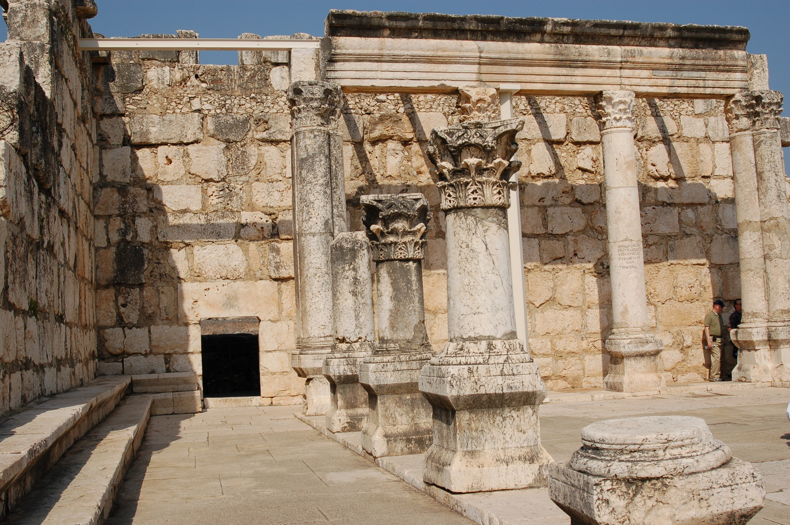
6:1-19
KJV ~ in the midst
NIV ~ stand in front of everyone

Slide 17
6:1-19

Slide 18
6:1-19
Mark 3:5 ~ And when He had looked around at them with anger,

Slide 19
6:1-19

Slide 20
6:1-19
filled with rage ~ anoia, literally, without mind
KJV ~ madness

Slide 21
6:1-19
Justin Martyr (c. AD 100 – c. AD 165), Dialogues 12:3 ~ “The new law requires you to keep perpetual Sabbath, and you, because you are idle for one day, suppose you are pious … The Lord God does not take pleasure in such observances, if there is any perjured person or thief among you, let him cease to be so; if any adulterer, let him repent; then he has kept the sweet and true sabbaths of God. If anyone has
impure hands, let him wash
and be pure.”

Slide 22
6:1-19

Slide 23
6:1-19
Matt. 10:2-4
Mark 3:14-19
Luke 6:12-16
1.
Simon
Simon
Simon
2.
Andrew
James
Andrew
3.
James
John
James
4.
John
Andrew
John
5.
Philip
Philip
Philip
6.
Bartholomew
Bartholomew
Bartholomew
7.
Thomas
Matthew
Matthew
8.
Matthew
Thomas
Thomas
9.
James (Alphaeus)
James (Alphaeus)
James (Alphaeus)
10.
Lebbaeus
Thaddaeus
Simon (Zealot)
11.
Simon (Canaanite)
Simon (Canaanite)
Judas (of James)
12.
Judas Iscariot
Judas Iscariot
Judas Iscariot

Slide 24
6:1-19
=
=
Lebbaeus
Thaddaeus
Judas (of James)

Slide 25
6:1-19

Slide 26
6:1-19
Sermon on the Mount/Sermon on the Plain
Similarities
Great multitudes
Similar content
Disimilarities
Matt. ~ 9 Beatitudes; Luke ~ 4 Beatitudes
Matt. ~ “on a “mountain”; Luke ~ “on a level place”

Slide 27
6:1-19

Slide 28
6:1-19
Heb. 4:10-11 ~ ¹⁰ For he who has entered His rest has himself also ceased from his works as God did from His.
¹¹ Let us therefore be diligent to enter that rest, lest anyone fall according to the same example of disobedience.
KJV ~ Let us labor therefore to enter into that rest,

Slide 29
6:1-19

