Slide 1

1:1-38

Slide 2

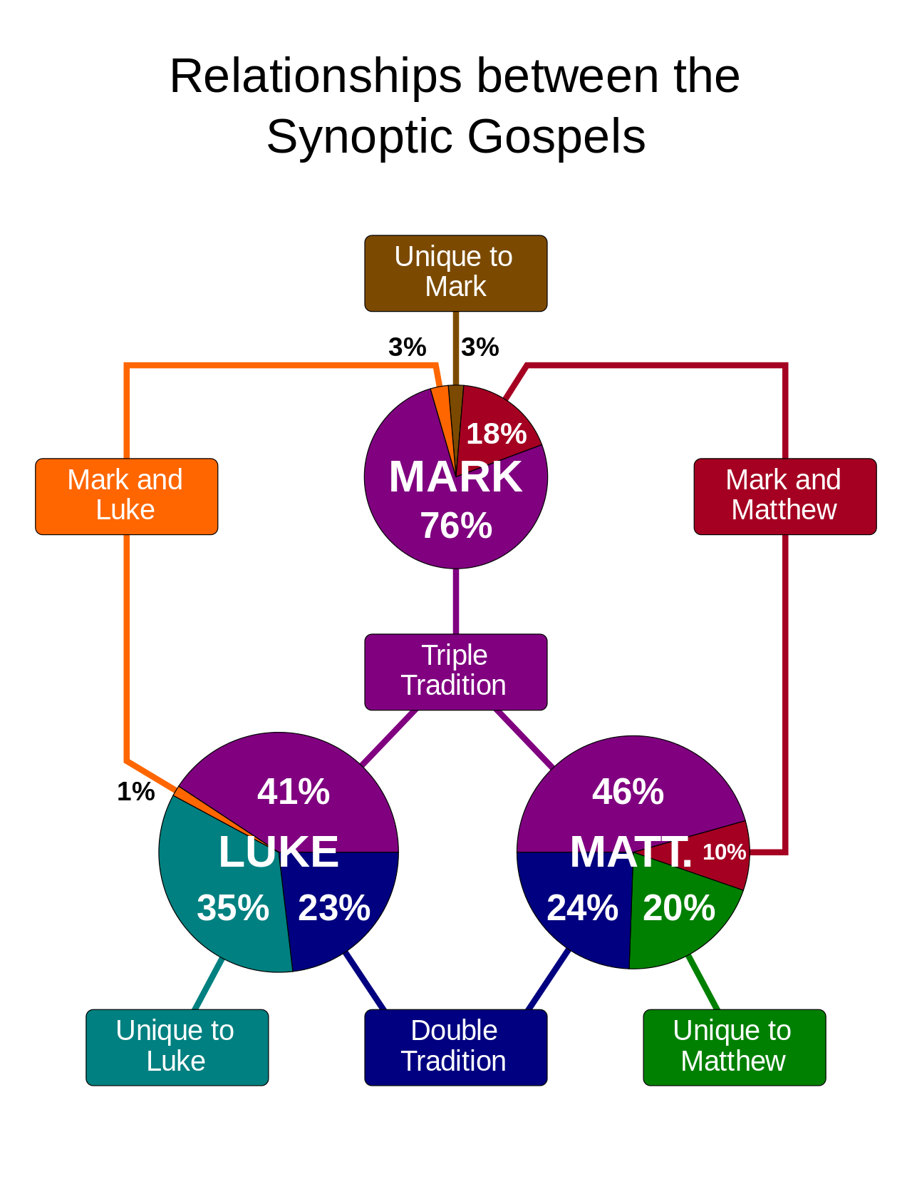
1:1-38
Synoptic ~ “to see together”

Slide 3

1:1-38
Matthew (AD 55-65) ~ King
“Synoptic Gospels”
to view together
Mark (AD 45-55) ~ Servant
Luke (AD 60-65) ~ Man
John (AD 90-95*) ~ God
AD 50
AD 55
AD 60
AD 65
AD 70
AD 75
AD 80
AD 85
AD 90
* Possibly much earlier ~ AD 45-66
Dating of the
4 Gospels

Slide 4
1:1-38
Luke
27.5%
All others
(8 or 9 authors)
72.5%

Slide 5

1:1-38

Slide 6
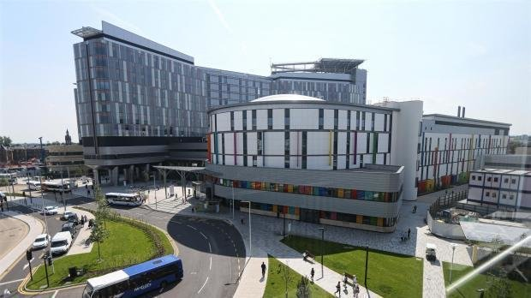
1:1-38
1. The patient was in his usual state of good health until his airplane ran out of fuel and crashed.
2. On the second day the knee was better and on the third day, it disappeared altogether.
3. While in ER, Eva was examined,
x-rated and sent home.
4. Discharge status: Alive, but without my permission.
NHS Greater Glasgow and Clyde

Slide 7
1:1-38
5. The patient has been depressed since she began seeing me in 1993.
6. Patient has two teenage children, but no other abnormalities.
7. Patient has chest pain if she lies on her left side for over a year.
NHS Greater Glasgow and Clyde

Slide 8
1:1-38

Slide 9
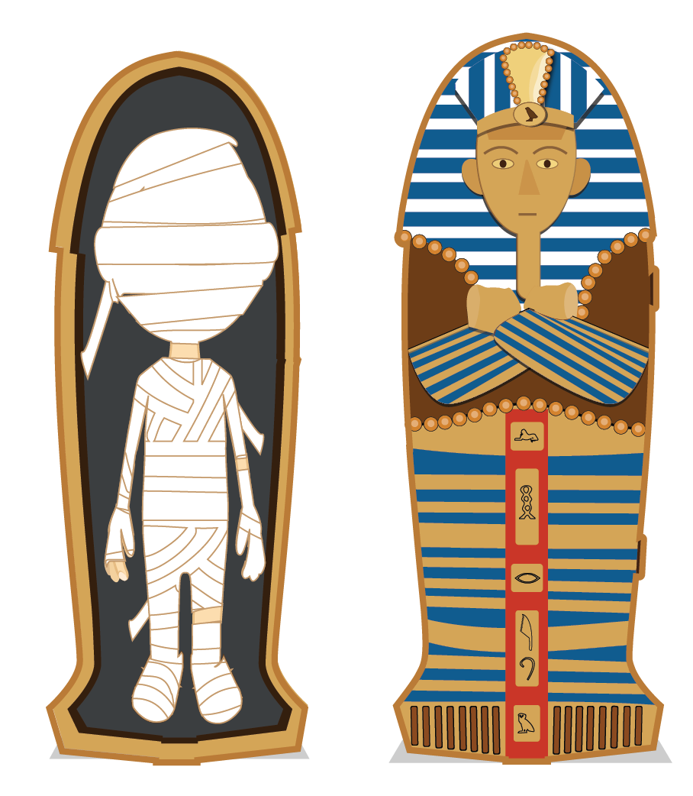

1:1-37
10,000 shekels on Goliath

Slide 10
1:1-38

Slide 11
1:1-38
Theophilus (v. 3) ~ lover of God
eyewitnesses (v. 2) ~ autoptēs – autopsy (“to see for oneself”)
instructed ~ katēcheō – “catechism” (kata, according to + ēchos, sound – “echo”)

Slide 12
1:1-38

Slide 13
1:1-38
Mal. 3:1a ~ “Behold, I send My messenger, and he will prepare the way before Me.”
Mal. 4:5-6 ~ “Behold, I will send you Elijah the prophet before the coming of the great and dreadful day of the Lord. And he will turn the hearts of the fathers to the children, and the hearts of the children to their fathers, lest I come and strike the earth with a curse.”

Slide 14
1:1-38

Slide 15
1:1-38
Method 1
Course of Abijah
Birth of Jesus
Birth of John
Mar
Apr
May
Jun
Jul
Aug
Sep
Oct
Nov
Dec
Jan
Feb
Mar
Nisan
Iyar
Sivan
Tammuz
Av
Elul
Tishri
Heshvan
Chislev
Tevet
Shevat
Adar
1 Chron. 24:1-18

Slide 16
1:1-38
Method 1
Course of Abijah
Birth of Jesus
Birth of John
Mar
Apr
May
Jun
Jul
Aug
Sep
Oct
Nov
Dec
Jan
Feb
Mar
Nisan
Iyar
Sivan
Tammuz
Av
Elul
Tishri
Heshvan
Chislev
Tevet
Shevat
Adar
Birth of John
Course of Jehoiarib
Birth of Jesus
Method 2
1 Chron. 24:1-18

Slide 17
1:1-38
Method 1
Course of Abijah
Birth of Jesus
Birth of John
Mar
Apr
May
Jun
Jul
Method 3
Aug
Sep
Oct
Nov
Dec
Jan
Feb
Mar
Jan. 1-Dec. 31
Nisan
Iyar
Sivan
Tammuz
Av
Elul
Tishri
Heshvan
Chislev
Tevet
Shevat
Adar
Birth of John
Course of Jehoiarib
Birth of Jesus
Method 2
1 Chron. 24:1-18

Slide 18
1:1-38
Zacharias = Yahweh remembers
Elizabeth = God’s oath
400 BC
300 BC
200 BC
100 BC
BC/AD
Over 400 years
Malachi
Birth of John

Slide 19
1:1-38

Slide 20
1:1-38
Between 18,000 – 20,000 priests per year

Slide 21
1:1-38

Slide 22
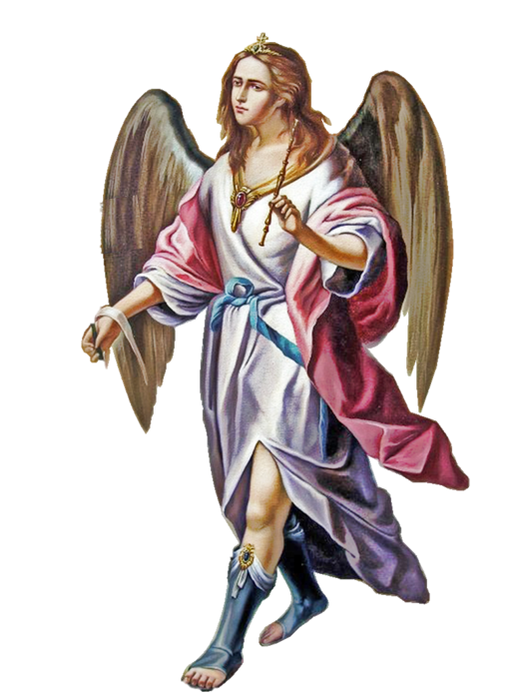
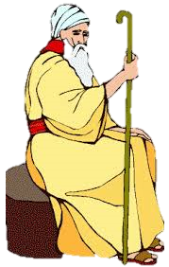
1:1-38
Don’t be afraid, Zach, your prayer is heard
Uhh, what prayer is that?

Slide 23
1:1-38

Slide 24
1:1-38
Matt. 7:7 ~ “Ask, and it will be given to you; seek, and you will find; knock, and it will be opened to you.”
ask and keep asking;
seek and keep seeking;
knock and keep knocking;

Slide 25
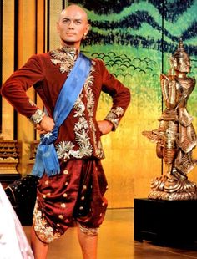
1:1-38
Etc., etc., etc.

Slide 26
1:1-38
John ~ Iōannēs – “Yahweh is a gracious giver”

Slide 27
1:1-38

Slide 28
1:1-38
Nazirite vow (Num. 6:1-21):
1. Not to ingest any part of the fruit of the vine
2. Not to cut hair
3. Not to touch a dead body

Slide 29
1:1-38

Slide 30
1:1-38
Matt. 11: 14 ~ “And if you are willing to receive it, he is Elijah who is to come.”
John 1:21 ~ And they asked him, “What then? Are you Elijah?”
He said, “I am not.”
2 Comings of Elijah
2 Comings of Jesus
~ Rev. 11:3-12

Slide 31
1:1-38

Slide 32
1:1-38
I am Gabriel*
Way!!!
No way!!!
* Gabriel ~ man of God

Slide 33
1:1-38

Slide 34
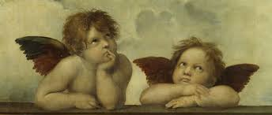
1:1-38

Slide 35
1:1-38

Slide 36
1:1-38
virgin ~ parthenos

Slide 37
1:1-38

Slide 38
1:1-38
Jesus ~ – Jehovah (Yahweh) is salvation
oshua
J
Jehoshua
eh

Slide 39
1:1-38

Slide 40
1:1-38
NKJV, NASB ~ How can this be?
Future tense
NIV, How will this be?
KJV, How shall this be?

Slide 41

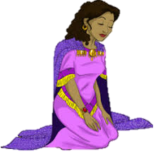
1:1-38
I know … high key, right?
Pretty cool, Gabe
Get out!!!
No way!!!

Slide 42
1:1-38
Eph. 1:3a ~ (He) has blessed us with every spiritual blessing in the heavenly places in Christ …
Heb 4:16 ~ (We can) come boldly before the throne of grace …
Eph. 1:7 ~ In Him we have redemption through His blood,
2 Cor. 5:21 ~ (We have) the righteousness of God in (Christ Jesus)
Eph 2:6 ~ and raised us up together, and made us sit together in the heavenly places in Christ Jesus,

Slide 43
1:1-38
2 Pet. 1:3 ~ as His divine power has given to us all things that pertain to life and godliness…
Heb. 13:5 ~ “I will never leave you nor forsake you.”

Slide 44

1:1-38
Infinity

Slide 45
1:1-38

