Slide 1
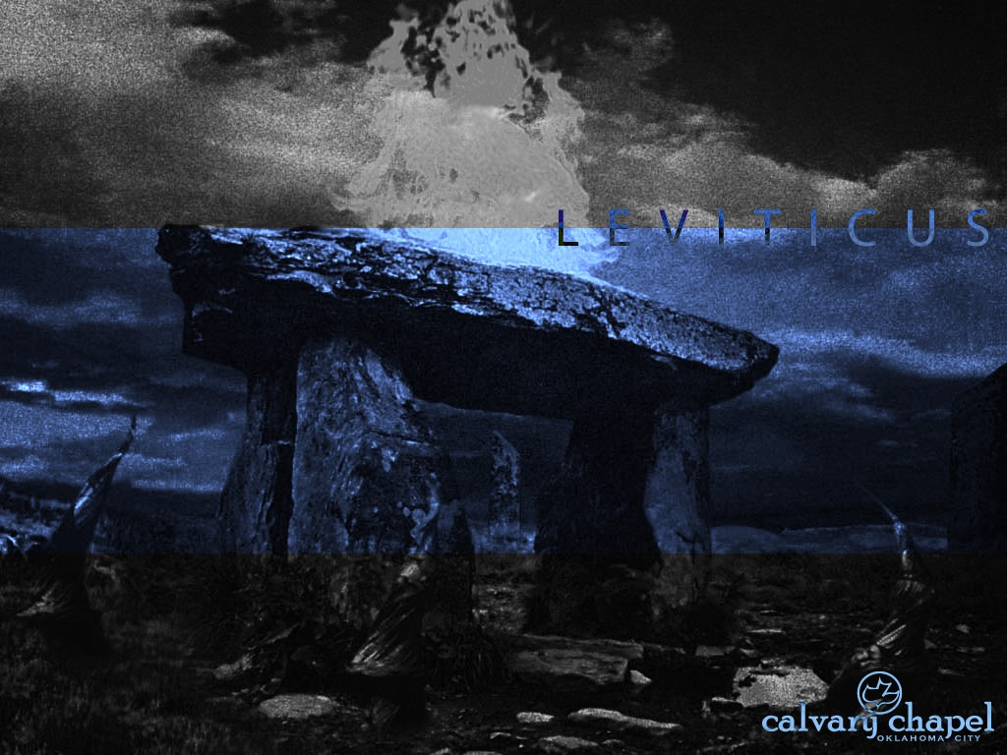
L E V I T I C U S
A CD OF THIS MESSAGE WILL BE AVAILABLE IMMEDIATELY FOLLOWING THE SERVICE
2 5 : 1 – 2 7 : 3
It will also be available for podcast later this week at calvaryokc.com

Slide 2
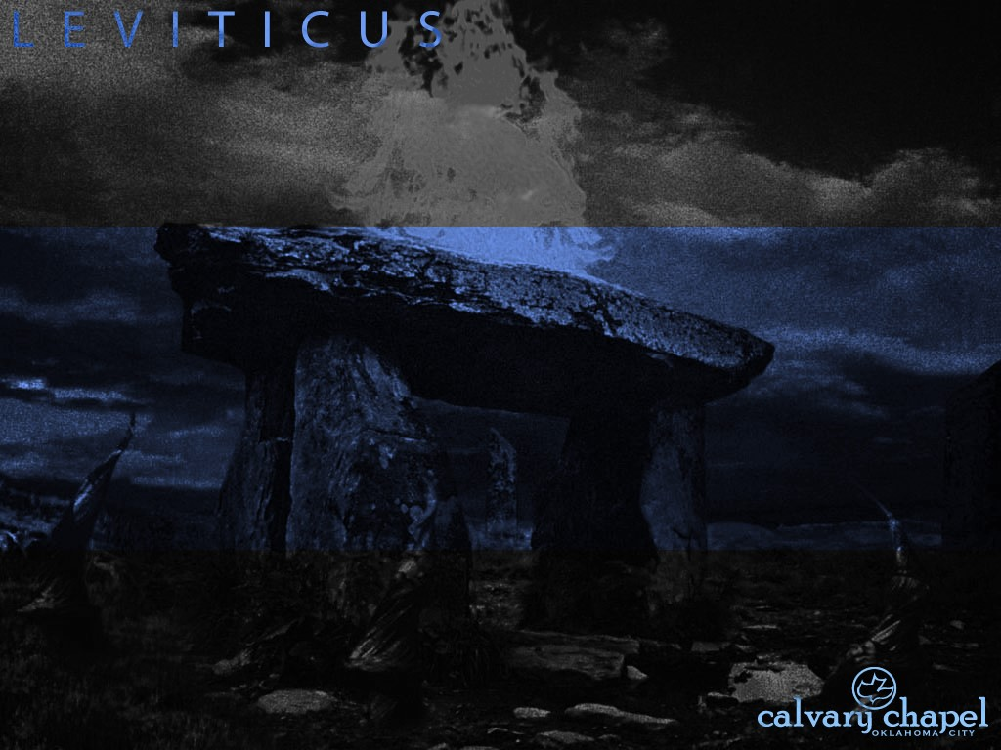
3 : 1 – 4 : 3 5
L E V I T I C U S 2 5 : 1 – 2 7 : 3 4
Land ~ 45x in chapters 25-27

Slide 3
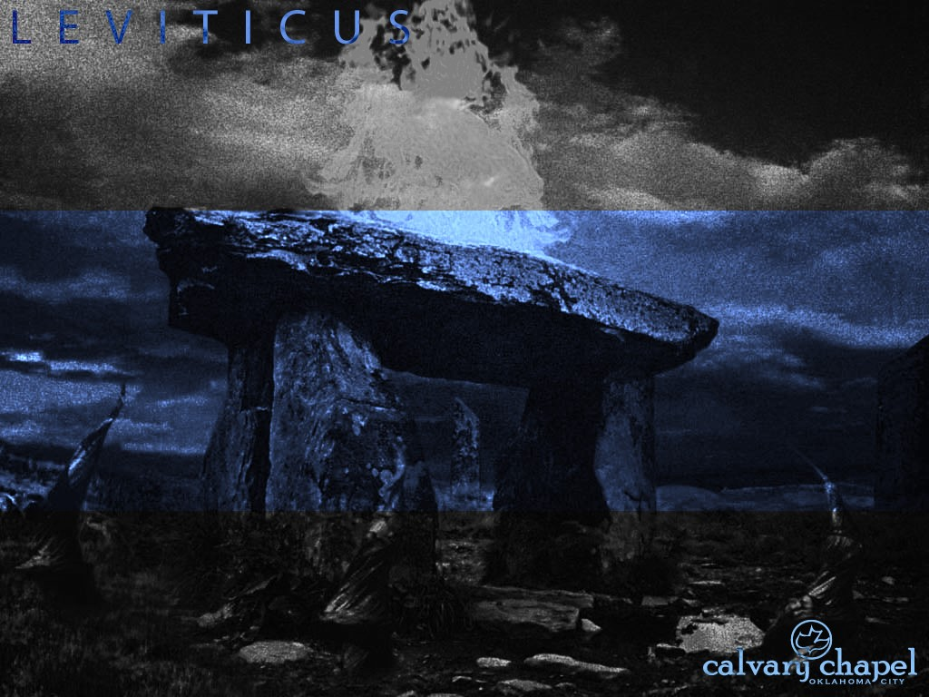
3 : 1 – 4 : 3 5
L E V I T I C U S 2 5 : 1 – 2 7 : 3 4

Slide 4
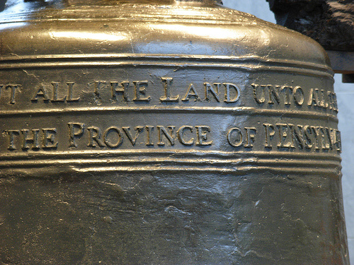
3 : 1 – 4 : 3 5
L E V I T I C U S 2 5 : 1 – 2 7 : 3 4
Jubilee ~yobēl – ram's horn

Slide 5
3 : 1 – 4 : 3 5
L E V I T I C U S 2 5 : 1 – 2 7 : 3 4
49 years
1
2
3
4
5
6
7
7 years
7 years
7 years
7 years
7 years
7 years
7 years
70 shekels
10 shekels

Slide 6
3 : 1 – 4 : 3 5
L E V I T I C U S 2 5 : 1 – 2 7 : 3 4

Slide 7
3 : 1 – 4 : 3 5
L E V I T I C U S 2 5 : 1 – 2 7 : 3 4
Redeeming relative ~ literally, near
NASB, nearest kinsman
gō'ēl

Slide 8
3 : 1 – 4 : 3 5
L E V I T I C U S 2 5 : 1 – 2 7 : 3 4

Slide 9
3 : 1 – 4 : 3 5
L E V I T I C U S 2 5 : 1 – 2 7 : 3 4
KJV ~ be waxen poor and fallen in decay with thee

Slide 10
3 : 1 – 4 : 3 5
L E V I T I C U S 2 5 : 1 – 2 7 : 3 4

Slide 11
3 : 1 – 4 : 3 5
L E V I T I C U S 2 5 : 1 – 2 7 : 3 4
Usury ~ neshek – from a root meaning to bite or to vex
From Middle English to use
1: archaic : interest
2: the lending of money with an interest charge for its use; especially: the lending of money at exorbitant interest rates
Holman Bible Dictionary ~ “The amount of money charged for a loan”

Slide 12
3 : 1 – 4 : 3 5
L E V I T I C U S 2 5 : 1 – 2 7 : 3 4

Slide 13
3 : 1 – 4 : 3 5
L E V I T I C U S 2 5 : 1 – 2 7 : 3 4
Idols ~ Hebrew, "nothings"

Slide 14
3 : 1 – 4 : 3 5
L E V I T I C U S 2 5 : 1 – 2 7 : 3 4

Slide 15
3 : 1 – 4 : 3 5
L E V I T I C U S 2 5 : 1 – 2 7 : 3 4
2 months of threshing
2 months of harvesting
Mar
Apr
May
Jun
Jul
Aug
Sep
Oct
Nov
Dec
Jan
Feb
Mar
Nisan
Iyar
Sivan
Tammuz
Av
Elul
Tishri
Heshvan
Chislev
Tevet
Shevat
Adar
Grain Harvest
Grape Harvest
Sowing Time

Slide 16
3 : 1 – 4 : 3 5
L E V I T I C U S 2 5 : 1 – 2 7 : 3 4

Slide 17
3 : 1 – 4 : 3 5
L E V I T I C U S 2 5 : 1 – 2 7 : 3 4
“I'll give you two choices:”
1. We can do it My way
2. We can do it My way

Slide 18
3 : 1 – 4 : 3 5
L E V I T I C U S 2 5 : 1 – 2 7 : 3 4

Slide 19
3 : 1 – 4 : 3 5
L E V I T I C U S 2 5 : 1 – 2 7 : 3 4
KJV ~ terror, consumption and the burning ague

Slide 20
3 : 1 – 4 : 3 5
L E V I T I C U S 2 5 : 1 – 2 7 : 3 4

Slide 21
3 : 1 – 4 : 3 5
L E V I T I C U S 2 5 : 1 – 2 7 : 3 4
Jer. 25:11-12 ~ ¹¹ “And this whole land shall be a desolation and an astonishment, and these nations shall serve the king of Babylon seventy years.
¹² “Then it will come to pass, when seventy years are completed, that I will punish the king of Babylon and that nation, the land of the Chaldeans, for their iniquity,” says the Lord; “and I will make it a perpetual desolation.”

Slide 22
3 : 1 – 4 : 3 5
L E V I T I C U S 2 5 : 1 – 2 7 : 3 4
2 Chr. 36:20-21 ~ ²⁰ And those who escaped from the sword he carried away to Babylon, where they became servants to him and his sons until the rule of the kingdom of Persia, ²¹ to fulfill the word of the Lord by the mouth of Jeremiah, until the land had enjoyed her Sabbaths. As long as she lay desolate she kept Sabbath, to fulfill seventy years.

Slide 23
3 : 1 – 4 : 3 5
L E V I T I C U S 2 5 : 1 – 2 7 : 3 4
Saul’s reign
1051-1011 BC
Cyrus’ decree
538 BC
1000
900
800
700
600
490 years

Slide 24
3 : 1 – 4 : 3 5
L E V I T I C U S 2 5 : 1 – 2 7 : 3 4

Slide 25
3 : 1 – 4 : 3 5
L E V I T I C U S 2 5 : 1 – 2 7 : 3 4
Accept their guilt
1. Without making excuses
2. Accepting the consequences

Slide 26
3 : 1 – 4 : 3 5
L E V I T I C U S 2 5 : 1 – 2 7 : 3 4

Slide 27
3 : 1 – 4 : 3 5
L E V I T I C U S 2 5 : 1 – 2 7 : 3 4
Eccl. 5:2 ~ Do not be rash with your mouth, and let not your heart utter anything hastily before God.
Prov. 20:25 ~ It is a snare for a man to devote rashly something as holy, and afterward to reconsider his vows.

Slide 28
3 : 1 – 4 : 3 5
L E V I T I C U S 2 5 : 1 – 2 7 : 3 4

Slide 29
3 : 1 – 4 : 3 5
L E V I T I C U S 2 5 : 1 – 2 7 : 3 4
Eccl. 5:4-6 ~ ⁴ When you make a vow to God, do not delay to pay it;
For He has no pleasure in fools.
Pay what you have vowed—
⁵ Better not to vow than to vow and not pay.
⁶ Do not let your mouth cause your flesh to sin, nor say before the messenger of God that it was an error. Why should God be angry at your excuse and destroy the work of your hands?

Slide 30
3 : 1 – 4 : 3 5
L E V I T I C U S 2 5 : 1 – 2 7 : 3 4

