Slide 1
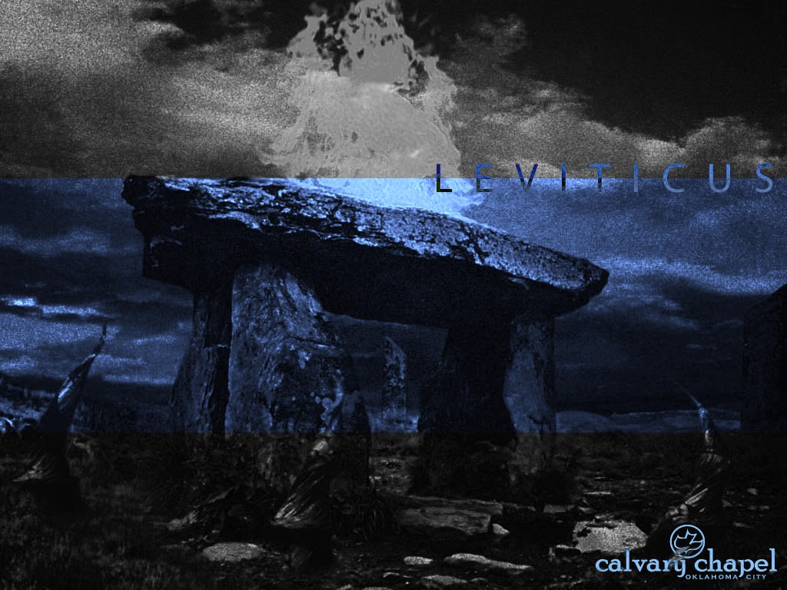
L E V I T I C U S
A CD OF THIS MESSAGE WILL BE AVAILABLE IMMEDIATELY FOLLOWING THE SERVICE
2 3 : 1 – 2 4 : 2 3
It will also be available for podcast later this week at calvaryokc.com

Slide 2
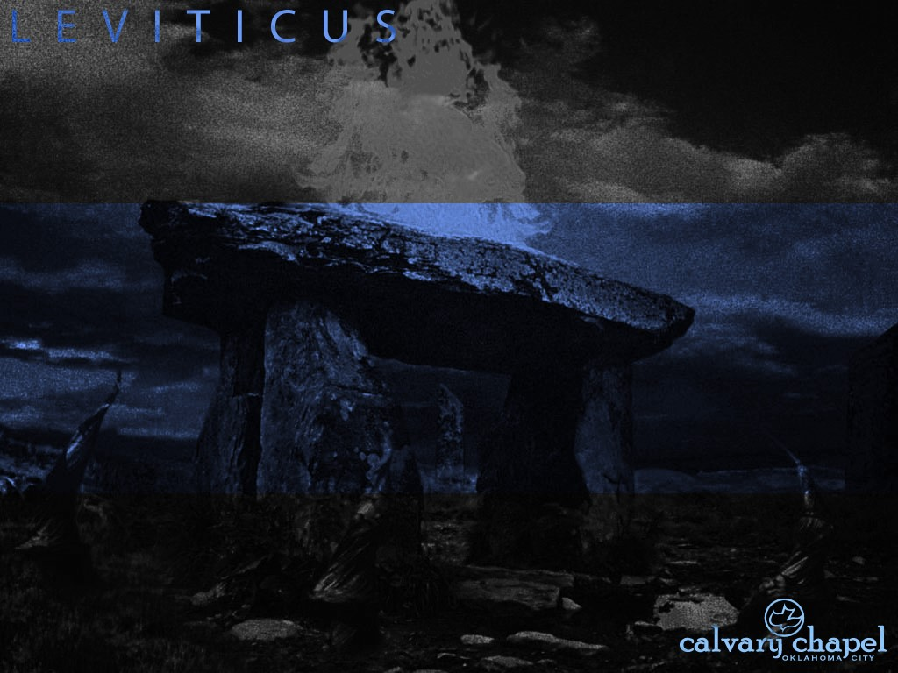
3 : 1 – 4 : 3 5
L E V I T I C U S 2 3 : 1 – 2 4 : 2 3
Holy convocation ~ qodesh mikrah
NIV ~ sacred assemblies
mikrah alone means holy convocation

Slide 3
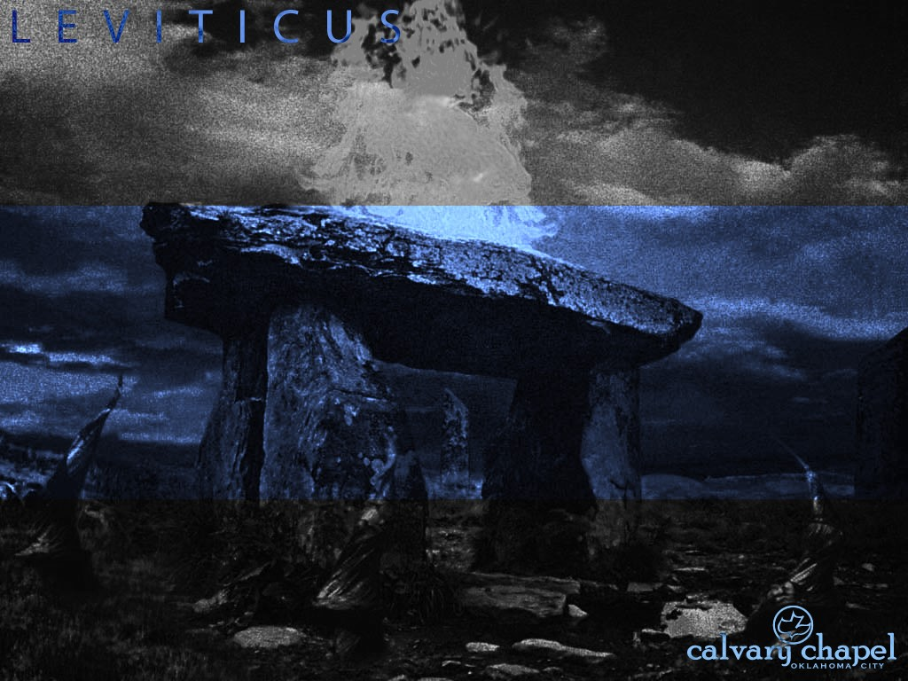
3 : 1 – 4 : 3 5
L E V I T I C U S 2 3 : 1 – 2 4 : 2 3

Slide 4
3 : 1 – 4 : 3 5
L E V I T I C U S 2 3 : 1 – 2 4 : 2 3
Passover, Nisan 14 ~ Jesus' death

Slide 5
3 : 1 – 4 : 3 5
L E V I T I C U S 2 3 : 1 – 2 4 : 2 3

Slide 6
3 : 1 – 4 : 3 5
L E V I T I C U S 2 3 : 1 – 2 4 : 2 3
Unleavened bread, Nisan 15-21 ~ our fellowship based on His sinlessness

Slide 7
3 : 1 – 4 : 3 5
L E V I T I C U S 2 3 : 1 – 2 4 : 2 3

Slide 8
3 : 1 – 4 : 3 5
L E V I T I C U S 2 3 : 1 – 2 4 : 2 3
Firstfruits, 1st Sunday after Passover ~ Christ's Resurrection

Slide 9
3 : 1 – 4 : 3 5
L E V I T I C U S 2 3 : 1 – 2 4 : 2 3

Slide 10
3 : 1 – 4 : 3 5
L E V I T I C U S 2 3 : 1 – 2 4 : 2 3
Trumpets, Tishri 1, Regathering of Israel

Slide 11
3 : 1 – 4 : 3 5
L E V I T I C U S 2 3 : 1 – 2 4 : 2 3

Slide 12
3 : 1 – 4 : 3 5
L E V I T I C U S 2 3 : 1 – 2 4 : 2 3
Is. 27:13 ~ So it shall be in that day:
The great trumpet will be blown;
They will come, who are about to perish in the land of Assyria,
And they who are outcasts in the land of Egypt,
And shall worship the LORD in the holy mount at Jerusalem

Slide 13
3 : 1 – 4 : 3 5
L E V I T I C U S 2 3 : 1 – 2 4 : 2 3

Slide 14
3 : 1 – 4 : 3 5
L E V I T I C U S 2 3 : 1 – 2 4 : 2 3
Day of Atonement, Tishri 10 ~ Jesus' work on the Cross

Slide 15
3 : 1 – 4 : 3 5
L E V I T I C U S 2 3 : 1 – 2 4 : 2 3

Slide 16
3 : 1 – 4 : 3 5
L E V I T I C U S 2 3 : 1 – 2 4 : 2 3
Tabernacles, Tishri 15-22, Jesus "tabernacling" with men

Slide 17
3 : 1 – 4 : 3 5
L E V I T I C U S 2 3 : 1 – 2 4 : 2 3

Slide 18
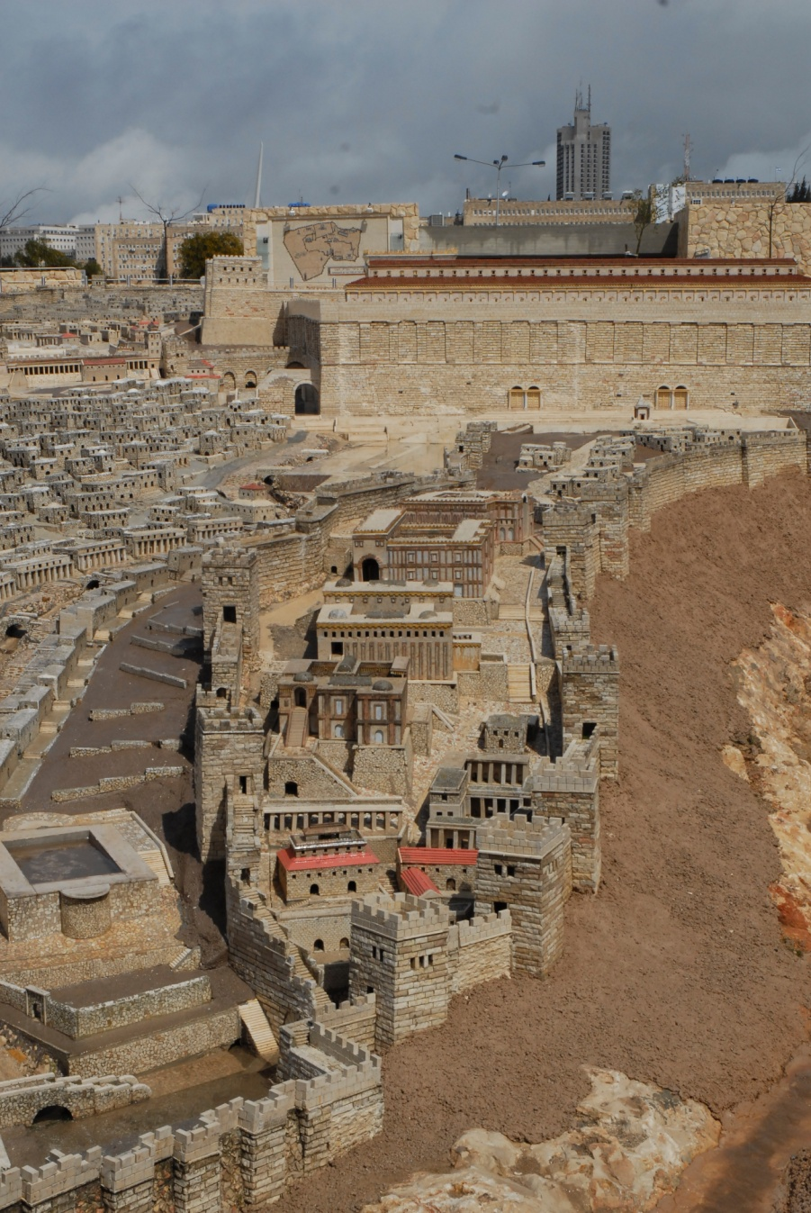
3 : 1 – 4 : 3 5
L E V I T I C U S 2 3 : 1 – 2 4 : 2 3
Pool of Siloam

Slide 19
3 : 1 – 4 : 3 5
L E V I T I C U S 2 3 : 1 – 2 4 : 2 3
John 7:37-39 ~ ³⁷ On the last day, that great day of the feast, Jesus stood and cried out, saying, “If anyone thirsts, let him come to Me and drink. ³⁸ He who believes in Me, as the Scripture has said, out of his heart will flow rivers of living water.” ³⁹ But this He spoke concerning the Spirit, whom those believing in Him would receive; for the Holy Spirit was not yet given, because Jesus was not yet glorified.

Slide 20
3 : 1 – 4 : 3 5
L E V I T I C U S 2 3 : 1 – 2 4 : 2 3

Slide 21
3 : 1 – 4 : 3 5
L E V I T I C U S 2 3 : 1 – 2 4 : 2 3
Zech. 14:16-19 ~ ¹⁶ And it shall come to pass that everyone who is left of all the nations which came against Jerusalem shall go up from year to year to worship the King, the Lord of hosts, and to keep the Feast of Tabernacles. ¹⁷ And it shall be that whichever of the families of the earth do not come up to Jerusalem to worship the King, the Lord of hosts, on them there will be no rain. ¹⁸ If the family of Egypt will not come up and enter in,

Slide 22
3 : 1 – 4 : 3 5
L E V I T I C U S 2 3 : 1 – 2 4 : 2 3
they shall have no rain; they shall receive the plague with which the Lord strikes the nations who do not come up to keep the Feast of Tabernacles. ¹⁹ This shall be the punishment of Egypt and the punishment of all the nations that do not come up to keep the Feast of Tabernacles.

Slide 23
3 : 1 – 4 : 3 5
L E V I T I C U S 2 3 : 1 – 2 4 : 2 3
Rev. 21:3 ~ And I heard a loud voice from heaven saying, “Behold, the tabernacle of God is with men, and He will dwell with them, and they shall be His people. God Himself will be with them and be their God.

Slide 24
3 : 1 – 4 : 3 5
L E V I T I C U S 2 3 : 1 – 2 4 : 2 3

Slide 25
3 : 1 – 4 : 3 5
L E V I T I C U S 2 3 : 1 – 2 4 : 2 3
2. Unleavened Bread Nisan 15 (Remission)
6. Day of Atonement
Tishri 10 (Redemption)
4. Pentecost 49 days after Firstfruits (Regeneration)
1st Coming
Church Age
2nd Coming
Mar
Apr
May
Jun
Jul
Aug
Sep
Oct
Nov
Dec
Jan
Feb
Mar
Nisan
Iyar
Sivan
Tammuz
Av
Elul
Tishri
Heshvan
Chislev
Tevet
Shevat
Adar
3. Firstfruits Sunday after Passover (Resurrection)
7. Tabernacles
Tishri 15-22 (Residing)
1. Passover
Nisan 14 (Rest)
5. Trumpets
Tishri 1 (Rapture)

Slide 26
3 : 1 – 4 : 3 5
L E V I T I C U S 2 3 : 1 – 2 4 : 2 3
1. Unleavened Bread Nisan 15
4. Day of Atonement
Tishri 10
7. Purim
Adar 14
2. Pentecost 49
days after Firstfruits
6. Hanukkah
Chislev 25-Tevet 2
Mar
Apr
May
Jun
Jul
Aug
Sep
Oct
Nov
Dec
Jan
Feb
Mar
Nisan
Iyar
Sivan
Tammuz
Av
Elul
Tishri
Heshvan
Chislev
Tevet
Shevat
Adar
1. Firstfruits Sunday
after Passover
5. Tabernacles
Tishri 15-22
1. Passover
Nisan 14
3. Trumpets
Tishri 1

Slide 27
3 : 1 – 4 : 3 5
L E V I T I C U S 2 3 : 1 – 2 4 : 2 3

Slide 28
3 : 1 – 4 : 3 5
L E V I T I C U S 2 3 : 1 – 2 4 : 2 3
Ark
Veil
Table of Showbread
Outer Court
Golden Altar
Menorah
Bronze Laver
Bronze Altar
Holy of Holies
Holy Place

Slide 29
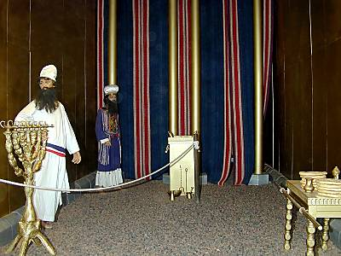
3 : 1 – 4 : 3 5
L E V I T I C U S 2 3 : 1 – 2 4 : 2 3

Slide 30
1 : 1 – 2 : 1 6
L E V I T I C U S 2 3 : 1 – 2 4 : 2 3

Slide 31
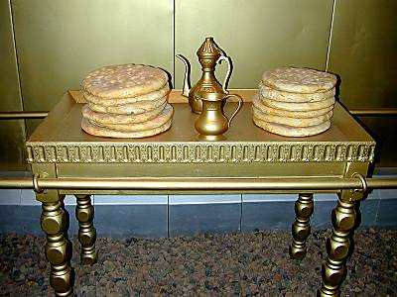
3 : 1 – 4 : 3 5
L E V I T I C U S 2 3 : 1 – 2 4 : 2 3

Slide 32
3 : 1 – 4 : 3 5
L E V I T I C U S 2 3 : 1 – 2 4 : 2 3

Slide 33
3 : 1 – 4 : 3 5
L E V I T I C U S 2 3 : 1 – 2 4 : 2 3
Disfigurement ~ KJV, blemish

Slide 34
1 : 1 – 2 : 1 6
L E V I T I C U S 2 3 : 1 – 2 4 : 2 3

Slide 35
3 : 1 – 4 : 3 5
L E V I T I C U S 2 3 : 1 – 2 4 : 2 3
Gen. 4:23-24 ~ ²³ "Adah and Zillah, hear my voice;
Wives of Lamech, listen to my speech!
For I have killed a man for wounding me,
Even a young man for hurting me.
²⁴ If Cain shall be avenged sevenfold,
Then Lamech seventy- sevenfold."

Slide 36
3 : 1 – 4 : 3 5
L E V I T I C U S 2 3 : 1 – 2 4 : 2 3

