Slide 1
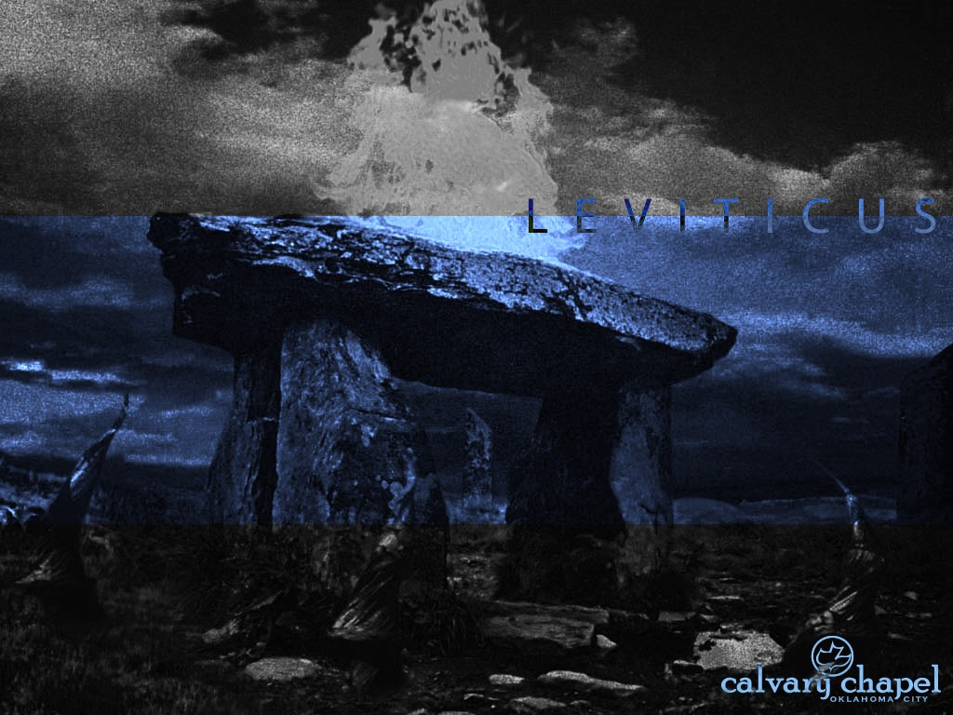
L E V I T I C U S
A CD OF THIS MESSAGE WILL BE AVAILABLE IMMEDIATELY FOLLOWING THE SERVICE
2 0 : 1 – 2 2 : 3 3
It will also be available for podcast later this week at calvaryokc.com

Slide 2
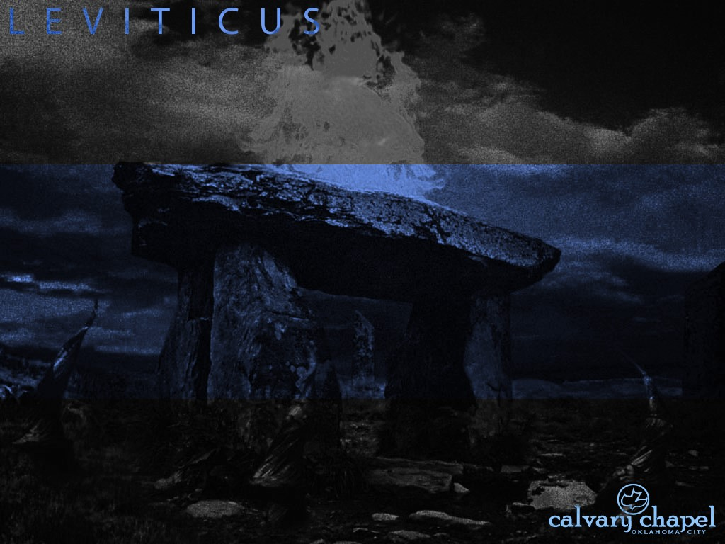
3 : 1 – 4 : 3 5
L E V I T I C U S 2 0 : 1 – 2 2 : 3 3

Slide 3
3 : 1 – 4 : 3 5
L E V I T I C U S 2 0 : 1 – 2 2 : 3 3
Capital Crimes of Israel:
1. Striking or cursing a parent (Ex. 21:15, 17)
2. Breaking the Sabbath (Ex. 31:14)
3. God (Lev. 24:10–16)
4. Practicing the occult (Ex. 22:18)
5. False prophesy (Deut. 13:1–5)
6. Adultery (Lev. 20:10)
7. Rape (Deut. 22:25)
8. Unchastity before marriage (vv. 13-24)

Slide 4
3 : 1 – 4 : 3 5
L E V I T I C U S 2 0 : 1 – 2 2 : 3 3
Capital Crimes of Israel:
9. Incest (Lev. 20:11–12)
10. Homosexuality (Lev. 20:13)
11. Bestiality (vv. 15–16)
12. Kidnapping (Ex. 21:16)
13. Idolatry (Lev. 20:1–5)
14. False witness in a capital crime (Deut. 19:16–21)
15. Murder (Ex. 21:12)

Slide 5
3 : 1 – 4 : 3 5
L E V I T I C U S 2 0 : 1 – 2 2 : 3 3
Acts 23:10-11 ~ ¹⁰ So Paul said, “I stand at Caesar's judgment seat, where I ought to be judged. To the Jews I have done no wrong, as you very well know. ¹¹ For if I am an offender, or have committed anything deserving of death, I do not object to dying; but if there is nothing in these things of which these men accuse me, no one can deliver me to them. I appeal to Caesar.”

Slide 6
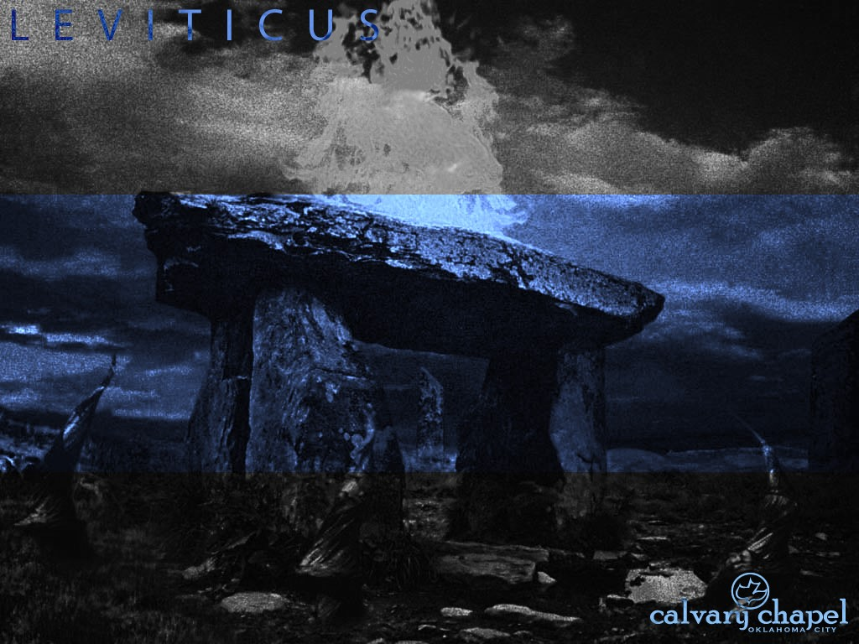
3 : 1 – 4 : 3 5
L E V I T I C U S 2 0 : 1 – 2 2 : 3 3

Slide 7
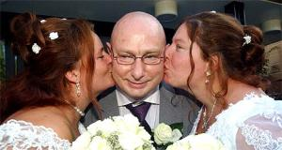
3 : 1 – 4 : 3 5
L E V I T I C U S 2 0 : 1 – 2 2 : 3 3
Victor (46) and his blushing "brides" Bianca (31) and Mijam (35)

Slide 8
3 : 1 – 4 : 3 5
L E V I T I C U S 2 0 : 1 – 2 2 : 3 3

Slide 9
3 : 1 – 4 : 3 5
L E V I T I C U S 2 0 : 1 – 2 2 : 3 3
Joe Focht ~ “God is more concerned about our ‘character’ than He is about our ‘reputation’ – what we are in private – what we are when no one’s watching.”

Slide 10
3 : 1 – 4 : 3 5
L E V I T I C U S 2 0 : 1 – 2 2 : 3 3

Slide 11
3 : 1 – 4 : 3 5
L E V I T I C U S 2 0 : 1 – 2 2 : 3 3
Matt. 26:65 ~ Then the high priest tore his clothes, saying, “He has spoken blasphemy! What further need do we have of witnesses? Look, now you have heard His blasphemy!”
1 Thess. 4:13 ~ But I do not want you to be ignorant, brethren, concerning those who have fallen asleep, lest you sorrow as others who have no hope.

Slide 12
3 : 1 – 4 : 3 5
L E V I T I C U S 2 0 : 1 – 2 2 : 3 3

Slide 13
3 : 1 – 4 : 3 5
L E V I T I C U S 2 0 : 1 – 2 2 : 3 3
Cattle ~ KJV, beeves

Slide 14
3 : 1 – 4 : 3 5
L E V I T I C U S 2 0 : 1 – 2 2 : 3 3

