Slide 1
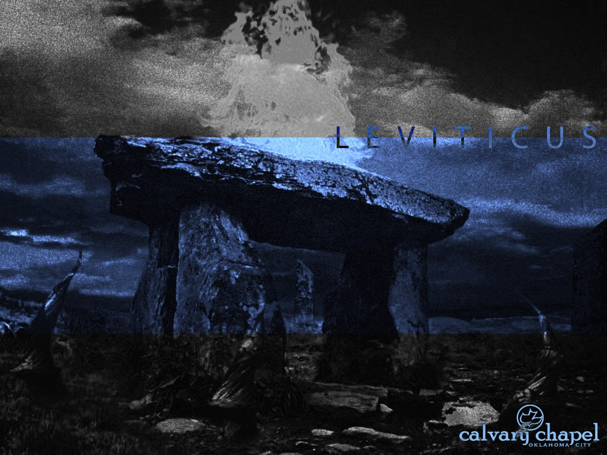
L E V I T I C U S
A CD OF THIS MESSAGE WILL BE AVAILABLE IMMEDIATELY FOLLOWING THE SERVICE
1 7 : 1 – 1 9 : 3 7
It will also be available for podcast later this week at calvaryokc.com

Slide 2
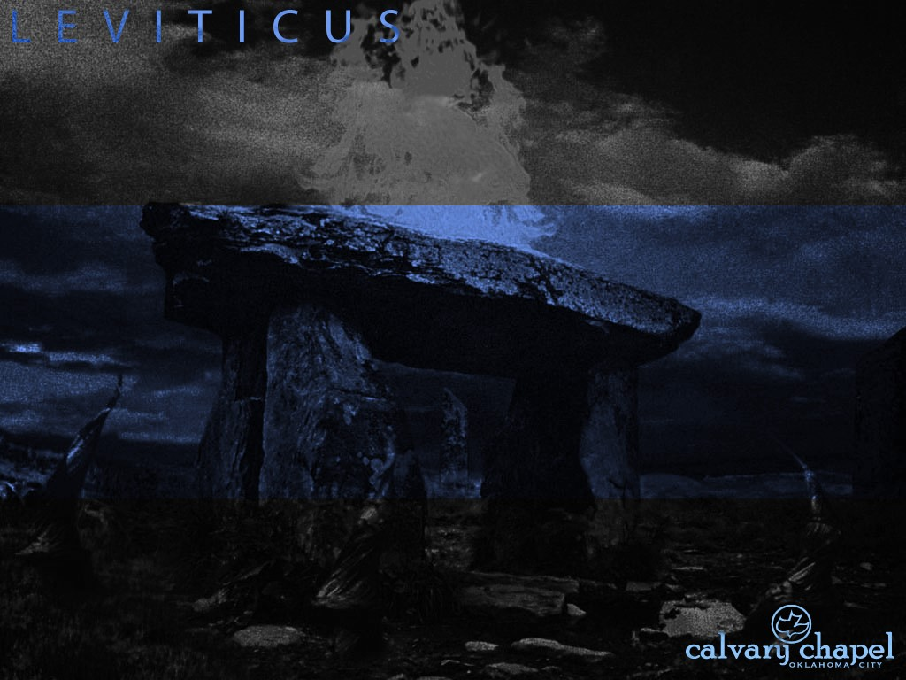
3 : 1 – 4 : 3 5
L E V I T I C U S 1 7 : 1 – 1 9 : 3 7
Kills (v. 3) ~ slaughters, NASB; sacrifices, NIV, NLT
Sometimes excommunication
Cut off (v. 4) ~
Sometimes
capital punishment
Usually determined by context

Slide 3
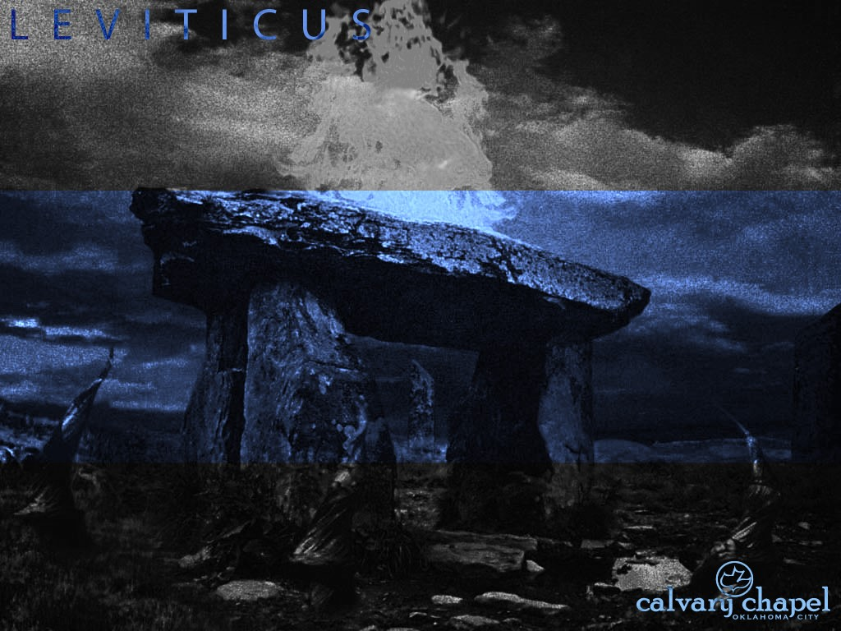
3 : 1 – 4 : 3 5
L E V I T I C U S 1 7 : 1 – 1 9 : 3 7

Slide 4
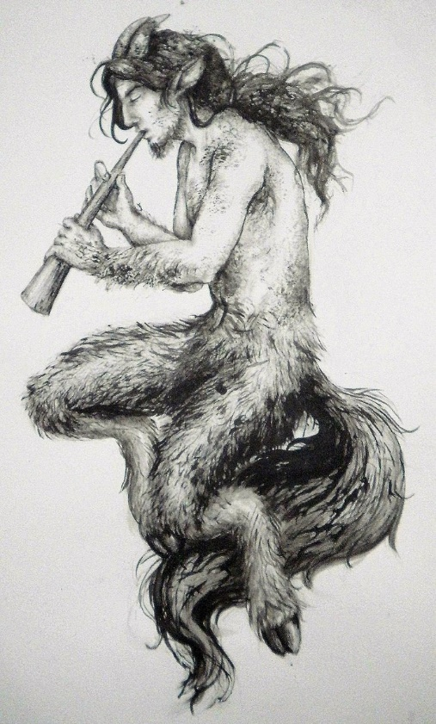
3 : 1 – 4 : 3 5
L E V I T I C U S 1 7 : 1 – 1 9 : 3 7
Demons ~ KJV, devils
NIV, NLT ~ goat idols
NASB ~ goat demons
Hebrew, sa`iyr ~ usually translated kid or goat
Satyr

Slide 5
3 : 1 – 4 : 3 5
L E V I T I C U S 1 7 : 1 – 1 9 : 3 7

Slide 6
3 : 1 – 4 : 3 5
L E V I T I C U S 1 7 : 1 – 1 9 : 3 7
Eating blood prohibited 7x in Pentateuch
1. Gen. 9:4
2. Lev. 3:17
3. Lev. 7:26-27
4. Lev. 17:10-14
5. Lev. 19:26
6. Deut. 12:15-16, 23-24
7. Deut. 15:24

Slide 7
3 : 1 – 4 : 3 5
L E V I T I C U S 1 7 : 1 – 1 9 : 3 7

Slide 8
3 : 1 – 4 : 3 5
L E V I T I C U S 1 7 : 1 – 1 9 : 3 7
Uncover … nakedness ~ NIV, have sexual relations

Slide 9
3 : 1 – 4 : 3 5
L E V I T I C U S 1 7 : 1 – 1 9 : 3 7

Slide 10
3 : 1 – 4 : 3 5
L E V I T I C U S 1 7 : 1 – 1 9 : 3 7
Exception: Deut. 25:5-10 (Levirate marriage)

Slide 11
3 : 1 – 4 : 3 5
L E V I T I C U S 1 7 : 1 – 1 9 : 3 7

Slide 12
3 : 1 – 4 : 3 5
L E V I T I C U S 1 7 : 1 – 1 9 : 3 7
KJV, confusion (only here and 20:12 ~ lying with daughter-in-law)
KJV, confusion (only here and 20:12)

Slide 13
3 : 1 – 4 : 3 5
L E V I T I C U S 1 7 : 1 – 1 9 : 3 7

Slide 14
3 : 1 – 4 : 3 5
L E V I T I C U S 1 7 : 1 – 1 9 : 3 7
I (am) the Lord your God
16x in this chapter
40x in 18-26

Slide 15
3 : 1 – 4 : 3 5
L E V I T I C U S 1 7 : 1 – 1 9 : 3 7

Slide 16
3 : 1 – 4 : 3 5
L E V I T I C U S 1 7 : 1 – 1 9 : 3 7
Mal. 1:8 ~ “And when you offer the blind as a sacrifice,
Is it not evil?
And when you offer the lame and sick,
Is it not evil?
Offer it then to your governor!
Would he be pleased with you?
Would he accept you favorably?”
Says the Lord of hosts.

Slide 17
3 : 1 – 4 : 3 5
L E V I T I C U S 1 7 : 1 – 1 9 : 3 7

Slide 18
3 : 1 – 4 : 3 5
L E V I T I C U S 1 7 : 1 – 1 9 : 3 7
Eph. 4:26b ~ “Be angry and do not sin”: do not let the sun go down on your wrath.
6PM
14.5 hr.
9.8 hr.
3PM
12PM
9AM
MAR
MAY
JUL
SEP
NOV

Slide 19
3 : 1 – 4 : 3 5
L E V I T I C U S 1 7 : 1 – 1 9 : 3 7

Slide 20
3 : 1 – 4 : 3 5
L E V I T I C U S 1 7 : 1 – 1 9 : 3 7
Scourging ~ NIV; NASB, punishment

Slide 21
3 : 1 – 4 : 3 5
L E V I T I C U S 1 7 : 1 – 1 9 : 3 7

Slide 22
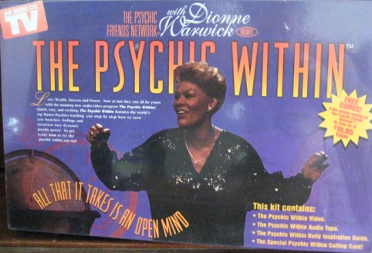
3 : 1 – 4 : 3 5
L E V I T I C U S 1 7 : 1 – 1 9 : 3 7
Bankrupt in 1998

Slide 23
3 : 1 – 4 : 3 5
L E V I T I C U S 1 7 : 1 – 1 9 : 3 7

Slide 24
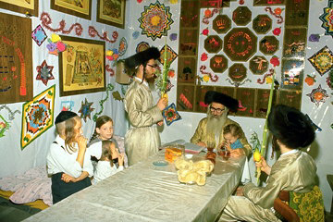
3 : 1 – 4 : 3 5
L E V I T I C U S 1 7 : 1 – 1 9 : 3 7
Shave around ~ KJV, you shall not round the corners of your head
payot

Slide 25
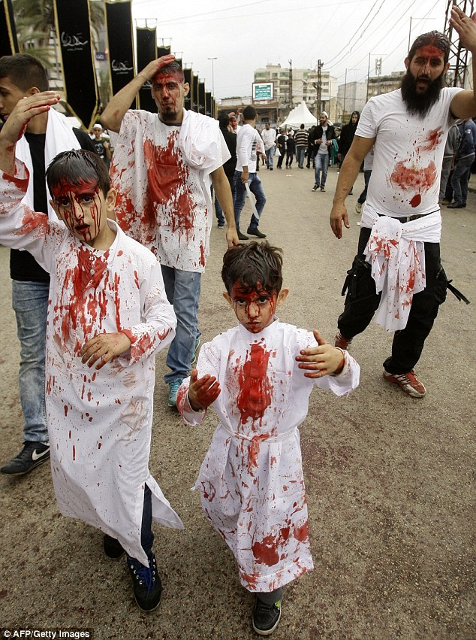
3 : 1 – 4 : 3 5
L E V I T I C U S 1 7 : 1 – 1 9 : 3 7
Ashura (Islamic day of atonement)

Slide 26
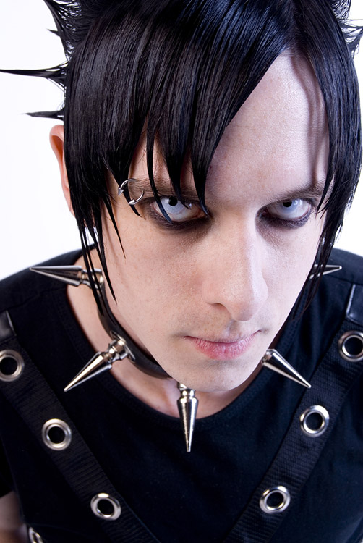

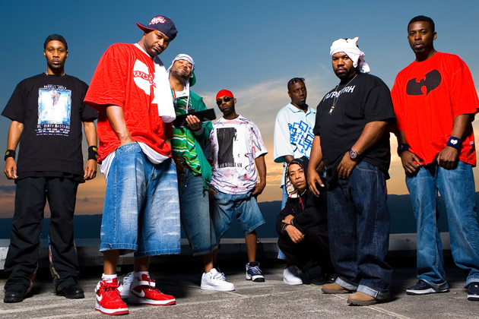
3 : 1 – 4 : 3 5
L E V I T I C U S 1 7 : 1 – 1 9 : 3 7

Slide 27
3 : 1 – 4 : 3 5
L E V I T I C U S 1 7 : 1 – 1 9 : 3 7

