Slide 1
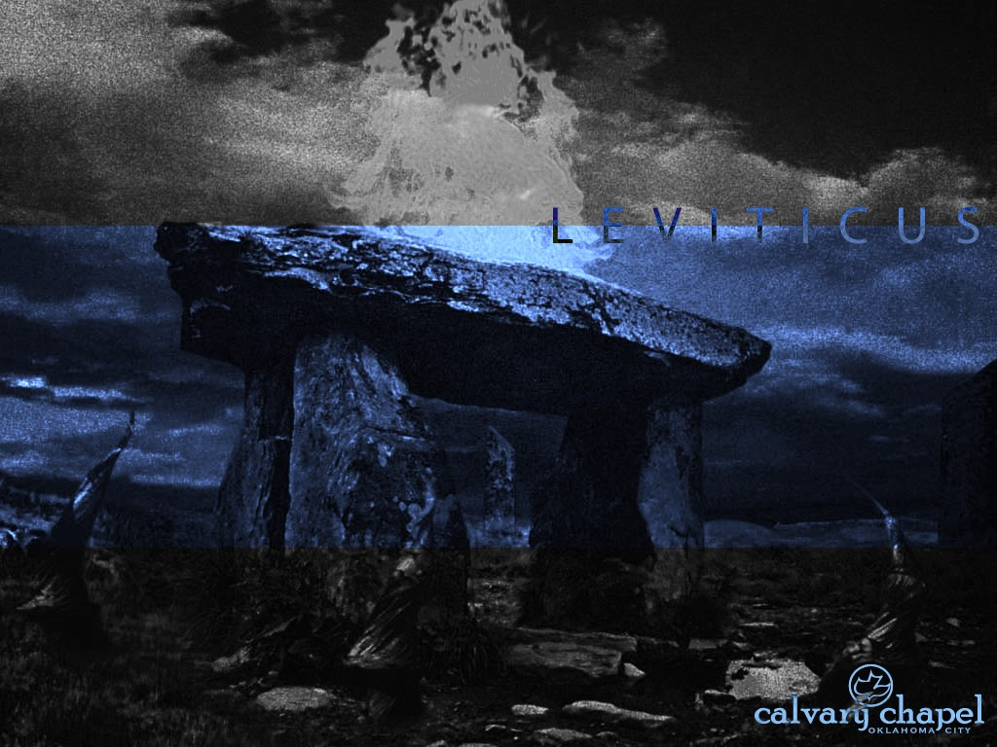
L E V I T I C U S
A CD OF THIS MESSAGE WILL BE AVAILABLE IMMEDIATELY FOLLOWING THE SERVICE
1 4 : 1 – 1 6 : 3 4
It will also be available for podcast later this week at calvaryokc.com

Slide 2
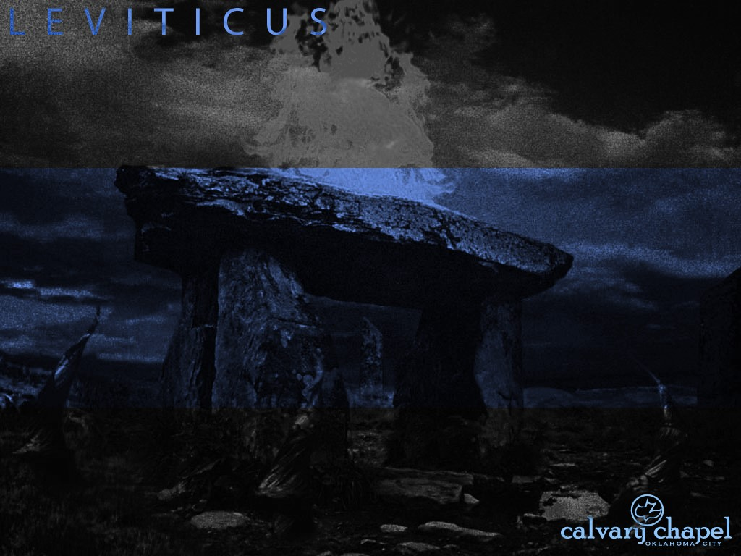
3 : 1 – 4 : 3 5
L E V I T I C U S 1 4 : 1 – 1 6 : 3 4
Two birds ~ death and resurrection
1st bird ~ death of Jesus
Earthen vessel ~ humanity of Jesus
Running water ~ work of the Holy Spirit
Cedar wood ~ incorruption of Jesus' life
Scarlet ~ the blood of Jesus
Hyssop ~ faith in action
2nd bird ~ Jesus’ ressurection

Slide 3
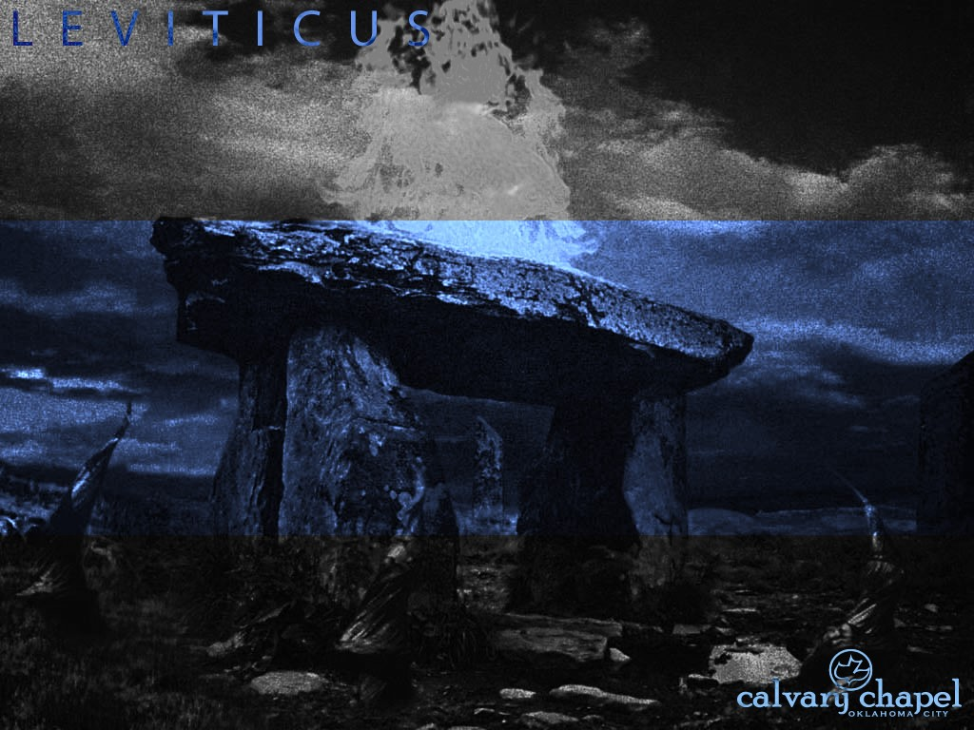
3 : 1 – 4 : 3 5
L E V I T I C U S 1 4 : 1 – 1 6 : 3 4

Slide 4
3 : 1 – 4 : 3 5
L E V I T I C U S 1 4 : 1 – 1 6 : 3 4
Eph. 4: 1 ~ I, therefore, the prisoner of the Lord, beseech you to walk worthy of the calling with which you were called …

Slide 5
3 : 1 – 4 : 3 5
L E V I T I C U S 1 4 : 1 – 1 6 : 3 4

Slide 6
3 : 1 – 4 : 3 5
L E V I T I C U S 1 4 : 1 – 1 6 : 3 4
So that her impurity is on him ~ KJV, and her flowers be upon him

Slide 7
3 : 1 – 4 : 3 5
L E V I T I C U S 1 4 : 1 – 1 6 : 3 4

Slide 8
3 : 1 – 4 : 3 5
L E V I T I C U S 1 4 : 1 – 1 6 : 3 4
Other Scriptures on Day of Atonement:
Ex. 30:10
Lev. 23:26-32
Lev. 25:9
Num. 29:7-11
Philo of Alexandria (c. 25 BC – c. AD 50) called it “the greatest of the feasts”

Slide 9
3 : 1 – 4 : 3 5
L E V I T I C U S 1 4 : 1 – 1 6 : 3 4

Slide 10
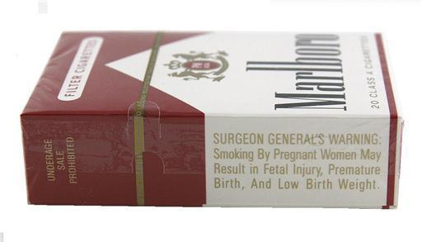
3 : 1 – 4 : 3 5
L E V I T I C U S 1 4 : 1 – 1 6 : 3 4
Warning: The Great Physician Has Determined The Sin Of Presumption Can Be Hazardous To Your Health

Slide 11
3 : 1 – 4 : 3 5
L E V I T I C U S 1 4 : 1 – 1 6 : 3 4

Slide 12
3 : 1 – 4 : 3 5
L E V I T I C U S 1 4 : 1 – 1 6 : 3 4
Col. 2:16-17 ~ ¹⁶ So let no one judge you in food or in drink, or regarding a festival or a new moon or sabbaths, ¹⁷ which are a shadow of things to come, but the substance is of Christ.
Christ’s condescension ~ kenōsis

Slide 13
3 : 1 – 4 : 3 5
L E V I T I C U S 1 4 : 1 – 1 6 : 3 4

Slide 14
3 : 1 – 4 : 3 5
L E V I T I C U S 1 4 : 1 – 1 6 : 3 4
Heb. 7:26-28 ~ ²⁶ For such a High Priest was fitting for us, who is holy, harmless, undefiled, separate from sinners, and has become higher than the heavens; ²⁷ who does not need daily, as those high priests, to offer up sacrifices, first for His own sins and then for the people’s, for this He did once for all when He offered up Himself. ²⁸ For the law appoints as high

Slide 15
3 : 1 – 4 : 3 5
L E V I T I C U S 1 4 : 1 – 1 6 : 3 4
priests men who have weakness, but the word of the oath, which came after the law, appoints the Son who has been perfected forever.
Atonement ~ kaphar – "to cover"
Heb. 10:4 ~ For it is not possible that the blood of bulls and goats could take away sins.

Slide 16
3 : 1 – 4 : 3 5
L E V I T I C U S 1 4 : 1 – 1 6 : 3 4
Heb. 10:11-14 ~ ¹¹ And every priest stands ministering daily and offering repeatedly the same sacrifices, which can never take away sins. ¹² But this Man, after He had offered one sacrifice for sins forever, sat down at the right hand of God, ¹³ from that time waiting till His enemies are made His footstool. ¹⁴ For by one offering He has perfected forever those who are being sanctified.
At
one
ment
-

Slide 17
3 : 1 – 4 : 3 5
L E V I T I C U S 1 4 : 1 – 1 6 : 3 4
Sin

Slide 18
3 : 1 – 4 : 3 5
L E V I T I C U S 1 4 : 1 – 1 6 : 3 4

Slide 19
3 : 1 – 4 : 3 5
L E V I T I C U S 1 4 : 1 – 1 6 : 3 4
Ark
Veil
Table of Showbread
Golden Altar
Menorah
Bronze Laver
Bronze Altar
Holy of Holies
Holy Place

Slide 20
3 : 1 – 4 : 3 5
L E V I T I C U S 1 4 : 1 – 1 6 : 3 4

Slide 21
3 : 1 – 4 : 3 5
L E V I T I C U S 1 4 : 1 – 1 6 : 3 4
Transgressions ~ pesha – noun form of the verb meaning "to rebel" or "to revolt"

Slide 22
3 : 1 – 4 : 3 5
L E V I T I C U S 1 4 : 1 – 1 6 : 3 4

Slide 23
3 : 1 – 4 : 3 5
L E V I T I C U S 1 4 : 1 – 1 6 : 3 4
Scapegoat ~ v. 8
Compound word from "goat" and "to go away" or "to use up"
Hebrew, azazel – "escape goat"

Slide 24
3 : 1 – 4 : 3 5
L E V I T I C U S 1 4 : 1 – 1 6 : 3 4

Slide 25
3 : 1 – 4 : 3 5
L E V I T I C U S 1 4 : 1 – 1 6 : 3 4
Feast of Trumpets
(Rosh Hashanah)
ADAR
12
NISAN
1
Days of Awe (days 1-10)
SHEVAT
11
IYAR
2
MAR
FEB
APR
Day of Atonement (Yom Kippur)
TEVET
10
JAN
MAY
SIVAN
3
DEC
JUN
Feast of Tabernacles (Sukkot)
KISLEV
9
TAMMUZ
4
NOV
JUL
Rosh Hashanah
1st Day
OCT
AUG
Sukkot
15th Day
HESHVAN
8
SEP
AV
5
TISHRI
7
ELUL
6
Yom Kippur
10th Day

Slide 26
3 : 1 – 4 : 3 5
L E V I T I C U S 1 4 : 1 – 1 6 : 3 4

Slide 27
3 : 1 – 4 : 3 5
L E V I T I C U S 1 4 : 1 – 1 6 : 3 4
Heb. 9:22 ~ And according to the law almost all things are purified with blood, and without shedding of blood there is no remission.
Day of Reflection
Heb. 9:16-17 ~ ¹⁶ For where there is a testament, there must also of necessity be the death of the testator. ¹⁷ For a testament is in force after men are dead, since it has no power at all while the testator lives.

Slide 28
3 : 1 – 4 : 3 5
L E V I T I C U S 1 4 : 1 – 1 6 : 3 4

