Slide 1
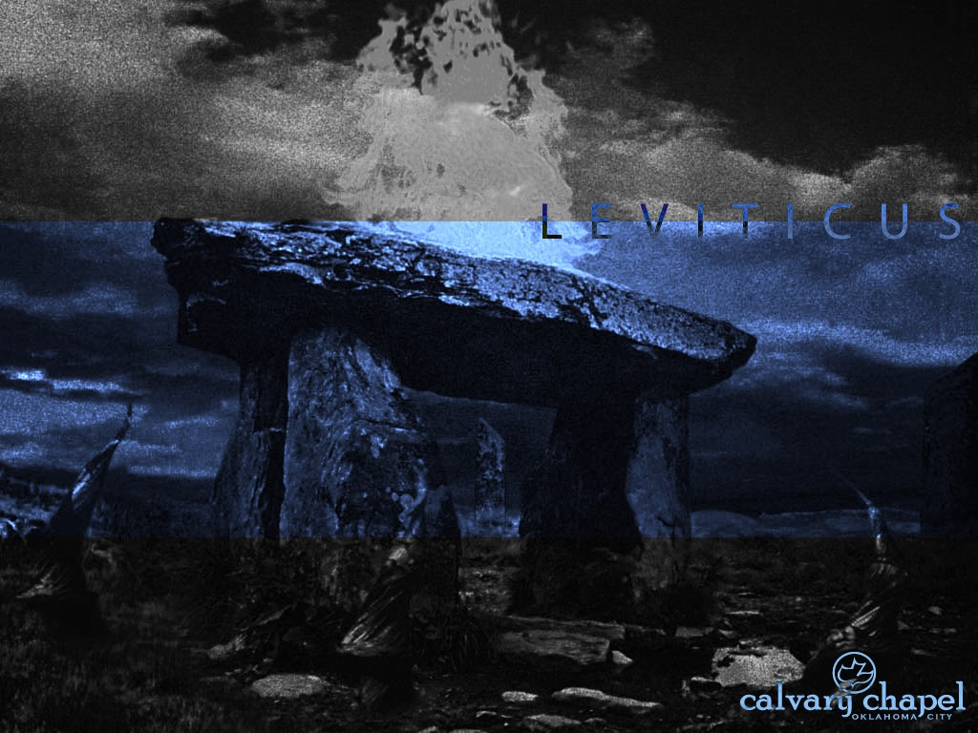
L E V I T I C U S
A CD OF THIS MESSAGE WILL BE AVAILABLE IMMEDIATELY FOLLOWING THE SERVICE
1 1 : 1 – 1 3 : 5 9
It will also be available for podcast later this week at calvaryokc.com

Slide 2
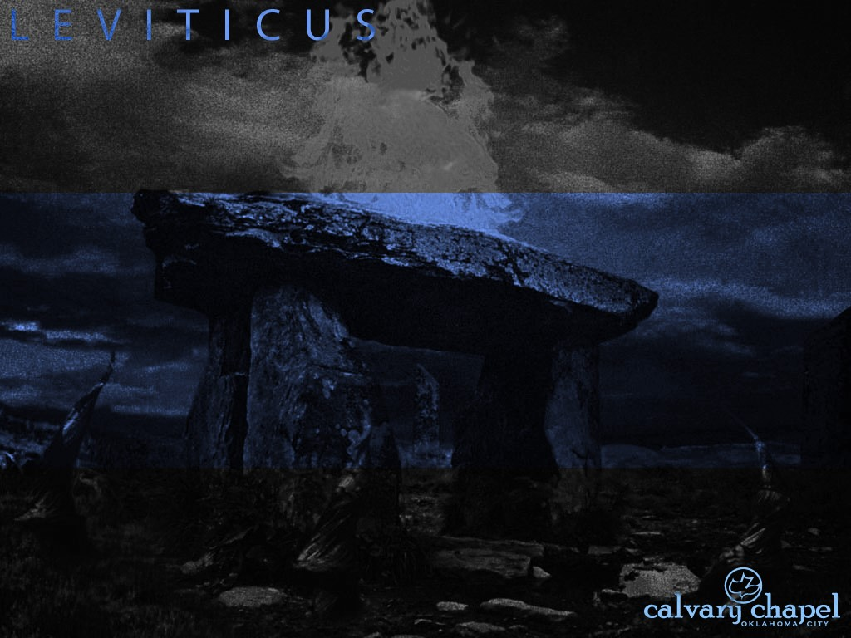
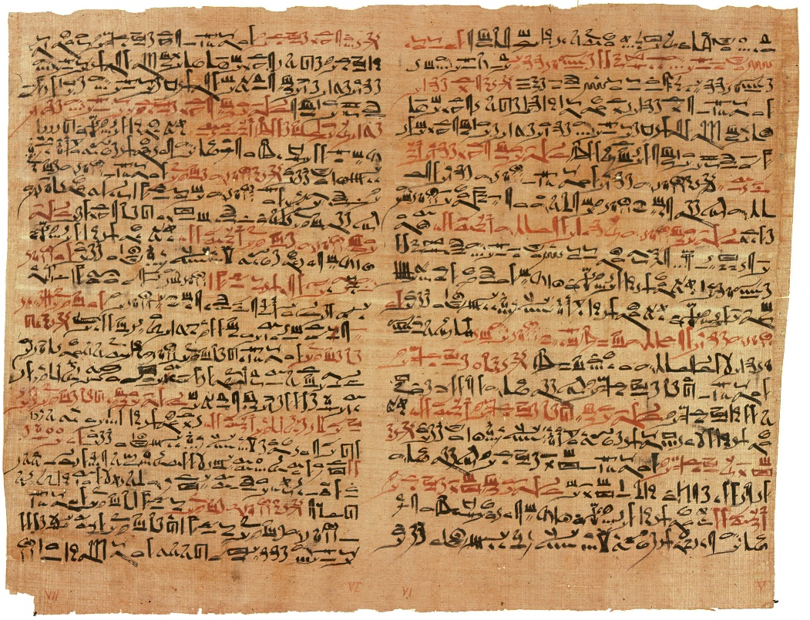
3 : 1 – 4 : 3 5
L E V I T I C U S 1 1 : 1 – 1 3 : 5 9
Edwin Smith papyrus ~ “Fat of lion, fat of hippo, fat of cat, fat of crocodile, fat of ibex, fat of serpent,
are mixed together
and the head of the
bald person is
anointed with them.”

Slide 3
3 : 1 – 4 : 3 5
L E V I T I C U S 1 1 : 1 – 1 3 : 5 9
Acts 15:29 ~ that you abstain from things offered to idols, from blood, from things strangled, and from sexual immorality. If you keep yourselves from these, you will do well.
1 Cor. 10:31 ~ Therefore, whether you eat or drink, or whatever you do, do all to the glory of God.

Slide 4
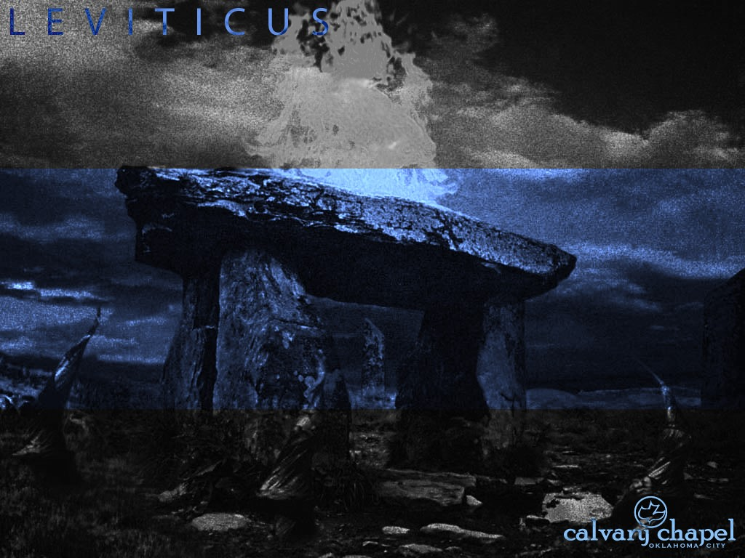
L E V I T I C U S 1 1 : 1 – 1 3 : 5 9

Slide 5
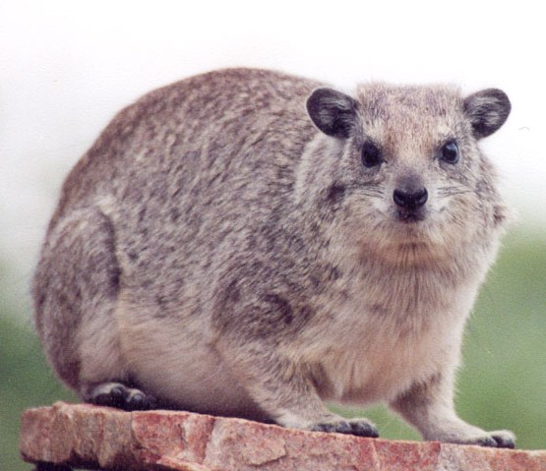
3 : 1 – 4 : 3 5
L E V I T I C U S 1 1 : 1 – 1 3 : 5 9
Rock hyrax,
Rock badger,
Coney

Slide 6
L E V I T I C U S 1 1 : 1 – 1 3 : 5 9

Slide 7
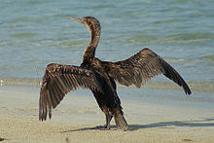
3 : 1 – 4 : 3 5
L E V I T I C U S 1 1 : 1 – 1 3 : 5 9
Fisher owl,
Cormorant,
Pelican

Slide 8
L E V I T I C U S 1 1 : 1 – 1 3 : 5 9

Slide 9
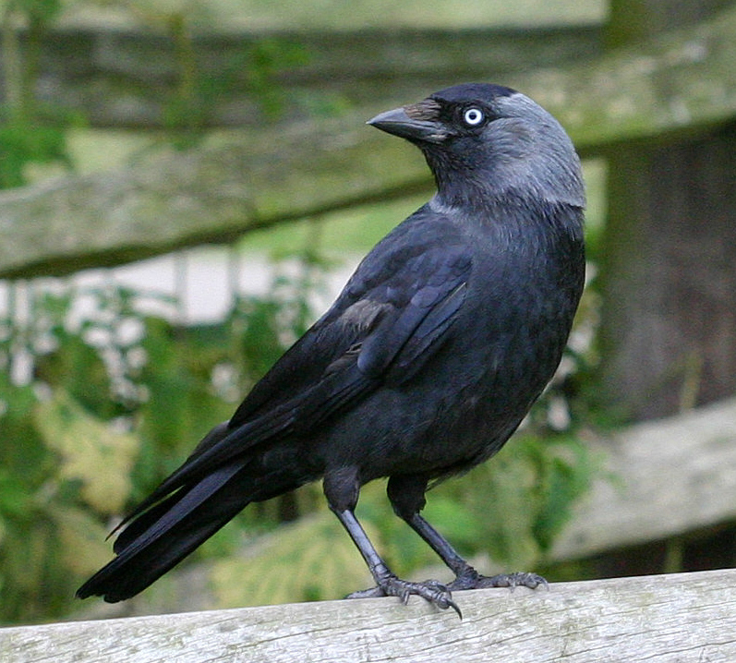
3 : 1 – 4 : 3 5
L E V I T I C U S 1 1 : 1 – 1 3 : 5 9
Jackdaw ~ from Hebrew word for vomit
Pelican,
Desert Owl

Slide 10
L E V I T I C U S 1 1 : 1 – 1 3 : 5 9

Slide 11
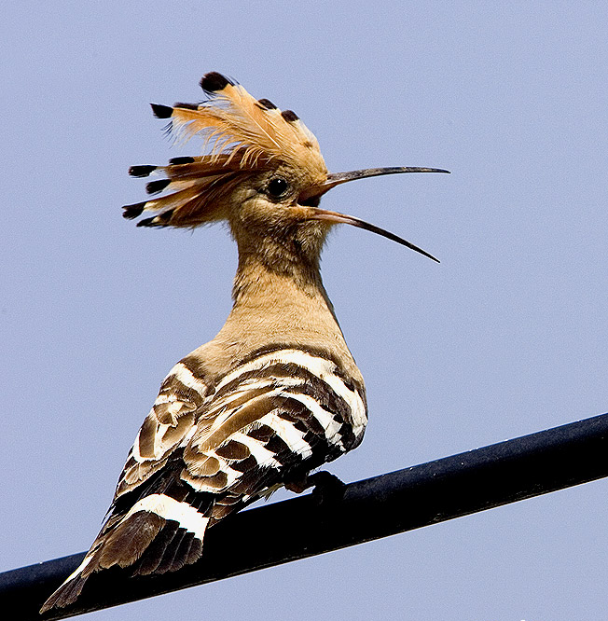
3 : 1 – 4 : 3 5
L E V I T I C U S 1 1 : 1 – 1 3 : 5 9
Hoopoe ~ Arab “doctor bird”

Slide 12
L E V I T I C U S 1 1 : 1 – 1 3 : 5 9

Slide 13
3 : 1 – 4 : 3 5
L E V I T I C U S 1 1 : 1 – 1 3 : 5 9
Flying insects ~ KJV, fowls – from Hebrew word meaning to fly

Slide 14
L E V I T I C U S 1 1 : 1 – 1 3 : 5 9

Slide 15
3 : 1 – 4 : 3 5
L E V I T I C U S 1 1 : 1 – 1 3 : 5 9
Boy ~ unclean 40 days
Girl ~ unclean 80 days

Slide 16
L E V I T I C U S 1 1 : 1 – 1 3 : 5 9

Slide 17
3 : 1 – 4 : 3 5
L E V I T I C U S 1 1 : 1 – 1 3 : 5 9
Ps. 51:5 ~ Behold, I was brought forth in iniquity,
And in sin my mother conceived me.

Slide 18
L E V I T I C U S 1 1 : 1 – 1 3 : 5 9

Slide 19
3 : 1 – 4 : 3 5
L E V I T I C U S 1 1 : 1 – 1 3 : 5 9
Leprosy ~ tsara'ath – “A slowly progressing and intractable disease characterized by subcutaneous nodules, scabs or cuticular crusts; and white shining spots appearing to be deeper than the skin.” (International Standard Bible Encyclopedia)

Slide 20
3 : 1 – 4 : 3 5
L E V I T I C U S 1 1 : 1 – 1 3 : 5 9
Maclear’s Handbook O.T ~ “Leprosy was ‘the outward and visible sign of the innermost spiritual corruption; a meet emblem in its small beginnings, its gradual spread, its internal disfigurement, its dissolution little by little of the whole body, of that which corrupts, degrades, and defiles man’s inner nature, and renders him unmeet to enter the presence of a pure and holy God.’”

Slide 21
L E V I T I C U S 1 1 : 1 – 1 3 : 5 9

Slide 22
3 : 1 – 4 : 3 5
L E V I T I C U S 1 1 : 1 – 1 3 : 5 9
As a type of sin:
Initially considered just a surface condition
Unseen cause
Isolates
Spreads
Causes lack of sensitivity
Leads to blindness
Often leads to loss of hearing

Slide 23
L E V I T I C U S 1 1 : 1 – 1 3 : 5 9

Slide 24
3 : 1 – 4 : 3 5
L E V I T I C U S 1 1 : 1 – 1 3 : 5 9
Unclean ~ used 54x in chapters 13-15

Slide 25
L E V I T I C U S 1 1 : 1 – 1 3 : 5 9

Slide 26
3 : 1 – 4 : 3 5
L E V I T I C U S 1 1 : 1 – 1 3 : 5 9
Scaly sore ~ KJV, the plague of the scall

Slide 27
L E V I T I C U S 1 1 : 1 – 1 3 : 5 9

Slide 28
3 : 1 – 4 : 3 5
L E V I T I C U S 1 1 : 1 – 1 3 : 5 9
KJV, forehead bald

Slide 29
L E V I T I C U S 1 1 : 1 – 1 3 : 5 9

Slide 30
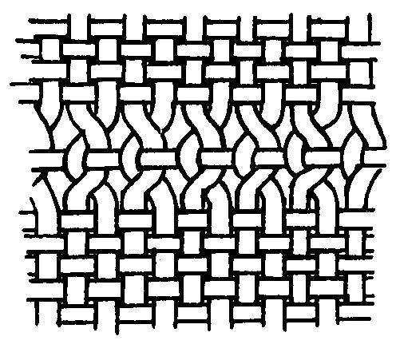
3 : 1 – 4 : 3 5
L E V I T I C U S 1 1 : 1 – 1 3 : 5 9
Warp ~ Vertical threads
Woof ~ Horizontal threads

Slide 31
L E V I T I C U S 1 1 : 1 – 1 3 : 5 9

