Slide 1
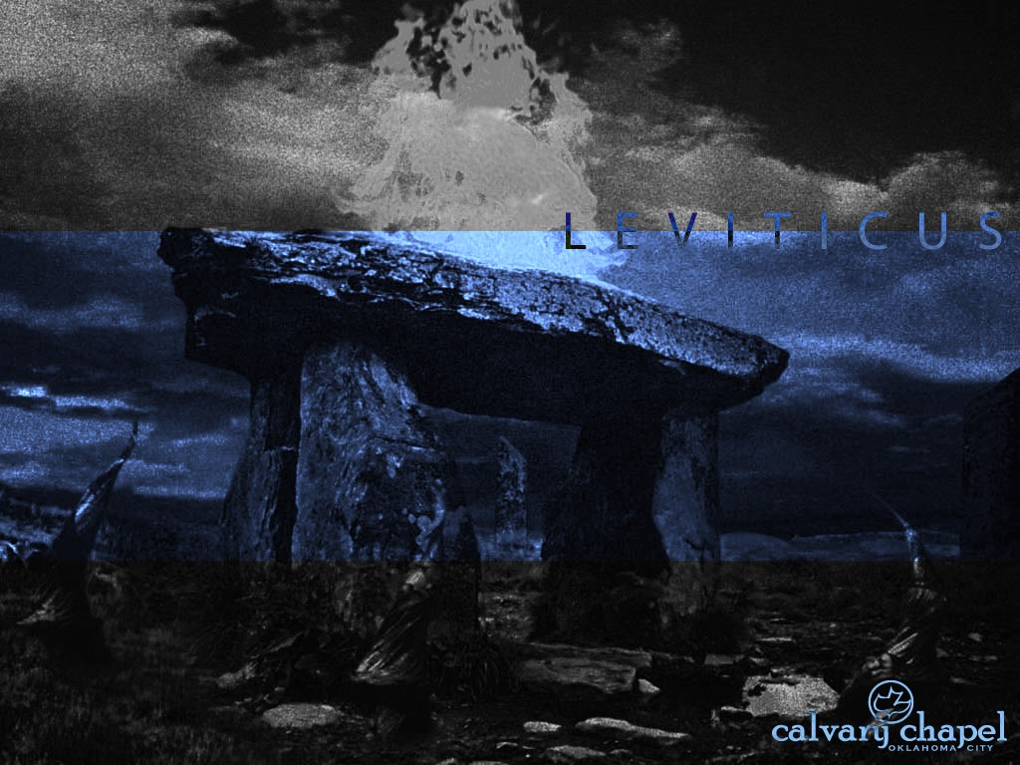
L E V I T I C U S
A CD OF THIS MESSAGE WILL BE AVAILABLE IMMEDIATELY FOLLOWING THE SERVICE
9 : 1 – 10 : 2 0
It will also be available for podcast later this week at calvaryokc.com

Slide 2
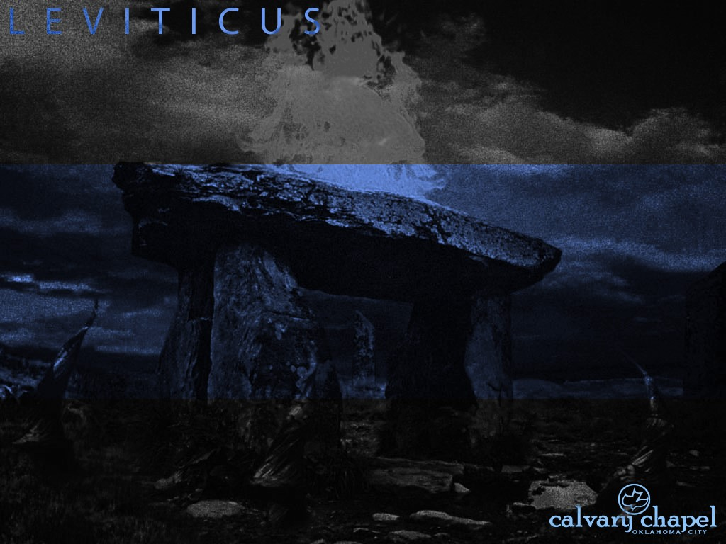
3 : 1 – 4 : 3 5
L E V I T I C U S 9 : 1 – 1 0 : 2 0
Eighth day ~ the day of new beginnings
Sun.
1
Mon.
2
Tues.
3
Wed.
4
Thurs.
5
Fri.
6
Sat.
7
Sun.
8
Baby boys were circumcised on the 8th day
David was the 8th son of Jesse
Jesus rose on the 8th day following His “Triumphal Entry”

Slide 3
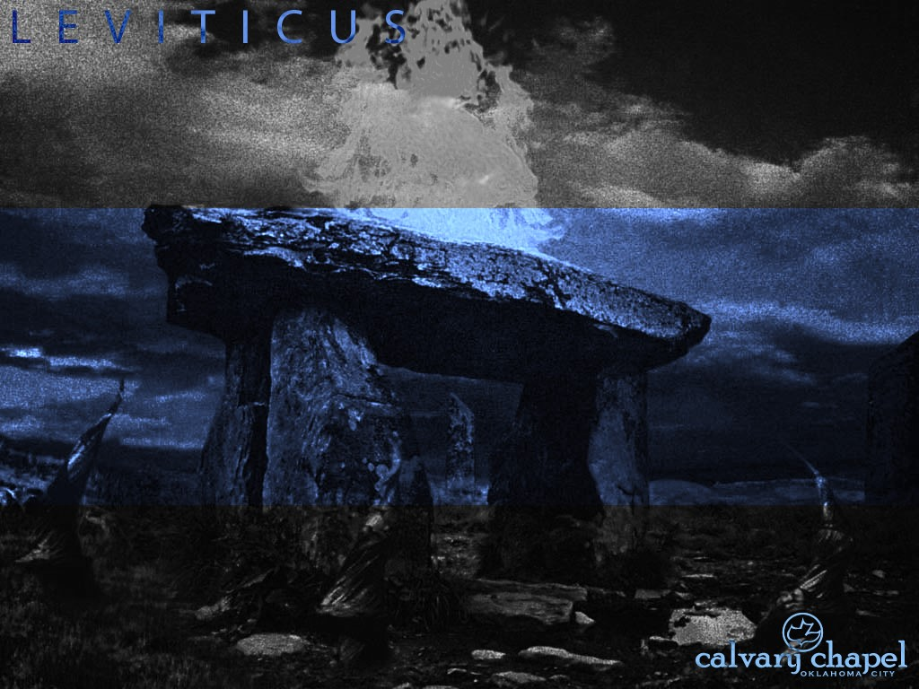
3 : 1 – 4 : 3 5
L E V I T I C U S 9 : 1 – 1 0 : 2 0

Slide 4


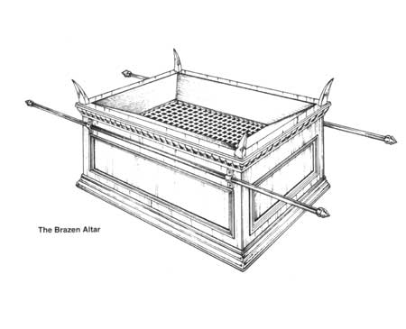

3 : 1 – 4 : 3 5
L E V I T I C U S 9 : 1 – 1 0 : 2 0
Glory ~ kabode (heavy) – not shekinah

Slide 5
3 : 1 – 4 : 3 5
L E V I T I C U S 9 : 1 – 1 0 : 2 0

Slide 6
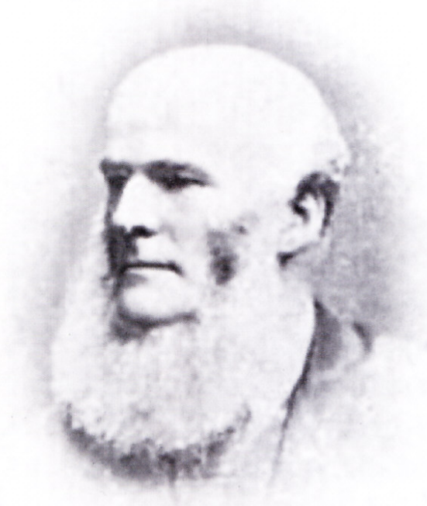
3 : 1 – 4 : 3 5
L E V I T I C U S 9 : 1 – 1 0 : 2 0
C. H. Mackintosh, Notes on
Leviticus ~ “The page of human
history has ever been a sadly
blotted one. It is a record of
failure from first to last. Amid all
the delights of Eden, man hearkened to the tempter’s lie (Gen. 3); when preserved from judgment by the hand of electing love, and introduced into a restored earth, he was guilty of the sin of

Slide 7
3 : 1 – 4 : 3 5
L E V I T I C U S 9 : 1 – 1 0 : 2 0
intemperance (Gen. 9); when
conducted, by Jehovah’s
outstretched arm, into the land
of Canaan, he ‘forsook the Lord,
and served Baal and Ashtaroth’
(Judges 2:3); when placed at the
very summit of earthly power and glory, with untold wealth at his feet, and all the resources of the world at his command, he gave his heart to the

Slide 8
3 : 1 – 4 : 3 5
L E V I T I C U S 9 : 1 – 1 0 : 2 0
uncircumcised stranger (1 Kings
11). No sooner had the blessings
of the gospel been promulgated
than it became needful for the
Holy Ghost to prophesy
concerning ‘grievous wolves,’
‘apostasy,’ and all manner of failure. . . . Thus, man spoils everything.”

Slide 9
3 : 1 – 4 : 3 5
L E V I T I C U S 9 : 1 – 1 0 : 2 0

Slide 10
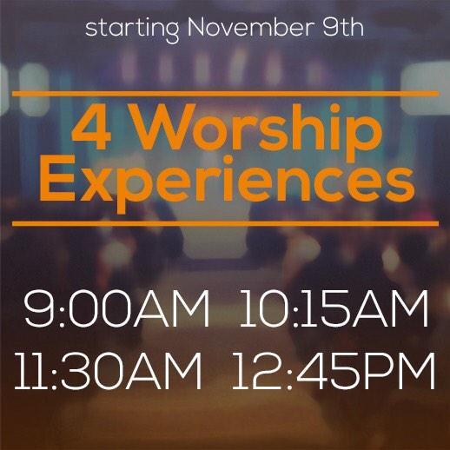



3 : 1 – 4 : 3 5
L E V I T I C U S 9 : 1 – 1 0 : 2 0

Slide 11
3 : 1 – 4 : 3 5
L E V I T I C U S 9 : 1 – 1 0 : 2 0
Profane fire ~ KJV, strange fire; NIV, unauthorized fire
John 4:23 ~ But the hour is coming, and now is, when the true worshipers will worship the Father in spirit and truth; for the Father is seeking such to worship Him.

Slide 12
3 : 1 – 4 : 3 5
L E V I T I C U S 9 : 1 – 1 0 : 2 0

Slide 13
3 : 1 – 4 : 3 5
L E V I T I C U S 9 : 1 – 1 0 : 2 0
Aaron, of the tribe of Levi
Nadab
Abihu
Eleazar
Ithamar

Slide 14
3 : 1 – 4 : 3 5
L E V I T I C U S 9 : 1 – 1 0 : 2 0

Slide 15
3 : 1 – 4 : 3 5
L E V I T I C U S 9 : 1 – 1 0 : 2 0
Nadab and Abihu ~ the beginning of the Old Covenant
Achan ~ the beginning of the new nation
Uzzah ~ the beginning of the new kingdom
Ananias and Sapphira ~ the beginning of the New Covenant

Slide 16
3 : 1 – 4 : 3 5
L E V I T I C U S 9 : 1 – 1 0 : 2 0

Slide 17
3 : 1 – 4 : 3 5
L E V I T I C U S 9 : 1 – 1 0 : 2 0
Brethren ~ akh – brother, half-brother, kinsman

Slide 18
3 : 1 – 4 : 3 5
L E V I T I C U S 9 : 1 – 1 0 : 2 0

Slide 19
3 : 1 – 4 : 3 5
L E V I T I C U S 9 : 1 – 1 0 : 2 0
Others May, G.D. Watson, in Living Words ~ “If God has called you to be really like Jesus He will draw you into a life of crucifixion and humility, and will put upon you such demands of obedience, that you will not be able to follow other people, or measure yourself by other Christians, and in many ways He will seem to let other good people do things which He will not let you do.

Slide 20
3 : 1 – 4 : 3 5
L E V I T I C U S 9 : 1 – 1 0 : 2 0
“Other Christians and ministers who seem very religious and useful, may push themselves, pull wires, and work schemes to carry out their plans, but you cannot do it; and if you attempt it, you will meet with such failure and rebuke from the Lord as to make you sorely penitent.
“Others may boast of themselves, their work, of their success, of their writings, but the Holy Spirit will not allow you

Slide 21
3 : 1 – 4 : 3 5
L E V I T I C U S 9 : 1 – 1 0 : 2 0
to do any such thing, and if you begin it, He will lead you into some deep mortification that will make you despise yourself and all your good works.
“Others may be allowed to succeed in making money, or may have a legacy left to them, but it is likely God will keep you poor, because He wants you to have something far better than gold, namely, a helpless dependence on Him, that

Slide 22
3 : 1 – 4 : 3 5
L E V I T I C U S 9 : 1 – 1 0 : 2 0
He may have the privilege of supplying your needs day by day out of an unseen treasury.
“The Lord may let others be honored and put forward, and keep you hidden in obscurity, because He wants you to produce some choice, fragrant fruit for His coming glory, which can only be produced in the shade. He may let others be great, but keep you small. He may

Slide 23
3 : 1 – 4 : 3 5
L E V I T I C U S 9 : 1 – 1 0 : 2 0
let others do a work for Him and get the credit of it, but He will make you work and toil on without knowing how much you are doing; and then to make your work still more precious, He may let others get the credit for the work which you have done, and thus make your reward ten times greater when Jesus comes.
“The Holy Spirit will put a strict watch

Slide 24
3 : 1 – 4 : 3 5
L E V I T I C U S 9 : 1 – 1 0 : 2 0
over you, with a jealous love, and will rebuke you for little words or feelings, or for wasting your time, which other Christians never seem distressed over. So make up your mind that God is an infinite Sovereign, and has a right to do as He pleases with His own. He may not explain to you a thousand things which puzzle your reason in His dealings with you, but if you absolutely sell yourself to be

Slide 25
3 : 1 – 4 : 3 5
L E V I T I C U S 9 : 1 – 1 0 : 2 0
His love slave, He will wrap you in a jealous love, and bestow upon you many blessings which come only to those who are in the inner circle.
“Settle it forever, then, that you are to deal directly with the Holy Spirit, and that He is to have the privilege of tying your tongue, or chaining your hand, or closing your eyes, in ways that He does not seem to use with others. Now when you

Slide 26
3 : 1 – 4 : 3 5
L E V I T I C U S 9 : 1 – 1 0 : 2 0
are so possessed with the living God that you are, in your secret heart, pleased and delighted over this peculiar, personal, private, jealous guardianship and management of the Holy Spirit over your life, you will have found the vestibule of Heaven.”

Slide 27
3 : 1 – 4 : 3 5
L E V I T I C U S 9 : 1 – 1 0 : 2 0

