Slide 1
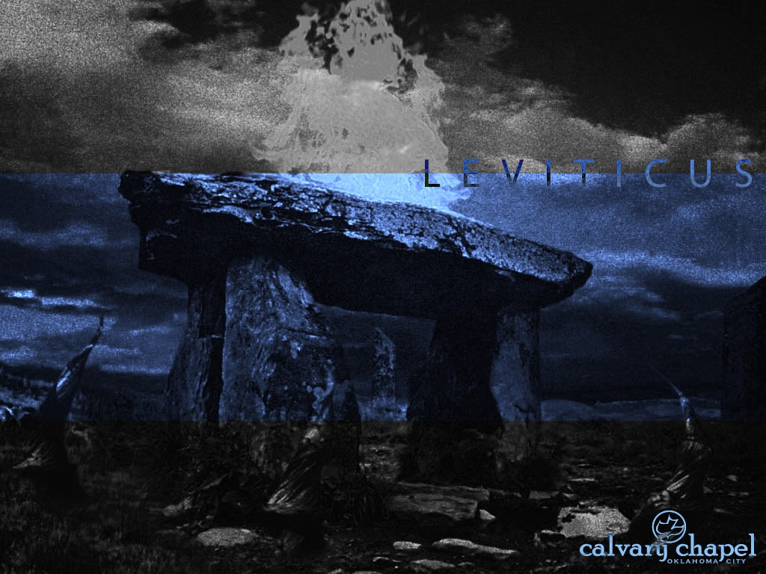
L E V I T I C U S
A CD OF THIS MESSAGE WILL BE AVAILABLE IMMEDIATELY FOLLOWING THE SERVICE
6 : 1 – 8 : 3 6
It will also be available for podcast later this week at calvaryokc.com

Slide 2
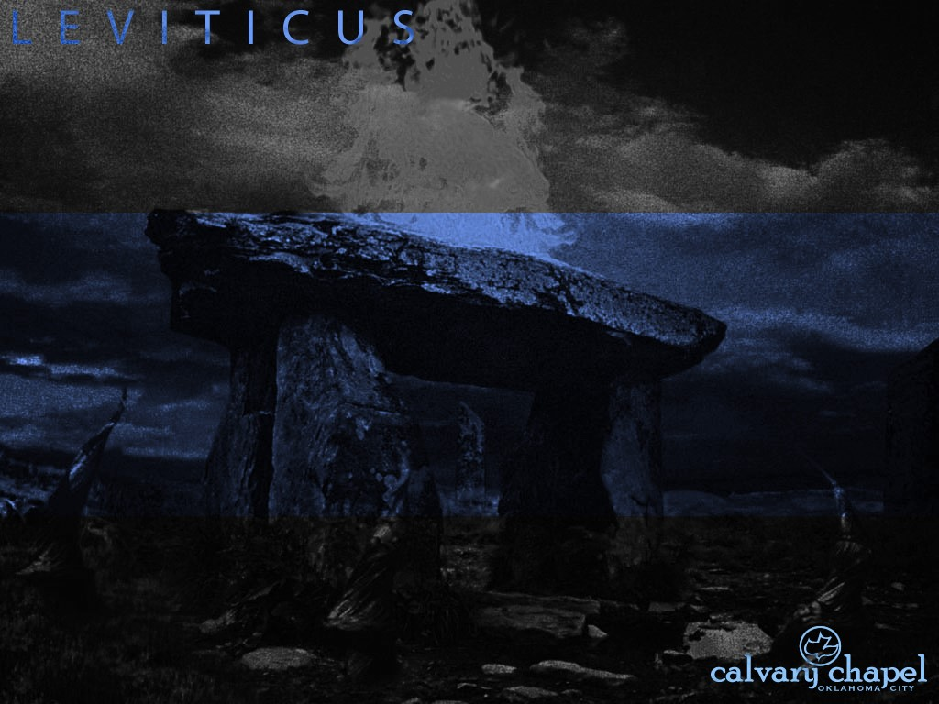
3 : 1 – 4 : 3 5
L E V I T I C U S 6 : 1 – 8 : 3 6
Two categories of trespasses:
1) Against “the holy things of the Lord”
2) Against one's neighbor

Slide 3
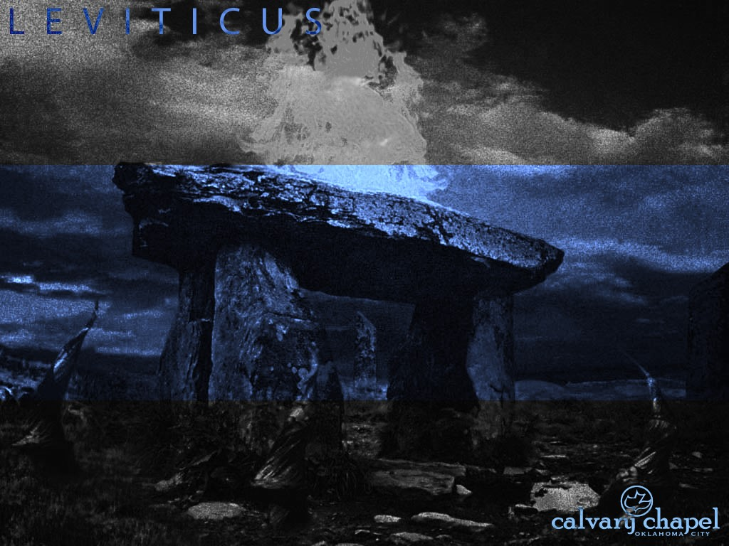
3 : 1 – 4 : 3 5
L E V I T I C U S 6 : 1 – 8 : 3 6

Slide 4
3 : 1 – 4 : 3 5
L E V I T I C U S 6 : 1 – 8 : 3 6
Trespass offering ~ asham
Is. 53:10 ~ Yet it pleased the Lord to bruise Him;
He has put Him to grief.
When You make His soul an offering for sin,
He shall see His seed, He shall prolong His days,
And the pleasure of the Lord shall prosper in His hand.

Slide 5
3 : 1 – 4 : 3 5
L E V I T I C U S 6 : 1 – 8 : 3 6
Distinctions between “Sin” and “Trespass” offerings
Sin
Trespass
Unintentional
Intentional
Emphasized guilt before God
Emphasized damage done to others
Deals with the nature of sin
Deals with the particular sin

Slide 6
1 : 1 – 2 : 1 6
L E V I T I C U S 6 : 1 – 8 : 3 6

Slide 7
3 : 1 – 4 : 3 5
L E V I T I C U S 6 : 1 – 8 : 3 6
Lev. 1:11 ~ He shall kill it (the burnt offering) on the north side of the altar before the Lord …

Slide 8
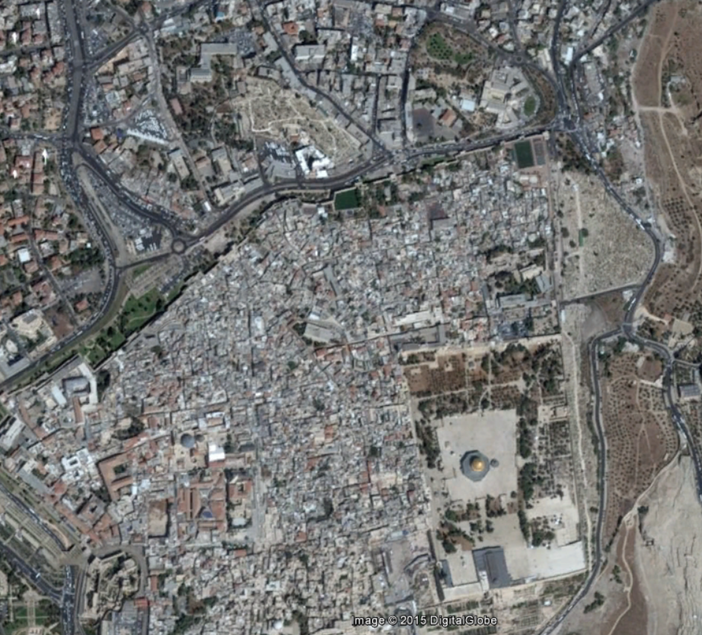

3 : 1 – 4 : 3 5
L E V I T I C U S 6 : 1 – 8 : 3 6
Mount Moriah
Mount Calvary
Temple Mount

Slide 9
1 : 1 – 2 : 1 6
L E V I T I C U S 6 : 1 – 8 : 3 6

Slide 10
3 : 1 – 4 : 3 5
L E V I T I C U S 6 : 1 – 8 : 3 6
Col. 3:24-25 ~ ²³ And whatever you do, do it heartily, as to the Lord and not to men, ²⁴ knowing that from the Lord you will receive the reward of the inheritance; for you serve the Lord Christ.

Slide 11
1 : 1 – 2 : 1 6
L E V I T I C U S 6 : 1 – 8 : 3 6

Slide 12
3 : 1 – 4 : 3 5
L E V I T I C U S 6 : 1 – 8 : 3 6
Heb. 13:15 ~ Therefore by Him let us continually offer the sacrifice of praise to God, that is, the fruit of our lips, giving thanks to His name.

Slide 13
1 : 1 – 2 : 1 6
L E V I T I C U S 6 : 1 – 8 : 3 6

Slide 14
3 : 1 – 4 : 3 5
L E V I T I C U S 6 : 1 – 8 : 3 6
Ps. 103:13-14 ~ ¹³ As a father pities his children,
So the Lord pities those who fear Him.
¹⁴ For He knows our frame;
He remembers that we are dust.

Slide 15
1 : 1 – 2 : 1 6
L E V I T I C U S 6 : 1 – 8 : 3 6

Slide 16
3 : 1 – 4 : 3 5
L E V I T I C U S 6 : 1 – 8 : 3 6
And the Lord spoke to Moses saying … 12x in chapter 8

Slide 17
1 : 1 – 2 : 1 6
L E V I T I C U S 6 : 1 – 8 : 3 6

Slide 18
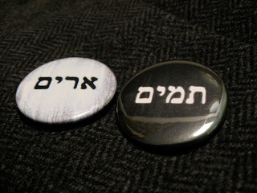
3 : 1 – 4 : 3 5
L E V I T I C U S 6 : 1 – 8 : 3 6
Urim
Lights
Thummim
Perfections

Slide 19
3 : 1 – 4 : 3 5
L E V I T I C U S 6 : 1 – 8 : 3 6
Ps. 19:7-8 ~ ⁷ The law of the Lord is perfect, converting the soul;
The testimony of the Lord is sure, making wise the simple;
⁸ The statutes of the Lord are right, rejoicing the heart;
The commandment of the Lord is pure, enlightening the eyes;
j

Slide 20
1 : 1 – 2 : 1 6
L E V I T I C U S 6 : 1 – 8 : 3 6

Slide 21
3 : 1 – 4 : 3 5
L E V I T I C U S 6 : 1 – 8 : 3 6

Slide 22
1 : 1 – 2 : 1 6
L E V I T I C U S 6 : 1 – 8 : 3 6

Slide 23
3 : 1 – 4 : 3 5
L E V I T I C U S 6 : 1 – 8 : 3 6
Anointing oil ~ Exodus 30 – myrrh, cinnamon, cassia, cane and oil

Slide 24
1 : 1 – 2 : 1 6
L E V I T I C U S 6 : 1 – 8 : 3 6

Slide 25
3 : 1 – 4 : 3 5
L E V I T I C U S 6 : 1 – 8 : 3 6
Hats ~ KJV, bonnets; NASB, caps; NIV, headbands

Slide 26
1 : 1 – 2 : 1 6
L E V I T I C U S 6 : 1 – 8 : 3 6

Slide 27
3 : 1 – 4 : 3 5
L E V I T I C U S 6 : 1 – 8 : 3 6
John 13:10 ~ Jesus said to him, “He who is bathed needs only to wash his feet, but is completely clean; and you are clean, but not all of you.”
Ps. 119:9 ~ How can a young man cleanse his way?
By taking heed according to Your word.
1 John 1:9 ~ If we confess our sins, He is faithful and just to forgive us our sins and to cleanse us from all unrighteousness.

Slide 28
1 : 1 – 2 : 1 6
L E V I T I C U S 6 : 1 – 8 : 3 6

Slide 29
3 : 1 – 4 : 3 5
L E V I T I C U S 6 : 1 – 8 : 3 6
Oh, be careful little ears, what you hear.
Oh, be careful little ears, what you hear.
There's a Father up above, looking down in tender love,
So be careful little ears, what you hear.

Slide 30
1 : 1 – 2 : 1 6
L E V I T I C U S 6 : 1 – 8 : 3 6

